Slide 1
Say My Name
Welcome
Digging into DNS
® 2017 | Trilogy Education Services

Slide 2

Notes:
It’s [tangentially] relevant, I swear!

Slide 3
Objectives
What is DNS?
How does it work?
What does a DNS request look like?

Slide 4

Hi, can you please send me Google’s webpage?
I don’t know what that is. Do you have an IP address?
...
Notes:
After reading this, explain that this is an issue that’s solved by domain names
The lady to the left is a client and the server is the man on the right.

Slide 5
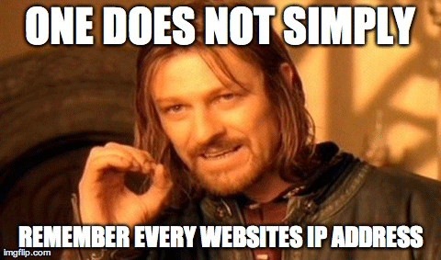
Notes:
Boromir’s right.

Slide 6
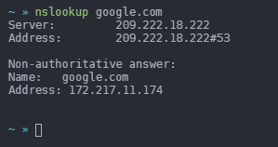
Domain Names
Computers look up websites based on their IP address
But strings of numbers aren’t memorable
Domain names let us say google.com instead of 172.217.11.174
Notes:
Make sure students understand that going to ‘google.com’ causes a translation to its IP address which a web browser will go to. A hostname is a pointer to an address.
It’s good to instill this detail right now because it will be easier to understand DNS record types later on

Slide 7

DNS Basics
DNS (Domain Name System) is an application-layer protocol
DNS is an application-layer protocol
DNS uses UDP port 53
[The] DNS is like a distributed directory of domain name IP address translations
It’s a backbone service to the internet
But it’s unencrypted by default
Notes:
Make sure students understand that this is an application layer protocol
Make sure students understand that DNS uses UDP and not TCP. Mention that UDP does the same job as TCP, but works a little differently under the hood.
The basic definition of DNS is that it’s a directory of translations (domain name -> IPs)
Might be worth asking if anyone remembers the internet-wide DDoS of 2016 (October). Dyn-DNS, one of the major DNS providers got hit with a 620Gbps DDoS which took down Twitter, Amazon, Spotify, and others. This is to emphasize that DNS is a backbone service.
Also, DNS does not use encryption by default. This means that ISP, man-in-the-middles, etc… can see what sites you’re going to even if the site is protected by HTTPS. More info in the “advanced topics” slide at the end.
It’s worth noting that DNS having no encryption is a boon for infosec professionals because even if the actual traffic between a victim computer and a command-and-control server were encrypted, checking the DNS request can signify a compromised machine.

Slide 8
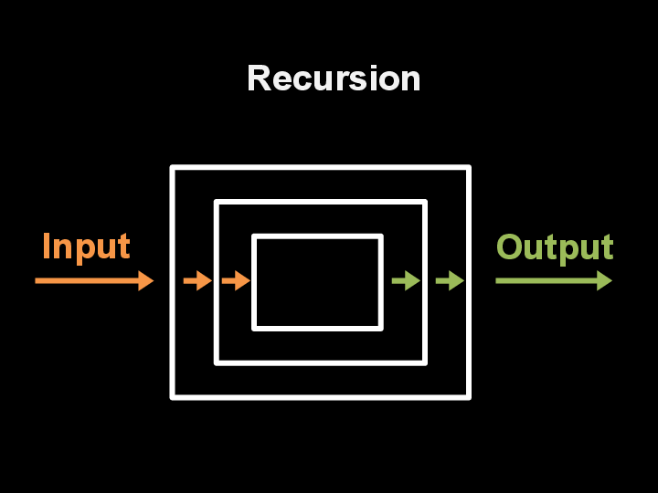
Recursion
Before we go into how DNS works, it’s good to understand some programming jargon: “recursion”
Recursion is repeating a process using the output of the previous as the input to the next:
Notes:
Recursion is a computer science principle that may help some people understand how DNS works (or it can confuse them even more)
If some students don’t understand, that’s fine.

Slide 9
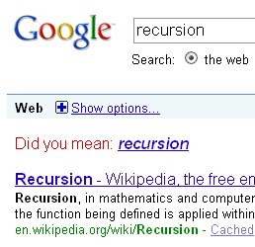
Notes:
Google with the jokes.
Navigate to Google and demonstrate this one: Simply type in recursion.

Slide 10
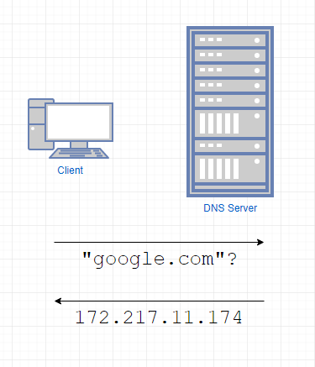
DNS Lookups
When you do a DNS lookup, you ask a DNS server to translate a domain name to an IP address
it has the answer in its cache, it sends it back
Notes:
This is the [2nd to] best case scenario for a DNS lookup
(the actual best case scenario is if the client’s “hosts” file contains a resolution but that might not be within scope of the lesson)

Slide 11
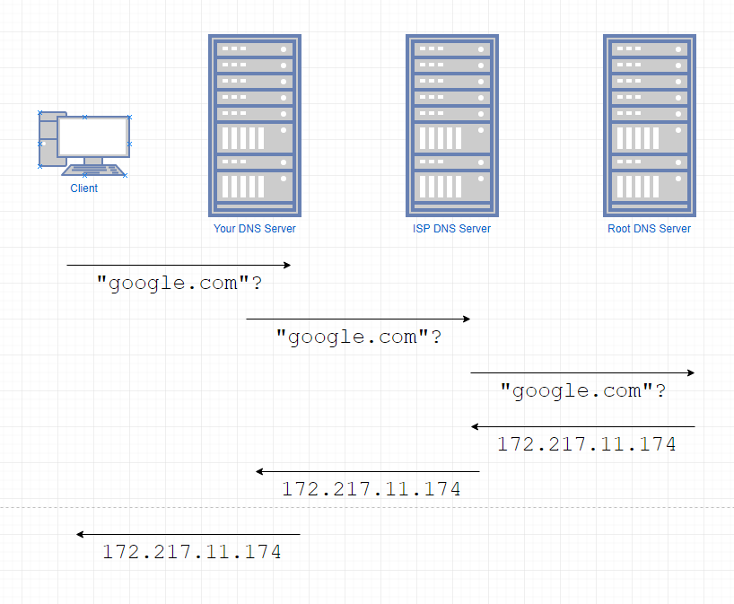
Recursive DNS Lookups
But if the DNS server doesn’t know, it must ask another DNS server
And if that DNS server doesn’t know, the query gets pushed down the line until there is no resolution:
Notes:
This is where recursion comes into play. The DNS query gets pushed down the line until either an answer is received or the final link in the chain doesn’t know.

Slide 12
Organizational Nameservers
Sometimes, you’ll have a domain name that’s for a device in your network
Say you own “iAmTheBest.com” but you also have:
mail.iAmTheBest.com
blog.iAmTheBest.com
music.iAmTheBest.com
You would need your own “nameserver” to handle requests to these URLs
“mail”, “blog”, and “music” in these cases are called “subdomains”
Notes:
It’s useful to know the difference between a domain name and a subdomain but in the context of this lesson, it’s not the most important fact.
It’s important to know that different organizations may have a “nameserver” which is a DNS server specifically for devices on their domain.
It’s important to know that if you’re looking for a specific device in an organization with a nameserver, your query will get an answer from them in the end.
As a final note to this slide, explain: “People wanting to get to “blog.iAmTheBest.com” would go all the way up to the root DNS server who would say “check iAmTheBest.com’s nameserver.”

Slide 13
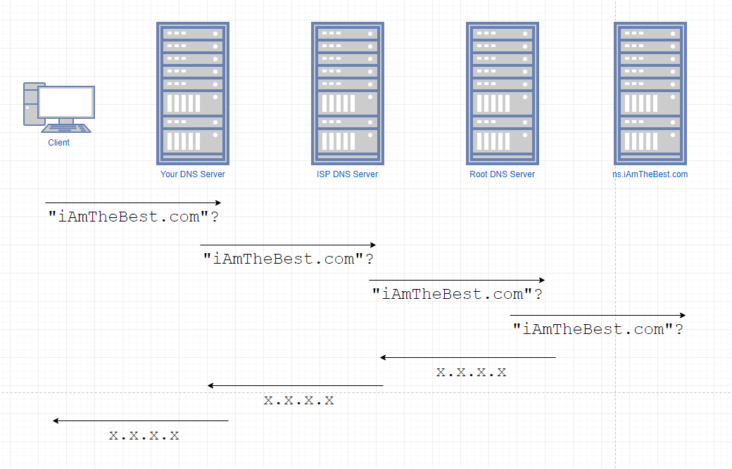
Notes:
Illustration of what a nameserver might do

Slide 14
Record Types
DNS can allow you to query for more than just a domain name to IP address translation. These other features are called “record types”
A record - returns an IPv4 address from a hostname query
AAAA record - returns an IPv6 address from a hostname query
MX record - returns the mail server for the domain
CNAME - an alias to the domain name
NS record - the nameserver of the domain
PTR record - returns a hostname from an IP address
There are many more
Notes:
Record types are different types of DNS records
DNS can hold more than one kind of record (hostname to IPv4)
Students don’t need to know all of these but they should know that these sorts of DNS resolutions exist
A records, CNAME records, and NS records may be the most important of the ones listed in this slide

Slide 15
Doing a DNS Resolution
Every time you call a domain name using any application, you do a DNS resolution
You can also do a manual DNS resolution by using nslookup
Notes:
This is to show how to do a manual DNS resolution instead of using a web browser and getting a response from the actual endpoint.
There are many tools you can use to do DNS resolutions. ‘nslookup’ is a big one and is on both *nix and Windows.
*nix machines can also use ‘host $DOMAIN_NAME’ or ‘dig +short $DOMAIN_NAME’
There are also online tools you can use to do DNS resolutions on your behalf.

Slide 16

Demo: DNS in Wireshark
Let’s look at DNS from the point of view of Wireshark so that we can get an idea about how a DNS packet actually looks like
Notes:
Open wireshark
Ask students what transport layer protocol and port does DNS use again
Do a live capture using capture filter “udp port 53” (the answer to the previous)
Go to “google.com” and the records list should start populating.
This is to show that despite what application you use, if you’re using a domain name, it must go through DNS
Do a manual DNS resolution for “google.com” using the command line/terminal.
Click around some packets and show off some of the requests and replies.
No need to spend too long on them though- students will be doing this themselves later.

Slide 17
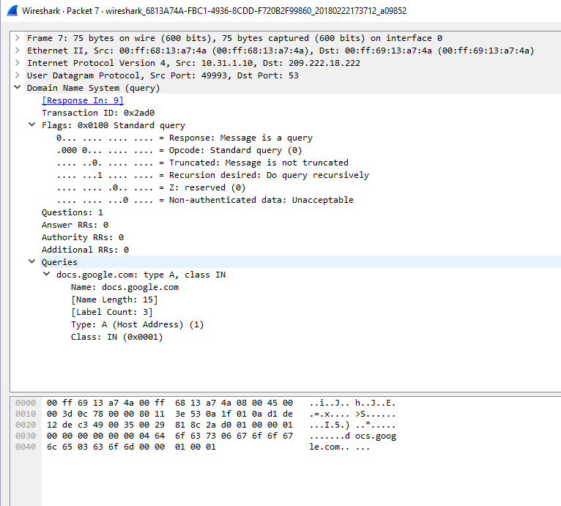
Into a DNS Request Packet
DNS packets run on “flags” which are just bits that indicate one thing or another
For this lesson, we will only look at the first bit for DNS request traffic:
The first bit is a ‘0’ which indicates a DNS “query” (a.k.a., a request)
Notes:
Students should understand what a “flag” is
Students should know that a single bit (a flag) is responsible for what constitutes a DNS request vs a DNS reply
Should ask students if a bit can only be a 1 or a 0 and ‘0’ is a request, what’s the flag for a reply?

Slide 18
Into a DNS Request Packet
Flags are followed by actual data
In this case, I am looking up an A record of docs.google.com
An “A record” is simply a translation from a domain name to an IP address
Notes:
Students should understand that this packet is looking for an A record for docs.google.com
Students should know what an “A record” is
Ask students what would happen to this DNS request
The answer is that the DNS request would go to your DNS server which would pass it along until the root DNS server. The root DNS server would tell you to ask Google’s nameservers since “docs.google.com” is a subdomain of google. Google’s nameserver will offer the response. (assuming none of the intermediate DNS servers knew the answer)

Slide 19
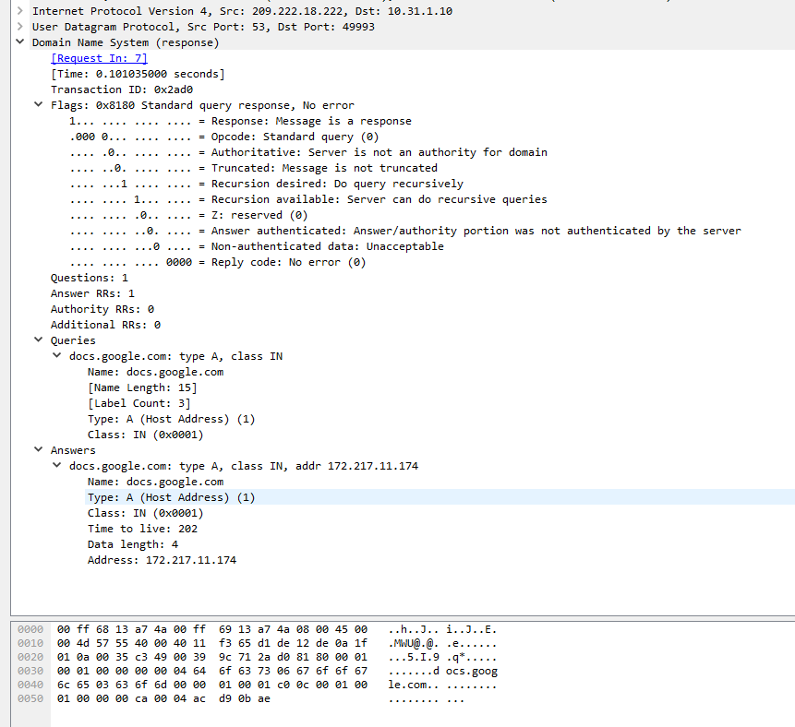
Into a DNS Reply Packet
If the first bit is ‘0’, it’s a request
So if the first bit is ‘1’, it’s a response!
Notes:
‘1’ is the response flag (slide 17’s question)

Slide 20
Into a DNS Reply Packet
It’s worth noting that this DNS server cannot tell you what the IP of docs.google.com, so it asked the Google nameserver
However, Google’s server is not the “authoritative” server
Notes:
This flag shows whether or not the DNS request used a nameserver to figure out the response.

Slide 21
Into a DNS Reply Packet
The actual DNS reply data contains the original query
And the answer!
Notes:
Note that the DNS reply contains the original query in the packet.
Mention that a DNS reply packet may contain more than 1 “answer”. Ask students why that might be the case.
Some websites may have multiple IP addresses for the sake of load balancing
Or if the DNS reply is a CNAME (an alias to the domain name), the “answer” will follow the CNAME pointer

Slide 22
External References
https://developers.google.com/speed/public-dns/
https://www.godaddy.com/help/what-is-dns-665
https://www.whois.com.au/whois/dns.html
https://www.verisign.com/en_US/website-presence/online/how-dns-works/index.xhtml
Not a reference but a cute comic about how DNS works: https://howdns.works/
Notes:
Google’s DNS servers are popular. Students should know it by heart. It’s one of those IPs you actually can remember: 8.8.8.8 and 8.8.4.4
GoDaddy is a big domain name provider. They have documentation on what DNS is.
You can check DNS using an online tool using whois.com
Verisign’s documentation on how DNS works
Lastly, mot a reference but a cute comic about how DNS works

Slide 23
Advanced Topics
DDNS - Dynamic DNS
You can change the IP behind your domain name whenever you want When the changes finish propagating, nobody was the wiser!
This is useful for home routers because your ISP will change your IP occasionally. Having a static domain name despite changing IPs can help if you’re running a server from home.
Notes:
Say you’re running an IoT network at home but you don’t want it to be accessible by people on the internet however you trust your home network. You can set up a VPN server which would be the only gateway from the internet to your intranet. This would make it so that you can access your network from anywhere so long as you have a device with a VPN client application installed.
However, consumer ISPs will not link a single IP to you. They will cycle IP addresses as needed so one day you may have one and another day, you may have another. This would be an issue because you would have to re-remember your IP every time it changed (your ISP won’t tell you when they change your IP anyway).
This is where DDNS comes in. DDNS providers will allow you to link a domain name to your IP and will automatically update the DNS records when your IP changes!
This is also helpful for enterprises that want to migrate servers or IP addresses because your clients will always use a domain name. An enterprise IT team can change the IP that the DNS A record points to and the client won’t even notice.

Slide 24
Advanced Topics
Ad blocking classically modifies the ‘host’ file of your computer.
The ‘host’ file is like a local DNS server and is the first place your computer will ask for a DNS resolution
The idea is that if you populate the ‘host’ file with a list of unwanted domain names, you can say that they don’t resolve
Notes:
The first place a DNS resolution request goes to is your operating system: the “hosts” file.

Slide 25
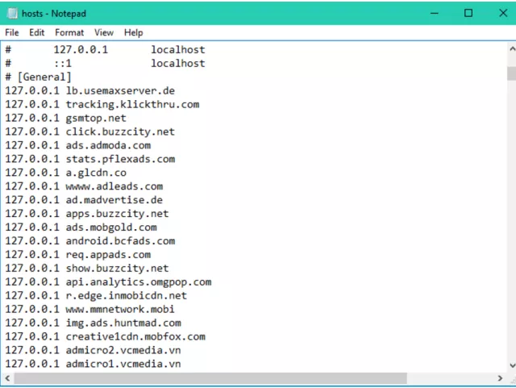
Notes:
This is an example of what a hosts file would look like in a Windows setting.

Slide 26
Advanced Topics
DNS is not encrypted by default
However, there has been an initiative to enable DNS encryption. It’s called “DNSCrypt”
Using a VPN that can handle protections against “DNS leaks” can also help but that encryption lasts only up to the VPN server
DNSSEC, despite its name, does not mean DNS is encrypted. DNSSEC is simply for response verification
Notes:
DNS encryption notes
Say you want to browse www.reddit.com. You will need to do a DNS request for it before going into the site. The initial DNS request is not encrypted but all your actual data going to reddit will be.
DNSCrypt is an application that you can use to encrypt DNS traffic. The reason why it’s not widely used yet is because DNS is the backbone of the internet. If you want to change it, you have to do so with a ton of planning and lots of big-name players being on board. That’s a lot of bureaucracy, logistics, and meetings to deal with.
DNSSEC is another infosec stipulation to DNS. Historically, DNS does not even validate the answer. There have been cases where man-in-the-middle attacks redirected applications to wrong IP addresses. DNS validation is like HTTPS’ feature of proving website ownership but it does not include encryption.

Slide 27

Notes:
Lastly, systems administrators find that DNS is a common source of their woes. This haiku is from www.reddit.com/r/sysadmin.

