Slide 1
Transport-layer Protocols
Let Me Tell You a TCP Joke
Analyzing Transport-layer Protocols in Wireshark
® 2017 / Trilogy Education Services

Slide 2
Table of Contents
Explain the TCP protocol
Analyze TCP packets
Objectives
® 2017 / Trilogy Education Services

Slide 3
The Communication Story
What is the purpose of application-layer protocols?
® 2017 / Trilogy Education Services

Slide 4
Transport-layer Protocols
TCP
TCP connects clients and servers
Transmission Control Protocol
Designed for 1:1 communication
Transport layer
Designed for reliability
® 2017 | Trilogy Education Services

Slide 5
Transport-layer Protocols
TCP Connections
TCP defines three major rules for managing connections
“Three-way handshake” to open connections
“Acknowledgements” during conversation
“Teardown” process to close connections
® 2017 | Trilogy Education Services

Slide 6

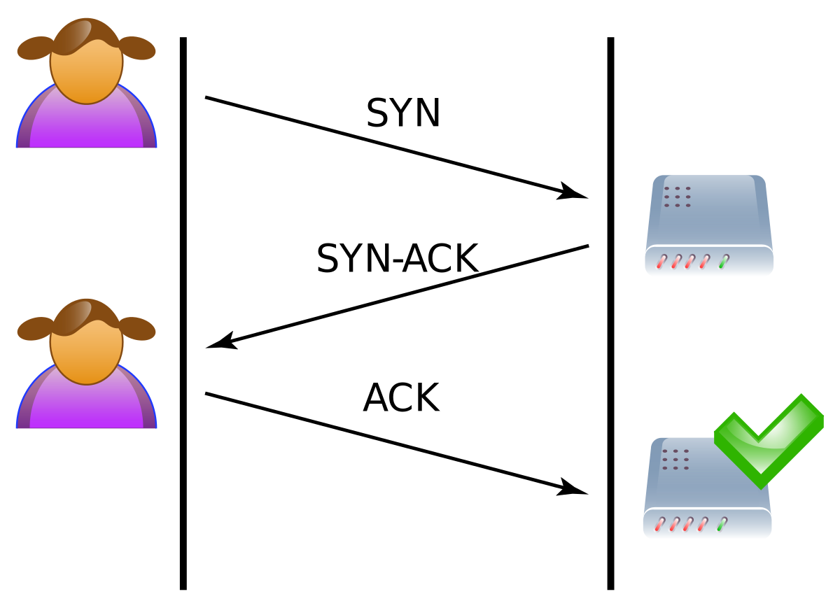
Transport-layer Protocols
Devices open a connection by “handshaking”
Three-Way Handshake
® 2017 / Trilogy Education Services
Notes:
Explain that, to open a connection, two devices perform a “three way handshake”.
Explain that this is exactly like what we did in the earlier protocol exercise.
First, we say hello (SYN).
Then, the other person says, “hello, there” (SYN/ACK).
Finally, we respond with an actual message (ACK).
Explain that, once this handshake is complete, the clients have agreed to connect, and the connection will remain open.
Explain that, from here on out,
Short answer: transmission reliability
Long answer: A client/server connection requires both to know that the other is guaranteed to be paying attention
What happens in a 1-step handshake?
What happens in a 2-step handshake?

Slide 7
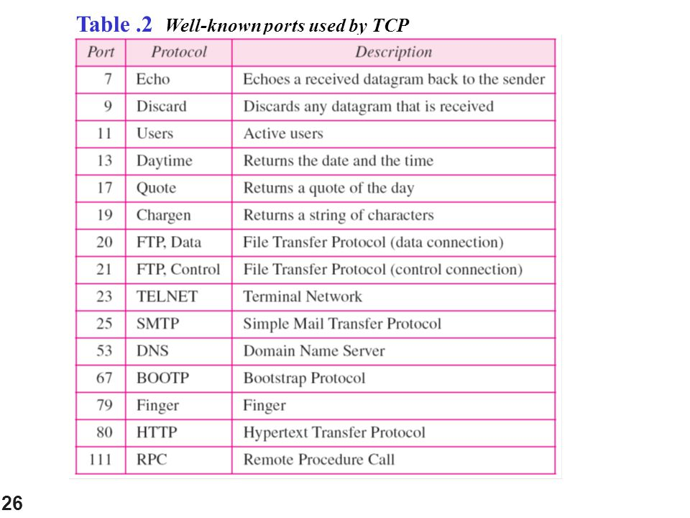
Transport-layer Protocols
Different protocols use different ports
® 2017 / Trilogy Education Services
Notes:
When the source device sends its SYN packet, it sends it to a particular port on the target machine.
Different applications use different ports. For example, HTTP uses port 80. Email (SMTP) uses port 25. Etc.
These are defaults, and can be configured, but it’s very common for devices to adhere to these defaults.

Slide 8

Transport-layer Protocols
Devices close a connection via “teardown”
Teardown
® 2017 / Trilogy Education Services
Notes:
Explain that, to close a connection, clients can perform something like a handshake, but in reverse.
Explain either client can send a FIN message (“goodbye”).
The other device sends ACK-FIN (“okay, goodbye”).
Finally, the initial computer sends ACK, to confirm the conversation is over (“alright, bye…really.”).

Slide 9

The Communication Story
Analyzing TCP traffic in Wireshark
® 2017 / Trilogy Education Services
Notes:
Conversely, if the devices are not connected, ping will report that the request has timed out.

Slide 10
Local Area Networks
Questions
® 2017 / Trilogy Education Services

