Slide 1
ClimatePulse
RESEARCH RESULTS · RUN 20261027_230426
Temporal Fusion Transformers and Spatio-Temporal Graph Networks in Climate Modeling
An open-source pipeline that forecasts El Niño, air pollution and global weather, and detects changes in the warming rate, with every result rebuilt from one script.
Aditri Paul · Dr. Hema Shekhawat
Manipal University Jaipur
Notes:
ClimatePulse combines four climate modelling tasks in one reproducible pipeline. Every number in this deck comes from the saved run 20261027_230426, the same snapshot the research paper and patent application report.

Slide 2
Four models, one reproducible pipeline
OVERVIEW
Each model answers a different climate question, at time scales from 6 hours to 75 years, and each is judged against a simple baseline.
El Niño
How warm will the tropical Pacific be in 1 to 12 months? A Temporal Fusion Transformer with forecast intervals.
Compared with an LSTM and persistence
Air pollution
How much PM2.5 tomorrow at 75 stations, and will it pass AQI 100? An A3TGCN graph network.
Compared with persistence and always-alert
Weather
What will global temperature and rain be in 6 hours? A graph network on a 2,000-node spherical mesh.
Compared with persistence, plus an ablation
Warming rate
When did the speed of global warming change since 1950? A segmented trend with autocorrelated errors.
Number of breaks chosen by BIC
TAKEAWAY
Four different tasks share one data pipeline, one split policy and one evaluation code base.
ClimatePulse · run 20261027_230426
Notes:
Persistence means assuming tomorrow, or next month, looks like today. It is the minimum any forecast must beat. Always-alert means predicting an unhealthy-air day every day.

Slide 3
Why each model was chosen
MODEL CHOICE
Each architecture fits the shape of its data: a time series, a station network, a sphere and a long-term trend.
Model | Why this model | Compared with
Temporal Fusion Transformer · El Niño | Forecasts all 12 months at once, uses known future inputs such as the calendar month, and outputs quantile intervals; its attention can be inspected | Bidirectional LSTM, the standard recurrent baseline; persistence
A3TGCN · air pollution | Stations form an irregular network, not a grid: graph convolution shares signal between nearby stations, a GRU tracks time, attention weighs recent days | Persistence; always-alert for exceedances
Encoder–processor–decoder GNN · weather | The design behind GraphCast and Keisler’s model; a Fibonacci mesh covers the sphere evenly and its size can be set freely | Persistence; ablation of the ENSO input and the loss
Segmented trend, AR(1) errors · warming | The question is when the warming rate changed, not the level; AR(1) errors stop year-to-year correlation from inventing breaks, and BIC sets how many | Mean-shift CUSUM, which finds 12 spurious breaks
TAKEAWAY
Each model matches its data’s structure, and a simpler baseline tests whether the extra complexity pays off.
Source: research paper §2 and §4
Notes:
TFT: Lim et al. 2021. A3TGCN: Bai et al. The weather model adapts GraphCast and Keisler's encoder-processor-decoder from an icosahedral mesh to a Fibonacci mesh. The change-point model is fitted by Prais-Winsten GLS and searches zero to three breaks exhaustively.

Slide 4
The chosen models and the alternatives
MODEL CHOICE · ALTERNATIVES
Each choice set against established approaches from the literature, and the reason it was preferred.
Task | Chosen | Alternatives | Why the choice
El Niño | Temporal Fusion Transformer | CNN on climate-model output (Ham et al.); plain LSTM | Calibrated quantile intervals, not only point forecasts; attention is interpretable
Air pollution | A3TGCN | Grid CNNs; diffusion GCN (DCRNN) | Sensors are irregular points, not a grid; attention over days in only 6,984 parameters
Weather | Mesh GNN (Fibonacci) | FourCastNet (regular grid); GraphCast (icosahedral mesh) | Grids crowd at the poles; a Fibonacci mesh is uniform at any size, icosahedra only at fixed levels
Warming rate | Segmented trend, AR(1), BIC | Mean-shift CUSUM; breaks with independent errors | Tests the rate, not the level; AR(1) stops autocorrelation inventing breaks (CUSUM finds 12)
TAKEAWAY
Each choice has a structural reason, and each is still tested against a simpler baseline rather than assumed better.
Source: research paper §2 (related work) and §4.4
Notes:
Ham et al. reached 18-month ENSO leads with CNNs but without calibrated uncertainty. DCRNN's diffusion convolution suits advection-diffusion over irregular networks, as does A3TGCN. FourCastNet uses Fourier neural operators on a regular grid; GraphCast and Keisler use icosahedral meshes with fixed subdivision levels.

Slide 5
Five open datasets
DATA SOURCES
All five are open access and are downloaded automatically by make download-data and make download-nwm-data.
Dataset | What it provides → used by | URL
NOAA ERSST v5 | Sea temperature 1950–2026 → El Niño | psl.noaa.gov/data/gridded/data.noaa.ersst.v5.html
OpenAQ v3 | PM2.5, 75 stations, 2016–2025 → pollution | openaq.org
NASA GISTEMP v4 | Global temp. 1950–2025 → warming rate | data.giss.nasa.gov/gistemp/
Climate TRACE v7 | Emissions, 93 countries → regression (optional) | climatetrace.org
ERA5 / WeatherBench2 | 2 m temp. and rain, 2020–21 → weather | weatherbench2.readthedocs.io
TAKEAWAY
No proprietary data: anyone can rebuild every input from these public sources (OpenAQ needs a free API key).
Source: research paper §3.1 and §7 · URLs prefixed with https://
Notes:
ERSST is monthly on a 2 degree grid; ERA5 is 6-hourly at 5.625 degrees, 2,924 time steps.

Slide 6
From raw downloads to model inputs
DATA PIPELINE
make download-data runs DataPipeline for four sources; ERA5 comes separately from make download-nwm-data.
Source
Processing
Stored in datasets/
Used by
NOAA ERSST v5
→
Clean → Niño indices → rolling and seasonal features
→
nino_features.parquet
→
TFT, LSTM; NWM Niño input
OpenAQ v3
→
Clean, add AQI; stations → 10-NN haversine graph
→
PM2.5 cache + openaq/locations.parquet
→
A3TGCN
NASA GISTEMP v4
→
Clean → rolling and seasonal features
→
gistemp_features.parquet
→
Change-point model
Climate TRACE v7
→
Clean → align with GISTEMP by year
→
regression_dataset.parquet
→
Bayesian regression (optional)
ERA5 / WeatherBench2
→
Subset 2020–2021, 5.625°, temperature and rain
→
era5_5deg_6hr_2020_2022.nc
→
NWM (mesh GNN)
TAKEAWAY
Each model reads its own cached file, so any stage can be rerun or inspected on its own.
Source: src/data/pipeline.py, src/data/processing/, src/scripts/download_nwm_data.py
Notes:
Each source is fetched with caching, cleaned by its own function in cleaning.py, and turned into features in feature_engineering.py. DataPipeline registers every source in a JSON metadata file. The splits and training-only normalisation happen later, inside each model's dataset module. The Bayesian regression is optional and not used in any reported result.

Slide 7
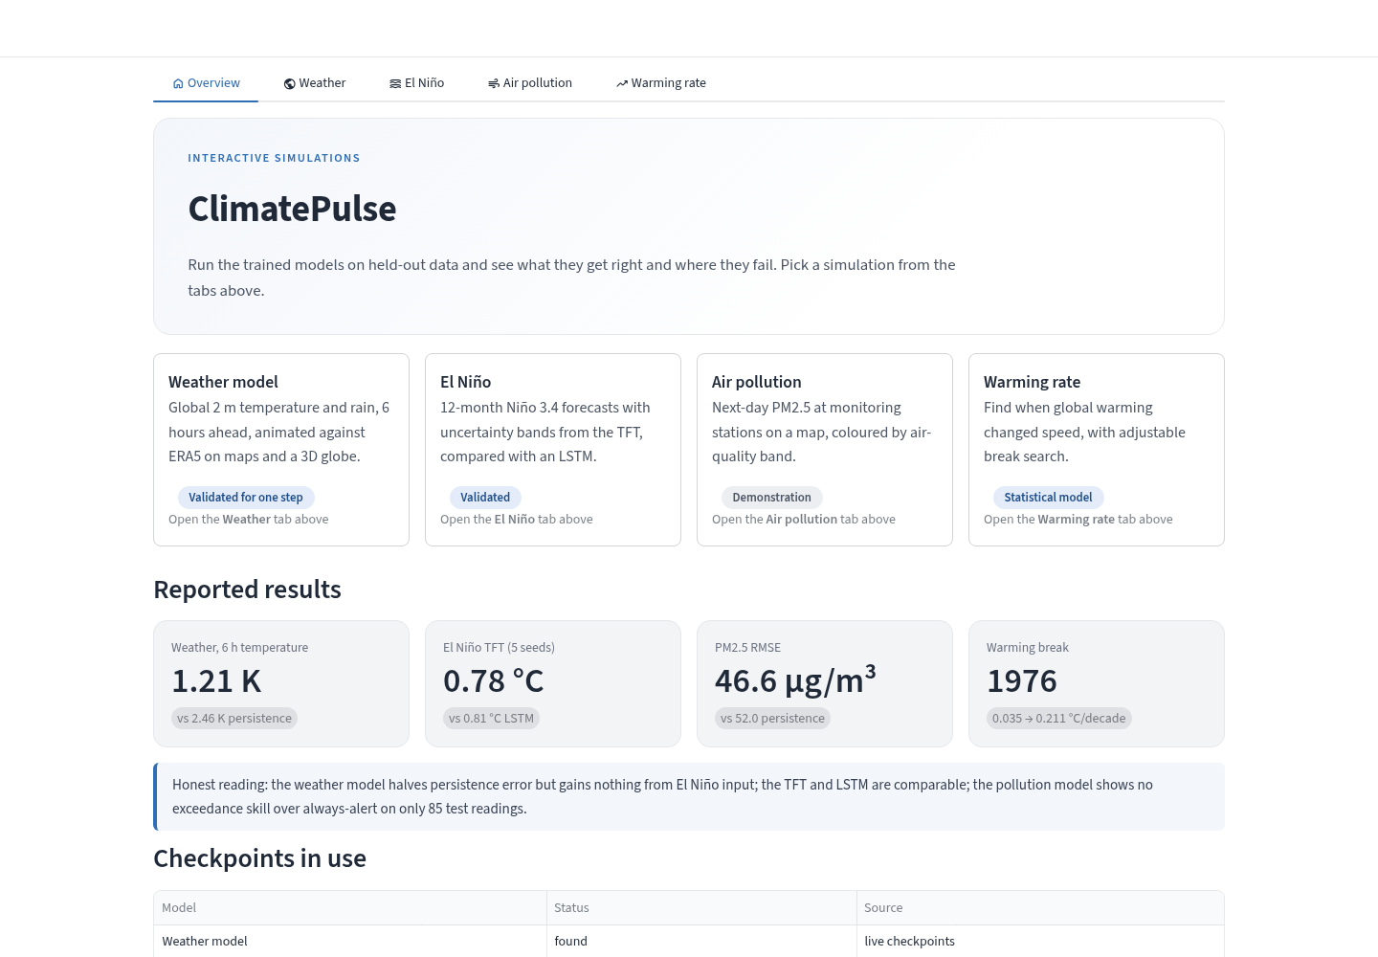
A browser app for the trained models
SIMULATION APP · OVERVIEW
make app opens a tabbed app that runs the trained models on held-out data. Nothing is retrained.
TABS
Overview plus one tab per simulation; only the open tab runs
REPORTED RESULTS
The headline numbers and which checkpoints were found
HONEST BADGES
Each page says what was validated and what is only a demonstration
TAKEAWAY
People can explore the results interactively instead of reading tables.
Screenshot of the running app · make app · src/app/
Notes:
The app is in src/app and runs with make app. It reads the same checkpoints and evaluation code as the paper, so its numbers match.

Slide 8
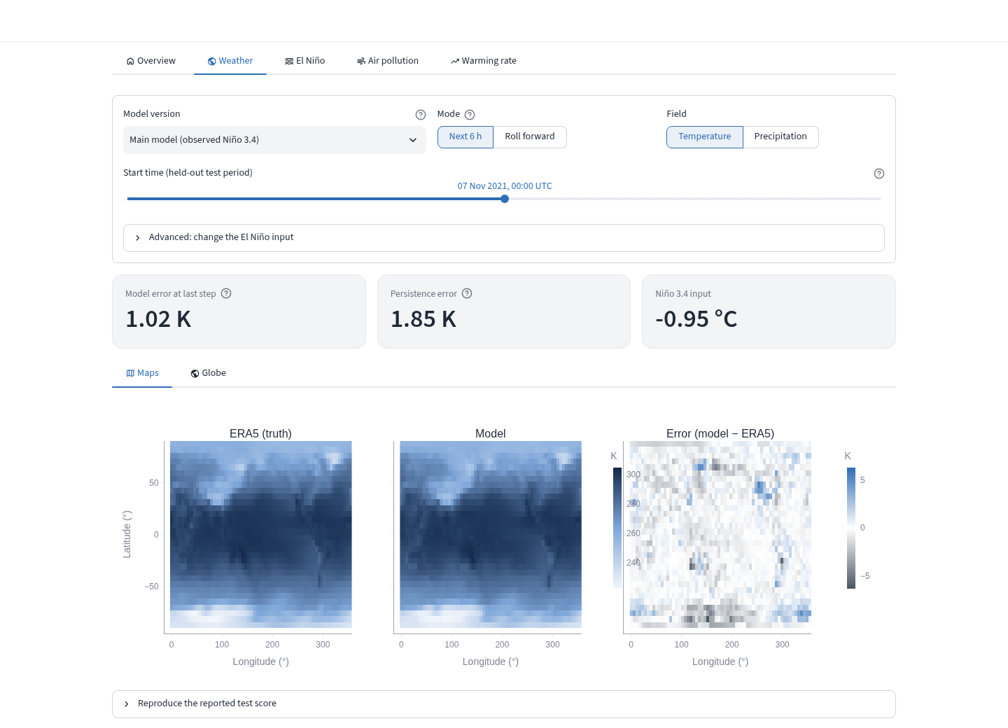
Pick a moment, compare with ERA5
SIMULATION APP · WEATHER
Choose any held-out time and see truth, model and error as maps or on a rotatable 3D globe.
CONTROLS
Model version, start time, temperature or rain, and an optional El Niño input
VIEWS
Maps and a 3D globe; roll forward and press Play to animate
CAUTION
Only the next 6 hours is validated; rolled-forward runs drift and can be worse than persistence
TAKEAWAY
It shows where the model is right and where it fails, one moment at a time.
Screenshot of the running app · make app · src/app/
Notes:
Roll forward feeds the model its own output, which it was never trained or tested for, so the page warns about it. Predictions are computed one sample at a time, giving 1.217 K against the reported 1.214 K in batches of 16.

Slide 9
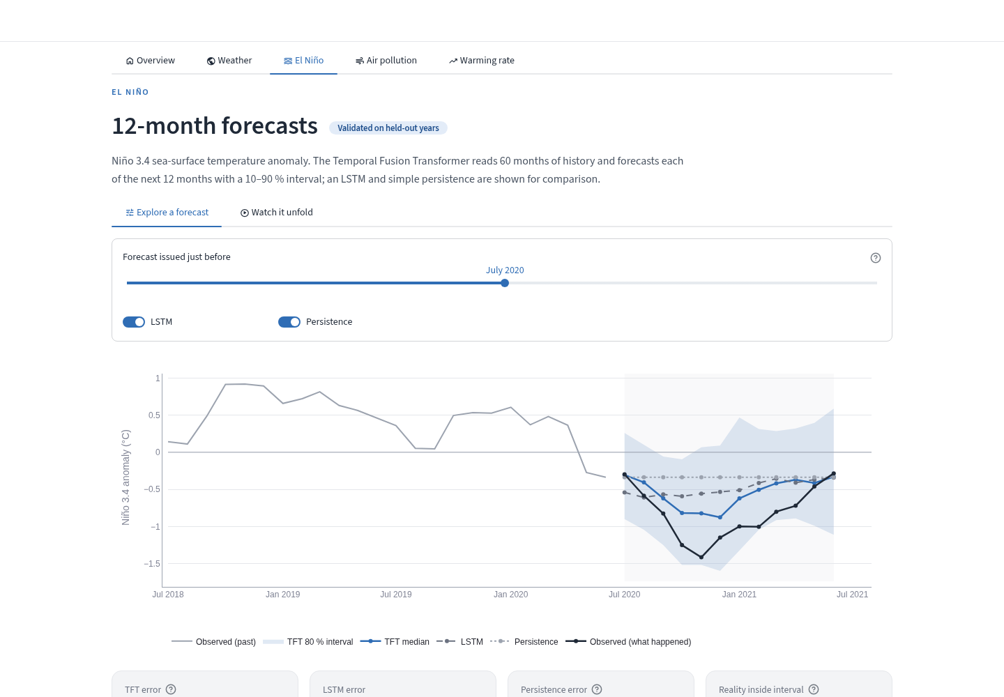
See each 12-month forecast against reality
SIMULATION APP · EL NIÑO
Slide to any forecast from 2015 to 2026 and compare the TFT with the LSTM, persistence and what happened.
EXPLORE
Median and 10–90 % band for the chosen window, with error for that window
WATCH IT UNFOLD
Play through the whole test period and see the band chase reality
SCORES
Error by lead time and the full metrics table
TAKEAWAY
The uncertainty band, and the cold bias in recent years, are visible at a glance.
Screenshot of the running app · make app · src/app/
Notes:
These are the seed-42 main-run forecasts. Across five seeds the TFT averages RMSE 0.78 degrees, so its edge over the LSTM is within run-to-run variation.

Slide 10

Next-day PM2.5 at each station
SIMULATION APP · AIR POLLUTION
Predicted and observed PM2.5 on a map, coloured by US EPA air-quality band.
MAPS
Model prediction beside the observed reading, where a station reported one
STATION
Highlight a station to see its recent inputs, its prediction and its reading
CAUTION
Most stations have no reading, so this is a demonstration, not evidence of skill
TAKEAWAY
The app makes the sparsity of the pollution data obvious, which headline numbers hide.
Screenshot of the running app · make app · src/app/
Notes:
The cached OpenAQ record has a median of one reporting station per date, and only 85 observed test station-days. The exceedance F1 equals an always-alert rule.

Slide 11
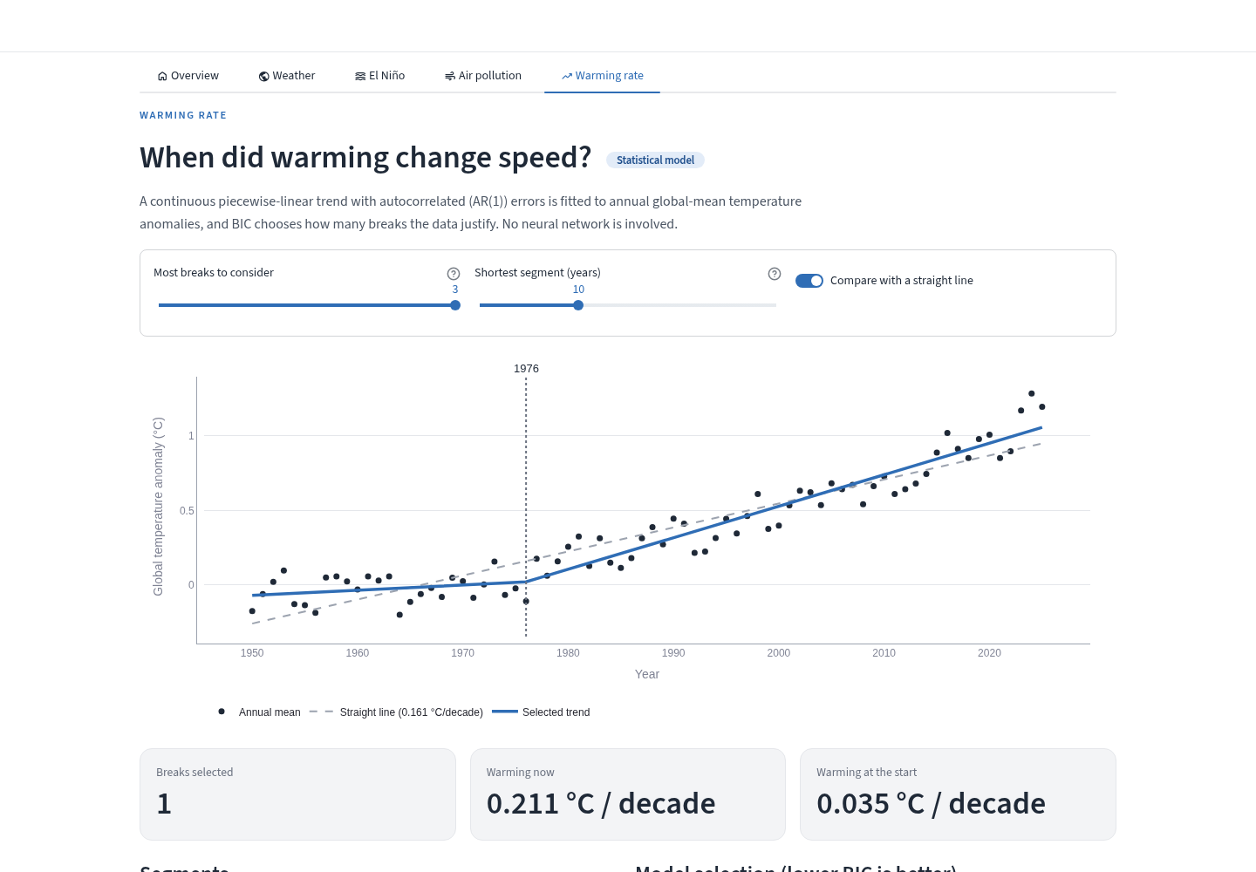
How firm is the 1976 break?
SIMULATION APP · WARMING RATE
Change the break search and watch the fitted trend, the BIC choice and the segment slopes update.
CONTROLS
Most breaks allowed, shortest segment, and a straight-line comparison
RESULT
BIC picks one break in 1976: 0.035 to 0.211 °C per decade
COMPARE
The straight line shows what the break adds
TAKEAWAY
Changing the settings shows how firm the 1976 break is.
Screenshot of the running app · make app · src/app/
Notes:
No neural network is involved: a continuous piecewise-linear trend with AR(1) errors is fitted to annual global means, and BIC chooses the number of breaks.

Slide 12
An evaluation designed to avoid leakage
EVALUATION
Leakage, test-period information reaching training, inflated an earlier version (TFT skill 0.91). These six rules remove it.
Chronological splits
70 / 15 / 15 train, validation and test, in time order, for every model
Training-only statistics
Normalisation never sees validation or test data
Persistence baselines
Every skill score is measured against carrying the last value forward
Five seeds
El Niño results as mean ± s.d.; the TFT variant chosen on validation loss
Physical units
Pollution in µg/m³ at the AQI-100 threshold, missing readings masked
Ablation
Weather-model input and loss tested one change at a time
TAKEAWAY
The numbers that follow are lower than the leaky run’s, but each one is a fair test on unseen data.
ClimatePulse · run 20261027_230426
Notes:
Skill compares a model's squared error with persistence's: 0 means no better than repeating the last value, 1 would be perfect. The TFT variant, with or without the calendar year, was chosen on validation loss before looking at test results.

Slide 13
Persistence: the forecast every model must beat
BASELINES
Persistence assumes nothing changes: the forecast is simply the latest observed value, carried forward. It needs no model at all.
El Niño
Each of the next 12 months = this month’s Niño 3.4
Air pollution
Tomorrow’s PM2.5 = today’s PM2.5 at the same station
Weather
The field in 6 hours = the current field
Skill = 1 − MSE(model) / MSE(persistence)
0 means no better than persistence, 1 would be perfect, below 0 is worse
Always-alert
For exceedance days: predict unhealthy air every day
TAKEAWAY
A model adds value only where it beats persistence; climate variables change slowly, so at short leads this is a demanding test.
Skill-score convention: Barnston et al., as adopted in the research paper
Notes:
Persistence is the standard reference in forecasting because it is free and surprisingly strong when a quantity changes slowly. MSE is mean squared error.

Slide 14
How each network is trained
TRAINING SETUP
All models use PyTorch; the learning rate halves when validation loss stops improving (ReduceLROnPlateau, factor 0.5).
Model | Parameters | Loss | Optimiser | Stopping
TFT | 96,047 | Quantile (pinball) loss at τ = 0.1, 0.5, 0.9 | Adam, lr 10⁻³, clip 0.1 | Early stop, patience 10
BiLSTM | 142,668 | MSE over 12 leads | Adam, lr 10⁻³, clip 1.0 | Early stop, patience 15
A3TGCN | 6,984 | MSE on observed station-days only | Adam, lr 10⁻³, clip 1.0 | 100 epochs, best kept
NWM | 217,346 | MSE weighted by cos(latitude) | AdamW, lr 10⁻³, decay 10⁻⁴ | Early stop, patience 10
TAKEAWAY
The networks are small (7k to 217k parameters) and train on a CPU; data, not compute, limits this study.
Source: research paper §4 · parameter counts from the run’s logs and checkpoints
Notes:
Batch size 32 for the TFT, LSTM and NWM; the A3TGCN trains on one graph window per step. The best checkpoint by validation loss is kept in every case.

Slide 15
Inside the Temporal Fusion Transformer
EL NIÑO · ARCHITECTURE
The TFT reads 60 months of history and outputs the 10th, 50th and 90th percentile forecast for each of the next 12 months.
Variable selection
Gated residual networks weight each input
→
LSTM encoder–decoder
Local patterns, hidden size 32
→
Self-attention
4 heads, softmax(QKᵀ/√d)·V over 60 months
→
Quantile heads
τ = 0.1, 0.5, 0.9 for leads 1–12
Inputs
Known ahead: month as sin/cos. Observed: Niño 1+2, 3, 3.4 and 4, plus 3-, 6- and 12-month rolling mean and s.d.
Pinball loss
ρτ(u) = u · (τ − 1[u < 0])
Under-forecasts cost τ, over-forecasts 1 − τ
LSTM baseline
2-layer bidirectional LSTM, 64 units per direction, then an MLP 128 → 64 → 12
TAKEAWAY
The TFT adds attention and calibrated quantiles on top of an LSTM; the question is whether 573 training windows are enough to use them.
Source: research paper §3.2 and §4.1 · Lim et al. (2021)
Notes:
Gated residual networks let the model switch off inputs that do not help. Attention lets each forecast step look back at any month in the 60-month window. Dropout 0.1 throughout. Training uses 573 windows, validation 127 and test 128.

Slide 16
The TFT edges the LSTM, within its own spread
EL NIÑO · FIVE SEEDS
RMSE: average error, lower is better. ACC: correlation with observed anomalies. Skill: error reduction against persistence, where 0 is no better.
Model | RMSE (°C) | ACC | Skill | Bias (°C)
TFT, no year (selected) | 0.782 ± 0.075 | 0.645 ± 0.023 | 0.427 ± 0.113 | −0.321 ± 0.146
TFT, with year | 0.838 ± 0.070 | 0.483 ± 0.193 | 0.341 ± 0.106 | −0.242 ± 0.141
Bidirectional LSTM | 0.809 ± 0.020 | 0.562 ± 0.035 | 0.390 ± 0.029 | −0.268 ± 0.078
Persistence | 1.036 | 0.383 | 0.000 | +0.062
TAKEAWAY
Both learned models clearly beat persistence. The TFT’s edge over the LSTM is smaller than its seed-to-seed spread, so treat them as comparable.
Source: elnino_seeds.csv · mean ± s.d. over 5 seeds · test Mar 2015 – Sep 2026, leads 1–12
Notes:
Removing the calendar-year covariate lowered mean validation loss from 0.331 to 0.283, so that variant was selected before looking at test results. The TFT's RMSE spread is nearly four times the LSTM's. The seed-42 main run scored better than this average, RMSE 0.684.

Slide 17
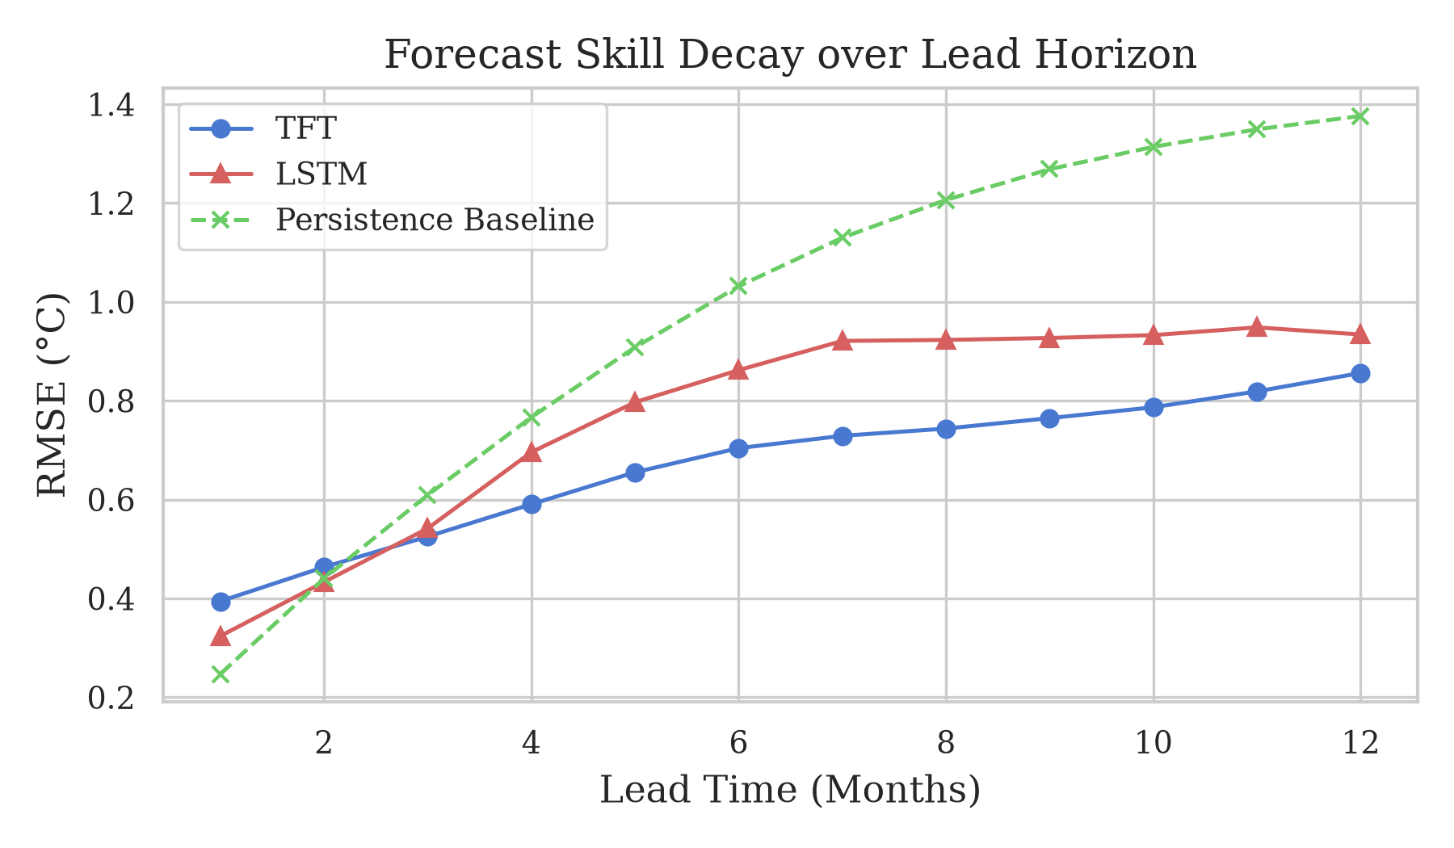
The TFT’s advantage grows with lead time
EL NIÑO · LEAD TIME
Lead time is how far ahead a forecast is made. The chart shows error (RMSE, °C) at each lead from 1 to 12 months.
1 MONTH
Persistence is best: 0.247 °C
2 MONTHS
The LSTM overtakes persistence
3–12 MONTHS
The TFT is most accurate at every lead
12 MONTHS
TFT 0.856, LSTM 0.934, persistence 1.376 °C
TAKEAWAY
For next month, simply repeating today’s value is hard to beat; from three months ahead the TFT is the most accurate of the three.
Source: elnino_lead_time_metrics.csv · main run, seed 42
Notes:
Short leads favour persistence because Niño 3.4 changes slowly from month to month; the learned models earn their keep from about three months out.

Slide 18
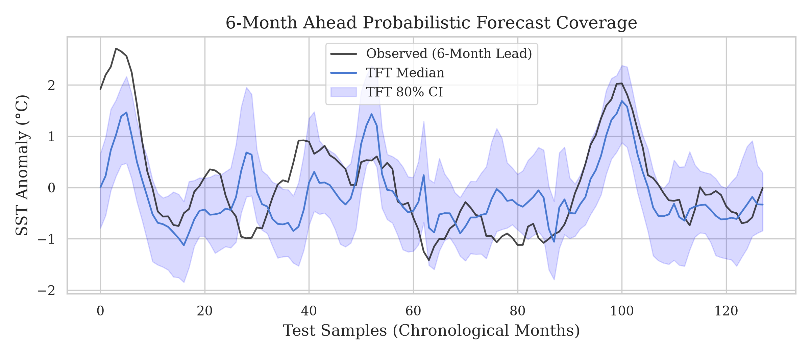
Both models run cold in a warmer test period
EL NIÑO · BIAS AND CALIBRATION
Bias is forecast minus observed, averaged; negative means too cold. An 80 % interval should contain 80 % of observations.
−0.32 °C
Mean TFT bias, five seeds (LSTM −0.27 °C)
−0.23 → +0.14 °C
Mean Niño 3.4, training → test period
75.7 %
Inside the 80 % interval; 16.1 % above its top
TAKEAWAY
Recent years are warmer than the training years, so both models under-predict; fixing the bias matters more than widening the interval.
Source: summary_metrics.json, elnino_seeds.csv · chart: 6-month-ahead TFT forecast
Notes:
The LSTM never sees the calendar year and shares the bias, so the year covariate is not the cause. The likelier cause is non-stationarity. Coverage of 75.7 percent is for the main run; the five-seed mean is 63 percent.

Slide 19
Inside the A3TGCN graph network
AIR POLLUTION · ARCHITECTURE
Each day’s readings are a signal on a 75-node station graph: graph convolution mixes space, a GRU mixes time, and attention picks the useful days.
Station graph
10 nearest stations, haversine, 705 edges
→
Graph conv.
Â = D^−½ (A + I) D^−½
→
GRU
Hidden state over 7 snapshots
→
Attention
Softmax weights on the 7 states
→
MLP head
32 → 16 → 1, next-day PM2.5
Edge weights
w = 1 / (d + 1), d in km, edges beyond 500 km dropped
Masked loss
MSE only on station-days with a reading; missing inputs set to the training mean
Data
118 / 21 / 20 windows; median one reporting station per date
TAKEAWAY
The architecture suits sensor networks, but with one station reporting on a typical date the graph rarely has neighbours to learn from.
Source: research paper §3.2 and §4.2 · Bai et al. A3T-GCN · 6,984 parameters
Notes:
The ingested record holds 10,000 hourly readings, the configured download limit, covering only 180 distinct dates, so consecutive snapshots are usually not consecutive days. A longer OpenAQ download is the first fix.

Slide 20
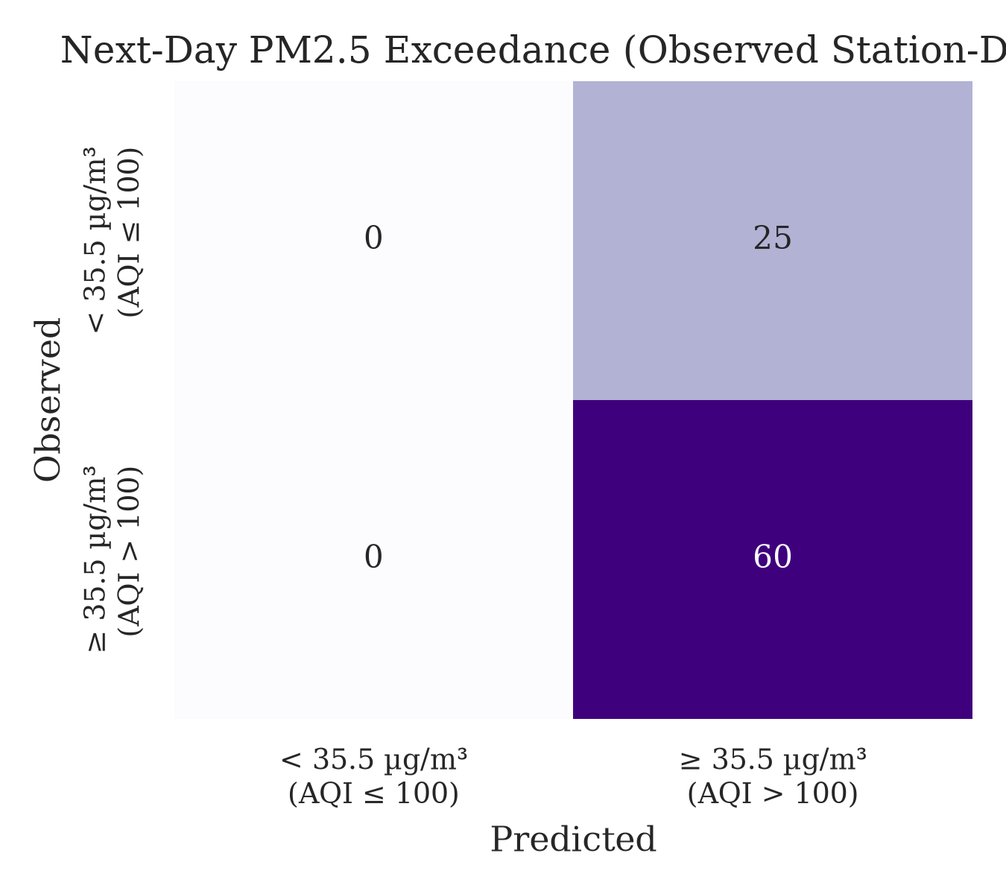
Modest gains, no exceedance skill yet
AIR POLLUTION · NEXT-DAY PM2.5
Forecasts are scored only where a reading exists. An exceedance is a day with PM2.5 ≥ 35.5 µg/m³, i.e. AQI above 100.
46.6 vs. 52.0 µg/m³
RMSE, model vs. persistence: about 10 % lower
F1 0.828 = always-alert
The model flags every day; persistence scores 0.881
85 of 1,500
Test station-days with a reading, from 36 stations
TAKEAWAY
Concentration forecasts beat persistence slightly, but 85 test readings are too few to show the model can spot unhealthy-air days.
Source: summary_metrics.json · chart: exceedance confusion matrix
Notes:
Missing readings are masked in training and evaluation. Of the 85 observed test station-days, 62 fall on two dates and 70.6 percent exceed the threshold, which makes always-alert a strong baseline.

Slide 21
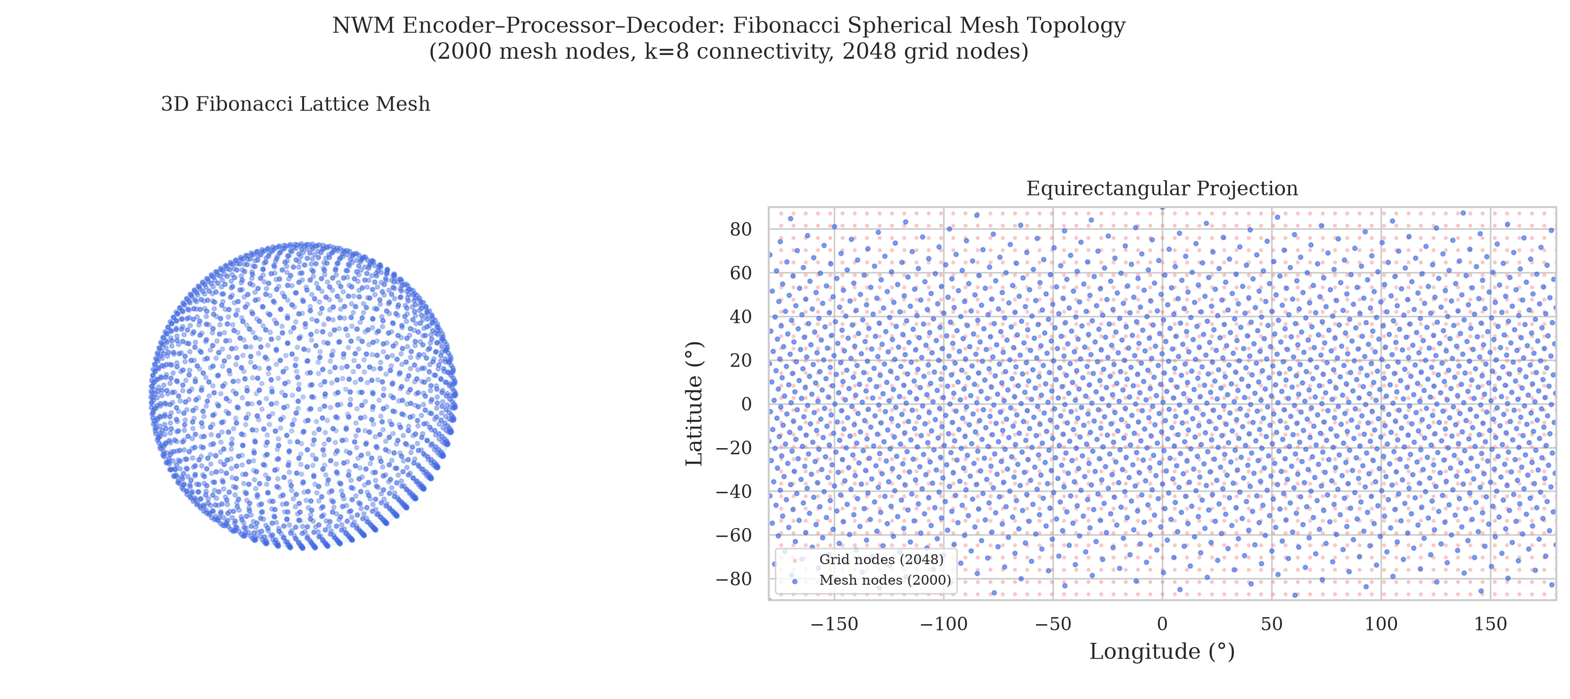
A weather model on a Fibonacci spherical mesh
WEATHER · ARCHITECTURE
Given the last two 6-hour global fields, the model predicts the next one: grid points are mapped onto an evenly spaced mesh and back.
ENCODER
2,048 grid points → 2,000 mesh nodes
PROCESSOR
4 GraphSAGE layers pass messages between mesh neighbours; Niño 3.4 can be added to each layer
DECODER
Mesh → grid, with a skip connection
TAKEAWAY
An evenly spaced mesh avoids the crowding of grid points near the poles that distorts regular-grid models.
ERA5 2 m temperature and precipitation, 5.625°, 6-hourly, 2020–2021
Notes:
The mesh follows a golden-angle spiral. Edges come from nearest-neighbour searches in 3-D: 4 mesh neighbours per grid point, 8 per mesh node. The loss is weighted by the cosine of latitude.

Slide 22
Inside the encoder–processor–decoder
WEATHER · LAYERS
Features move from the grid to the mesh, are refined by message passing between mesh neighbours, then return to the grid as a forecast.
Embed
12 inputs → 128, Linear + LayerNorm + GELU
→
Encoder
Bipartite SAGEConv, grid → mesh
→
Processor
4 residual SAGEConv layers, 8 neighbours
→
Decoder
Mesh → grid, plus skip connection
→
Output
128 → 2: temperature and rain
Processor layer with ENSO conditioning
h ← h + GELU(LN(SAGEConv(h + c)))
c = MLP(Niño 3.4), 1 → 128 → 128, added to the messages only
Fast batching
Edge indices for a whole batch built by offset arithmetic, with no Python loops
TAKEAWAY
A GraphCast-style design at small scale (217k parameters); the conditioning term c is the one part the ablation shows adds nothing.
Source: research paper §4.3 · AdamW, lr 10⁻³, weight decay 10⁻⁴
Notes:
Each grid point's 12 inputs are temperature and precipitation at two time steps plus sin and cos of latitude and longitude. The batching method is what patent claims 8 and 9 cover.

Slide 23
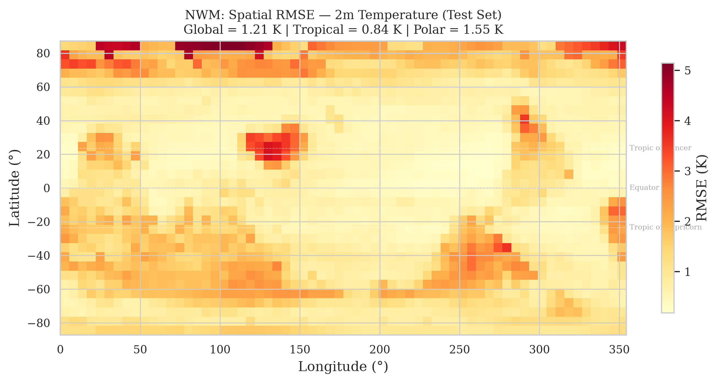
The weather model halves persistence error
WEATHER · TEST SKILL
Error in 2 m temperature 6 hours ahead, weighted by area (cos latitude), over 438 test samples. The map shows the error at each grid point.
1.21 K
Model RMSE
2.46 K
Persistence RMSE on the same samples
Tropics 0.84 K · poles 1.55 K · Precipitation error 24 % below persistence
TAKEAWAY
The model learns real 6-hour dynamics: its error is half that of persistence, lowest in the tropics and highest near the poles.
Source: summary_metrics.json · chart: per-grid-point RMSE map
Notes:
Best validation loss 0.1173 at epoch 70 of 81, with a train-validation gap of about 9 percent: mild overfitting at most. Normalisation statistics come from the training period only.

Slide 24
ENSO conditioning does not help
WEATHER · ABLATION
An ablation changes one thing in the main model, retrains it, and scores every variant on the same test samples. Shorter bars are better.
Test 2 m temperature RMSE (K), one training run per variant; gaps below about 0.05 K are within seed noise
TAKEAWAY
Niño 3.4 adds nothing at 6 hours, and feeding in TFT forecasts makes the model worse (+0.12 K); the area-weighted loss does not help either.
Source: nwm_ablation.csv · run 20261027_230426
Notes:
Over a 6-hour step, the recent atmospheric state carries far more information than a monthly ENSO index, and 2020 to 2021 spans a single La Niña episode, so the index barely varies. Precipitation error is the same across variants.

Slide 25
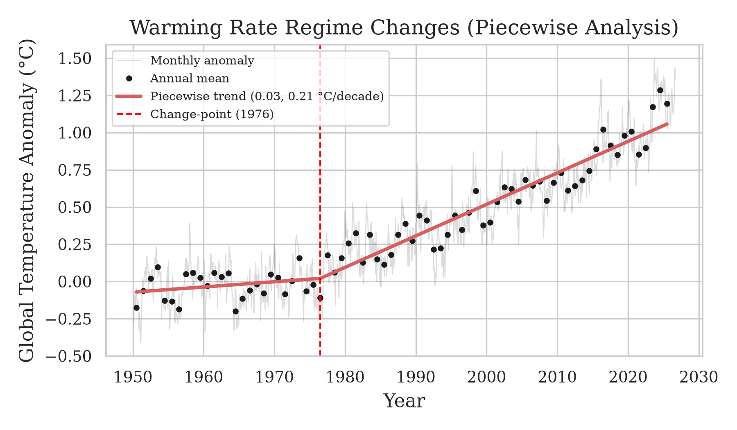
Warming accelerated in the mid-1970s
WARMING RATE · GISTEMP 1950–2025
A trend of joined straight segments is fitted to 76 annual global means; BIC decides how many breaks the data justify.
1976
One change-point selected
0.035 → 0.211 °C per decade
Break years 1970–1986 fit almost as well (ΔBIC < 2)
A second break in 2012 is nearly tied (ΔBIC 0.4)
TAKEAWAY
Warming sped up about six-fold in the mid-1970s; a further acceleration after 2012 is possible but not yet established.
Source: climate_feedback_results.json · chart: GISTEMP with fitted trend
Notes:
Fitted by Prais-Winsten GLS with AR(1) errors, searching zero to three breaks exhaustively with segments of at least 10 years. A lower BIC means a better balance of fit and simplicity.

Slide 26
What the training run recorded
TRAINING LOGS · EL NIÑO AND POLLUTION
Verbatim lines from the main run on 27 October 2026; only the logger prefix (level and module) is trimmed.
# El Niño main run · runtime/logs/run.log
14:31:54 Prepared TFT DataFrame: 921 timesteps, 15 features
14:31:57 Split: train=644 months, val=138 months, test=139 months; windows train=573, val=127, test=128
14:31:57 Created TFT model: 96,047 parameters
14:31:57 Training TFT: 100 epochs, batch_size=32
14:32:50 TFT training complete. Best val_loss=0.287493
14:32:52 Created LSTM model: 142,668 params, hidden=64, layers=2, bidirectional=True
14:33:03 Early stopping at epoch 21
14:33:03 LSTM training complete. Best val_loss=0.337486
# Pollution A3TGCN · same log
14:33:17 Created PollutionSTGNN: 6,984 params, hidden=32, periods=7
14:33:17 Training PollutionSTGNN: 100 epochs, lr=0.001, device=cpu, params=6,984
14:33:20 Epoch 1/100: train=1.741392, val=0.380588
14:37:44 Epoch 100/100: train=0.968618, val=0.301509
TAKEAWAY
The log shows each model built, trained and stopped, with the parameter counts and data splits reported in the paper.
Source: runtime/logs/run.log, lines from 2026-10-27 14:31–14:37
Notes:
The TFT trained in under a minute; its best validation quantile loss was 0.2875, which matches the checkpoint name tft-epoch=13-val_loss=0.2875. The LSTM stopped at epoch 21. The pollution model ran all 100 epochs and keeps the best validation checkpoint.

Slide 27
Two hours on CPU, then early stopping
TRAINING LOGS · WEATHER MODEL
Verbatim lines from the main weather run, one ablation run and the evaluation step; logger prefix trimmed.
# Main weather model · runtime/logs/run.log
14:37:52 NWM conditioning=observed (nino_features.parquet), area_weighted_loss=True
14:37:53 Training NWM ST-GNN: 100 epochs, device=cpu, lr=0.001, wd=0.0001
14:39:11 Epoch 1/100: train_loss=0.286078, val_loss=0.193916, val_rmse=0.440358
⋮
16:32:23 Epoch 80/100: train_loss=0.107055, val_loss=0.117450, val_rmse=0.342710
16:33:47 Early stopping triggered at epoch 81.
16:33:47 NWM training complete. Best val_loss=0.117334
# Ablation · nwm_ablation/forecast/train_nwm_forecast.log
16:53:06 NWM conditioning=forecast (nino34_tft_lead1.parquet), area_weighted_loss=True
22:06:03 Early stopping triggered at epoch 85.
# Evaluation · make gen-eval-artifacts
23:04:07 NWM test (observed): T2m RMSE 1.214 K (persistence 2.457 K), precip RMSE 6.821e-04 (persistence 9.032e-04)
TAKEAWAY
Training ran to early stopping on CPU, and the logged test RMSE is exactly the 1.214 K reported.
Source: runtime/logs/run.log and the ablation logs, 2026-10-27
Notes:
The main model trained from 14:37 to 16:33, about 86 seconds per epoch. The three ablation variants trained in parallel from 16:53 to 22:06. The best validation loss, 0.117334, matches the paper's 0.1173.

Slide 28
What the application claims
PATENT APPLICATION
The draft application has 15 claims covering the spherical-mesh weather model, a fast graph-batching method and the four-module system.
Claims 1–7 | Fibonacci-mesh weather model with ENSO conditioning
Claims 8–9 | Loop-free batching of graph edge indices
Claims 10–13 | Four-module system, TFT forecasts driving the weather model
Claims 14–15 | Matching method and storage-medium claims
Status
Draft; inventor names still to be completed
Section 7 now discloses the ablation results
Revised claim wording drafted for the patent agent
TAKEAWAY
Claims built on ENSO coupling (1(d), 3, 10, 14) conflict with the disclosed results and need revising; the mesh and batching claims are the strongest.
Source: docs/patent/patent_application.md, claims 1–15
Notes:
Claims 5 and 6, on the area-weighted loss and the normalisation statistics, also need attention. The strongest technical effects to argue are halving the persistence error and the batch-offset method.

Slide 29
What the evidence supports
CONCLUSIONS
One finding per model from this run, and the next step it points to.
El Niño
TFT and LSTM are comparable and beat persistence from 2–3 months; next, remove the shared cold bias
Air pollution
10 % below persistence on concentration; next, a longer download to test exceedance skill
Weather
Halves persistence error at 6 hours; ENSO coupling is not supported on two years of data
Warming rate
A regime change around 1976, from 0.03 to 0.21 °C per decade
TAKEAWAY
The integration works and is reproducible; the scientific claims must stay modest, and ENSO coupling of the weather model is not supported.
ClimatePulse · run 20261027_230426
Notes:
Multi-year weather training spanning several ENSO phases, and longer lead times, are needed before ENSO conditioning can be properly tested.

Slide 30
Rebuild every result from a fresh clone
HOW TO RUN
Run these in order, from §7 of the research paper. The same steps are listed in run.sh, and run.ipynb runs them on Google Colab.
# 0. Get the code
git clone https://github.com/aditripaul/climatepulse
cd climatepulse
# 1. Environment and credentials
make install-dev
cp -n .env.example .env # DATA_OPENAQ_API_KEY
# 2. Data
make download-data
make download-nwm-data
make test
# 3. El Niño: five seeds, then main run
make train-elnino-seeds
# set tft_use_year from the selection file
make train-elnino
# 4. Other models
make train-pollution
make train-nwm # about 2 h on CPU
make export-tft-forecasts # needs main TFT
make nwm-ablation # about 5 h on CPU
# 5. Artifacts, snapshot, documents
make gen-eval-artifacts
make save-run
make sync-paper-artifacts
make gen-research-paper-pdf
TAKEAWAY
One ordered run rebuilds every figure and table; the committed snapshot run_20261027_230426 lets you check results without retraining.
github.com/aditripaul/climatepulse · GPL v3.0
Notes:
Copy tft_use_year from elnino_seed_selection.json into configs/runtime_conf.yaml before the main El Niño run; the Colab notebook does this automatically. The ablation scores the main weather model, and exporting TFT forecasts needs the main TFT.

