Slide 1


NS3-BASED SIMULATION OF A COMPUTER NETWORK
Aditri Paweria (2022027)
Tanishk Singh (2022612)

Slide 2

INTRODUCTION
Objective: Simulate a network of 7 hosts and 4 routers to study:
  Throughput
  Packet Drops
  End-to-End Delays
  Queue Lengths
Tools Used:
  NS3: A discrete-event network simulator for simulating IP networks.
  NetAnim: A visualization tool to analyze packet flows.

Slide 3

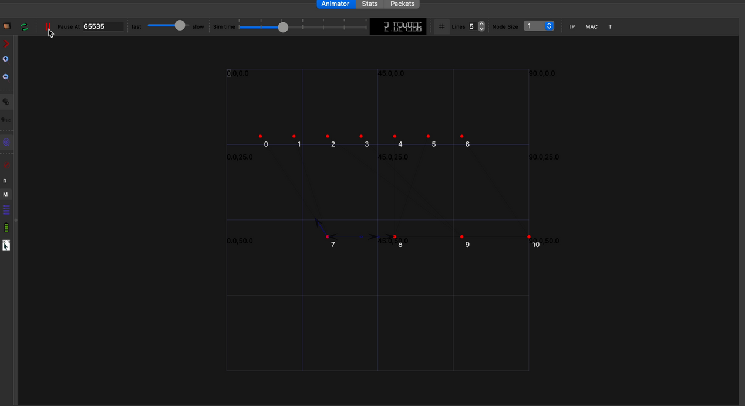
NETWORK TOPOLOGY AND PARAMETERS
Topology:
  7 Hosts: Represented as endpoints generating or receiving traffic.
  4 Routers: Intermediary nodes managing data transmission.
Link Parameters:
  Point-to-Point links with varying bandwidth (10 Mbps to 30 Mbps).
  Uniform delay of 1 ms.
  Packet drop rate: 0.5%.

Slide 4
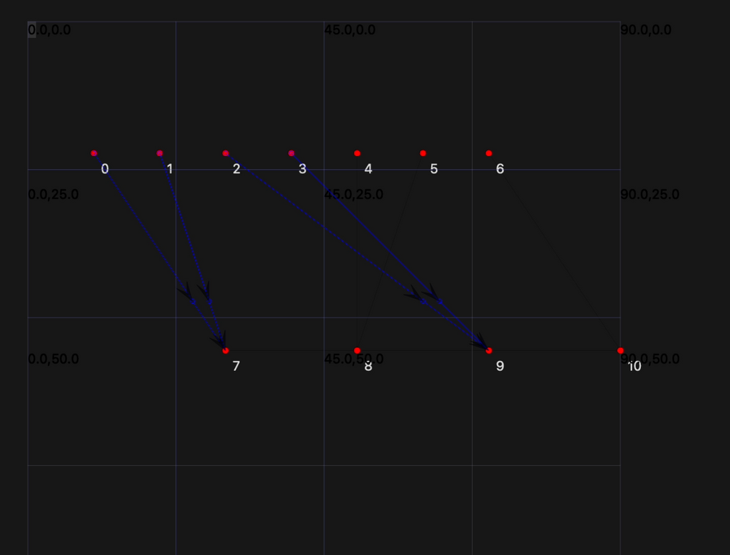
SIMULATION SETUP
Environment: NS3 on Linux with dependencies like g++, Python3, CMake.
Code Integration: Assignment topology file added to NS3 scratch folder.
Execution:
  Run simulation with logging: NS_LOG="AssignmentTopology=info" ./ns3 run scratch/assignment_topology.
  Generated XML file for NetAnim visualization.

Slide 5
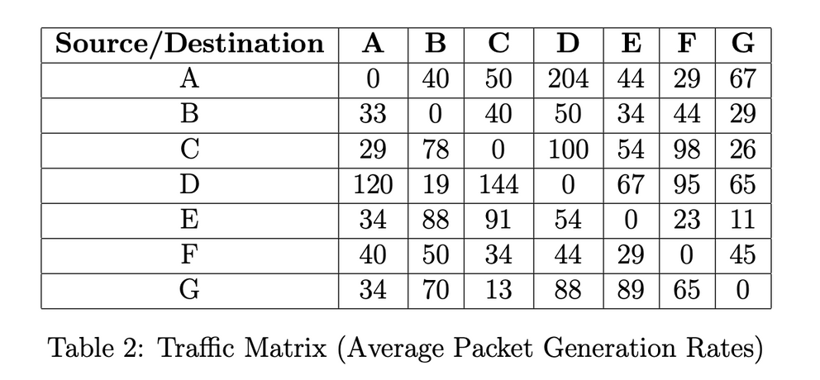
TRAFFIC PATTERNS
Traffic Matrix:
  Example: A to E: 44 packets, B to F: 34 packets.
Key Observations:
Traffic Hotspots: Occur on links with high data rates and multiple connections (e.g., routers connecting to multiple hosts with high-bandwidth links). These routes experience more traffic, resulting in higher throughput but potentially increased delays and packet loss.
Low-Traffic Routes: Found on links with lower data rates or fewer connections (e.g., connections with 10-20 Mbps capacity). These routes experience less congestion but may have lower throughput.
Impact on Network Behavior:
  Throughput: Higher on high-capacity routes.
  Delay: Increases on congested hotspots.
  Packet Loss: More common on congested paths.

Slide 6
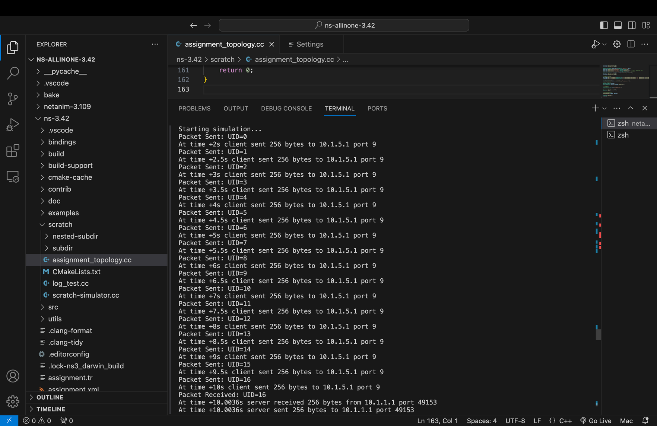

OBSERVED RESULTS – PACKET DROPS AND DELAYS
Most Congested Route:
  Flow 1 (10.1.1.1 → 10.1.5.1) with 92 packet drops, throughput 0.002 Mbps, and average delay 3.57 ms.
Insights:
  Higher traffic density leads to more packet drops and delays: As Flow 1 sent 116 packets, compared to only 6 in Flow 2, the high volume caused congestion, leading to delays and drops.
  Solutions: Use QoS, load balancing, and optimize retransmission to reduce congestion.

Slide 7

OBSERVED RESULTS – QUEUE LENGTHS
Maximum Queue Lengths:
  R1: 116 packets, R2: 6 packets (based on the data from Flow 1 and Flow 2).
Impact of Queue Sizes:
  Larger queues: Reduce packet drops but increase delay (seen in Flow 1).
  Smaller queues: Better for low-traffic networks like Flow 2, ensuring minimal delays but risk of drops in high traffic.

Slide 8
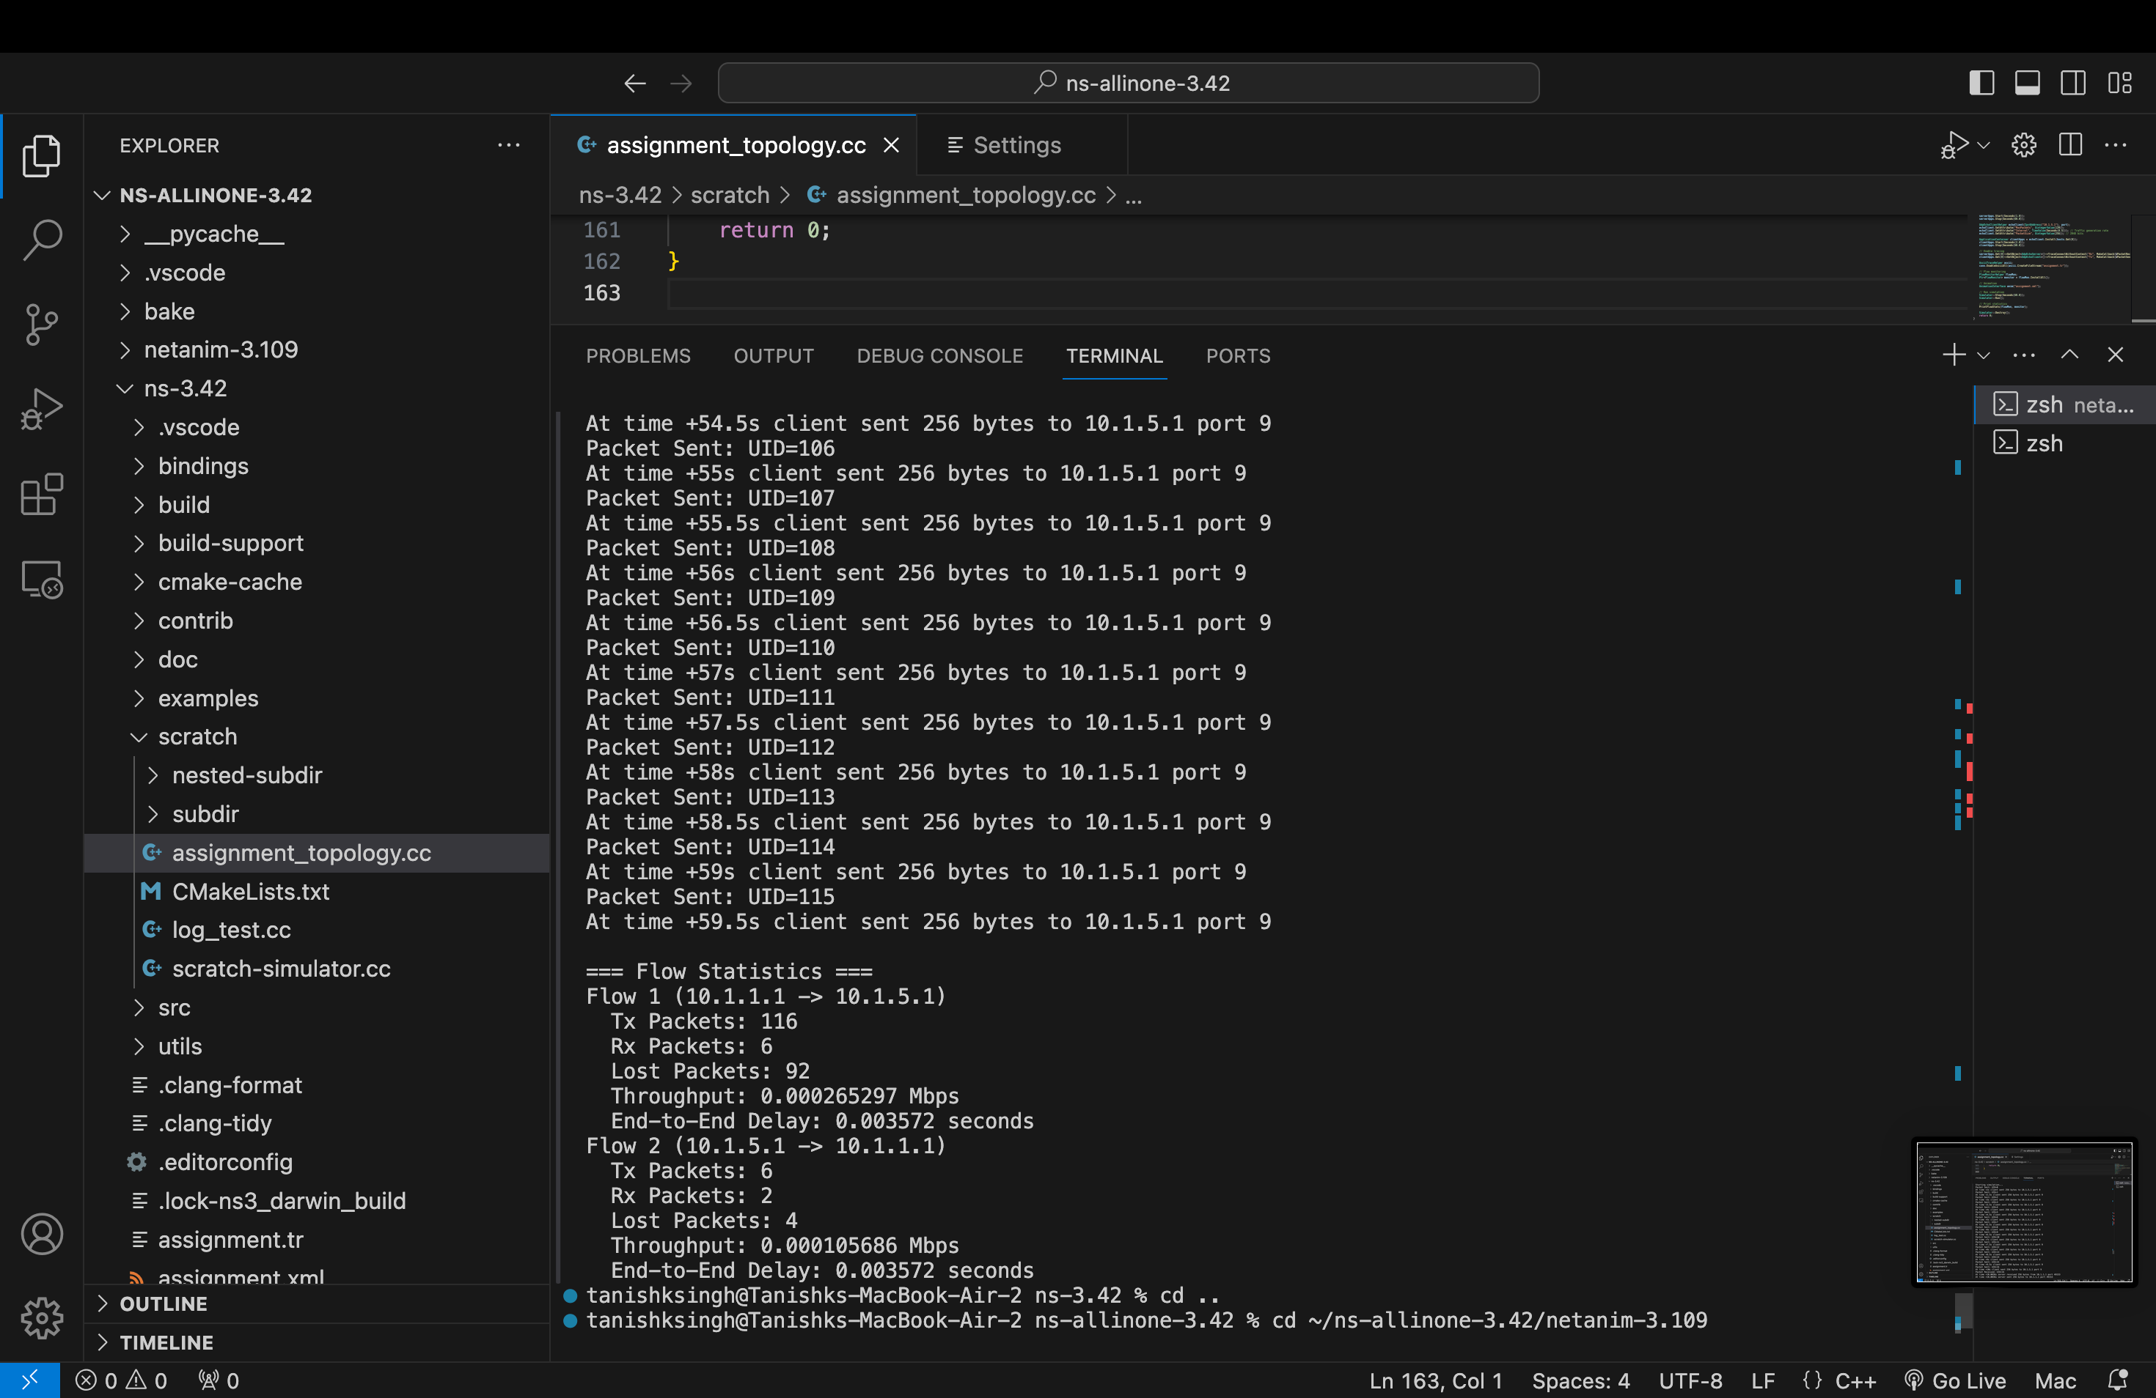
FLOW STATISTICS
Example: 10.1.1.1 → 10.1.5.1:
  Tx Packets: 116
  Rx Packets: 6
  Lost Packets: 92
  Throughput: 0.002 Mbps
  End-to-End Delay: 3.572 ms
NS3 Output Logs:
Refer to the logs in the provided screenshots for packet transmission and reception details. The logs clearly show the packet flow, timestamps, and congestion statistics.

Slide 9
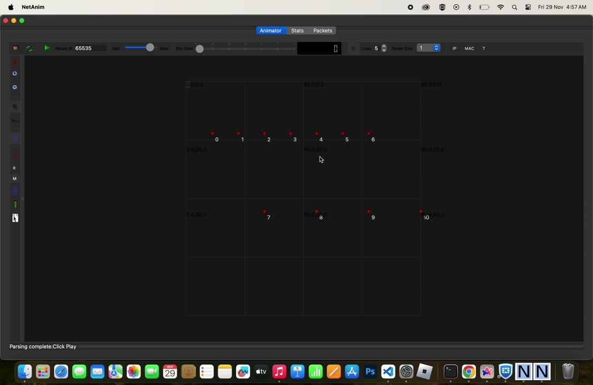
PACKET TRACE VISUALIZATION
Traces: a few packets traversing the network using NetAnim.

Slide 10
CONCLUSION
Findings:
  Bandwidth and traffic intensity heavily influence performance.
  Packet drops increase with traffic, but larger queues mitigate losses.
  Visualization tools like NetAnim are invaluable for understanding flow patterns.
Recommendations:
  Optimize routing protocols.
  Use dynamic traffic management to prevent congestion.

Slide 11
THANKYOU

