Slide 1


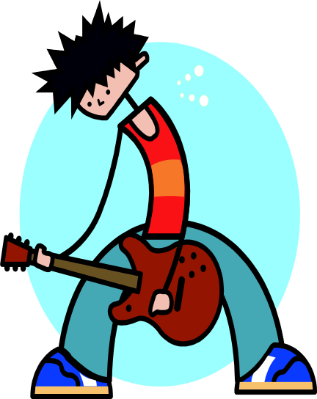
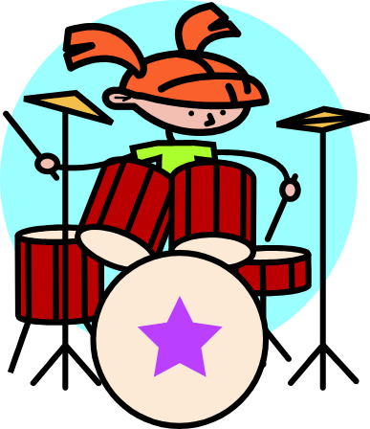
SHOW YOUR TALENTS
FIRST TIME MUSICIANS,DANCERS, SINGERS.
WANTED
WHO WANTS TO PERFORM AS A GROUP OR SOLO.
COME TO OUR AUDITION ON SATURDAY 15 OF OCTOBER 05
IT WILL BE FUN!!!!
SUBSCRIBE FREE FOR THE CODEMO’S MULTICULTURAL
MUSIC FESTIVAL
PRICES TO BE WON.
MORE INF. ON 8502 6300 OR 0402698447

