Slide 1
Develop a Tool to Visualize and Interpret an Image Classification ML Model

Slide 2
Motivation
ML holds immense potential to assist doctors in clinical decision-making settings
Lack of interpretability means its harder to trust the model
By visualizing a learned embedding space, we hope to identify relationships within the dataset as well as better understand how and why the model gives the results it does

Slide 3
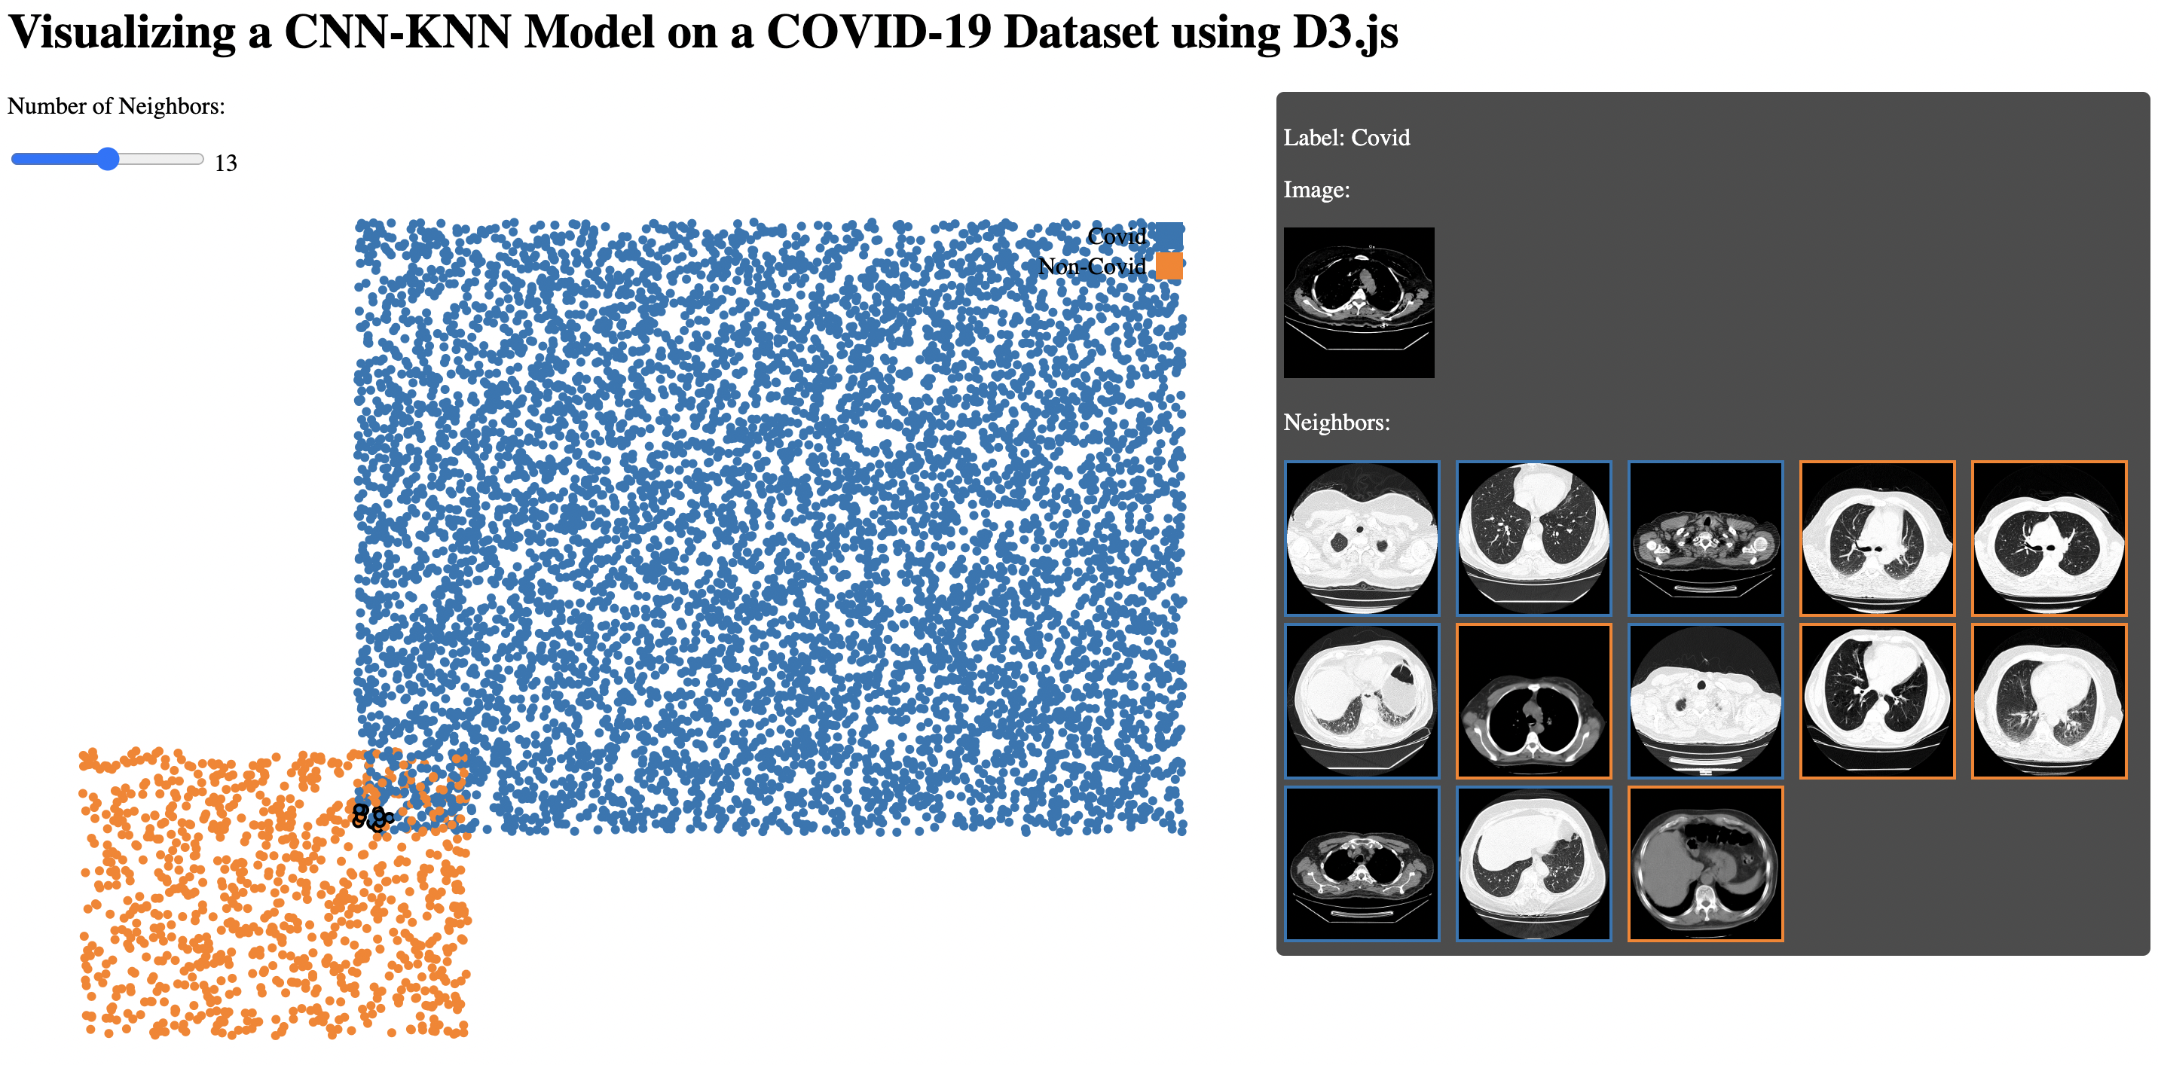
Current Progress
Built using HTML, CSS, and d3.js
For a toy model, for each point we can display image, true label, and neighbors

Slide 4
Next Steps
Make the visualization more interactive
Upload images
Better zooming and panning
Adjust visualization parameters (e.g. distance functions, dimensionality reduction, highlight higher dimensional neighbors)
Make images larger
Cosmetic changes to make tool prettier

