Slide 1

STOCKEDUP
Online Shopping (E-Commerce) System
A Project Presentation | MERN Stack Web Application
Presented by
Group Leader: Shubham Kr. Mandal (Regd. No. 2501445245)
Members: Aditya Raj (Regd. No. 2501445017)
Rudra Narayan Barik (Regd. No. 2501445603)
Chanchal Patar (Regd. No. 2501445488)
Live Project: https://stockedup.vercel.app
Department of Computer Science & Engineering
Gandhi Engineering College (GEC Autonomous), Bhubaneswar

Slide 2
Project Overview
Stockedup is a full-stack e-commerce website. Customers can browse products, add them to the cart and place orders, while an admin dashboard is used to manage the store. Built with the MERN stack.
Two parts of the application - customer storefront and admin dashboard
Product catalogue with 168 products in 6 categories, with search and filters
Login/signup using JWT tokens; passwords stored in encrypted (hashed) form
Cart, coupon-based discounts and order placement with e-mail confirmation
Responsive design, works on mobile as well as desktop
Hosted on Vercel, database on MongoDB Atlas (cloud)

Slide 3
Problem Statement
Why we built this project -
1) Small/local shops have a limited reach - they can only sell to nearby customers
2) Using existing marketplaces means paying high commission and platform fees
3) Customers waste time on slow search and unclear product information
4) Order and inventory handling is done manually, which is slow and error prone
5) Online stores are common targets of hacking - passwords and data need protection
6) There was no simple and affordable e-commerce solution for smaller stores

Slide 4
Objectives
Main Objectives
Technical Objectives
Build an easy-to-use online store for browsing, searching and buying products
Provide separate access for customers and admins using secure login
Allow cart management, coupon discounts and order placement with confirmation
Give admins a dashboard to manage products, categories and orders
REST API with clear separation of client and server code
Secure password hashing and JWT-based sessions
Responsive UI that works on all screen sizes
Cloud deployment on Vercel with MongoDB Atlas
Final deliverables: working web application, source code package and project report

Slide 5
Technology Stack
We used the MERN stack - JavaScript is used on both frontend and backend.
Layer | Technology | Used for
Frontend | React 18 + React Router + Vite | User interface, pages, routing
Backend | Node.js + Express | REST API, logic, authentication
Database | MongoDB (Atlas) + Mongoose | Stores users, categories, products, orders
Security | JWT + bcrypt | Login tokens and password hashing
Hosting / Tools | Vercel, Git, NPM | Deployment, version control, packages

Slide 6
System Architecture
CLIENT React SPA - user interface, pages, API calls
JSON over HTTPS
APPLICATION SERVER Node.js + Express - REST API, auth, business logic
Mongoose queries
DATABASE MongoDB Atlas - users, categories, products, orders
Important API calls Products & search -> GET /api/products, /api/categories
Login & register -> POST /api/auth/login, /api/auth/register
Place order -> POST /api/orders (can apply coupon code)

Slide 7
Database Design
MongoDB is a document database. This project uses 4 collections -
collection: users
collection: categories
name, email
password (hashed)
role (user/admin)
name
description
image
collection: products
collection: orders
name, price
description, image
categoryId, stock
userId, items[]
subtotal, discount, total
couponCode, status
Relations: products.categoryId -> categories orders.userId -> users orders.items[] -> products

Slide 8
Main Modules
Module | Description
Authentication | Register / login for customers and admin, JWT based security
Product catalogue | Browse, search and filter 168 products in 6 categories
Cart & checkout | Add/remove items, apply coupon (INDEPENDENCE25), place order
Orders | Order placement with e-mail confirmation, admin can update status
Admin dashboard | Manage products and categories, view all orders
Other pages | Contact page, about, offers, 404 error page

Slide 9
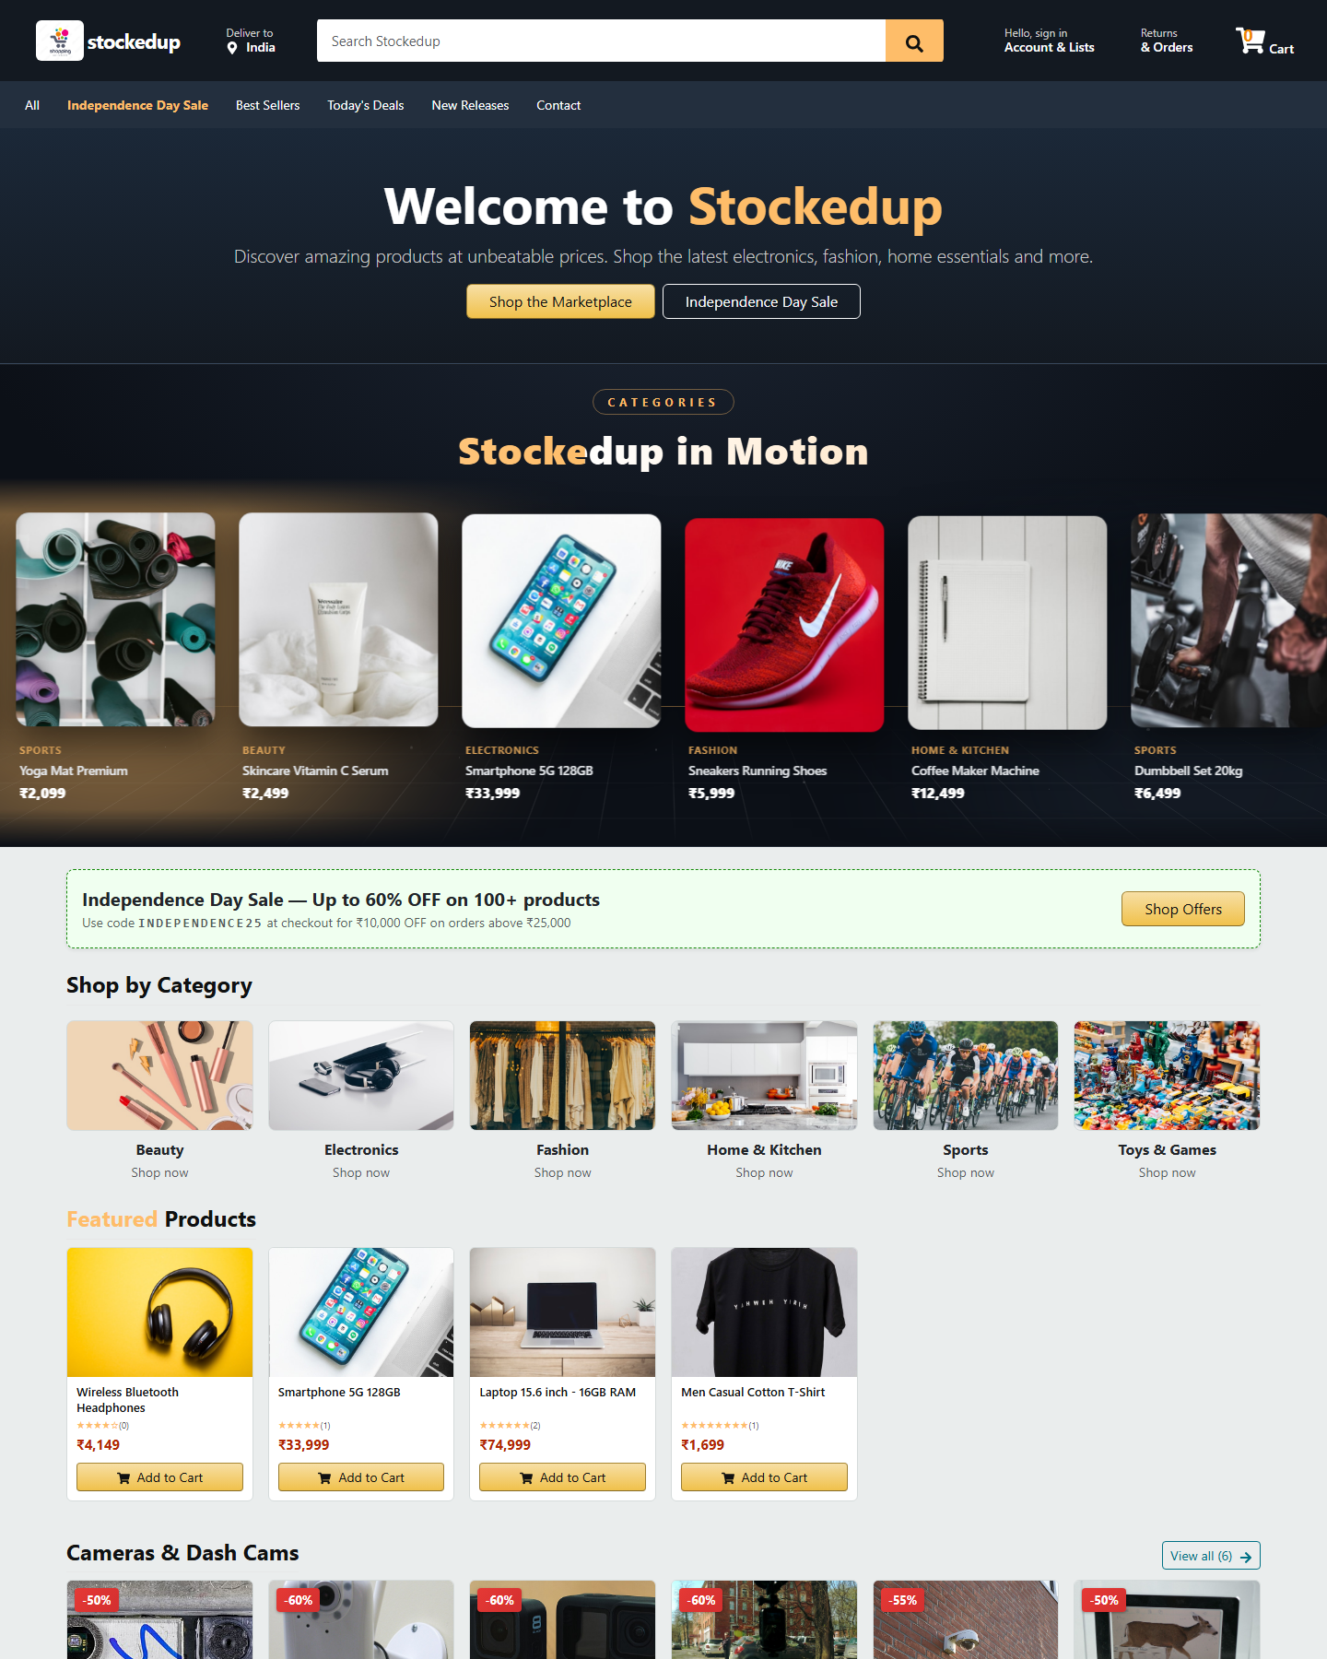
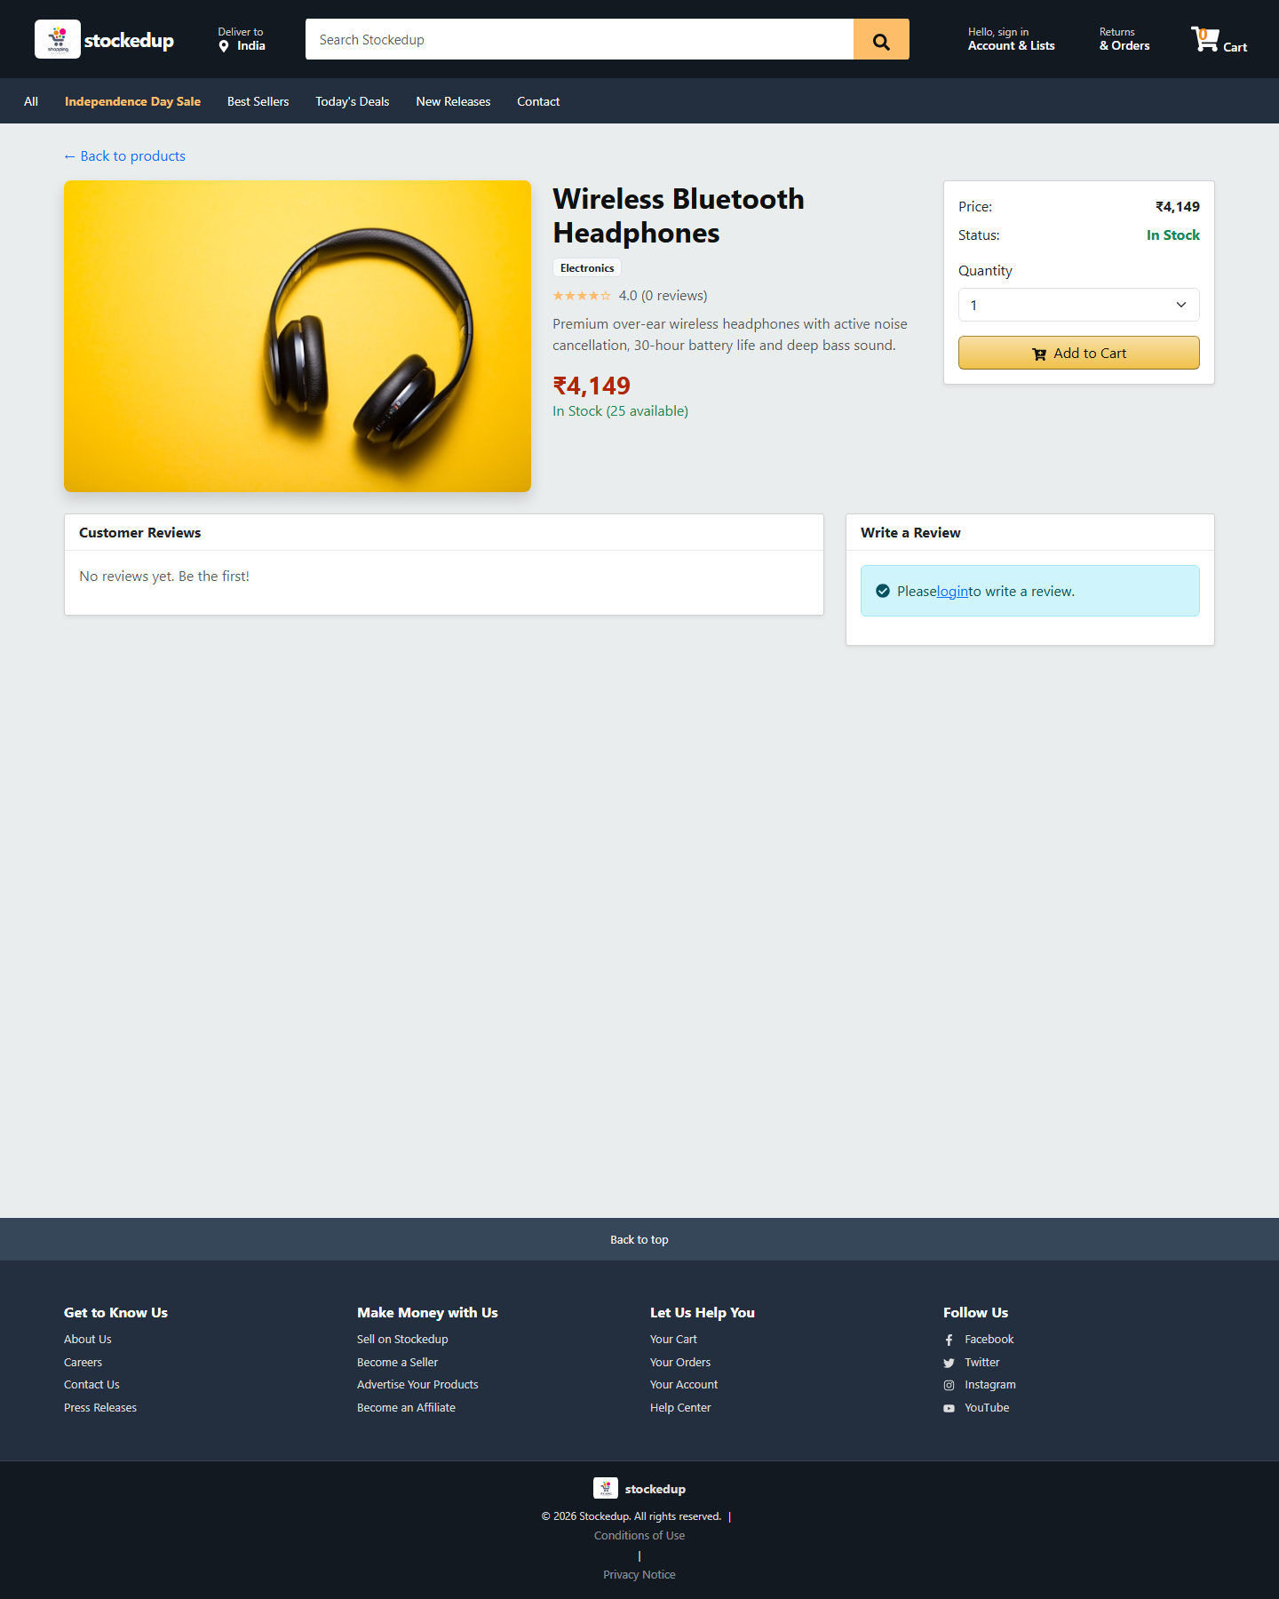
Screenshots - 1
Home page - storefront
Product detail page

Slide 10
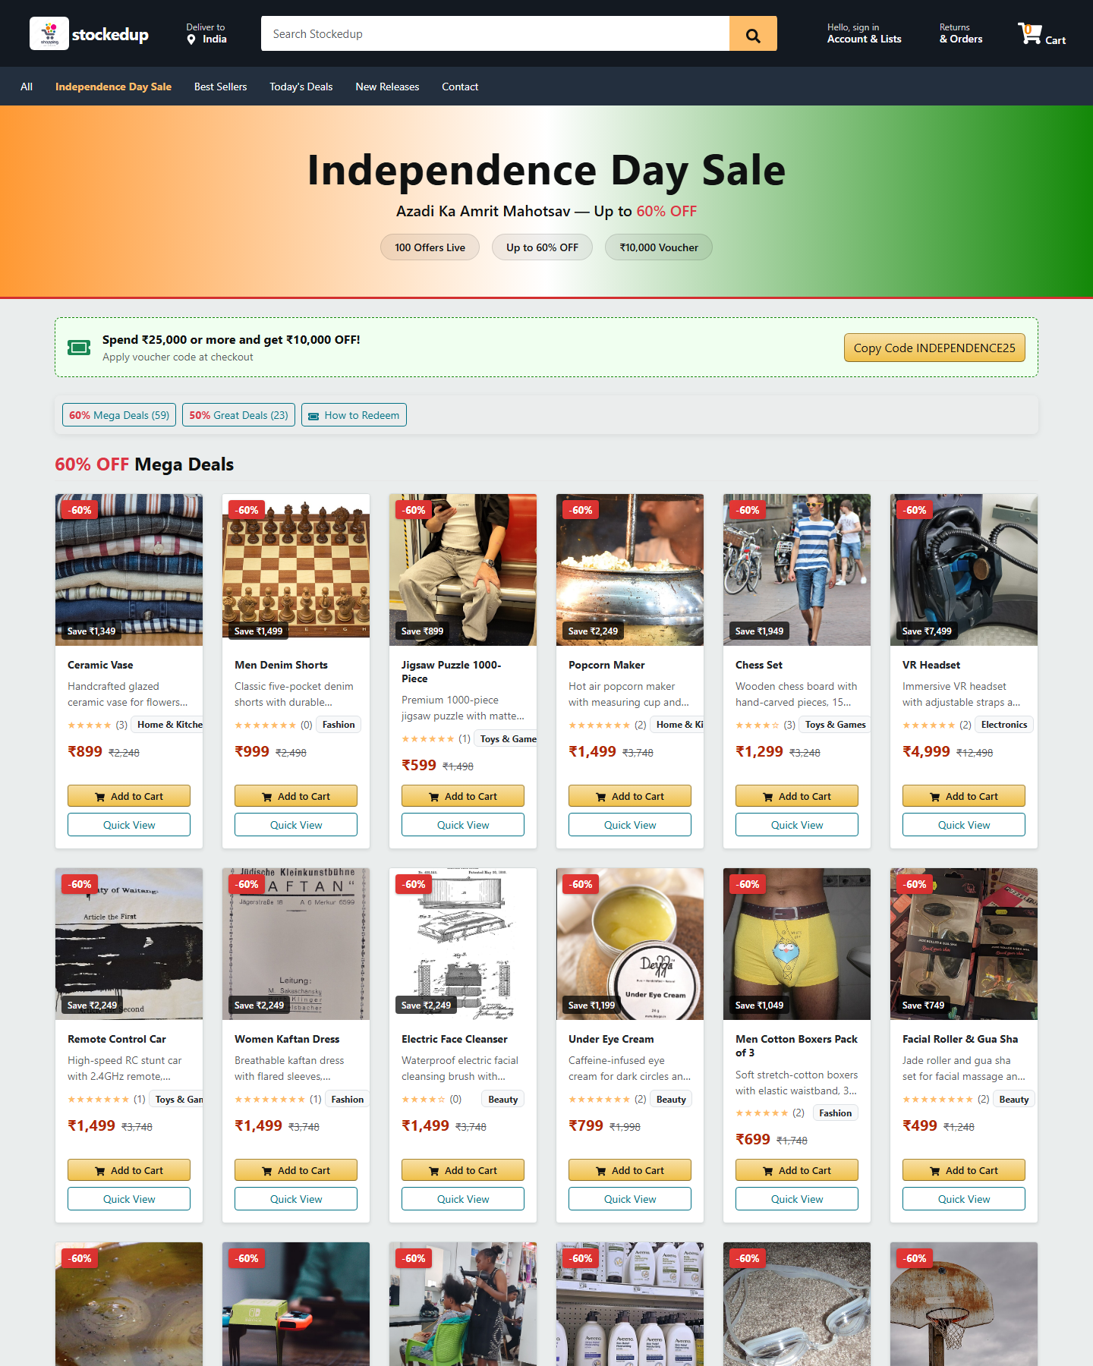
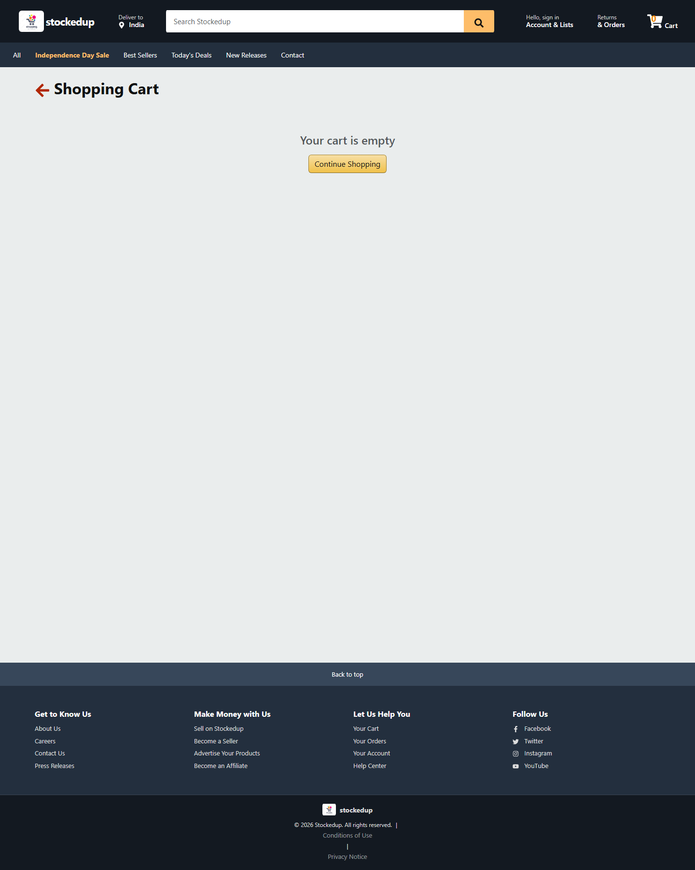
Screenshots - 2
Offers page with coupon INDEPENDENCE25
Cart page

Slide 11
Testing
API testing - 16 test cases for auth, products, categories, cart, coupons and orders - all passed
Functional testing - 10 user journeys tested on storefront and admin dashboard - all passed
Responsive testing - checked the layout on mobile, tablet and desktop sizes
Security testing - wrong passwords, fake tokens and unauthorised admin access are rejected
Fixed bugs - carousel fallback when images fail, zoom issue on iPhone (small input font), slow page loading due to large images
Overall: all test cases passed before final deployment.

Slide 12
Conclusion & Future Scope
Conclusion
The project was completed successfully. Stockedup works as a full e-commerce website - customers can shop and place orders, and admins can manage the store. The application is live on Vercel and was tested thoroughly before submission.
Future Scope
Online payment gateway (UPI / cards) for real transactions
Order tracking, wishlist, reviews and ratings for products
Better inventory management, stock alerts and sales reports
Cloud storage for product images
Installable mobile app support (PWA)

Slide 13
THANK YOU
Any questions?
Group Leader: Shubham Kr. Mandal (Regd. No. 2501445245)
Members: Aditya Raj (Regd. No. 2501445017)
Rudra Narayan Barik (Regd. No. 2501445603)
Chanchal Patar (Regd. No. 2501445488)
Department of CSE | Gandhi Engineering College (GEC Autonomous), Bhubaneswar • https://stockedup.vercel.app

