Slide 1
Affordable automated indoor plant monitoring system for visually impaired
Dr. Uma Maheshwari E
Aditi Singh 21BCE1376
Adittya Narayan 21BCE1672
Anjana S A 21BCE5632

Slide 2
Introduction
Indoor gardening promotes sustainability and healthier lifestyles but is often inaccessible to visually impaired individuals.
Existing solutions rely heavily on visual feedback, making them exclusionary.
Focused only on basic care tasks like water and light monitoring.
The proposed solution is intended to address the following key research questions:
How can IoT and machine learning technologies be integrated to develop a system that autonomously monitors plant growth and health for visually impaired users?
What visually impaired-friendly communication methods can be integrated to provide real-time updates about plant health and growth and provide security alerts?
How can the system be designed that can be affordable and accessible to use by visually impaired?

Slide 3
Background
Growing Interest in Indoor Gardening
Urbanization and limited outdoor spaces are driving the popularity of indoor gardening.
It promotes sustainability, access to fresh produce, and mental well-being.
Challenges for Visually Impaired Individual
Existing gardening systems rely heavily on visual cues like graphs, charts, and notifications.
These systems exclude visually impaired users from fully participating in indoor gardening.
Gaps in Current Solutions
Most smart gardening systems lack inclusivity, affordability, and multifunctionality.
There is no integration of security features to address personal safety.

Slide 4
Context
Advancements in IoT and Smart Technology:
IoT and machine learning technologies can enhance indoor gardening by providing real-time feedback and automation.
Need for Inclusivity and Accessibility:
Technologies must cater to diverse user groups, especially those with disabilities.
Personal Security in Indoor Spaces:
Enhances the safety and confidence of visually impaired individuals.

Slide 5
Significance of the Study
Inclusive Gardening Solutions:
Reduces barriers for visually impaired individuals by offering accessible and user-friendly systems.
Affordable and Practical Technology:
Ensures affordability without compromising functionality.
Enhanced Safety and Independence:
Security alerts empower visually impaired individuals to live more independently

Slide 6
Literature Surveys
Sl. No | Title | Publication Year | Description | Drawback
1 | How AI and NASA Can Help Gardeners Lacking a Green Thumb | 2023 | The article discusses advancements in AI and NASA-inspired technologies that facilitate indoor gardening for individuals without gardening expertise. | While highlighting technological aids, it does not specifically address the needs of users with disabilities or incorporate comprehensive IoT integration for personalized plant care, which our project aims to provide.

Slide 7
2 | Patent US11631243B2 | 2023 | This patent presents an IoT-based indoor gardening system with remote monitoring capabilities, allowing users to oversee plant health via mobile devices. | While offering remote monitoring, it may not provide real-time adaptive responses to environmental changes or integrate with AI-driven analytics for proactive plant care, features central to our project.

Slide 8
3 | Visual Impairment Spatial Awareness System for Indoor Navigation and Daily Activities | 2023 | The study introduces a system employing image sensors to aid individuals with visual impairments in indoor navigation and daily tasks. | The system focuses on spatial awareness and navigation rather than integrating with indoor gardening systems to assist in plant care activities.
4 | Smart Indoor Gardens That Make Gardening Easy and Accessible with Their Automated Tech | 2021 | This article reviews various smart indoor garden products that utilize automation to simplify plant care for users. | While these products offer automation, they may not be specifically designed with accessibility features for users with disabilities, an aspect central to our project's mission.

Slide 9
5 | Patent US10925219B2 | 2021 | This patent outlines a smart indoor garden that automates watering and lighting using IoT sensors to maintain ideal conditions for plants. | The focus is primarily on automation without addressing user accessibility features, such as accommodations for individuals with visual impairments, which our project includes.
6 | Gardening Tools and Equipment for the Blind or Visually Impaired | 2021 | This resource provides guidance on adaptive gardening tools and techniques to assist individuals with visual impairments in engaging with gardening activities. | The solutions are primarily manual adaptations and do not incorporate smart technologies or automation to facilitate independent indoor gardening for visually impaired users.

Slide 10
7 | Patent KR20200057831A | 2020 | This patent describes an indoor gardening system utilizing IoT technology to monitor and control environmental factors for optimal plant growth | The system may lack advanced AI integration for predictive analysis and personalized plant care recommendations, which our project aims to incorporate.
8 | Designing Sensory Gardens for Children with Disabilities in the UK | 2019 | This work discusses the principles of creating sensory gardens tailored for children with disabilities, highlighting the importance of accessibility and sensory stimulation. | The design principles are applied to outdoor settings and do not leverage IoT technologies for indoor gardening solutions, limiting year-round usability.

Slide 11
9 | Gardening Ideas for People with Vision Loss | 2019 | The article offers creative strategies to make gardening more accessible for individuals experiencing vision loss, focusing on tactile and sensory approaches. | It lacks integration with IoT systems that can provide real-time feedback and automated care, which are features designed into our indoor gardening solution.
10 | BRAC University Thesis | 2008 | The thesis explores the design of sensory gardens for children with disabilities, emphasizing the therapeutic benefits of gardening. | The study focuses on outdoor sensory gardens without incorporating IoT or smart technologies for indoor environments, which are integral to our project's design.

Slide 12
Problem Statement
Exclusion of Visually Impaired Individuals
Current indoor gardening systems rely on visual interfaces, creating barriers for visually impaired users.
Limited Functionality of Existing Solutions
Most systems focus solely on basic plant care tasks like watering and light monitoring, neglecting advanced plant health insights and additional features.
High Cost of Existing Systems
Dependence on expensive hardware makes these systems unaffordable for many users.

Slide 13
Lack of Personal Security Integration
Current systems do not offer features like motion detection or safety alerts, which could enhance usability for visually impaired individuals.
The Need for an Inclusive Solution
A system that is affordable, accessible, and multifunctional, integrating IoT and AI to provide advanced plant health monitoring, real-time feedback, and personal security features.

Slide 14
Methodology
Modules and Functionalities
Sensor Network Integration: Real-time monitoring of environmental conditions using soil moisture sensors, light sensors (LDR), temperature and humidity sensors (DHT22), pH sensors, and water level sensors.
Automation Control:
Automated irrigation system triggered by soil moisture levels.
Water reservoir monitoring and pump activation using the water level sensor and DC motor.
Plant Growth and Health Monitoring:
Image capture using ESP32-CAM.
Analysis via AI model to detect decay, diseases, and growth stages.

Slide 15
2. Algorithms
Image-Based Plant Health Analysis:
Pre-trained convolutional neural network (CNN) for detecting changes in plant health.
Time-series analysis for monitoring growth trends (leaf size, color).
Threshold-Based Automation:
Predefined moisture levels trigger pump activation.
pH level adjustments based on detected soil acidity/alkalinity.
3. Protocols:
IoT Communication:
Data transmission via MQTT between ESP32 devices and the Blynk app.
AI Deployment Protocol:
Model inference executed on a cloud platform for computational efficiency.

Slide 16
Data Collection Approaches/Strategies
Approach:
Sensor Data: Real-time environmental data (moisture, temperature, light, pH, water level) collected via ESP32-connected sensors.
Image Data: Periodic plant images captured by ESP32-CAM and sent to the AI model for analysis.
Advantage of Strategy:
High Accuracy and Efficiency: Sensors provide precise measurements, minimizing errors.
Real-Time Updates: Immediate detection of anomalies like low moisture or unhealthy plant conditions.
User Accessibility: Voice-readout features ensure inclusivity for visually impaired users.

Slide 17
3. Limitation of Strategy:
Sensor Dependency: Inconsistent or faulty sensors can result in inaccurate readings.
Network Reliance: Requires stable internet connectivity for seamless data transmission to the cloud and Blynk app.
AI Model Bias: Trained models may not generalize to all plant types or environmental conditions.
4. Potential Risk:
Hardware Malfunctions: Issues with sensors or pumps could lead to water wastage or plant damage.
Data Loss: In case of connectivity interruptions, sensor data may not sync with the app.

Slide 18
Proposed System
Objective:
The proposed system focuses on creating an automated and affordable indoor gardening solution tailored to the needs of visually impaired individuals.
Key Features:
Real-time monitoring of environmental conditions (soil moisture, pH, temperature, etc.) using IoT sensors.
Automated irrigation and fertilization based on soil health.
Growth and health analysis using image-based AI models.
Inclusive Design: Voice-based alerts and vibration notifications for accessibility.
Goal: To provide a user-friendly and sustainable system ensuring plant growth with minimal human intervention.

Slide 19
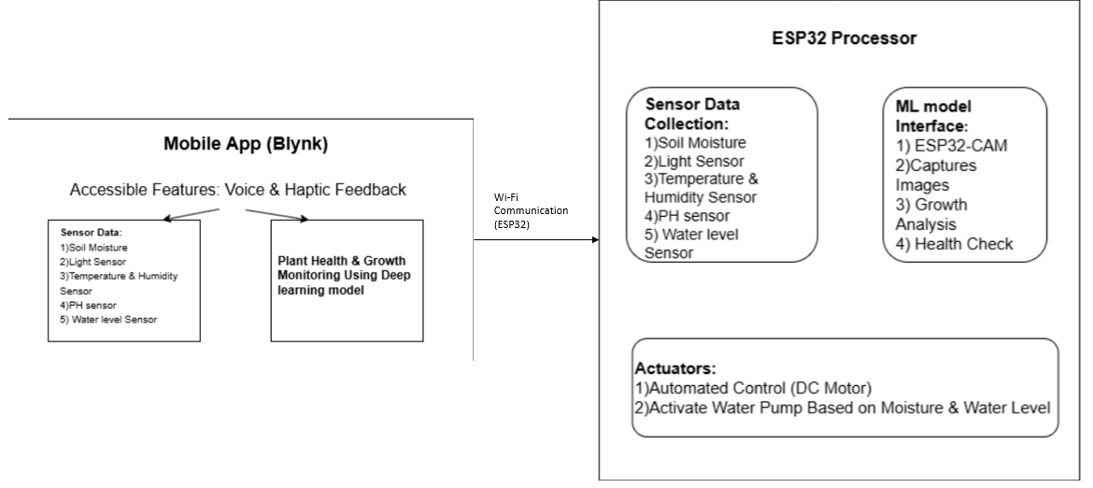
Architecture Diagram

Slide 20
List of Modules
Sensor Module: Collects environmental data (moisture, pH, temperature, etc.).
Control Module: Automates irrigation, fertilization, and other actions.
Monitoring Module: Real-time data monitoring via the Blynk app.
Image Analysis Module: AI-based plant growth and health detection using ESP32-CAM.
Alert Module: Provides voice/vibration alerts to users for system updates.

Slide 21
Sensor Module
Function:
Collects real-time data on moisture, pH, temperature, light intensity, and water levels.
Ensures accurate environmental monitoring to maintain optimal plant health.
Algorithm:
Threshold-Based Monitoring: Compares sensor data with predefined limits to decide actions (e.g., turn on/off pump).

Slide 22
Control Module
Function:
Automates the irrigation system based on soil moisture levels.
Dispenses fertilizer/pesticide as needed based on pH values.
Algorithm:
If-Else Logic:
If soil moisture < threshold, pump = ON.
If pH < optimal range, dispense fertilizer.

Slide 23
Monitoring Module
Function:
Displays sensor data and system status on the Blynk app.
Provides real-time updates on plant health and system activities.
Blynk Integration:
Uses ESP32’s Wi-Fi capabilities to send data to the Blynk cloud for visualization.

Slide 24
Image Analysis Module
Function:
Uses images captured by ESP32-CAM to monitor plant health and growth.
Detects issues like yellowing leaves or pests using AI models.
Algorithm:
Convolutional Neural Network (CNN):
Processes images for identifying visual symptoms of plant diseases.
Outputs health status (Healthy/Unhealthy) and recommends actions.

Slide 25
Alert Module
Function:
Provides accessibility-friendly notifications via:
Voice Alerts: Audible updates on plant status and system actions.
Vibrations: Immediate tactile feedback for critical conditions (e.g., low water levels).
Integration:
Alerts generated in the Blynk app and communicated to users.

Slide 26
Next steps
Hardware Implementation:
Integrating all hardware components, including ESP32 microcontroller, and essential sensors for soil monitoring and establishing efficient communication between the ESP32, sensors, and actuators like the DC motor with a water pump for automated watering.
Real-time analysis of plant health
Implementing AI-based plant health analysis model by processing images captured by the ESP32-CAM to detect decay, diseases, and growth stages of the plant.

Slide 27
Mobile Application Integration
Developing the Blynk-based IoT app to display real-time updates on plant growth and health and enabling voice-readout functionality and vibration-based notifications for visually impaired users to ensure inclusivity.

Slide 28
Research Paper Status
Literature Review Completed
Conducted an in-depth review of existing IoT-based plant monitoring systems and accessibility solutions for visually impaired individuals to identify research gaps and establish a foundation for the study.
Software Simulation
Designed a comprehensive system architecture and validated its feasibility through simulations using an IoT-based online simulation platform.
Hardware Components Analysis
Performed a detailed analysis of the hardware components necessary to build the system, ensuring compatibility, cost-effectiveness, and optimal functionality.

