Slide 1

Company Profile
Anugrah Insan Selaras, PT
Maintenance – Automation – Mold, JIG & CF Maker – CME –
Manufacturing – Special Purpose Machine (SPM) & Trading

Slide 2
Company Profile
Vision
Being a competitive and innovative company in field of mechanical, electrical, and automation by providing real contribution for Indonesia
Mission
Being one of great engineering company in Indonesia
Anugrah Insan Selaras, PT

Slide 3
Company Profile
Company Legaly
Akte : Deni Subarno, SH, M.Kn
No.46 Tanggal 30 April 2012 di Bandung
Akte
Perubahan : No. 294 Tanggal 30 Desember 2013 No. 62 Tanggal 3 Oktober 2014
SIUP : 00042/10‐12/PM/III/2014
NPWP : 66.242.826.7‐445.000
Office : Centre Point Apartement Tower C lantai 12 no.33
Jl. Ahmad Yani, Bekasi
Workshop : Ruko Villa Mutiara Blok R2 No. 10-11
Desa Ciantra Cikarang Selatan Bekasi
Phone : 021-2909 2011
Fax : -
E-mail : anugrah.insan.selaras@gmail.com
Marketing : Tedi Apandi, 0823 1203 5990, tedi.apandi@yahoo.co.id
Budi Purwanto, 0812 8190 6643, budipurwanto1326@gmail.com
Syaiful Anwar, 0813 8292 3242, syaiful.ais04@gmail.com
Bank account :132‐00‐1507581‐6
(Bank Mandiri KCP BandungCimindi)
PT. Anugrah Insan Selaras
Anugrah Insan Selaras, PT

Slide 4
Company Profile
Anugrah Insan Selaras with AIS as its trade mark, is a national company
providing engineering solution in field of civil, mechanical & electrical, automation, manufacturing & trading
We have experiences in structure design, piping, heat exchanging, sheet metal, mold maker, JIG & CF maker and machine design as well.
Electrical and control design is also our experties.
For integration or factory system we also provide automation design and instalation.
Anugrah Insan Selaras, PT

Slide 5
Company Profile
Machine and Facility :
NO | MACHINE | MAKER | QTY | CAPACITY
1 | CNC MILLING ECCOCA | TAIWAN | 1 | 1050 x 550 x 500
2 | EDM ZNC C TEK | TAIWAN | 1 | 1000 x 800 x 400
3 | SURFACE GRINDING NAGASE | JAPAN | 1 | 550 x 300 x 200
4 | MANUAL MILLING | TAIWAN | 1 | 320 x 1000
5 | MANUAL LATHE | TAIWAN | 1 | LENGTH. 1500
6 | HAND STACKER & PALLET | TAIWAN | 2 | 2 TON
7 | CNC MILLING QUASSER | TAIWAN | 1 | 1200 x 550 x 500
8 | CNC MILLING HARTFORD | TAIWAN | 1 | 1000 x 500 x 500
9 | ARGON & CO WELD | TAIWAN | 3 | 250A
10 | ELEKTROD WELD | CHINA | 2 | 200A
11 | MOBILE CRANE | LOCAL | 2 | 5 TON
12 | COMPRESSOR | TAIWAN | 2 | 5,5 HP
Measurment :
NO | MACHINE | MAKER | QTY | CAPACITY
1 | MICROMETER DIGITAL 0 - 30 | JAPAN | 1 | 0 – 30 MM
2 | MICROMETER 0 - 25 | JAPAN | 1 | 0 – 25 MM
3 | CALIPER DIGITAL 0 - 200 | JAPAN | 1 | 0 – 200 MM
4 | CALIPER DIGITAL 0 - 300 | JAPAN | 1 | 0 – 300 MM
5 | CALIPER 0 - 150 | JAPAN | 3 | 0 – 150 MM
6 | HEIGHT GAUGE | JAPAN | 1 | 0 – 300 MM
7 | Tang Ampere | JAPAN | 1 | AC-DC
8 | AVO Meter | JAPAN | 2 | -
Anugrah Insan Selaras, PT

Slide 6
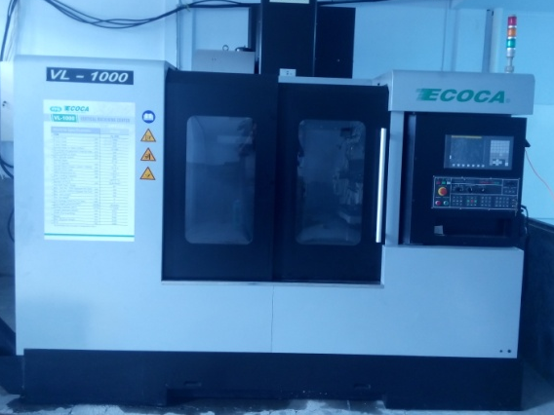
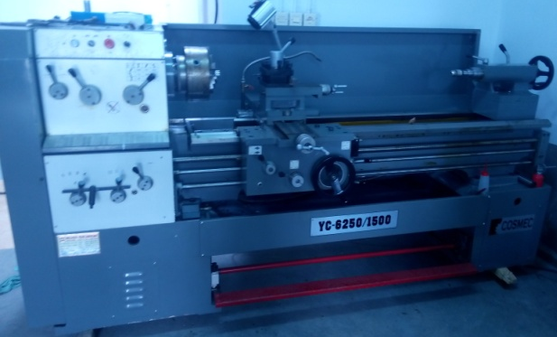
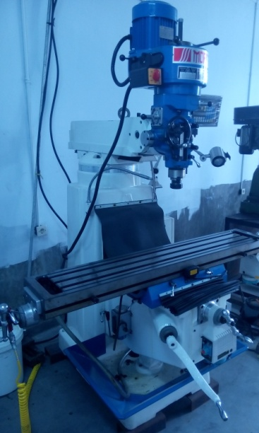
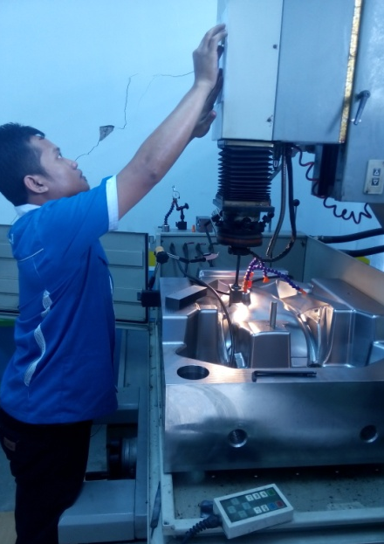
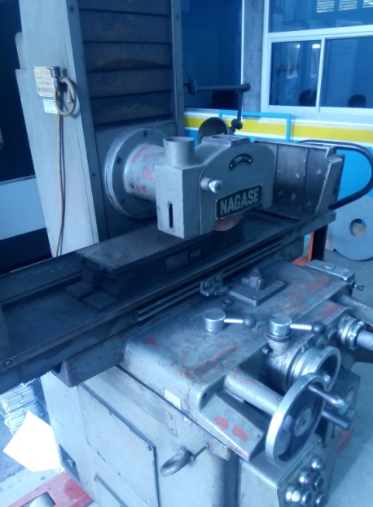
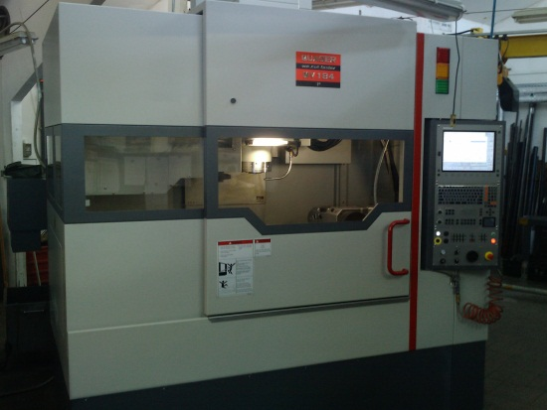
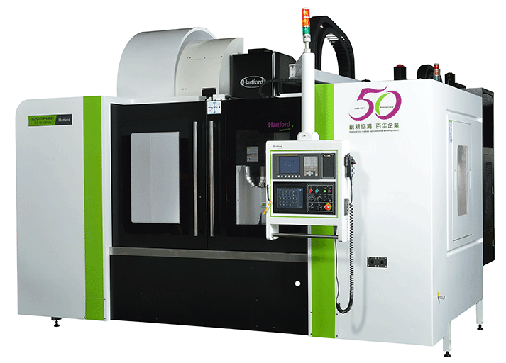
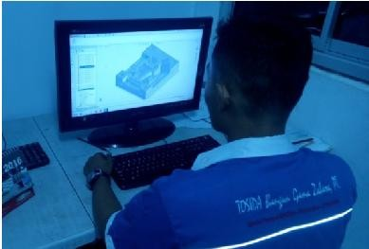
Company Profile
Machine and Facility :
Manual Lathe - 1500
CNC MILLING – 1000x550x500
Manual Milling
Edm ZNC
Surface Grinding
CNC MILLING QUASSER
1200x550x500
CNC MILLING HARTFORD
1000x500x500
CAD/CAM ENG TEAM

Slide 7
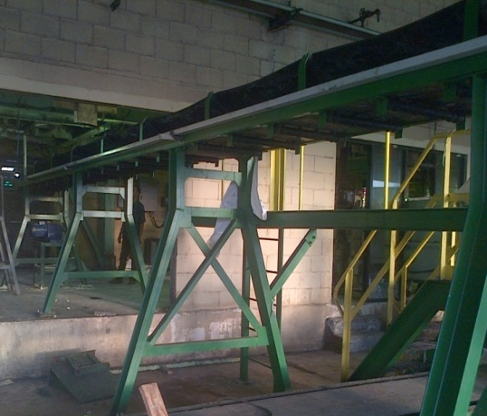
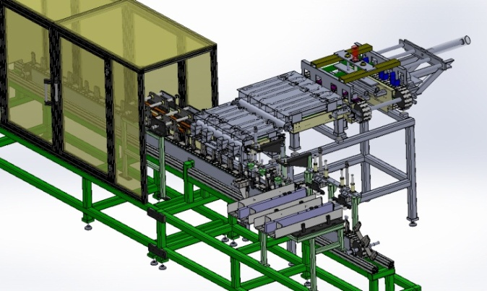
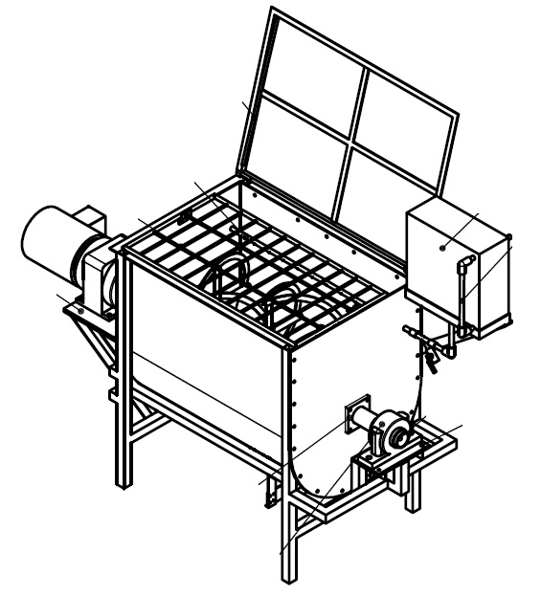
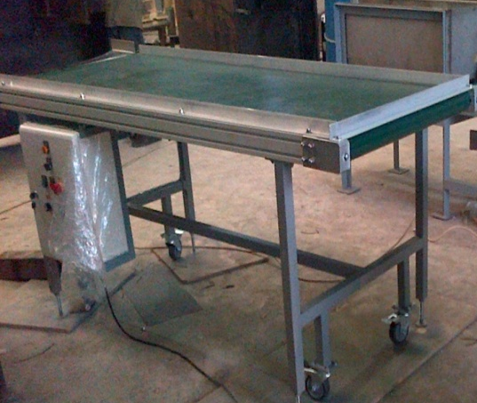
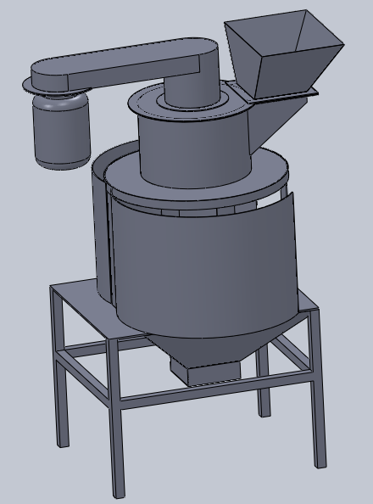
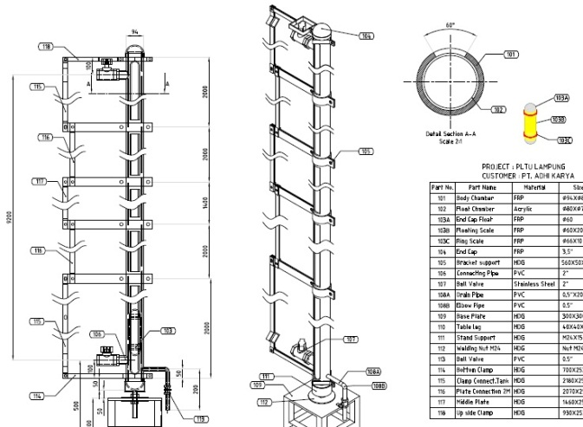
Company Profile
Our Experience :
2 x 280 m Conveyor Project
Pouch Filling Machine
Ribbon Mixer
2 x 20 m Automatic Infeed Belt Conveyor
Fine Bread Crusher
Level Gauge for 10 m height of tank

Slide 8
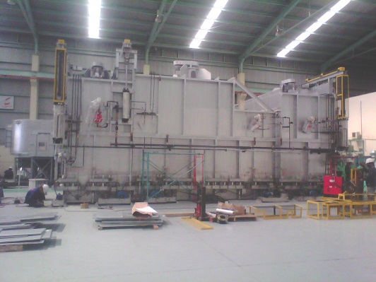
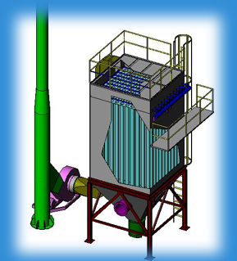
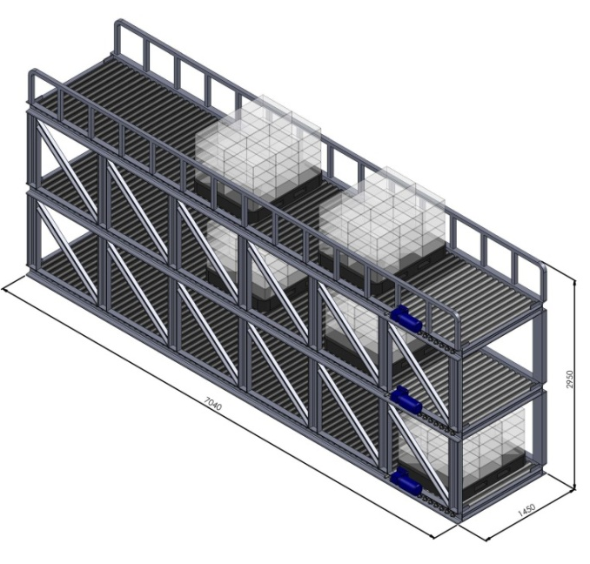
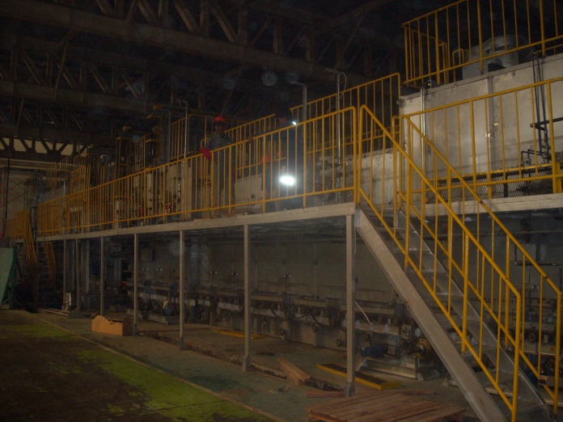
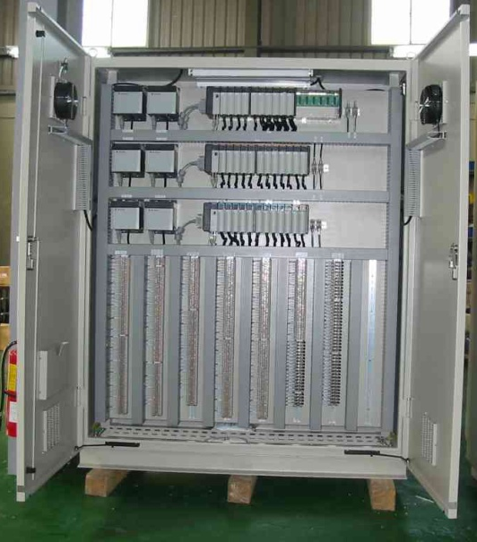
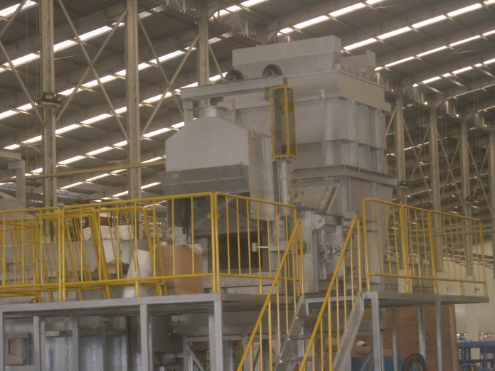
Company Profile
Our Experience :
Dust Collector
Heat treatment oven
Triple Deck Storage System – with motorized infeed rollers
Painting Line
Ducting system
Logic Control design and wiring

Slide 9
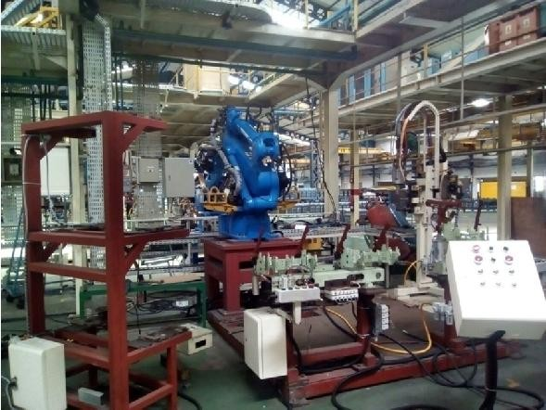
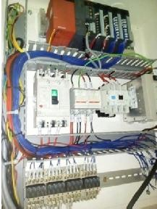
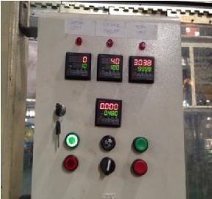
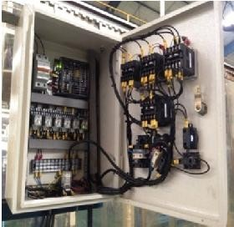
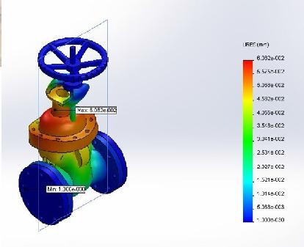
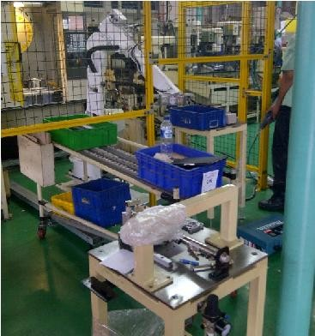
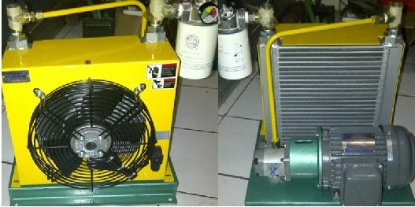
Company Profile
Our Experience :
INTEGRATION
WELDING & HANDLING ROBOT
COUNTER STROKE
Valve Strength Analysis
Inspection Jig Line with
automation system controlled by PLC
Oil Cooler for Hydraulic System

Slide 10
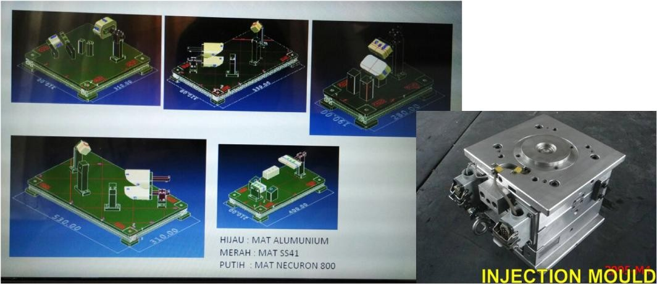
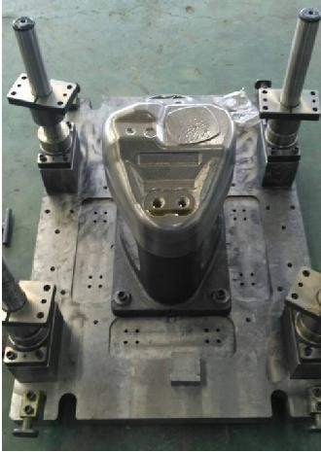
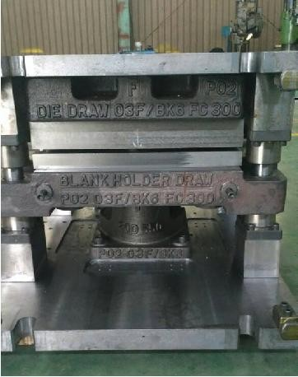
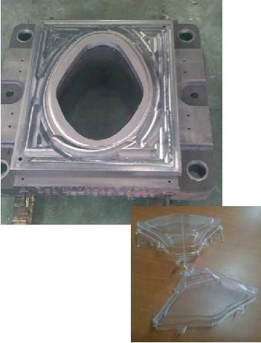
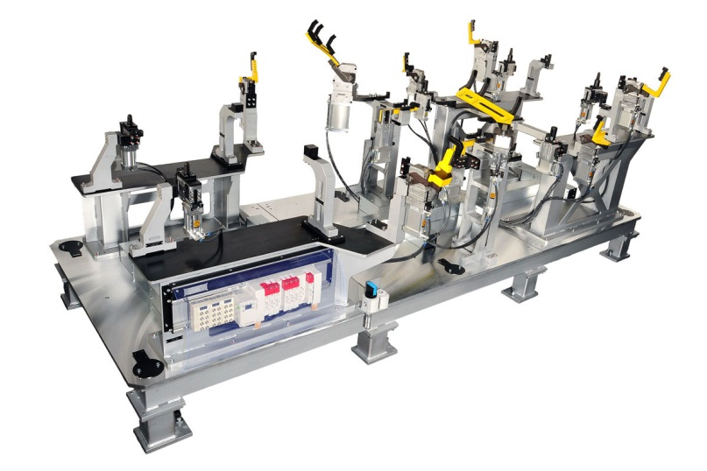
Company Profile
Our Experience :
CF
INJECTION MOLD
JIG

Slide 11
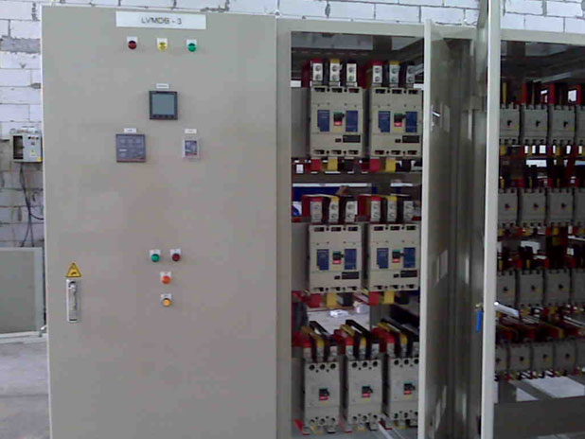
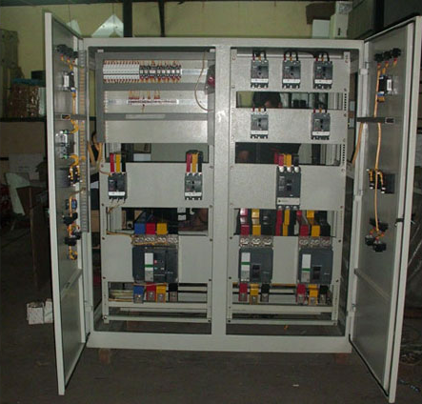
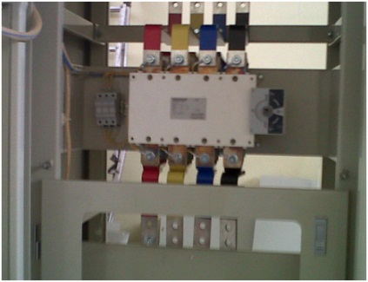
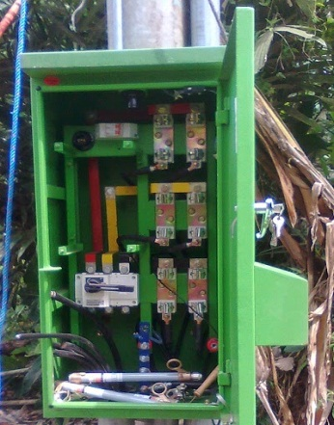
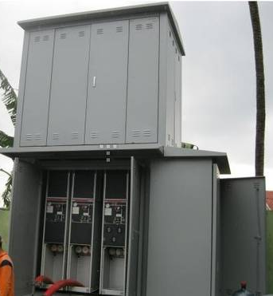
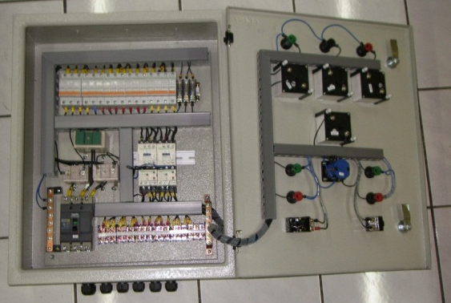
Company Profile
Our Experience :
Low Voltage Main Distribution Panel
cos
PHBTR
GARDU KOMPAK
SDP

Slide 12
Company Profile
Customer Experience :
No. | Item | Customer | Year
1 | Level Gauge for Solar Tank | PT. Adhikarya | 2011
2 | Mobile BTS relocation for Smartfriend | PT. AIN | 2012
3 | Capacity Power TTC PT. Telkomsel | PT. Telehouse Eng | 2012
4 | Robot welding mounting for Car body | PT. Daihatsu | 2013
5 | Conveyor belt for urea width 1 m x length 50 m | PT. Pupuk Kujang | 2013
6 | Installation Shelter Tellecommunication | PT. HDTE | 2013
7 | Instalation panel Workshop | PT. HDTE | 2014
8 | Box APP Terpadu, PHBTR PLN Area Jateng | PT. Tritunggal Swarna | 2014
9 | BOX APP & PHBTR | PT. PLN Area Bandung | 2014
10 | Mixer Tank (SS316L) for food repair | PT. URC | 2014
11 | MDP TR | PT. Unicorn | 2014
12 | Stanchion | PT. Adhikarya | 2015
13 | Thermo-well | PT. Adhikarya | 2015
14 | FEA and CFD valve analysis for Chevron | PT. SPV | 2015
15 | Spot welding counter system with PLC | PT. Summit Adyawinsa | 2015
16 | Integration welding & Handling robot | PT. Summit Adyawinsa | 2016
17 | Cork & Spray Mixer capacity 150L | PT. Daesuko Eng | 2016
18 | Molina BUS system control | Universitas Indonesia | 2016
19 | Installation Panel Building asrama & Lab | STT Texmaco | 2016
20 | Mold Repair | PT. Tupperware Ind | 2017
21 | Mold D20NRR-FR | PT. Bahana Unindo | 2017
22 | Mold Repair | PT. Meiji Rubber | 2017
23 | CF | PT. Solotech | 2017
24 | Stamping Dies | PT. FCC Indonesia | 2017

Slide 13























Company Profile
AIS Structure :
DIREKTUR
ADMIN
MNG. SALES & PROJECT
MNG. MARKETING &
ENGINEERING
MNG.
Produksi
PROJECT
ENGINEERING
PROJECT
AIS Flow Process
ORDER/PO
TECHNICAL DISCUSS
DESIGN & ENGINEERING
INSPECTION
CAM PROCESS/
PABRICATION/MACHINING
SCHEDULING
DELIVERY

