Slide 1

Data Analysis
HOTEL RECORD
By Aditya Dhumal

Slide 2


Problem Statement
Hotel booking platform holds a large volume of user, review, and hotel data. This analysis extracts insights about user behavior, hotel performance, rating distributions, and regional trends to improve decision-making.
Dataset Overview
hotels_sql_ready: 25 rows
reviews_sql_ready: 50,000 rows
users_sql_ready: 2,000 rows

Slide 4
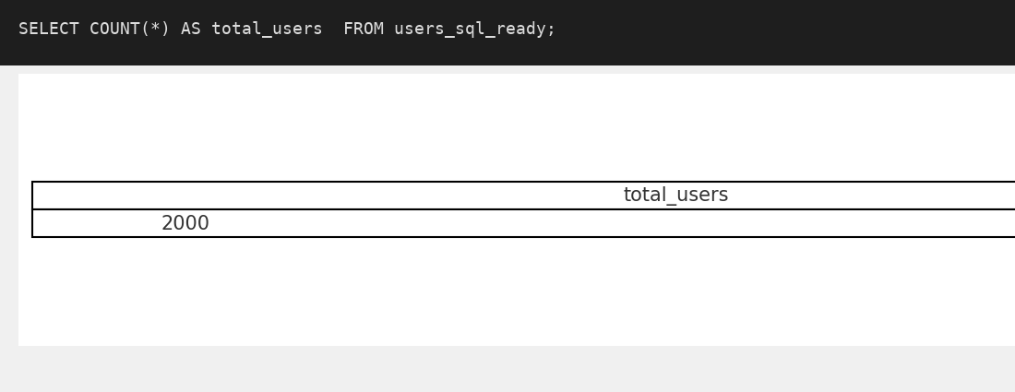
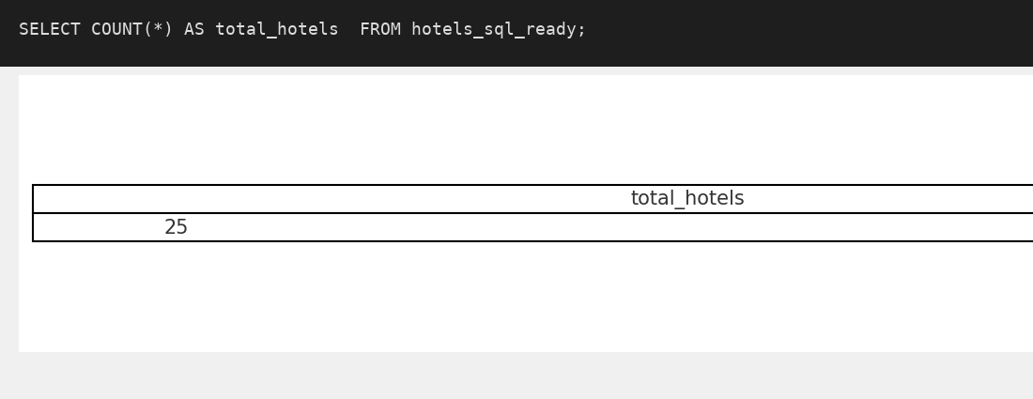
Q1} Total number of users

Slide 5
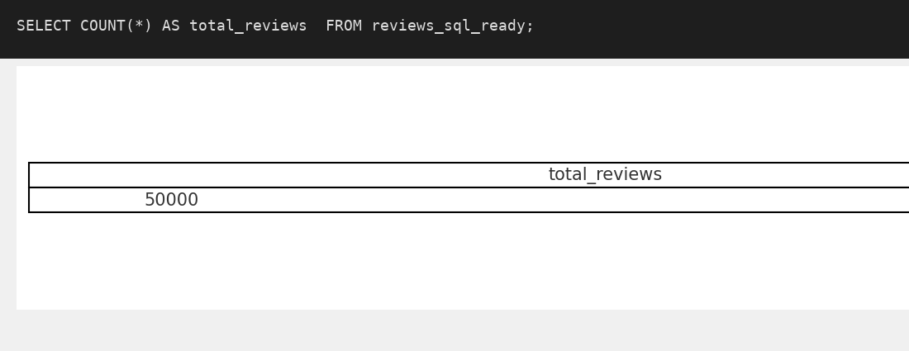
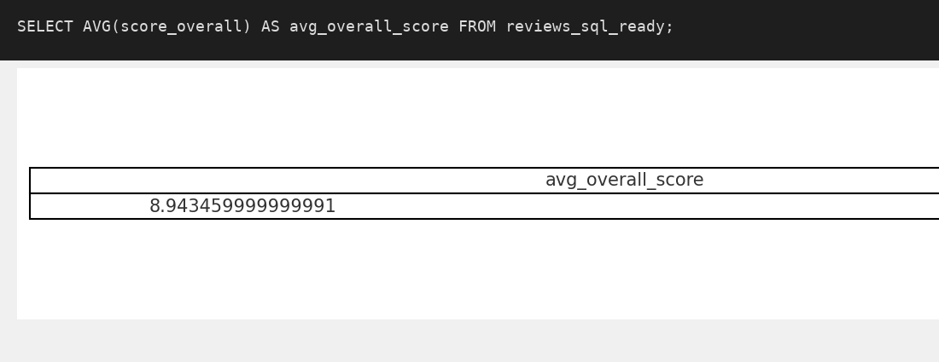

Slide 6
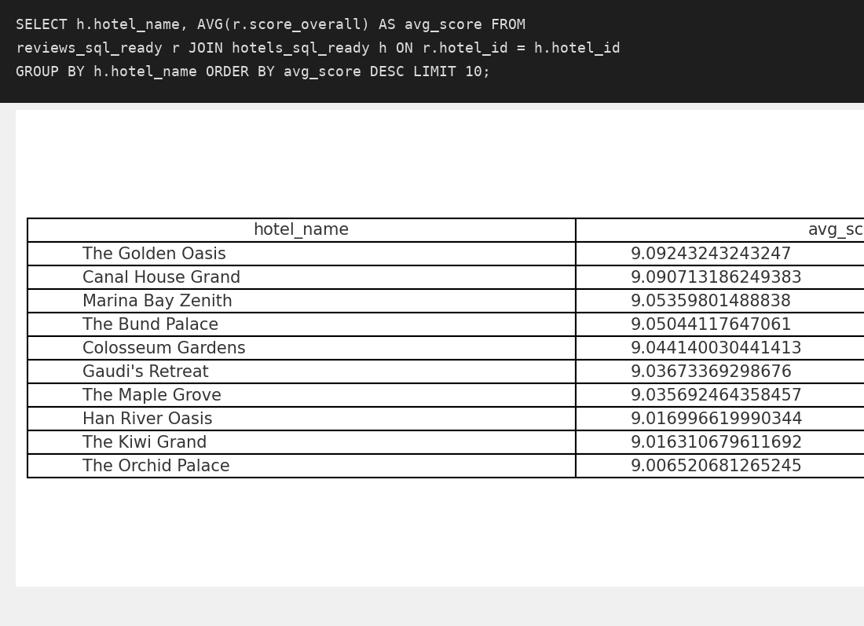
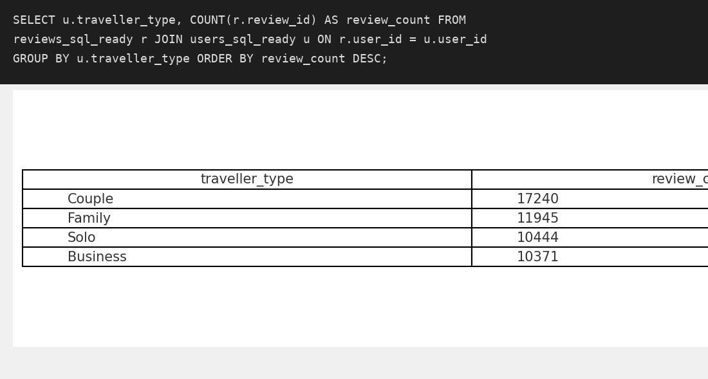

Slide 7
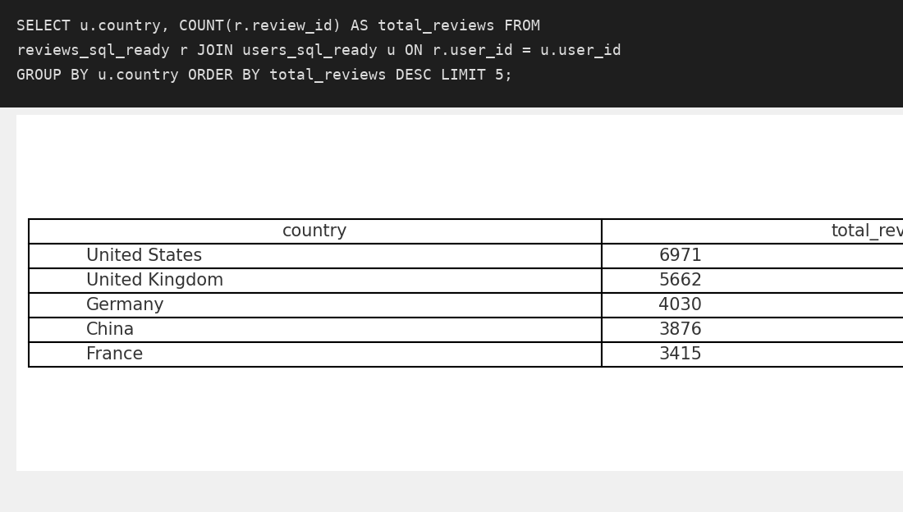
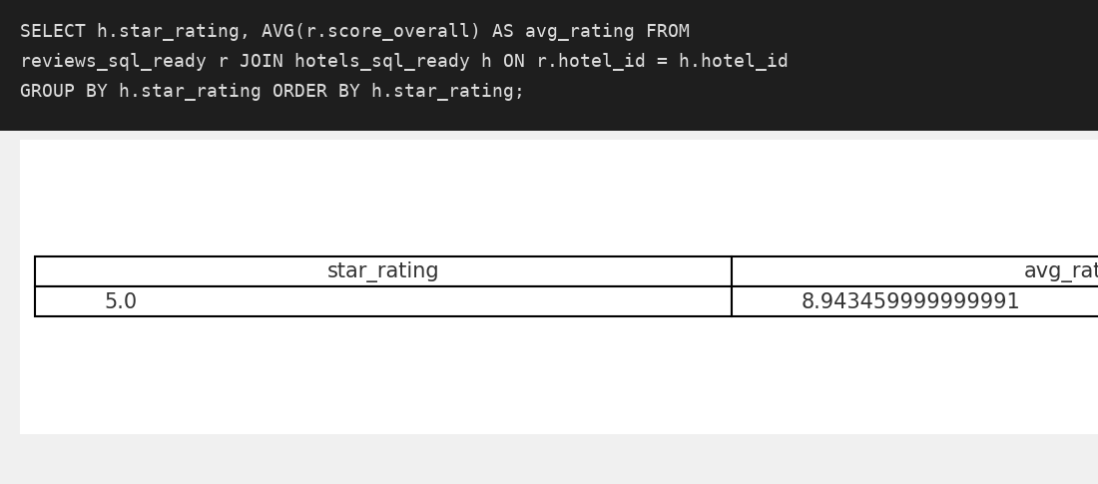

Slide 8
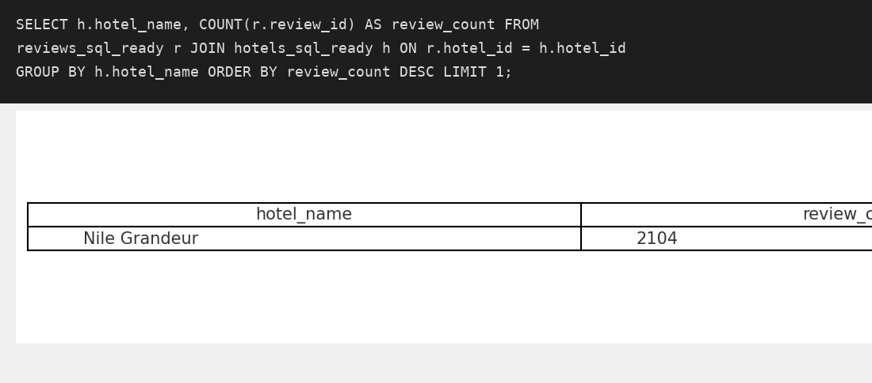
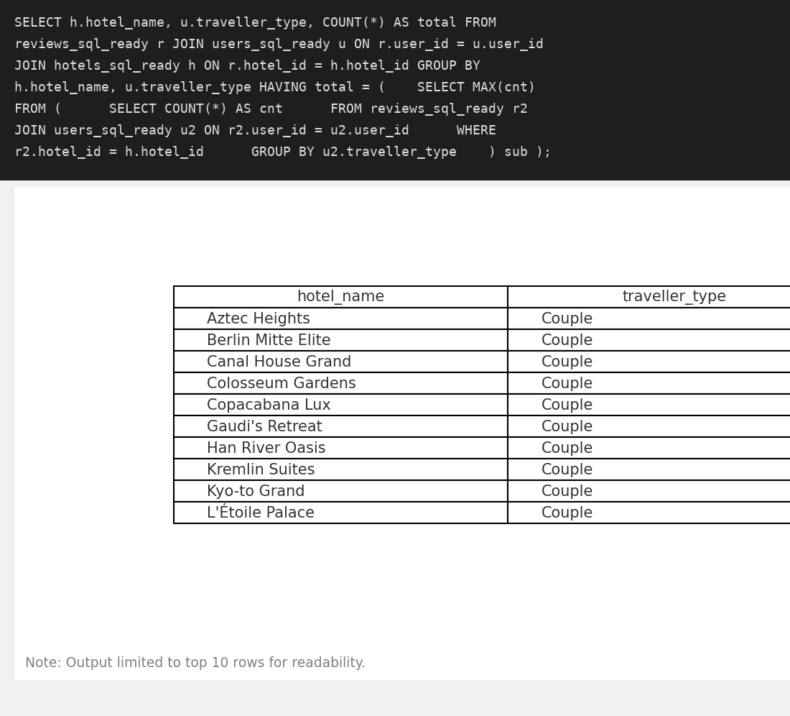

Slide 9
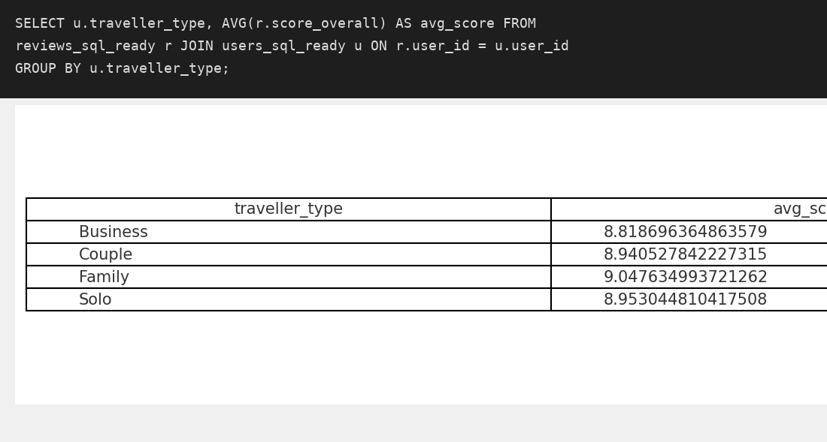
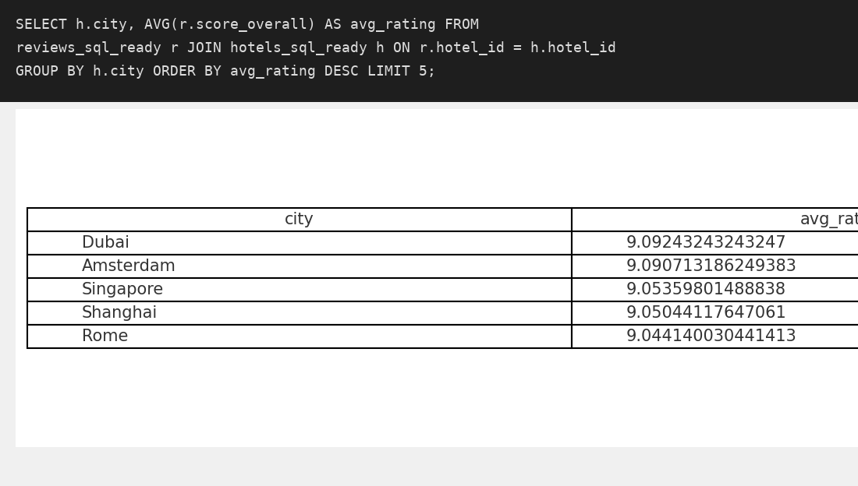

Slide 10
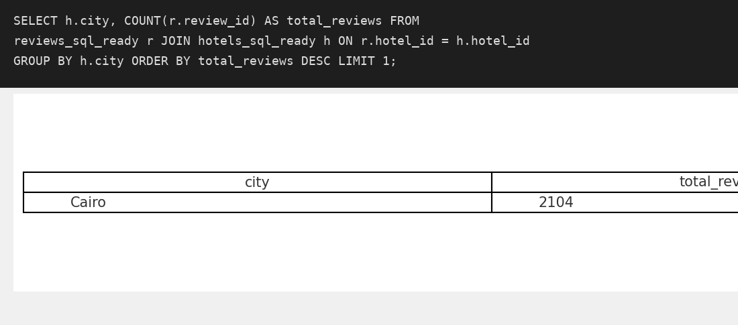
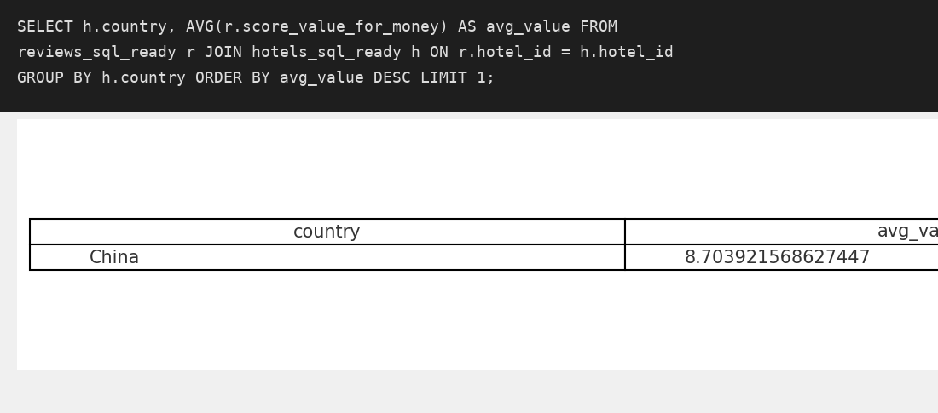

Slide 11
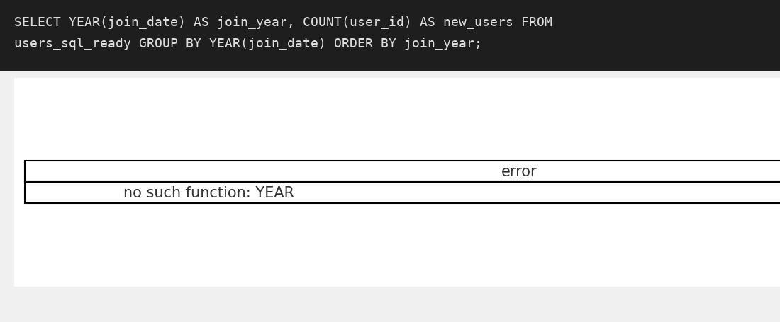

Slide 12
Thank You!
Prepared by Aditya Dhumal

