Slide 1
Algo Trading Competition
Submission by Aditya Jain (23322003)

Slide 2
What was the objective?
We had to make an algorithmic trading strategy for ETH
We were to use only the data from 1 Jan 2021 to 31 Dec 2023
Only day Candles were allowed and we can’t short

Slide 3
What were the indicators used?
Heikenashi candles – to reduce noise
Keltner Channels – to catch trends
ATR – for risk management

Slide 4
What was my strategy
I used heikenashi candles with keltner channels to come up with a trading strategy for ETH
I entered a trade when I got 2 consecutive green HA Candles and the later candle crossed the upper Keltner Channel line
I used ATR for setting my take profit value and stop loss for risk management. I tried some different combinations to come up with the optimal values.
Back test basic strat
Find Optimal settings
Do final back test
Set up function to take inputs and back test based on them
Task Run through different combinations to find best settings of indicators
Back test with the values we found earlier and then calculate different stats for it

Slide 5
What were the results?
Total trades: 21
Win Rate: 48.0%
Average winning trade: 32.31%
Average losing trade: 6.98%
Average holding duration: 20.76 days
Charges: 164.34
Gross profit: 5377.48
Net profit: 5213.14
Sharpe Ratio: 1.6
Maximum Drawdown: 30.36%
Sortino Ratio: 32.39

Slide 6
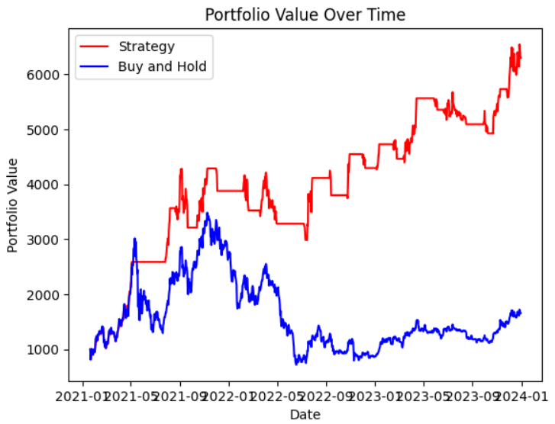
Results Visualized

Slide 7
Thank You

