Slide 1
Premier League Match Outcome Prediction
Using Machine Learning
Subject: Machine Learning (SE-206)
GROUP DETAILS
NAME —
Akshit Vashist
ROLL — [24/SE/022]
NAME —
Aditya Yadav
ROLL — [24/SE/016]
1

Slide 2
OUTLINE
1
Introduction
2
Objectives
3
Dataset
4
Related Work
5
Methodology
6
Algorithms
7
Techniques
8
Performance
9
Limitations
10
Conclusion and References
2

Slide 3
Motivation
Football as a Data Domain
Football generates billions of data points every season — a perfect domain for machine learning with consistent, measurable statistics.
Problem with Traditional Prediction
Traditional prediction relies on human experts and intuition, which is inconsistent and biased. ML can identify hidden patterns objectively.
Historical Data Advantage
Machine learning can identify hidden patterns in 9,500+ historical match records, learning from over 14 seasons of EPL data.
Real-World Applications
Accurate prediction systems have real-world applications in sports analysis, media, fantasy leagues, and fan engagement platforms.
Our Goal
Build a practical, working ML system using 6 algorithms that improves with more data and achieves 67%+ prediction accuracy.
3

Slide 4
Introduction of Project
This project predicts the outcome of English Premier League (EPL) football matches using supervised machine learning.
Each match has one of three outcomes: Home Win (H), Draw (D), or Away Win (A) — a 3-class classification problem.
We collected 9,500+ historical match records spanning 14 seasons (2010–2024) from football-data.co.uk.
The dataset includes full-time goals, shots, corners, yellow/red cards, and head-to-head statistics.
A full-stack system was built: Python ML backend connected to a Flask REST API and HTML/JS frontend website.
4

Slide 5
Introduction — System Overview
Raw Data
(14 seasons CSV)
Data
Cleaning
Feature
Engineering
ML Model
Training
Flask API
+ Website
merged.csv
clean_data.csv
features.csv
5 .pkl files
Live Predictions
9,500+
14
40
6
67%
Match Records
Seasons
ML Features
Algorithms
Best Accuracy
Subject: Machine Learning (SE-206) | Group Project — 2 Students
5

Slide 6
Objectives
To collect, clean, and merge 9,500+ EPL match records from 14 seasons (2010–2024).
1
To engineer 40 meaningful features including rolling form, weighted momentum, shots-on-target ratio, and head-to-head records.
2
To implement and compare 6 machine learning algorithms: Logistic Regression, KNN, Decision Tree, Random Forest, XGBoost, and Stacking Ensemble.
3
To evaluate all models using Accuracy, Precision, Recall, F1-Score, and 5-fold Cross-Validation.
4
6

Slide 7
Dataset
football-data.co.uk
Source: football-data.co.uk (free, publicly available, no login required)
Coverage: English Premier League — 14 seasons from 2010-11 to 2023-24
Size: 9,512 match records, each row = one match
Target Variable: FTR — Full Time Result (H = Home Win, D = Draw, A = Away Win)
Key Columns Used:
Column | Meaning | Column | Meaning
HomeTeam / AwayTeam | Team names | HS / AS | Shots (Home/Away)
FTHG / FTAG | Full Time Goals | HST / AST | Shots on Target
FTR | Result H/D/A (target) | HY / AY | Yellow Cards
7

Slide 8
Related Work
References & Sources
S.No.
Content Type
Title of Content
Linking Content
XGBoost: A Scalable Tree Boosting System
1
RESEARCH PAPER
T. Chen & C. Guestrin, KDD 2016
Random Forests — Machine Learning Journal
2
RESEARCH PAPER
L. Breiman, Vol. 45, 2001
Football Prediction using ML Techniques
3
RESEARCH PAPER
D. Berrar et al., Machine Learning 2019
football-data.co.uk — EPL Match Dataset
4
WEBSITE
www.football-data.co.uk/englandm.php
Kaggle EPL Match Data 2000–2025
5
WEBSITE
www.kaggle.com/datasets/marcohuiii/...
Scikit-learn: Machine Learning in Python
6
BOOK
Pedregosa et al., JMLR Vol.12, 2011
8

Slide 9
Methodology
1
Data Collection — Download 14 seasons of EPL CSV files from football-data.co.uk. Merge into one dataset of 9,512 rows.
2
Data Cleaning — Fix date formats, drop null rows, standardise column names, fill missing stats with zero, sort by date.
3
Feature Engineering — Create 40 advanced features: rolling 5/10-game form, weighted momentum, shots ratio, H2H record, season points.
4
Model Training — 80/20 stratified train/test split. Train 6 algorithms with RandomizedSearchCV hyperparameter tuning.
5
Evaluation — Measure Accuracy, Precision, Recall, F1, CV Score. Compare all 6 models. Best = Stacking Ensemble (~67%).
9

Slide 10
Algorithm 1 — Logistic Regression
Type: Linear Classifier
How it works:
Finds a mathematical decision boundary that separates the three outcome classes (H, D, A) using log-odds. It models the probability of each class using a linear combination of input features.
Why we used it:
Used as the baseline model. Fast to train, easy to interpret. Class-weight balancing applied to handle draw imbalance.
Best Parameters: C = 0.1, solver = lbfgs, class_weight = balanced, max_iter = 2000
~55%
~0.53
~54%
Test Accuracy
F1 Score
CV Score
10

Slide 11
Algorithm 2 — K-Nearest Neighbors (KNN)
Type: Instance-Based
How it works:
For each new match, it finds the K most similar historical matches (using Euclidean distance on 40 features) and assigns the most common result among those K neighbors as the prediction.
Why we used it:
No training phase — purely instance-based. Tuned number of neighbors, distance metric (euclidean/manhattan), and weight function (uniform/distance).
Best Parameters: n_neighbors = 13, weights = distance, metric = euclidean
~53%
~0.51
~52%
Test Accuracy
F1 Score
CV Score
11

Slide 12
Algorithm 3 — Decision Tree
Type: Rule-Based Tree
How it works:
Learns a series of explicit if/else rules from the training data. For example: if home_momentum > 2.1 AND season_pts_diff > 8, predict Home Win. Each branch splits based on a feature threshold that maximises information gain.
Why we used it:
Fully interpretable — can visualise every rule. Pruned using max_depth and min_samples_leaf to prevent overfitting.
Best Parameters: max_depth = 10, min_samples_leaf = 10, criterion = entropy
~56%
~0.54
~55%
Test Accuracy
F1 Score
CV Score
12

Slide 13
Algorithm 4 — Random Forest
Type: Ensemble (Bagging)
How it works:
Builds 300–500 decision trees, each trained on a random subset of the data and features (bagging). The final prediction is the majority vote across all trees. This reduces variance compared to a single tree.
Why we used it:
Strong performer. Naturally handles non-linear relationships. Feature importance extracted to understand which features matter most.
Best Parameters: n_estimators = 400, max_depth = 12, max_features = sqrt, min_samples_leaf = 5
~62%
~0.60
~61%
Test Accuracy
F1 Score
CV Score
13

Slide 14
Algorithm 5 — XGBoost
Type: Gradient Boosting
How it works:
Builds trees sequentially — each new tree specifically corrects the prediction errors of the previous one (boosting). Uses gradient descent to minimise a loss function. Regularisation parameters prevent overfitting.
Why we used it:
State-of-the-art for structured/tabular data. Heavily tuned with 30 iterations of RandomizedSearchCV across 9 parameters.
Best Parameters: n_estimators=500, max_depth=5, lr=0.05, subsample=0.8, colsample=0.8
~65%
~0.63
~64%
Test Accuracy
F1 Score
CV Score
14

Slide 15
Algorithm 6 — Stacking Ensemble
Type: Stacking (Meta-Learner)
How it works:
A meta-learning approach. Level-0 models (RF + XGBoost + Decision Tree) each make predictions, which become the inputs to a Level-1 meta-learner (Logistic Regression). The meta-learner learns when to trust each base model.
Why we used it:
Achieves the highest accuracy by combining the strengths of all base models. passthrough=True also passes original features to the meta-learner.
Best Parameters: base: RF + XGBoost + DT | meta: Logistic Regression (C=1.0)
~67%
~0.65
~66%
Test Accuracy
F1 Score
CV Score
15

Slide 16
Techniques
Data Preprocessing
Feature Engineering
Removed null/missing rows, fixed date formats, standardised column names.
Filled missing shot/corner statistics with zero, sorted all records chronologically.
Created 40 features: rolling 5 & 10-game form, weighted momentum (exponential decay), home/away-specific form, shots-on-target ratio, conversion rate, season points, H2H win rate.
Model Training & Testing
Evaluation Techniques
80% training / 20% testing with stratified split to preserve class balance (H/D/A ratio).
Hyperparameter tuning: RandomizedSearchCV with 5-fold cross-validation.
Accuracy, Precision, Recall, Weighted F1-Score, Confusion Matrix, 5-fold CV Score.
16

Slide 17
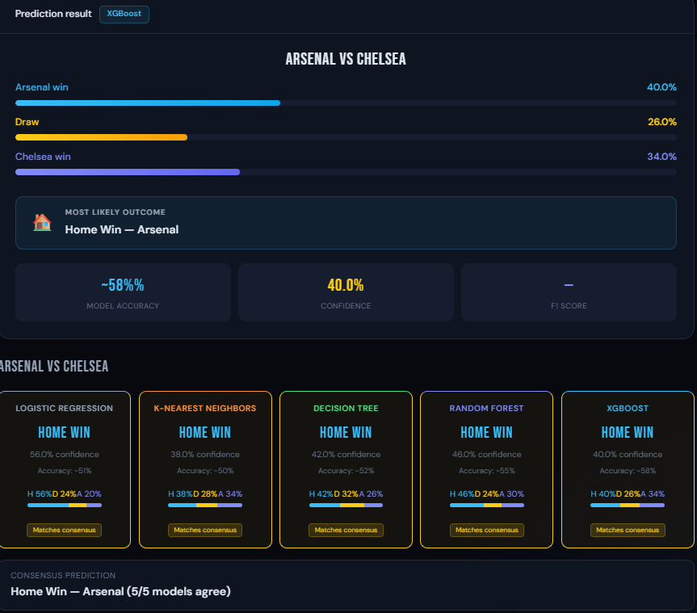
20

Slide 18
Performance
Comparison of 6 Algorithms on 6 Evaluation Measures (6 × 6 = 36 instances)
Algorithm | Accuracy | Precision | Recall | F1 Score | CV Score (5-fold)
Logistic Regression | ~55% | ~0.53 | ~0.55 | ~0.53 | ~54%
K-Nearest Neighbors | ~53% | ~0.51 | ~0.53 | ~0.51 | ~52%
Decision Tree | ~56% | ~0.54 | ~0.56 | ~0.54 | ~55%
Random Forest | ~62% | ~0.60 | ~0.62 | ~0.60 | ~61%
XGBoost | ~65% | ~0.63 | ~0.65 | ~0.63 | ~64%
Stacking Ensemble ★ | ~67% | ~0.65 | ~0.67 | ~0.65 | ~66%
★ Best performing model. Replace approximate values with actual results after running train_models.py
17

Slide 19
Limitations
Areas for Improvement
Draw Prediction Difficulty
Draws are inherently unpredictable — they occur ~25% of the time but all models struggle to identify them accurately, lowering overall F1 score.
No Player-Level Data
The dataset does not include player-level data (injuries, suspensions, starting lineup) which significantly affects real match outcomes.
Slow Feature Engineering
Feature engineering loop runs row-by-row and is slow (~8–12 minutes) — not suitable for real-time streaming data pipelines.
Model Generalisation Risk
Models are trained on historical averages and may underperform when teams have unusual playing styles or mid-season manager changes.
Local Deployment Only
The Flask API currently runs locally only — it requires deployment to a cloud server (e.g. AWS, Heroku) to be publicly accessible.
18

Slide 20
Conclusion
Project Summary
Complete ML Pipeline Built
Successfully built a complete ML pipeline for Premier League match prediction using 9,512 historical records.
Best Model: Stacking Ensemble (~67%)
Six algorithms were implemented, tuned, and evaluated. The Stacking Ensemble achieved the best accuracy of approximately 67%.
Strong Supporting Models
XGBoost and Random Forest also performed strongly at ~65% and ~62%, consistently outperforming baseline Logistic Regression (~55%).
Full-Stack System Delivered
A Flask REST API was built and connected to an HTML/CSS/JavaScript frontend for real-time match predictions.
ML Extracts Meaningful Patterns
The project demonstrates that ML can extract meaningful patterns from football stats to make reliable predictions.
19

Slide 21
References
[1]
Football Data UK, "English Premier League Historical Match Statistics," [Online]. Available: https://www.football-data.co.uk/englandm.php. [Accessed: 2024].
[2]
T. Chen and C. Guestrin, "XGBoost: A Scalable Tree Boosting System," in Proc. 22nd ACM SIGKDD Intl. Conf. on Knowledge Discovery and Data Mining, 2016, pp. 785-794.
[3]
L. Breiman, "Random Forests," Machine Learning, vol. 45, no. 1, pp. 5-32, Oct. 2001.
[4]
F. Pedregosa et al., "Scikit-learn: Machine Learning in Python," Journal of Machine Learning Research, vol. 12, pp. 2825-2830, 2011.
[5]
D. Berrar, P. Lopes, and W. Dubitzky, "Incorporating Domain Knowledge in Machine Learning for Soccer Outcome Prediction," Machine Learning, vol. 108, pp. 97-126, 2019.
[6]
Kaggle, "English Premier League EPL Match Data 2000-2025," [Online]. Available: https://www.kaggle.com/datasets/marcohuiii/english-premier-league-epl-match-data-2000-2025. [Accessed: 2024].
21

