Slide 1
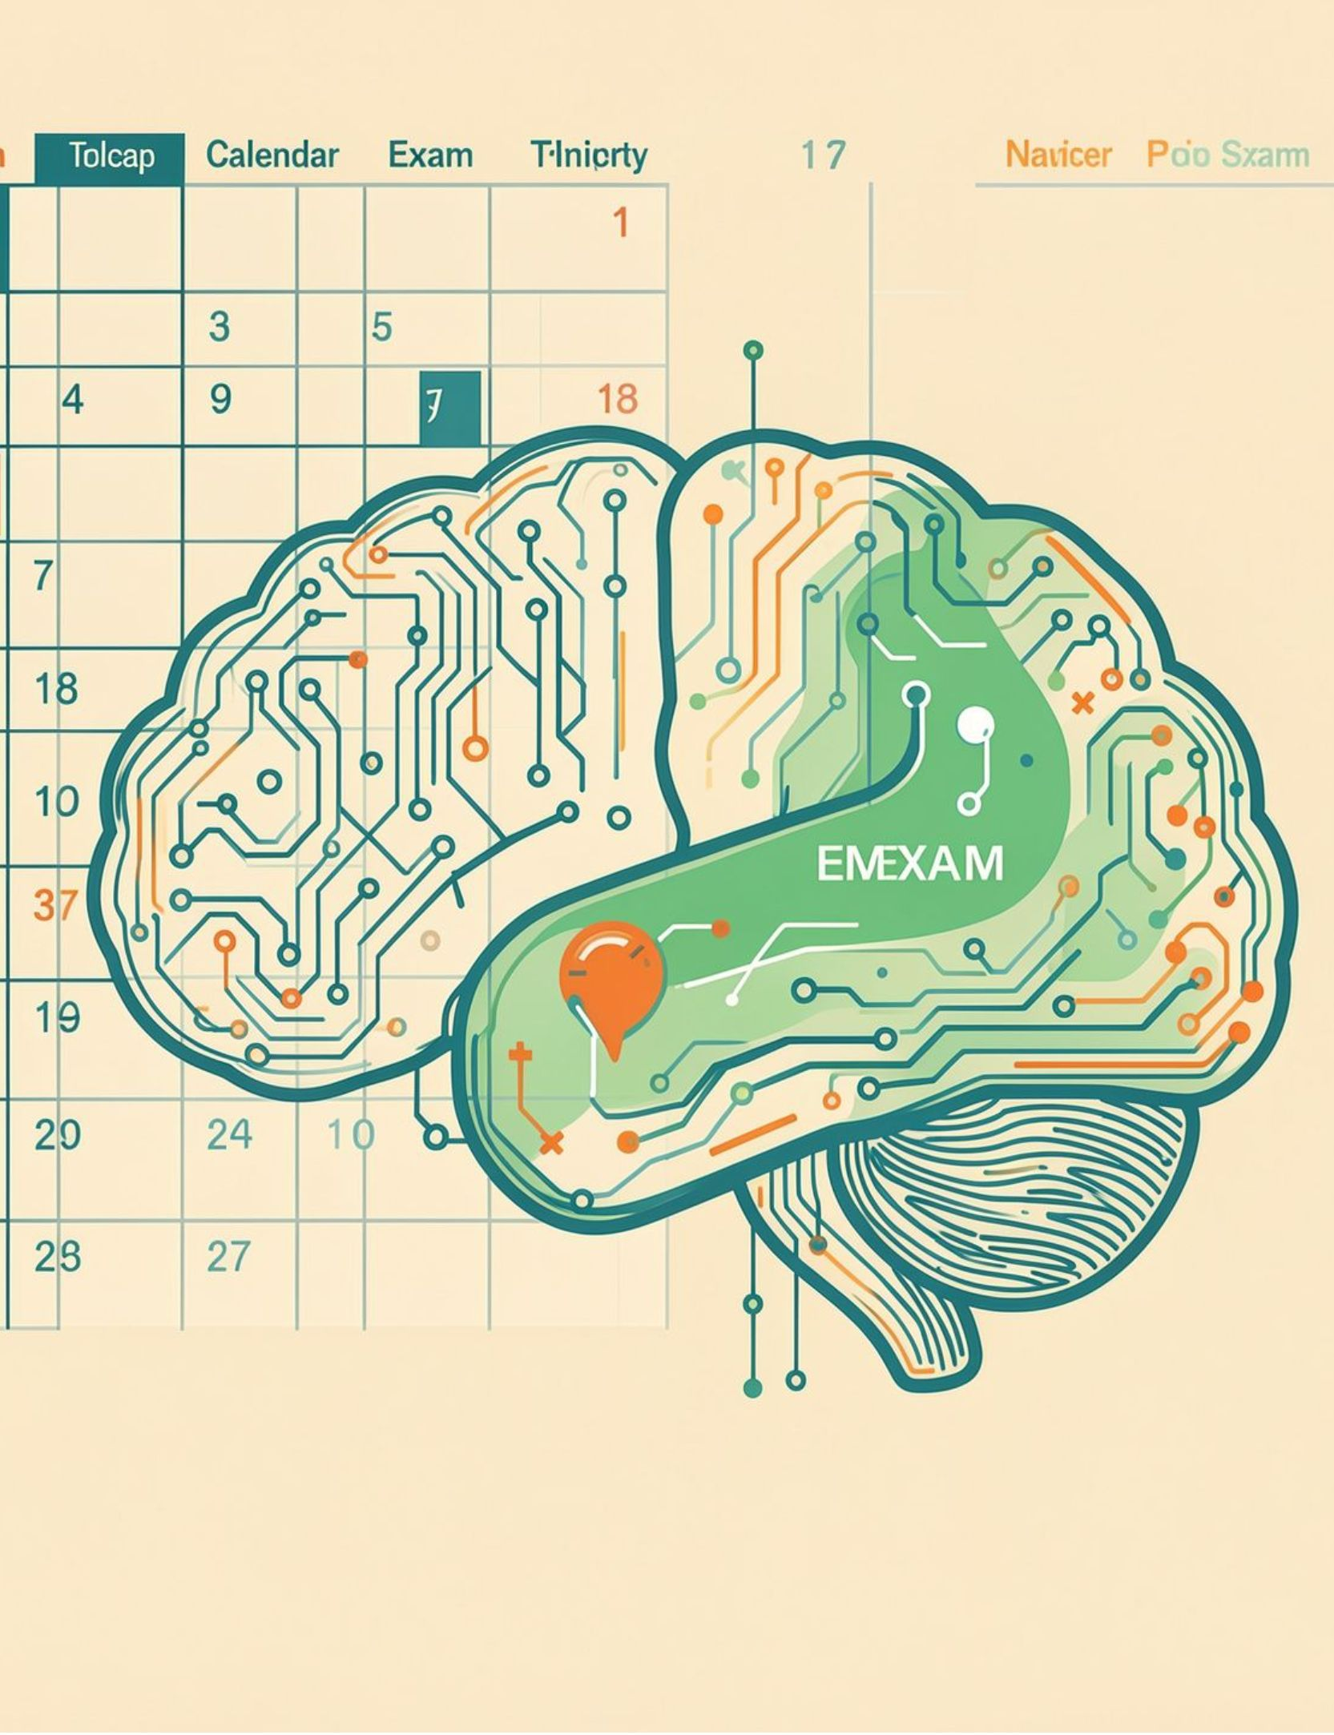
BUILD FOR YOUR CAMPUS
MentalPlanner:
Your Personal
Exam Preparation Agent
Personalized timetable, study plan, curated materials, and doubt-clearing chatbot powered by Gemma 4
Build for Your Campus
MLH: Best Use of Gemma 4
MLH: Best Open Source AI Project · Team: Mentals · Kanad - Aditya - Rahul - Ishwar - Shlok
Notes:
Exam season shouldn't start with figuring out your own exam schedule. MentalPlanner turns a campus timetable and course material into a personal preparation agent. We are building for your campus, using Gemma 4 and open-source AI.

Slide 2


THE PROBLEM
Exam prep on campus is fragmented and manual
One dense PDF
Every schedule differs
180+ page Course of Study; materials scattered across Classroom, slides, and web.
Every student has a different course mix, so schedules are never alike.
MID-SEMS
18–25 Sept
2026
Dense multi-page PDF: merged and cross-listed codes, such as CSL201/MAL503.
Hundreds of students per slot.
One generic PDF.
Manual consequences: no personalized plan, late clash discovery, and unanswered midnight doubts.
MentalPlanner · Built with Gemma 4 | Open Source (MIT)
Notes:
Open with the relatable pain. Students start with a dense, multi-page PDF and then stitch together Classroom, slides, and web materials. Each student's reality is different because every course mix is different, yet the campus gives everyone one generic PDF. That creates late clashes and unanswered midnight doubts.

Slide 3
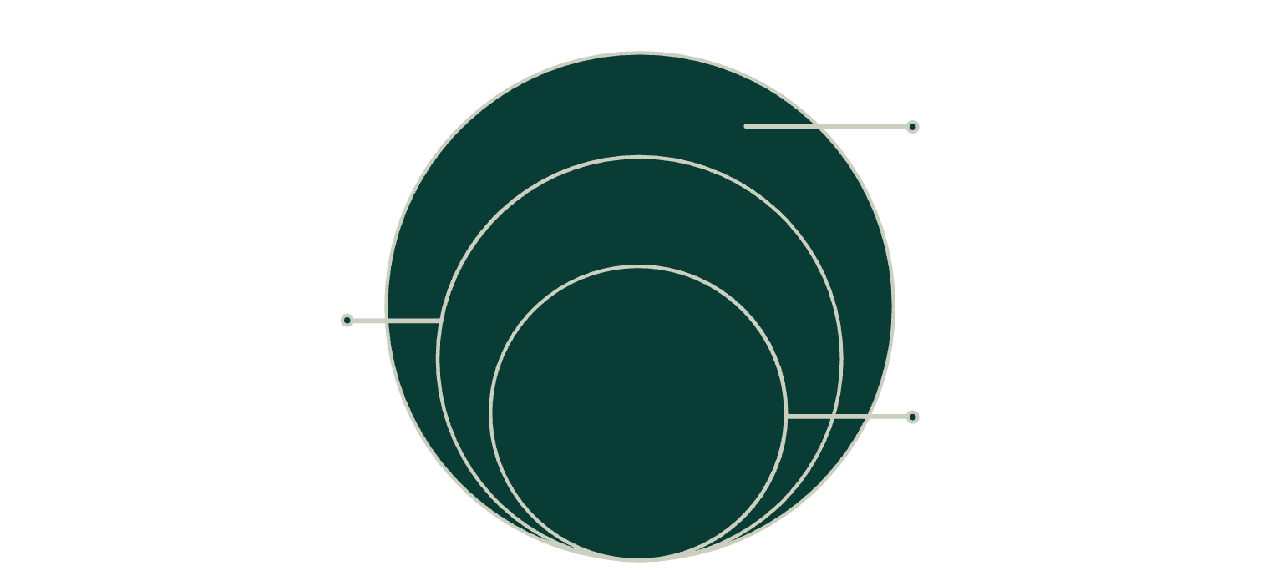
THE USERS
Who we are building for
CURRENT SCOPE
Mid-semester exams · real timetable · Course of Study data
Campus System
1000+ students and 40+ courses in Course of Study
CAMPUS REACH
Secondary Users
1000+ students on campus · 40+ courses in the Course of Study
Faculty, academic offices, mentors, student bodies
Primary Users
BTech students — CSE Semester III (demo scope)
Architecture remains branch-agnostic beyond the demo.
MentalPlanner · Built with Gemma 4 | Open Source (MIT)
Notes:
Be explicit about the boundary. The demo is scoped to BTech CSE, Semester III, using a real timetable and Course of Study. The secondary users are the people who support that workflow. Even though we demonstrate one branch, the architecture is branch-agnostic.

Slide 4
THE PRODUCT FLOW
One agent, from timetable to topic-wise plan
01
02
03
04
05
Choose
Schedule
Scope
Plan
Ask
Pick branch and semester; deselect or add courses.
Get a personal timetable with clash and tight-gap alerts.
Mark in-syllabus versus excluded topics per course.
Generate a day-by-day study plan automatically.
Ask course-aware doubts with citations and NPTEL-first links.
SCREENSHOT PLACEHOLDER
SCREENSHOT PLACEHOLDER
Personal timetable
Topic-wise plan
Clash and tight-gap alerts
Daily study plan and cited doubts
Deterministic date logic; Gemma 4 for understanding and reasoning · MentalPlanner · Built with Gemma 4 | Open Source (MIT)
Notes:
Walk the flow left to right in about thirty seconds. Students choose their actual course mix, receive a timetable with alerts, mark the syllabus scope, generate a day-by-day plan, and then ask course-aware doubts. The date logic stays deterministic; Gemma 4 handles understanding and reasoning.

Slide 5
THE FOUNDATION
Tech stack: open-source first
Frontend | Vanilla HTML5, CSS3, and JavaScript
Backend | Python + FastAPI
AI | Gemma 4 behind one configurable llm.py wrapper
Parsing + integrations | pdfplumber, YouTube, web search
100% open-source components, · model swap is one config change
MentalPlanner · Built with Gemma 4 | Open Source (MIT)
Notes:
Stress the architecture choice. The frontend, gateway, backend, data layer, parsing, and integrations are all replaceable components, with open-source choices throughout. Gemma 4 sits behind one configurable llm.py wrapper, so swapping the model is a one-line config change.

Slide 6
THE DATA PIPELINE
Turning messy PDFs into structured data
01
02
EDITABLE JSON
Extract
Fallback
{
"code": "CSL201",
"credits": 4,
"ltpc": "3-0-2-4",
"topics": ["Topic A"]
}
Word positions recover slots, rows, aliases, and split halls.
Gemma 4 page-wise JSON conversion handles difficult pages.
03
04
Decompose
Validate
Regex headers, then Gemma 4 topic decomposition.
Schema-validated fields produce timetable.json and courses.json.
Parsed once offline; retries and Pydantic validation protect the demo.
Alias matching: any slash-separated code matches the student's course.
MentalPlanner · Built with Gemma 4 | Open Source (MIT)
Notes:
Explain the pipeline from messy PDF to structured data. Word positions recover timetable structure, with Gemma 4 as the page-wise fallback. Course headers are found with regex, then topics are decomposed. Alias matching is important: any slash-separated code can match the student's course. Everything is parsed once offline, then retries and Pydantic validation protect the demo.

Slide 7
THE CONTROL PLANE
Deterministic engine + Gemma 4 reasoning
DETERMINISTIC ENGINE
REASONING LAYER
Plain Python
Gemma 4
Alias joins
Clash detection
Date math
Hour allocation and buffers
Topic difficulty
Plan reasoning
Material matching
Coverage gaps
The LLM never does date math, as stated in the README.
JSON outputs are verified in code before reaching students.
/api/timetable/upload · /api/courses/scope · /api/plan/generate · /api/timetable/personal · /api/chat
RAG chatbot answers with citations from course materials · MentalPlanner · Built with Gemma 4 | Open Source (MIT)
Notes:
Emphasize the boundary: the LLM never does date math, as stated in the README. Plain Python owns aliases, clashes, dates, hours, and buffers. Gemma 4 reasons over topic difficulty, plans, materials, and coverage gaps. JSON is verified in code, and the RAG chatbot answers with citations from course materials.

Slide 8







Gemma 4 at the core of every intelligent step
Structured extraction
Topic decomposition
Material matching
Strict JSON, schemas, validation, and retries.
Study-plan reasoning for each course.
Coverage-gap detection across resources.
Grounded RAG
Tool calling
SKILL.md
Refuses to invent material.
search_youtube,
get_exam_schedule, web_search, generate_study_plan, query_course_rag.
Capabilities, inputs, outputs, and tools.
Open models protect student privacy, avoid lock-in, run on campus, and stay reproducible
MentalPlanner · Built with Gemma 4 | Open Source (MIT)
Notes:
Slow down for the Gemma 4 and Open Source judges. Gemma 4 is used at every intelligent step, but with strict structure around it: schemas, validation, retries, grounded retrieval, and documented tools. Open models protect student privacy, avoid lock-in, run on campus, and stay reproducible.

Slide 9
THE ROADMAP
From one branch to every campus
Now
Feature growth
1
CSE Semester III, mid-sem, core pipeline, chatbot.
Faculty dashboard, mobile app, notifications, adaptive re-planning.
Next
2
All branches, end-sem and quizzes, Classroom sync, uploads, coverage table.
Campus deployment
Later
Self-hosted Gemma deployment on campus infrastructure.
3
Other universities with pluggable timetable and syllabus inputs.
MentalPlanner · Built with Gemma 4 | Open Source (MIT)
Notes:
Cover both types of growth. The user base expands from CSE Semester III to all branches, then to other universities through pluggable timetable and syllabus inputs. Feature growth adds Classroom sync, uploads, coverage tables, dashboards, mobile, notifications, adaptive re-planning, and finally self-hosted Gemma on campus infrastructure.

Slide 10
THE INVITATION
Study smarter.
Not harder.
Personal timetable. Smart plan. Cited answers. Powered by Gemma 4.
EXPLORE
BUILD
GitHub: https://github.com/aditya-91O2/mlh-hackathon
Team: Kanad - Shlok - Aditya - Rahul - Ishwar
MIT License · README mentions Gemma 4 · SKILL.md included
MentalPlanner · Built with Gemma 4 | Open Source (MIT)
Notes:
End with an invitation to the live demo. MentalPlanner gives every student a personal timetable, a smart plan, and cited answers, powered by Gemma 4. Point judges to the repository and demo, then close on the MIT License, README, and SKILL.md.

