Slide 1

IMAGE CRYPTOGRAPHY :
USING RSA FOR NETWORK
SECURITY
SUBMITTED BY- GUIDED BY
ADITYA KUMAR SINGH (004) Er. MOHD.SHAH ALAM
SUPRIYA SINGH (045)

Slide 2
OBJECTIVE
Image cryptography using RSA Algorithm
SOFTWARE USED
visual studio Community 2017
PROGRAMMING LANGUAGE
C# (Windows forms)

Slide 3
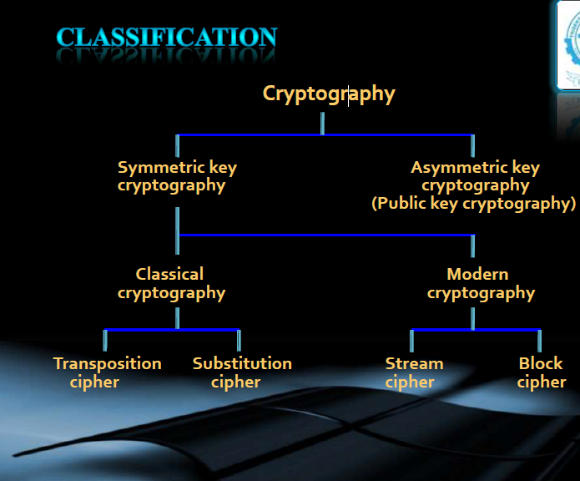
WHAT IS IMAGE CRYPTOGRAPHY
In the present day it refers to the tools and techniques used to make messages secure for communication between the participants and make messages immune to attacks by hackers.

Slide 4

WHY WE USE CRYPTOGRAPHY
Confidentiality of Message
Authentication of Source
Integrity of Data
Non Repudiation
Replay attack protection

Slide 5
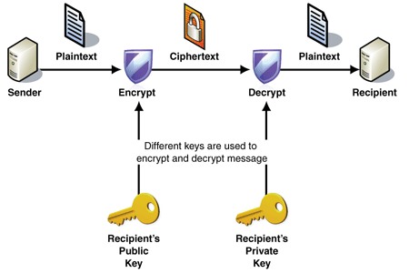
ASYMMETRIC CRYPTOGRAPHY With public key cryptography, keys work in pairs of matched public and private keys. Public key cryptography, also called asymmetric key cryptography which is using a pair of keys for encryption and decryption

Slide 6
Another way of asymmetric key cryptography
A
A
B
A
.
.
.
B
DATA B
Data A
B
B
A
.
.
.
DATA A
DATA B

Slide 7
IMAGE CRYPTOGRAPHY USING RSA
The RSA is an cryptographic algorithm which use public and private to encrypt and decrypt the data. This algorithm developed in 1977 by Ron Rivest, Adi Shamir, and Leonard Adleman.
WHAT IS PUBLIC AND PRIVATE KEY-
Public key is announce over the network and sender can easily access the public key of receiver and encrypt the message. The encrypted message is decrypted through the private key of receiver which is not shared by any host,

Slide 8
METHODOLOGY
The RSA algorithm consists of three major steps in encryption and decryption. The steps are following as,
1) Key Generation
2) Encryption
3) Decryption
1-KEY GENERATION
First choose the two distinct prime numbers p and q.
Then compute the n value, n = p*q.
Compute φ(n) = φ(p)φ(q)
= (p − 1)(q − 1)
= n - (p + q -1), where φ is Euler’s totient function.

Slide 9
Find encrypted or public key
Choose e such that 1< e < φ(n) and e & φ(n) are relatively prime .
i.e gcd(e, φ(n))=1
Find decrypted key
choose d such that e*d mod (φ(n))=1 , d is called as decrypted key.
Actual message - plain text (p)
Encrypted message - cipher text (c)
After decryption cipher text convert into plain text.
c = (p)^e mod (n)
p= (c)^d mod (n)

Slide 10
Here is a example of RSA
Given p=7 and q=17
n = 17*7 =119
now we choose e=5 in such way so that it is prime with respect
p-1 and q-1.
φ(n) = (17-1)*(7-1)
= 96
d*e mod φ(n)=1 d*5 mod (96) =1 d=77
Suppose A send 5 to B
Cipher =(5)^5 mod 119= 26 plain = (26)^77 mod 119 = 5

Slide 11
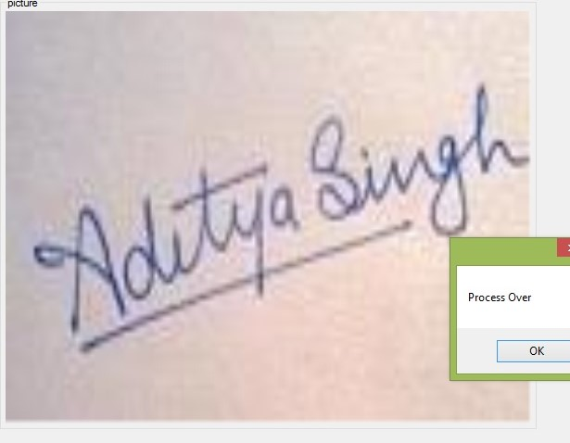
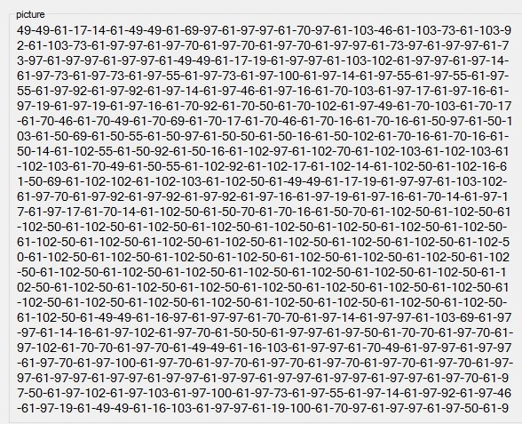
After encryption the plain text converted into hex code
IMAGE
encrypted data

Slide 12
WHAT IS ENCRYPTED CODE
First the colour value of the image is extracted Byte by Byte.
Each extracted value is converted to integer value (using ToInt() function).
The cipher value is calculated on each of the Integer value
(using c = (p)^e mod (n) ).
Each calculated cipher is stored as a string in CIPHER.TXT file.

Slide 14
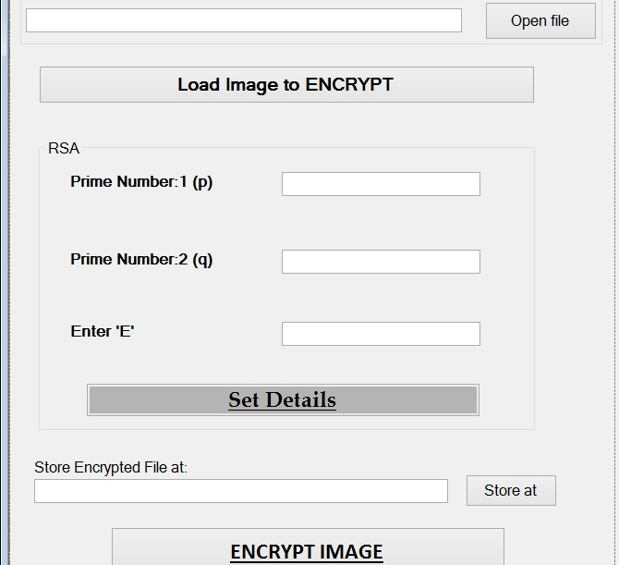
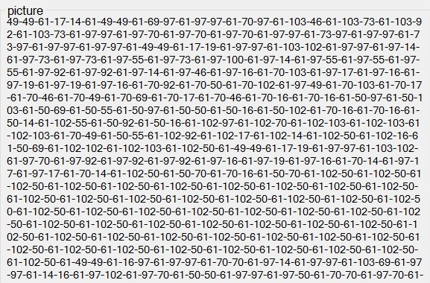
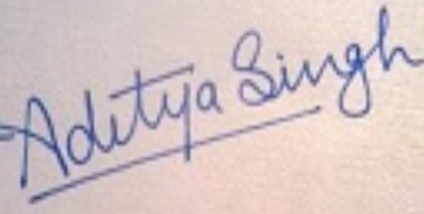
WORKING
STEP-1 STEP-2
Given input p and q as prime n Load the image and click on encrypt
And load images

Slide 15
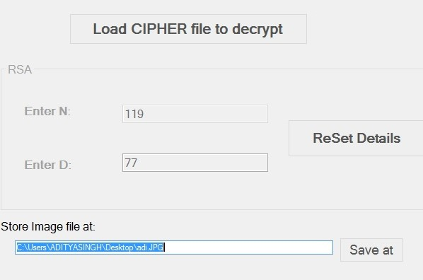
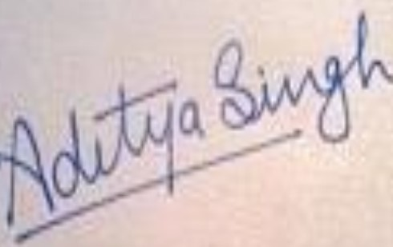
STEP-3 STEP-4
Load cipher ang giving suitable d convert cipher into actual image
and according to previous input

Slide 16
CONCLUSION
Our algorithm work properly.
All the image of any size will be easily encrypted and decrypted
Quality of image is decrease after decryption.
If the image of size > 550 kb then it can take more than 10 minute for encryption and decryption

