Slide 1
More Bikes or Better Allocation?
Bike-sharing demand analysis, forecast model and natural-language prototype
Sigmoid Data Science Trainee · Case Study Round 2
Aditya Anand · NIT Warangal · 26 October 2026
Notes:
Riders can't find bikes while bikes sit idle. The CEO asks: buy more bikes, or allocate better? This is a human-led, AI-assisted analysis of the 2011-12 Capital Bikeshare data.

Slide 2
Answer first: timing, not fleet size
What the data supports, and what it cannot prove
51.7%
R² 0.90
~491
of working-day rentals fall in the 07-09 and 17-19 commute windows (vs 26.0% on non-working days)
hourly forecast on unseen Jul-Dec 2012; under-predicts peaks by ~51/hr
bikes needed in the default scenario, vs a fictional fleet of 2,000 (scenario, not a requirement)
Recommendation: pilot forecast-guided redistribution and fleet-health fixes before buying bikes. Redistribution is not proven as the root cause: there is no station-level or unmet-demand data.
Sigmoid Round 2 · Aditya Anand
Notes:
Lead with the conclusion. All three numbers come from the executed notebook. The fleet number is a scenario built on assumptions.

Slide 3
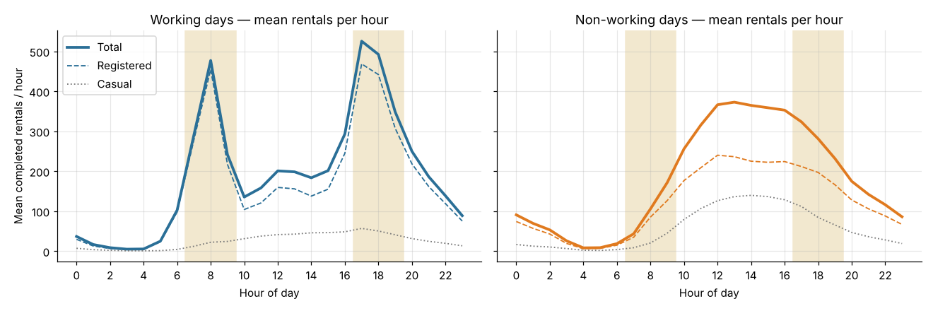
Data quality: clean, with documented gaps
17,379 hourly rows · 731 days · 2011-2012
No nulls or duplicates; cnt = casual + registered on every row; hourly sums match day.csv
165 missing hours, mostly 00-06 h; 8 incomplete days incl. Hurricane Sandy, flagged and excluded from tests
hum = 0 (22 rows) and windspeed = 0 (2,180 rows) look like missing values; documented
Leakage guard: casual and registered never used as model inputs
Working days: sharp 08:00 and 17-18:00 peaks. Non-working days: a midday plateau.
Sigmoid Round 2 · Aditya Anand

Slide 4
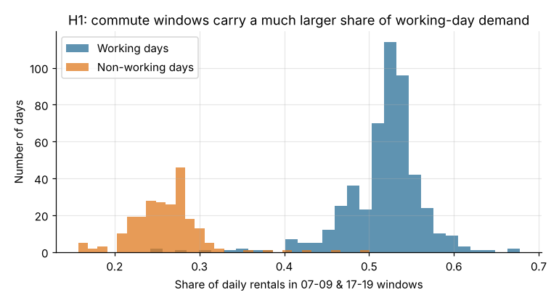
H1: commute windows dominate working days
One row per day · one-sided Mann-Whitney · incomplete days excluded
51.7% vs 26.0% of daily rentals in commute windows (494 vs 229 days)
p ≈ 4e-102; rank-biserial r = 0.99; shift 26.2 pts (95% CI 25.7-26.8)
Holds in all four seasons; 92% of peak riders are registered users
Shows WHEN bikes must be in place, not WHERE they travel: that needs trip data
Sigmoid Round 2 · Aditya Anand

Slide 5
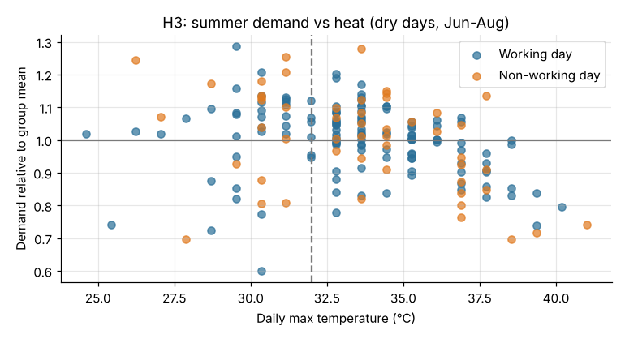
H3: the July dip looks like heat, not rain
Round 1 guessed 'monsoon'; the data says otherwise
July 2011: hottest month (31.1 °C) and fewest rain hours (2.0%)
Pre-specified 32 °C test: median shift −5.0 pts (95% CI −8.4 to −1.3), p = 0.003
Mean-based test borderline (95% CI includes 0): modest evidence
34-36 °C look stronger but were chosen after seeing data: exploratory only
Sigmoid Round 2 · Aditya Anand

Slide 6
Forecast model: best overall, misses peaks
Train to 30 Jun 2012 · test Jul-Dec 2012 · no leakage features, no lags
Primary model: HistGradientBoosting (MAE 44.5, R² 0.90)
Known limitation: under-predicts commute peaks by ~51/hr; trees can't extrapolate 2012 growth
Documented rather than tuned late; fleet sizing keeps observed percentiles as reference
Sigmoid Round 2 · Aditya Anand

Slide 7
Fleet scenarios: few bikes ride at once
fleet = demand/hr × trip hours × spatial buffer ÷ (1 − maintenance share)
Trip length \ buffer | 1.5x | 2x | 3x
15 min | 276 | 368 | 552
20 min | 368 | 491 | 736
30 min | 552 | 736 | 1,104
Share of a 2,000-bike fleet riding at once (20-min trips): 8.8% average busiest hour, 11.0% p95 hour, 16.3% single busiest hour
2,000 bikes only fall short if positioning needs a buffer of ~8x
Assumed trip length, buffer and fictional fleet: scenarios, not verified requirements
Scenario fleet at 2012 p95 demand (662/hr), 10% maintenance
Sigmoid Round 2 · Aditya Anand

Slide 8
Prototype: ask demand questions in plain English
Streamlit app · Gemini function calling · deterministic fallback
Manager's question
Gemini picks a validated function
Python runs on real data / model
Grounded answer + raw result
6 whitelisted functions: peaks, day types, weather, seasons, predictions, fleet scenarios
Grounding check flags any number not in the function output; unsupported questions (stations, routes) are refused honestly
No key or API failure → deterministic router, stated on every answer · 66 automated tests
Live app: https://sigmoid-bike-sharing-4sbnqpjtvqpqxdpayyzvjz.streamlit.app/
Sigmoid Round 2 · Aditya Anand

Slide 9
Recommendation: pilot before purchase
1
Fix fleet health first
Count rentable bikes at 07:00 and 16:30; repair before buying (fits the halved budget)
2
Trial a forecast-guided schedule
Rebalance before ~07:00 and ~16:30 on working days; shift driver hours seasonally (trial ideas)
3
Measure it properly
4-6 week zone pilot vs current schedule; metric: empty-station minutes at commute peaks
4
Buy only if still short
If stations still run empty after rebalancing and repairs, buy for those stations
Data needed to validate: station dock status, trip start/end and duration, failed rentals, bike health, rebalancing logs

