Slide 1
SkillMatch
TWO-STAGE SKILL-AWARE MATCHING SYSTEM
Match candidates to jobs
they're actually qualified for.
A two-stage retrieval-and-reranking system that scores resume–job pairs using semantic, lexical, and ESCO-grounded skill features.
Built for job seekers, career counselors, and placement teams — anywhere a quantitative skill-gap diagnosis matters.
SkillMatch Pipeline
STAGE 1 — RETRIEVAL
STAGE 2 — RERANKING
OUTPUT
SBERT
LogReg + 8 features
Skill Gap Diagnosis
Retrieves top-50 candidate pairs per job from 2.1M possible pairs (all-MiniLM-L6-v2).
Semantic, lexical, skill-coverage, ESCO-weighted importance, experience, title similarity.
Match probability + ranked missing skills + 2-year personalised roadmap.
SkillMatch - Endterm Project Evaluation - MLPR 2026 - 1 / 11

Slide 2
SkillMatch
Problem Statement & Applications
The problem
Applications
Given a resume and a job description, predict whether the candidate is a good match.
Recruiters screen 250+ resumes per role on average and reject 75% on primitive keyword matching. Job seekers see hundreds of postings with no systematic way to know which they're qualified for or what skills to develop.
Same model, two users: identify good matches at the recruiter end; quantify skill gaps at the candidate end.
FOR JOB SEEKERS
Personalised job-fit scoring
Rank live postings by match probability. Surface skill gaps with importance weights.
FOR PLAKSHA PLACEMENT
Internship & course mapping
Match students to internships; recommend electives by aligning transcripts with target-role skill graphs.
FOR CAREER COUNSELING
2-year skill roadmap
Aggregate gaps across target roles → quarterly learning plan with forward-simulation of match probability lift.
We don't just produce a score — we tell candidates which skills to learn next.
SkillMatch - Endterm Project Evaluation - MLPR 2026 - 2 / 11

Slide 3
SkillMatch
Literature Survey — three 2025 papers
P1 — DASH et al., IJEDR 2025
P2 — DABERAO et al., GITCON 2025
P3 — SRIBHARATHI et al., ICSSS 2025
AI Skill Gap Analyzer
ResumeInsight
Scopira AI Career Platform
Full-stack web app. BERT/RoBERTa NER + ESCO/O*NET ontologies. Reports 0.90 accuracy + 92% user satisfaction. Has course-recommendation engine.
Indian campus recruitment. spaCy + Levenshtein, RF/XGB/ANN classifier. K-Means cluster labels (a methodological weakness flagged in our review).
TF-IDF + BERT, 4-module system with career-path generator. 0.918 accuracy claimed; 200+ user pilot. Outperforms LinkedIn Skills Match.
WHAT UNITES THEM
WHERE OUR WORK ADVANCES THE FIELD
Same conceptual pipeline: extract skills → semantic match → surface gap → recommend learning.
All built for English IT/data-science roles. All evaluate on internal gold standards that are never disclosed.
• 3-LLM consensus labels (Claude+GPT+Gemini, κ=0.61)
• Empirical leakage detection (CV 0.99 → test 0.44)
• Head-to-head: weak / supervised / self-training / active learning
• Inter-rater agreement disclosed; reproducible
SkillMatch - Endterm Project Evaluation - MLPR 2026 - 3 / 11

Slide 4
SkillMatch
Dataset & Preprocessing
2,484
853
20,253
50,650
Resumes
(Kaggle, anonymized)
Job descriptions
(public corpus)
Skills in vocabulary
(ESCO + O*NET + tech)
Candidate pairs
(diversified pool)
Three preprocessing fixes that materially improved data quality
FIX 4A — JD YEARS-OF-EXPERIENCE
FIX 4B — AMBIGUOUS TECH TOKENS
FIX 4C — RESUME TITLES
Parse from model_response JSON
Raw-case + context check
First-line instead of Category
Original regex caught 0/853. After fix: 500/853 jobs have non-zero YoE.
Tokens like R, Go, Swift gated behind capitalization OR tech-context window. 654 false positives removed.
Was using broad Category column (7,286 unique). First-line extraction lifted unique title-similarity values to 31,254.
ESCO vocabulary expansion lifted skill_overlap > 0 from 36% to 68% of pairs.
SkillMatch - Endterm Project Evaluation - MLPR 2026 - 4 / 11

Slide 5
SkillMatch
Methodology — Two-Stage Architecture
STAGE 1 — RETRIEVAL
STAGE 2 — RERANKING
SBERT semantic similarity
Logistic Regression on 8 features
• all-MiniLM-L6-v2 (384-dim, ~22M params)
• 2.12M possible pairs → top 50 per job
• ~3ms per text on CPU; full matrix <1s
• 50× reduction in candidate space
• Trained on 600 LLM-consensus labels
• Class-balanced, CV threshold = 0.52
• Inference <1ms per pair
• Outputs match probability + skill gap
The 8 features (4 channels):
SEMANTIC
LEXICAL
SKILL
STRUCTURAL
• embedding_similarity
• title_similarity
• tfidf_similarity
• skill_overlap
• weighted_skill_score
• num_missing_skills
• avg_missing_skill_importance
• years_of_experience
SkillMatch - Endterm Project Evaluation - MLPR 2026 - 5 / 11

Slide 6
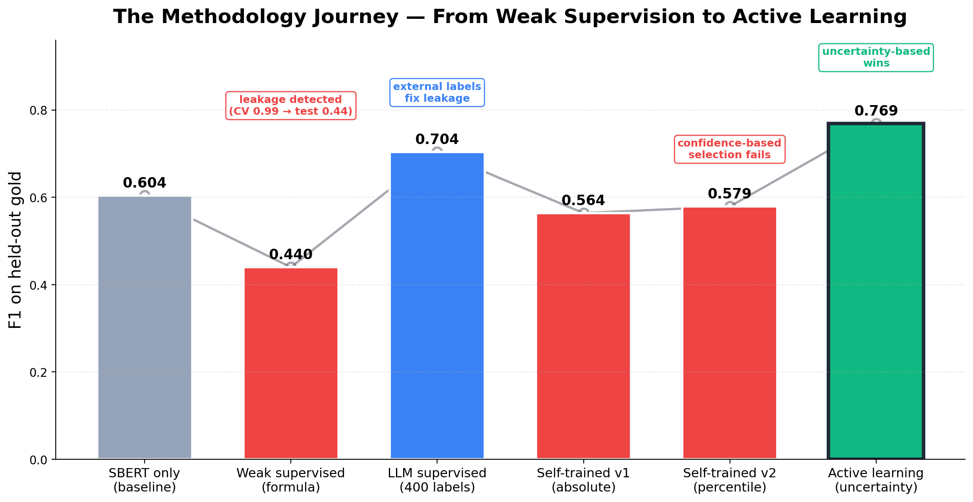
SkillMatch
Methodology Journey — five strategies tested
1 — WEAK SUPERVISION
Formula labels
F1=0.44 · CV-test gap 0.55 (leakage)
2 — LLM SUPERVISED
400 LLM labels
F1=0.704 · +10 over SBERT baseline
3 — SELF-TRAIN v1
Absolute threshold
F1=0.564 · class balance flipped
4 — SELF-TRAIN v2
Percentile + diversified
F1=0.579 · hard cases excluded
5 — ACTIVE LEARNING
Uncertainty-band sampling
F1=0.769 · +6.5 over supervised
Confidence-based selection (self-training) fails. Uncertainty-based selection (active learning) wins. Same label budget — opposite mechanisms.
SkillMatch - Endterm Project Evaluation - MLPR 2026 - 6 / 11

Slide 7
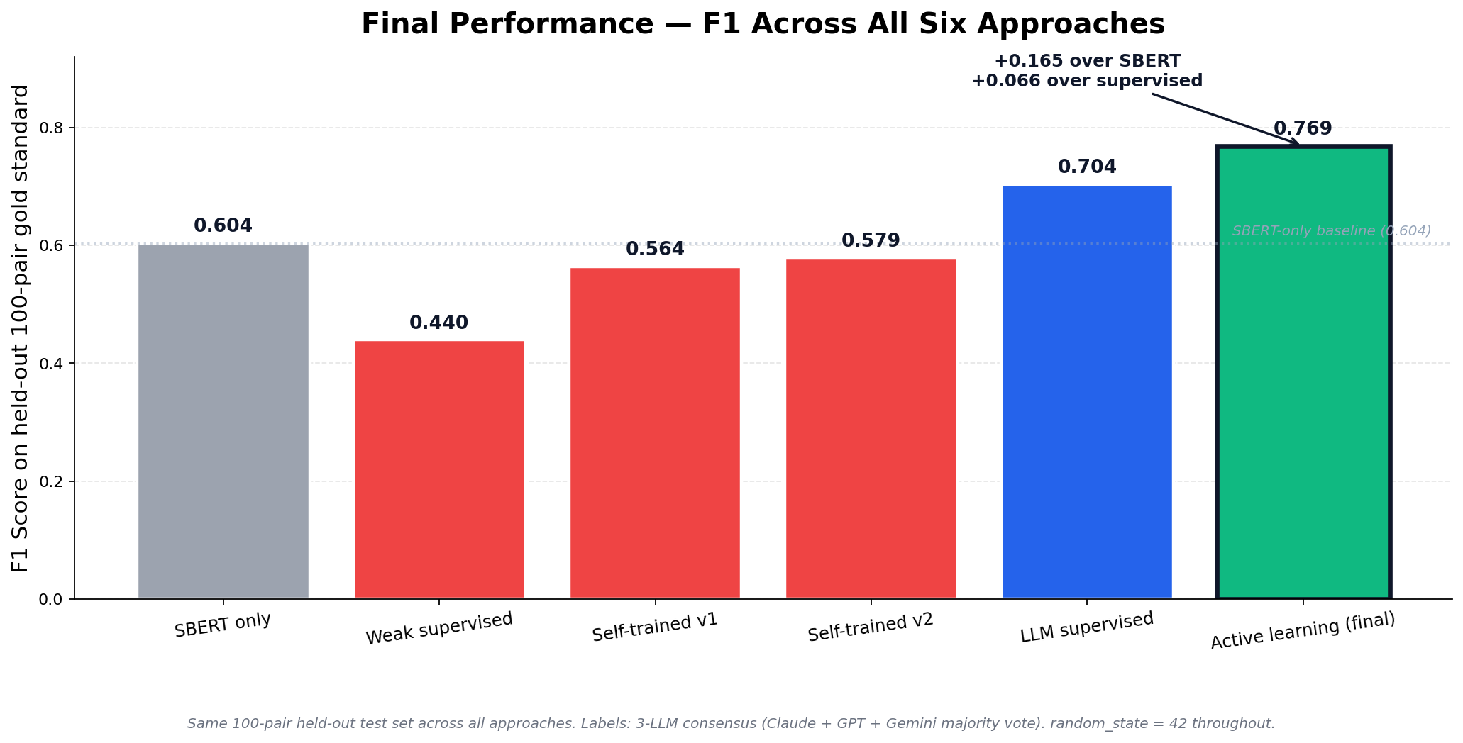
SkillMatch
Final Results — F1 = 0.769 on 100-pair LLM gold standard
FINAL MODEL F1
0.769
VS SBERT-ONLY BASELINE
+0.165 F1
Active learning beats semantic-similarity-only by 16.5 percentage points.
VS SUPERVISED BASELINE
+0.066 F1
200 uncertainty-band labels added 6.6 F1 points on top of 400-label baseline.
Test confusion matrix: TP=20, FN=2, FP=10, TN=68 · Precision=0.667, Recall=0.909, P@10=0.90
SkillMatch - Endterm Project Evaluation - MLPR 2026 - 7 / 11

Slide 8
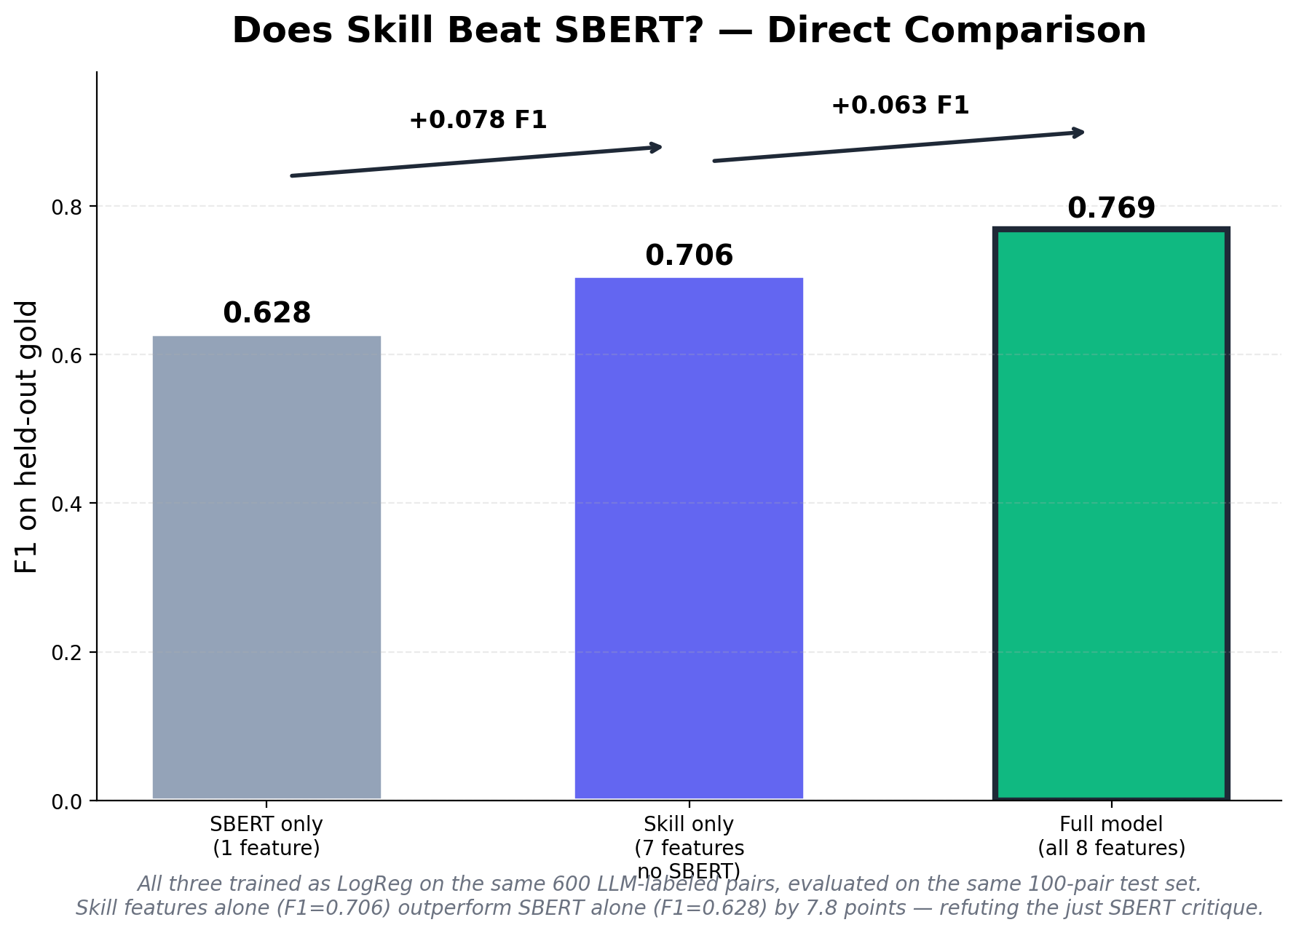
SkillMatch
Feature Importance — Do skill features add real signal?
THE CRITIQUE TO ADDRESS
"Your model is just SBERT dressed up with extra features."
Empirically refuted: a LogReg trained on the 7 non-SBERT features achieves F1=0.706 — beating an SBERT-only LogReg (F1=0.628) by 7.8 points.
Three independent feature-importance methods
COEFFICIENTS
PERMUTATION
ABLATION
embedding_similarity = +0.98 (largest). skill_overlap = +0.72. Multicollinearity between skill_overlap & weighted_skill_score.
embedding=0.25, title=0.12, num_missing_skills=0.11. SBERT strongest, but 5 features all contribute 0.05–0.12.
Drop title_similarity: −0.116 F1. Drop num_missing_skills: −0.088. Drop embedding: −0.063. Title hurts more than SBERT.
Skill features alone outperform SBERT alone by +7.8 F1. The senior's hypothesis is refuted with concrete numbers.
SkillMatch - Endterm Project Evaluation - MLPR 2026 - 8 / 11

Slide 9
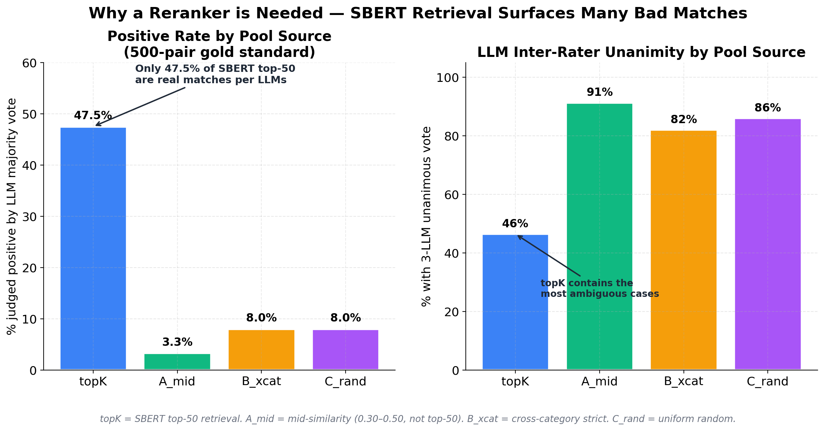
SkillMatch
LLM Labeling & Why a Reranker is Needed
47.5%
of SBERT top-50 retrievals are real matches per LLM consensus — the rest are plausible-looking false positives.
3-LLM CONSENSUS — 500-PAIR GOLD
Unanimous (3-0): 71.0%
Disputed (2-1): 29.0%
Mean pairwise: 80.7%
Chance-adjusted κ: 0.61
Claude pos rate: 22.4%
GPT pos rate: 13.6%
Gemini pos rate: 26.6%
SBERT is great at retrieval — but loses precision at the top of the ranked list. A reranker fills that gap.
SkillMatch - Endterm Project Evaluation - MLPR 2026 - 9 / 11

Slide 10
SkillMatch
Deployability — Dashboard & Plaksha Use Cases
CAREER PATH DASHBOARD (PROTOTYPE)
Plaksha-specific scenarios
1
Match score
PLACEMENT PORTAL
Probability + percentile rank vs other candidates for that role
Internship matching tool
When a student logs in, surface top-K live internship matches with per-job skill-gap reports.
2
Skill gap report
Skills you have + missing skills ranked by ESCO importance
3
2-year roadmap
COURSE PLANNING
Quarterly skill plan aggregated across top-5 target jobs
Course-to-career mapping
Given transcript + target role (e.g. ML engineer), recommend electives next semester.
4
Forward simulation
Re-scores you after adding learned skills (real model prediction)
CAREER ADVISORY
Skill-development advisor
Aggregate gaps across student's top-10 dream jobs → 5 highest-impact skills to learn.
SkillMatch - Endterm Project Evaluation - MLPR 2026 - 10 / 11

Slide 11
SkillMatch
Limitations & Future Work
Known limitations (disclosed honestly)
Future work (tied to literature-survey gaps)
Test set is small (N=100); F1 confidence ≈ ±0.07
LLM consensus is correlated noise, not ground truth
Skill vocabulary still contains residual noise tokens
Individual predictions can be domain-incoherent (dashboard adds category filter)
English-only, IT-heavy corpus; cross-domain transfer untested
No real-world deployment validation
LONGITUDINAL VALIDATION
Cohort study
12-month follow-up: does following recommendations actually change employment?
DOMAIN TRANSFER
Cross-industry test set
Healthcare, legal, creative — beyond English IT.
BIAS AUDIT
Demographic disaggregation
Per-group precision/recall; published audit.
Resume–job matching is fundamentally subjective.
We built a system that quantifies the gap honestly — and tells candidates which skills to learn next.
SkillMatch - Endterm Project Evaluation - MLPR 2026 - 11 / 11

