Slide 1
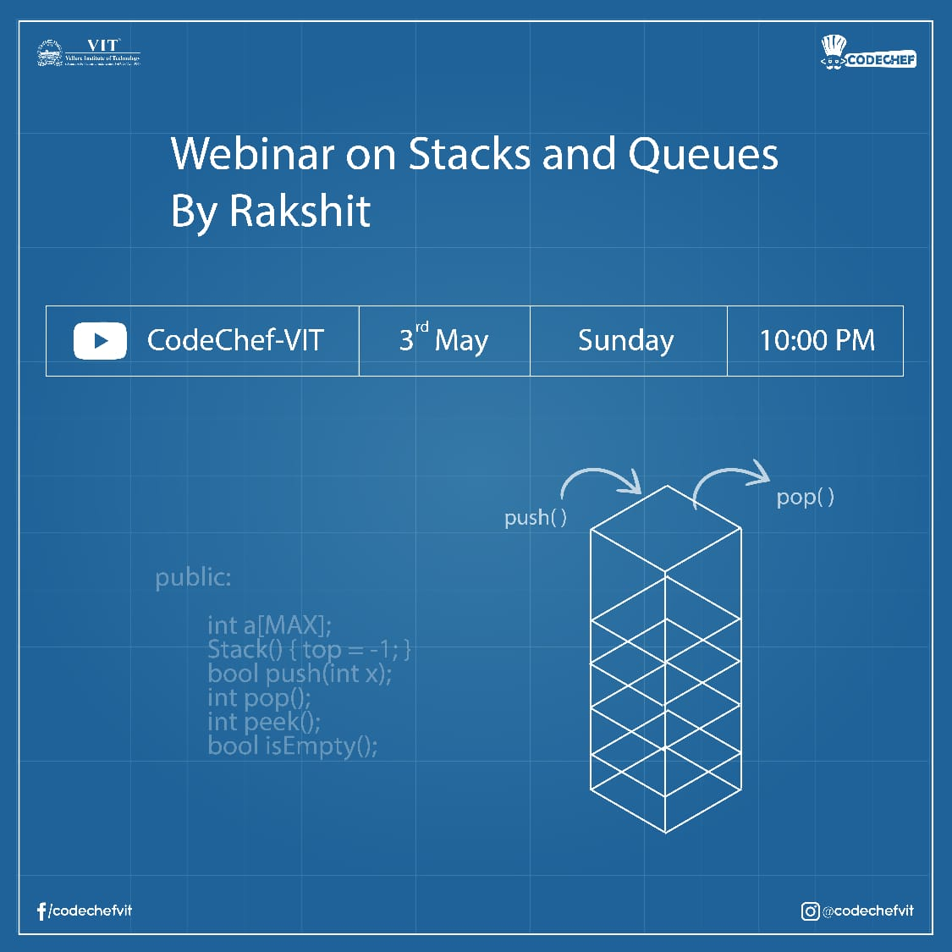

Slide 2
Stacks
Introduction of Stacks
Parenthesis Matching
Tower of Hanoi

Slide 3
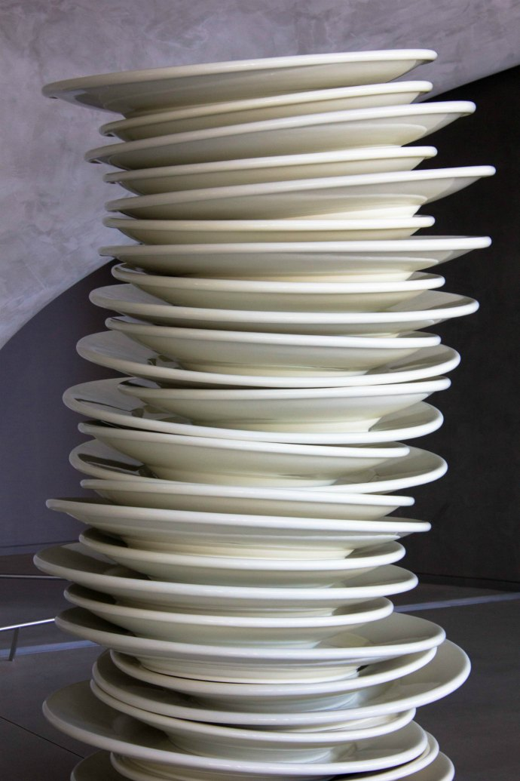
Collection of data item with a restriction that data can only be inserted or deleted from one side know as top of Stack.
Stack follows LIFO(Last In First Out) or FILO(First In Last Out).
Plates stacked over one another in a canteen. The plate which is at the top is the first one to be removed, i.e. the plate which has been placed at the bottommost position remains in the stack for the longest period of time. So, it can be simply seen to follow LIFO/FILO order.

Slide 4
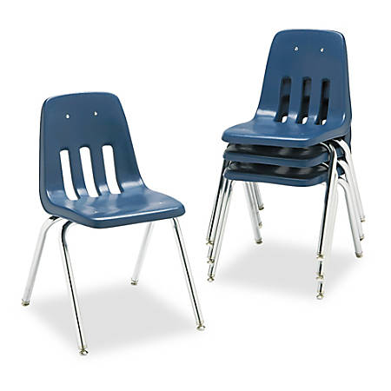
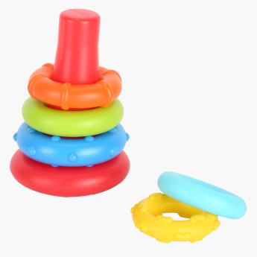
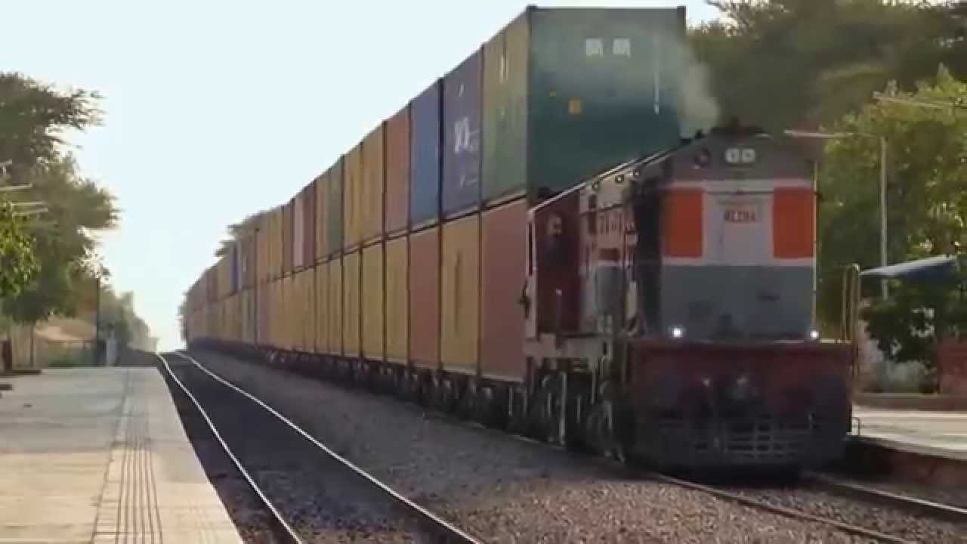
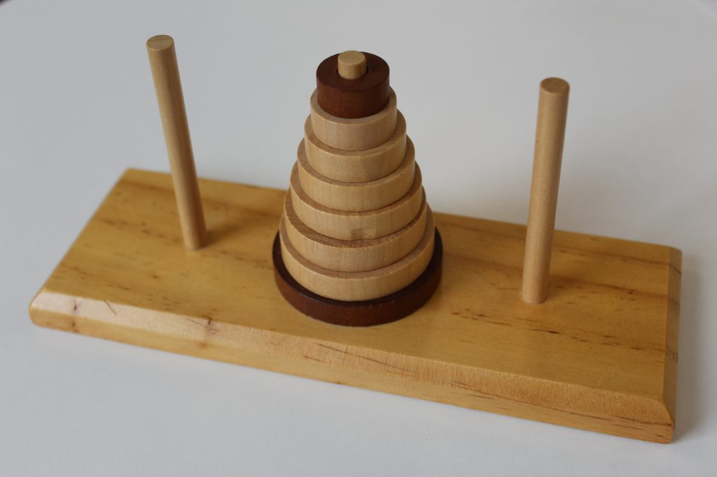

Slide 5
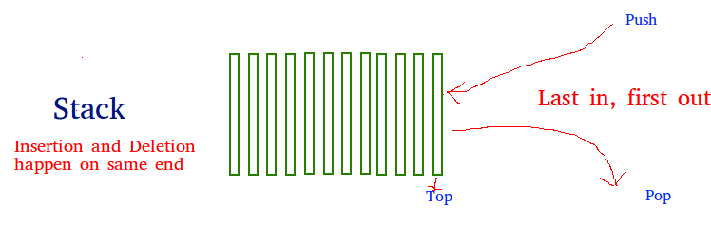
Some Basic Terminology:-
Push: Adds an item in the stack. If the stack is full, then it is said to be an Overflow condition.
Pop: Removes an item from the stack. The items are popped in the reversed order in which they are pushed. If the stack is empty, then it is said to be an Underflow condition.
Top: Returns top element of stack.

Slide 6
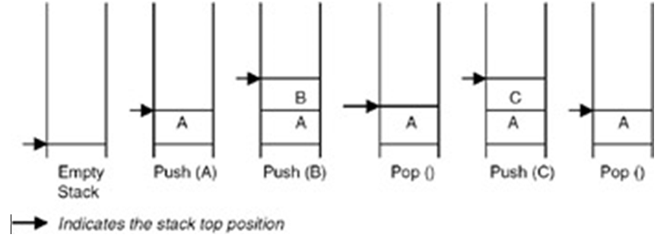
Some Basic Terminology-

Slide 7
Parenthesis Matching
Given an expression string exp , we need to examine whether the pairs and the orders of “{“,”}”,”(“,”)”,”[“,”]” are correct in expression .
For example:-
{ [ ( ) ] } – Balanced
{ [ ( } –Unbalanced
{ [ ( ) } ] –Unbalanced

Slide 8
Algorithm:
Declare a character Stack.
Now traverse the string expression
If the current character is a starting bracket (‘(‘ or ‘{‘ or ‘[‘) then push it to stack.
If the current character is a closing bracket (‘)’ or ‘}’ or ‘]’) then pop from stack and if the popped character is the matching starting bracket then fine else parenthesis are not balanced.
After complete traversal, if there is some starting bracket left in stack then “not balanced”

Slide 9
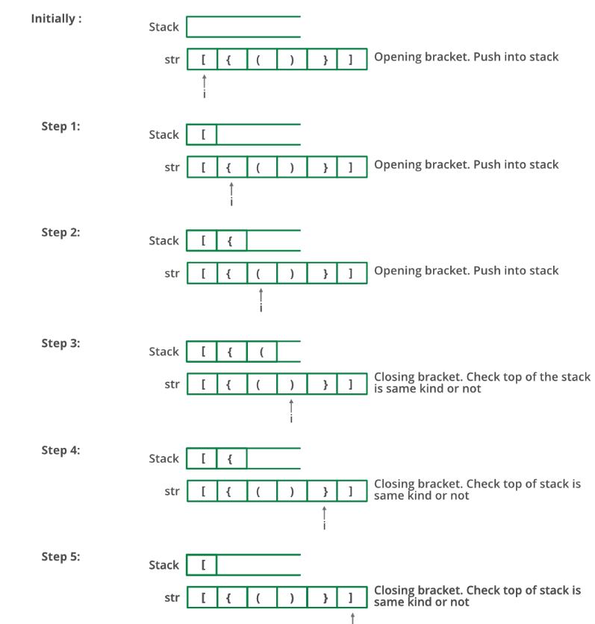

Slide 10
Tower of Hanoi
Tower of Hanoi is a mathematical puzzle where we have three rods and n disks. The objective of the puzzle is to move the entire stack to another rod, obeying the following simple rules:
1) Only one disk can be moved at a time.
2) Each move consists of taking the upper disk from one of the stacks and placing it on top of another stack i.e. a disk can only be moved if it is the uppermost disk on a stack.
3) No disk may be placed on top of a smaller disk.

Slide 11
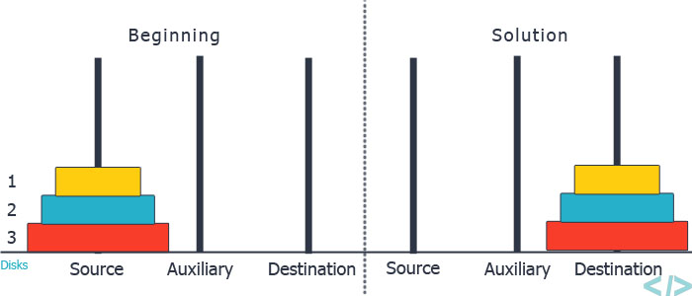
Tower of Hanoi

Slide 12
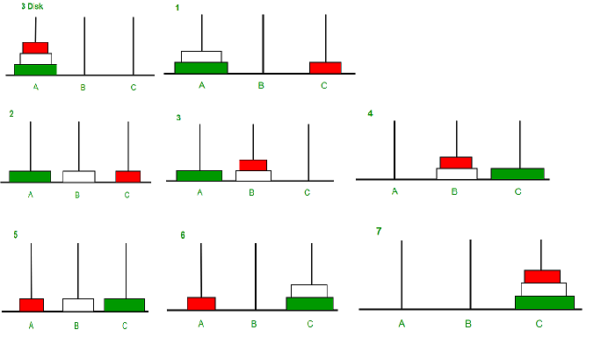

Slide 13
Queue
Introduction of Queue
Circular Queue

Slide 14

Collection of data items with the restriction that data can be inserted from one end known as rear end and data can be deleted from the other end known as front end .
Queue follows FIFO(First in First Out) or LILO(Last in Last out )
Size of the queue is limited / fixed .
Queue of consumers for a resource where the consumer that came first is served first.

Slide 15
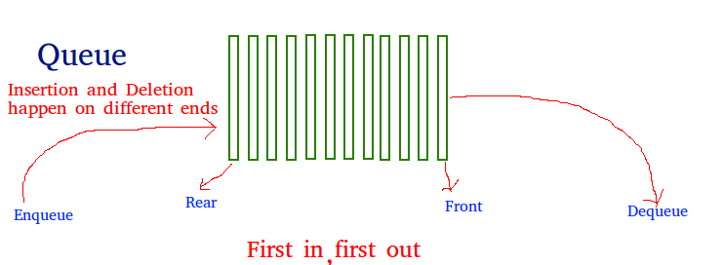
Some Basic Terminology-
Enqueue: Adds an item to the queue. If the queue is full, then it is said to be an Overflow condition.
Dequeue: Removes an item from the queue. The items are popped in the same order in which they are pushed. If the queue is empty, then it is said to be an Underflow condition.
Front: Get the front item from queue.
Rear: Get the last item from queue

Slide 16
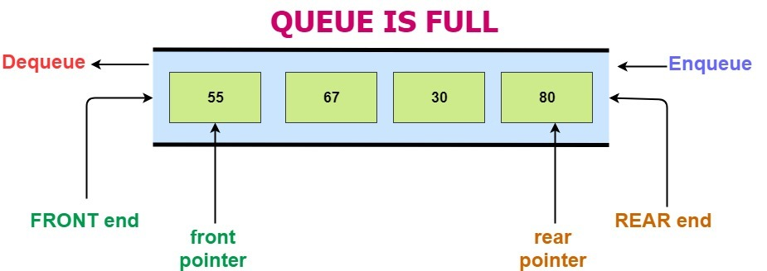
Some Basic Terminology-

Slide 17
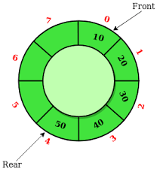
Circular Queue
Circular Queue is a special type of queue in which the last position is connected back to the first position to make a circle. It is also called Ring Buffer.
Queue follows FIFO(First in First Out) or LILO(Last in Last out )

Slide 18
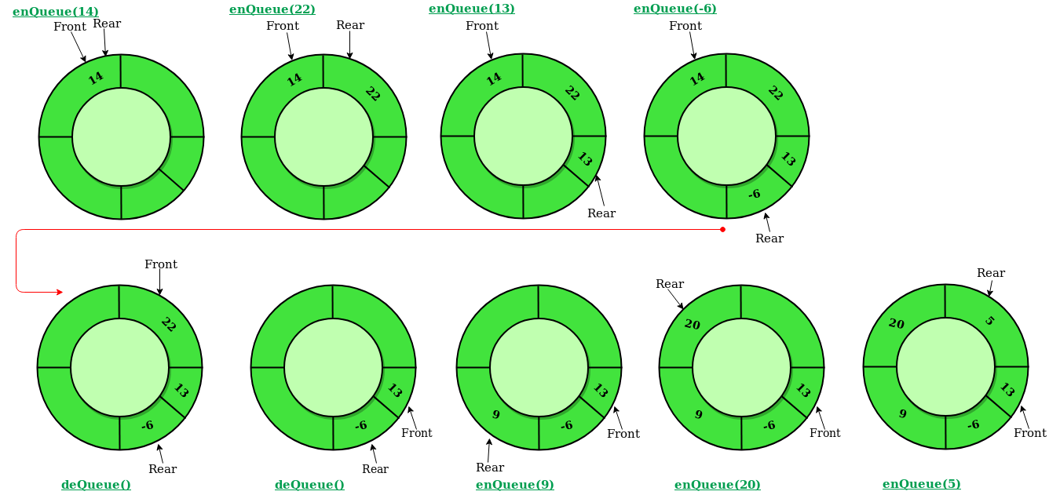
Some Basic Terminology-

