Slide 1
Semi-supervised Image segmentation

Slide 2
SAM-dsk summary
- Fine tune pretrained model on small annotated data
Using fine tuned model , generate pseudo labels for unlabelled data
Combine pseudo label + original (small data) to re-train model
Identify cases where model fails (dsk component)– correct them –> rinse and repeat
No github reference for dsk paper

Slide 3
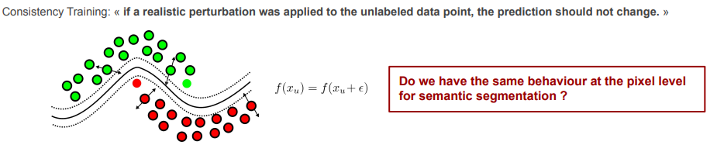
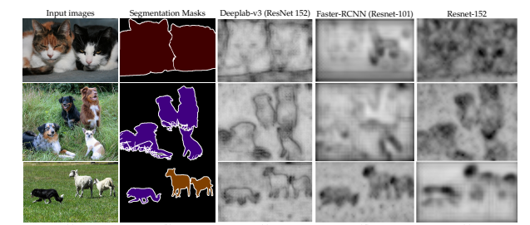
Dominant method in SSL for segmentation : Cross-consistency training
Cluster assumption

Slide 4
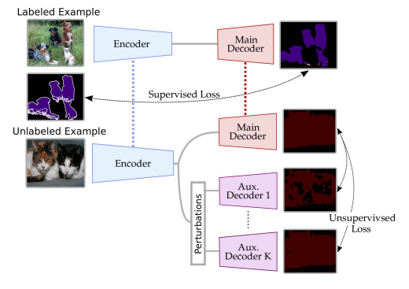
Cross-consistency training

Slide 5
Cross-consistency training with SAM
shared encoder to process both labeled and unlabeled images.
Decoders Setup: Incorporate a main decoder, directly following the shared encoder, for supervised learning on labeled data.
For Unlabelled data : multiple auxiliary decoders to handle
the encoder’s output after applying distinct perturbations.
Total loss = supervised + w * unsupervised loss

