Slide 1
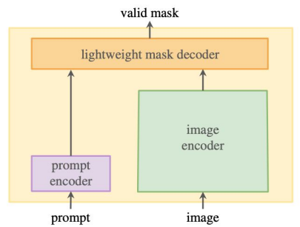
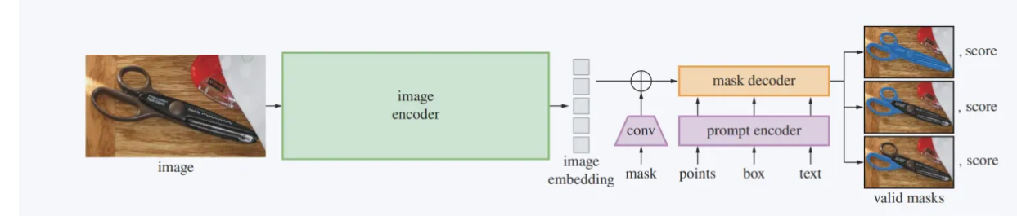
SAM model architecture
“a powerful image encoder computes an image embedding
+ a prompt encoder embeds prompts,
and then the sources are combined in a lightweight mask decoder that predicts segmentation masks.”
ViT
Special feature : prompt-able segmentation – input the points or box and get a mask

Slide 2
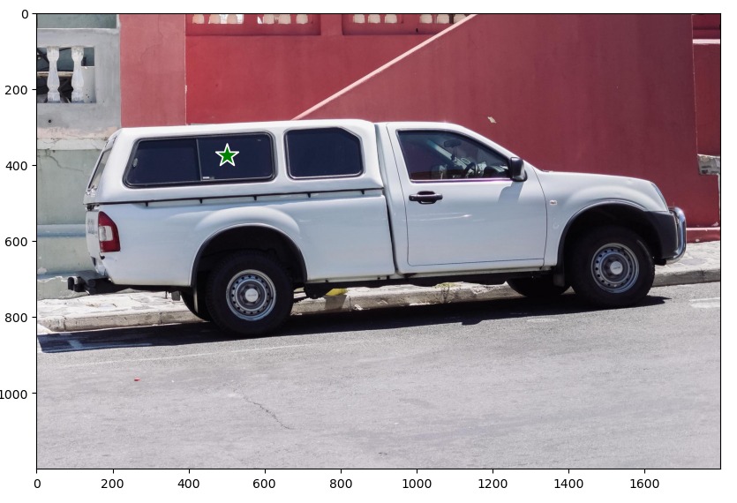
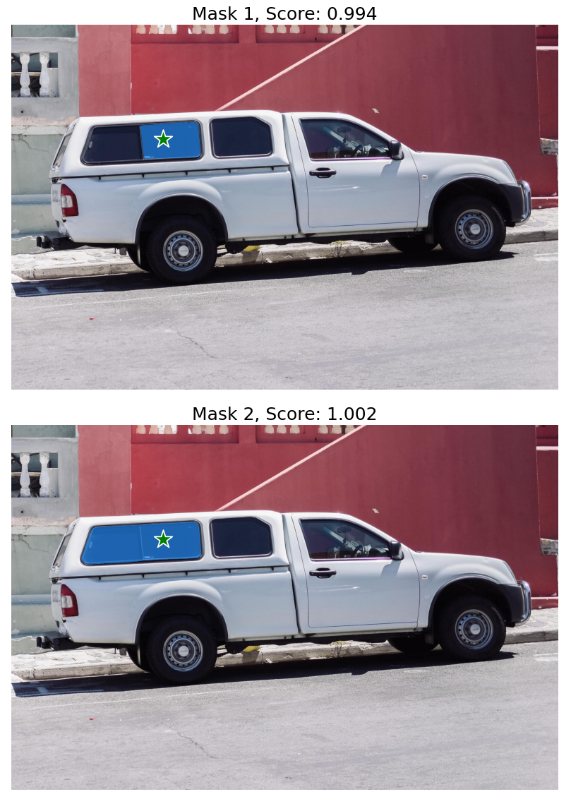
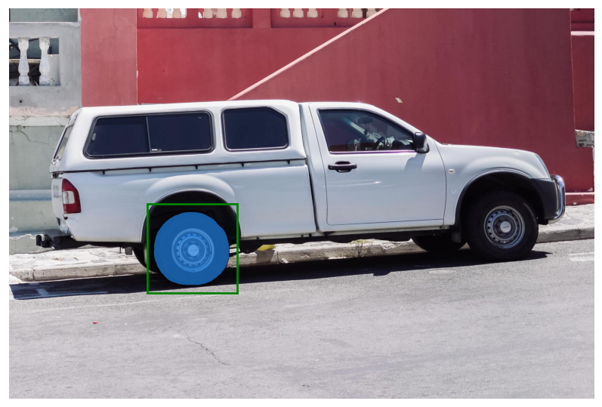
Special feature : prompt-able segmentation – input the points or box and get a mask

