Slide 1
How Does a Bike-Share Navigate Speedy Success?
Prepared By:
Aditya Chaudhary
September 2023

Slide 2
Key Business Statement
Analyze usage patterns of casual riders and annual members at Cyclistic bike-share company.
Procedure
Take a close look at the data from last 12 months and use the six steps of data analysis process to analyze it carefully. Find any recurring patterns, differences and similarities.

Slide 3
Major Analytical Goals
Find how casual and annual riders use cyclistic bikes differently.
Give recommendations on how bike-share company can convert casual riders to member riders and give some recommendations.

Slide 4
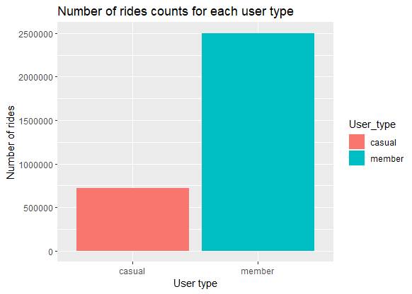
Casual vs Members Rides
There are about 3.4 times more member riders than casual riders, showing that the bike-sharing service is preferred by regular users who probably like the membership benefits.

Slide 5
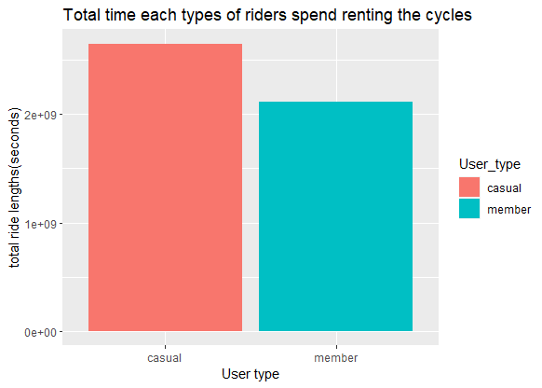
Casual riders rent bikes for longer periods than members, suggesting they use them for fun, picnics or longer trips, while members use it for shorter rides.

Slide 6
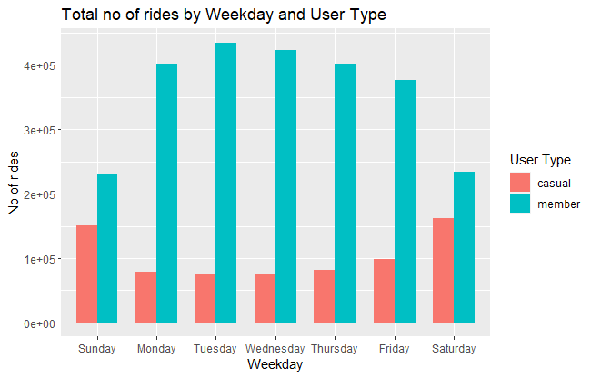
Preferred Rental days on weekdays.
Casual riders like renting bikes mostly on weekends (Saturday and Sunday) for fun, while members use them more on Tuesday and Wednesday, likely for regular commuting.

Slide 7
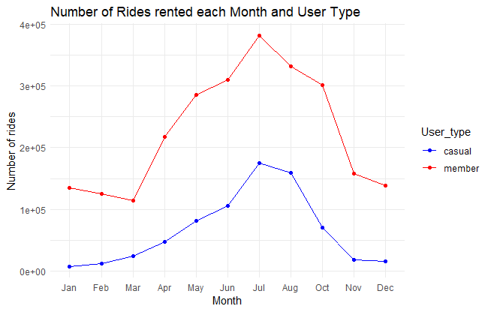
Seasonal Trends
The highest number of rides rented for both casual and member riders is in summer in the month of July. Possibly because of more favorable weather and more outdoor activities.

Slide 8
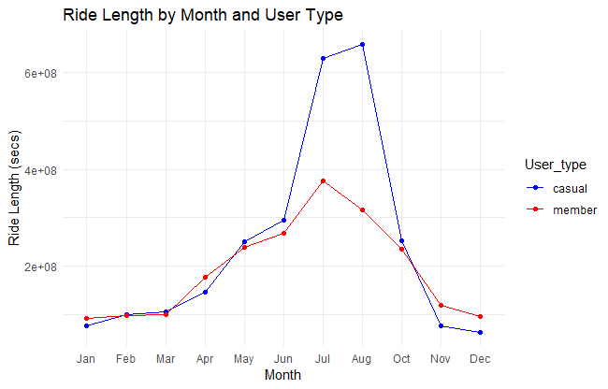
Similarly, both riders spending the most time renting the bikes is also during summer ie. the month of July and August.

Slide 9
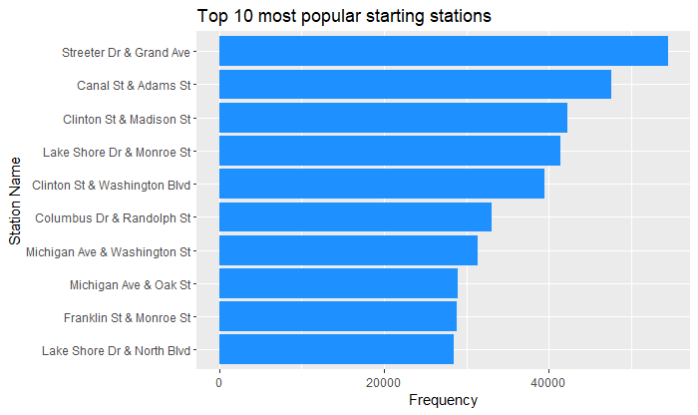
Most popular stations

Slide 10
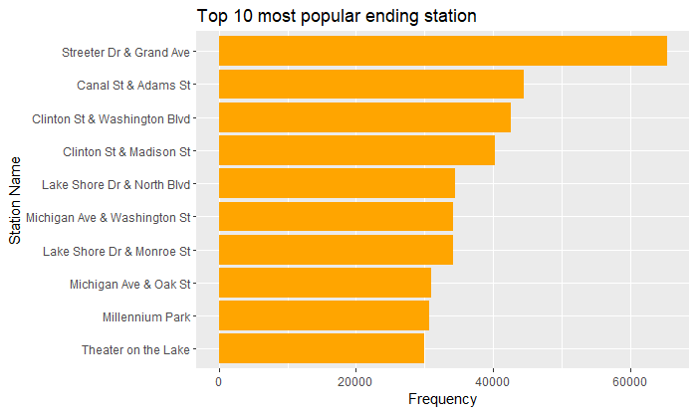

Slide 11
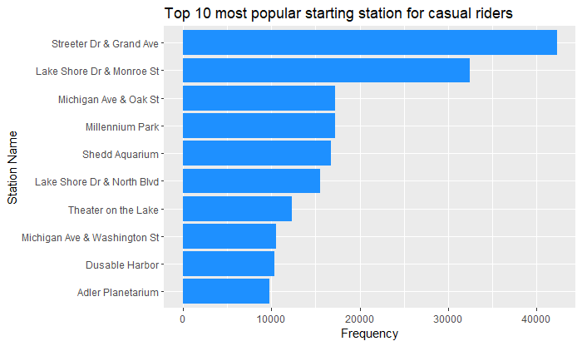

Slide 12
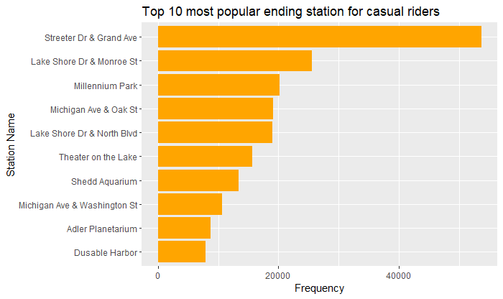

Slide 13
Riders prefer starting and ending at Street Dr & Grand Ave station, possibly because it’s centrally located or close to recreational areas.

Slide 14
Recommendations
Introduce a weekend trial membership with discounts for casual riders to experience member benefits and potentially transition to annual membership.
Create ride packages offering cost savings, like a bundle of 10 rides, encouraging casual riders to explore membership advantages.
Offer a summer membership featuring bike variety and ride discounts for July and August, highlighting the value and convenience for active summer users.
Emphasize membership perks, including exclusive access to popular stations like Street Dr & Grand Ave, to attract more riders to join.

Slide 15
THANK YOU

