Slide 1
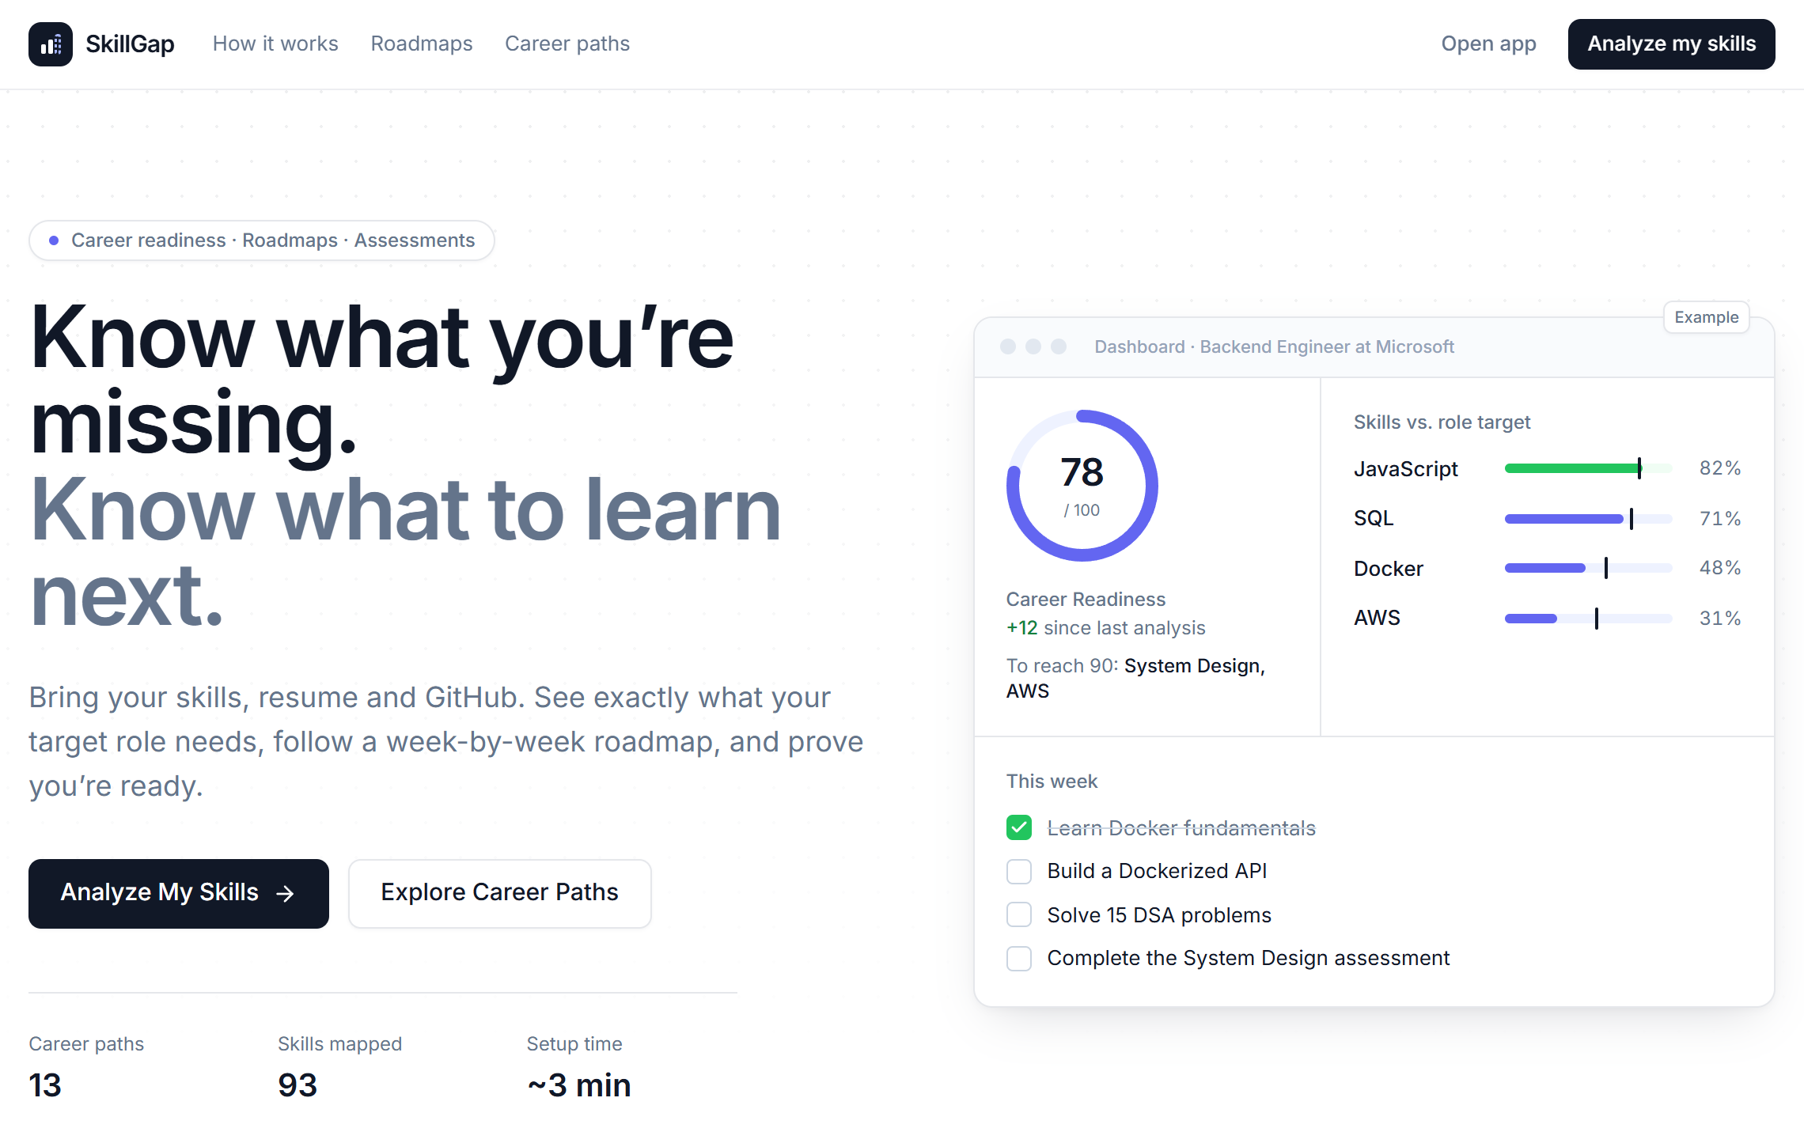
WEB APPLICATION · LIVE ON VERCEL
SkillGap Analyzer
Know what you’re missing.
Know what to learn next.
A web app that compares your skills with what a target job role expects, ranks the gaps, and turns them into a week-by-week learning roadmap.
13
93
26
career paths
skills mapped
skill assessments
Homepage of the live site, captured 15 Oct 2026
skillgapanalyzer-alpha.vercel.app
[Team name] · [Member names] · [Institution]: add before presenting
Notes:
Hello everyone. Our project is SkillGap Analyzer, a web application that is live at skillgapanalyzer-alpha.vercel.app. The idea is simple: a student tells the app which job role they want and which skills they already have, and the app shows what is missing and what to learn next, in order, week by week. It currently covers 13 career paths and 93 skills, with 26 short assessments. Every screenshot in this presentation was taken from the deployed site. I will cover the problem, how the app works, the logic behind it, and what we would improve next.

Slide 2
The problem: knowing what to learn next
Most students know the job title they want, but not the path to it.
THE QUESTION STUDENTS FACE
WHERE SKILLGAP ANALYZER ANSWERS IT
1
What does the role actually need?
Job posts list many tools at once and rarely say what level is expected.
13 career paths, each listing its required skills and a target level from 0 to 100
2
Where do I stand against it?
A resume lists skills, but not which ones are below the expected level, or by how much.
Skill Gap page: your level next to the target for every requirement, ranked by priority
3
What should I learn first?
Some skills depend on others and study time is limited, so learning becomes random.
Roadmap: prerequisites first, sized to the hours you have each week
Notes:
The problem we started from is common for students preparing for placements. First, most of us know the job title we want but not what that role really expects. Job posts list many tools at once and rarely say how deep the knowledge must be. Second, even with the requirements in hand, it is hard to measure yourself against them. A resume lists skills but does not show which ones fall short. Third, skills depend on each other and time is limited, so without an order, learning becomes random. The blue panel on the right shows which part of our app answers each question.

Slide 3
Our solution
One guided flow takes a student from a target role to a weekly study plan.
1
2
3
4
5
Choose a role
Add your skills
Analyse the gap
Get a roadmap
Prove progress
13 roles or a custom one, plus an optional target company
Pick and self-rate them, or import from a resume or GitHub
Readiness score out of 100, gaps ranked by priority
Week-by-week phases in prerequisite order
Assessments update skill levels and re-plan the roadmap
Without a plan | With SkillGap Analyzer
Guess which skills a role needs | ✓ Each role lists its required skills and target levels
Learn topics in any order | ✓ Prerequisites always come before the skills that need them
No way to tell if you are improving | ✓ Readiness score changes after assessments and finished work
Plans ignore the time you have | ✓ Plan is sized to your daily hours and warns if it will not fit the deadline
Notes:
Our solution is one guided flow. The student chooses a role and adds and rates their skills. The app compares them with that role’s targets and produces a readiness score out of 100 and a list of gaps ranked by priority. From those gaps it builds a roadmap of weekly phases where prerequisites always come first. Short assessments then let the student prove progress, which updates their skill levels and re-plans the roadmap. The table compares this with an unstructured approach. The main difference is that every step is based on the role’s requirements and on the time the student actually has.

Slide 4



Who it is for
Who uses it
Three use cases
College students
Preparing for campus placements
Situation | What they do on the site | What they get
Preparing for a role before placements | Pick Backend Developer, add 4 skills, choose 1 hour a day for 3 months | Readiness 32/100, 6 critical gaps and a 9-phase roadmap*
Applying to one specific job | Jobs → Job match: paste the job post and click Analyze job | A match % and a gap list for that job; “Target this job” plans for it
Choosing between roles or companies | Jobs → Career simulator | Match and preparation time for each role–company combination
Fresh graduates
Aiming for a first job role
Career switchers
Moving to a new track, e.g. Data Analyst to Data Engineer
Onboarding asks for your current level (Beginner, Intermediate or Advanced), so the pacing changes for each group.
* From our own test run on the live site, October 2026.
Notes:
Our main users are college students preparing for placements, fresh graduates aiming for a first role, and learners moving into a new track. Because the app asks for the user’s current level, the pacing adapts to each group. Here are three realistic use cases. The first is the run we did on the live site: a beginner targeting Backend Developer, with four skills, one hour a day and three months. They get a readiness of 32 out of 100 and a nine-phase roadmap. The second is checking one specific job post. The third is comparing roles or companies with the Career Simulator before choosing a direction.

Slide 5
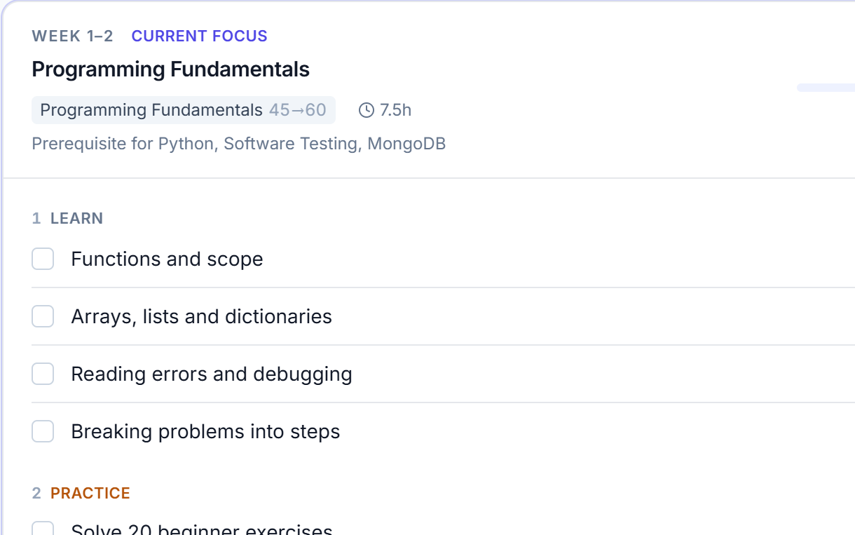
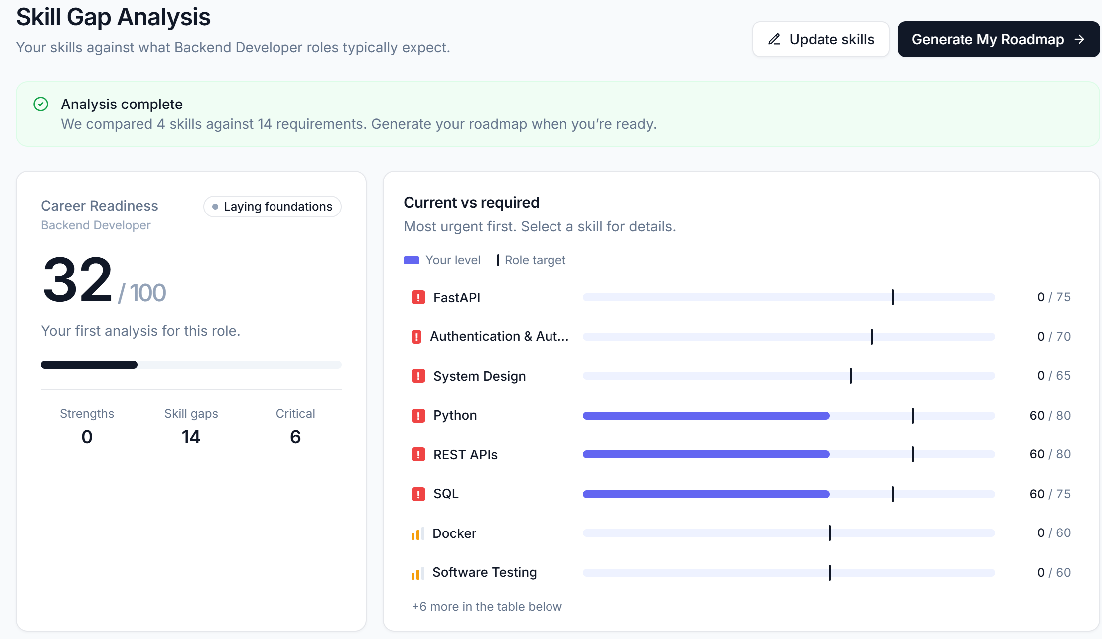
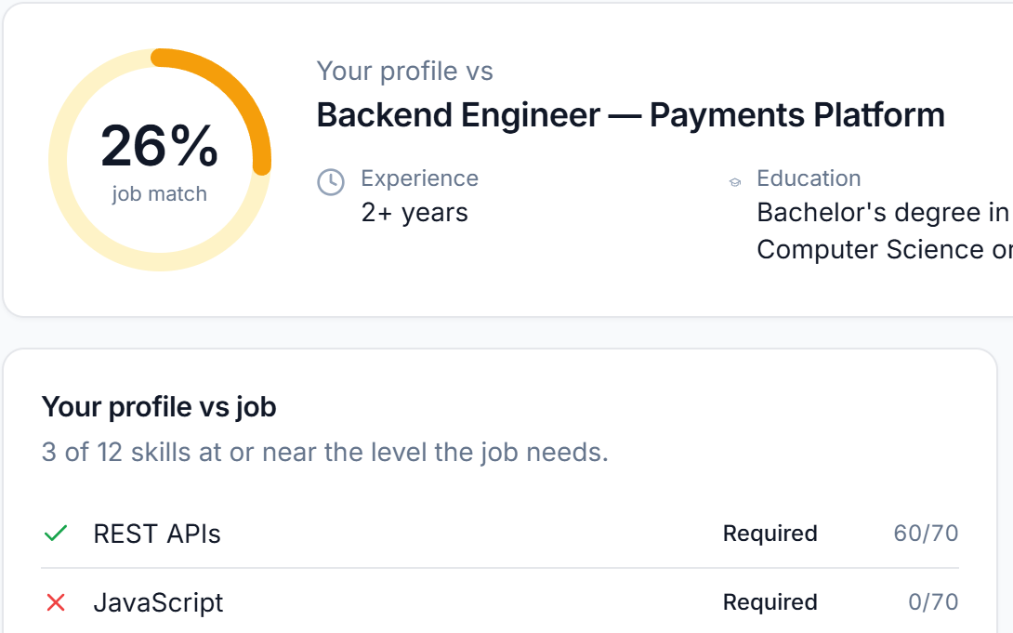
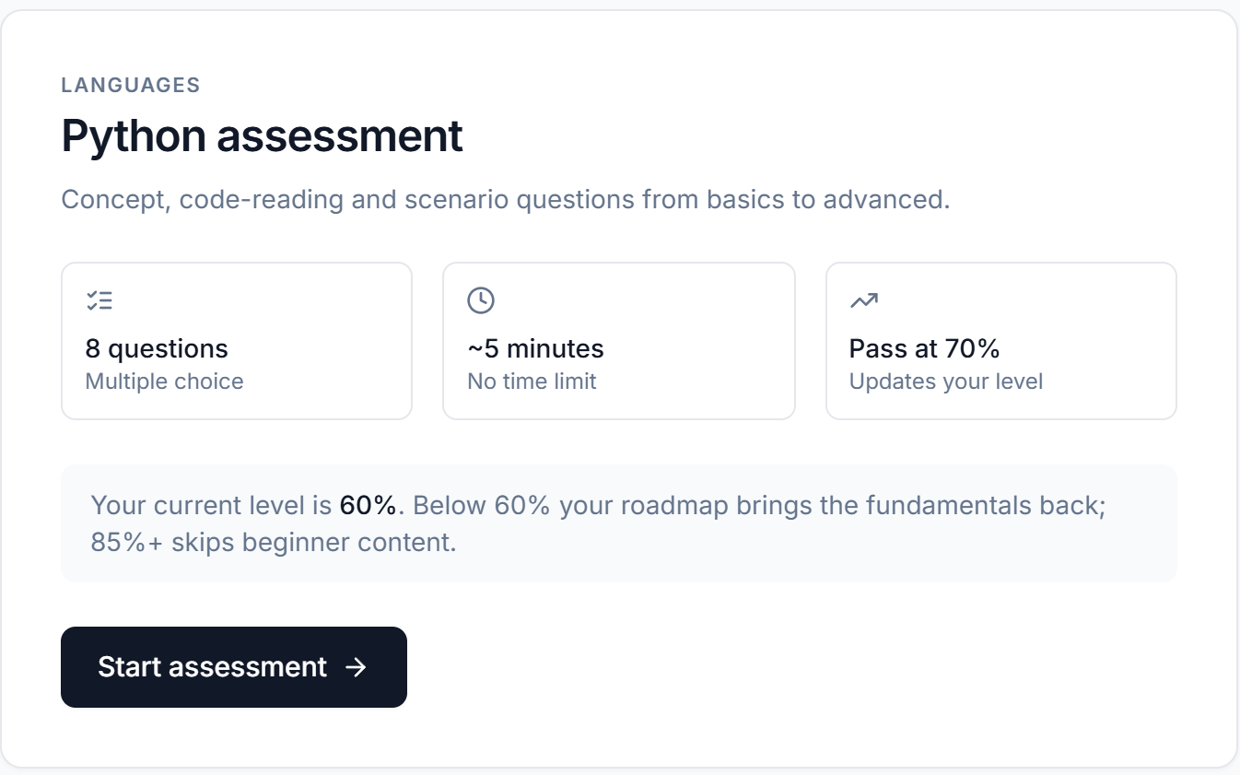
Key features on the live website
Skill gap analysis the core screen, shown after onboarding
Dependency-aware roadmap
Weekly phases; each skill runs Learn → Practice → Build → Assess.
Skill Gap → Generate My Roadmap
3
2
Job description match
Paste a real job post to get a match % and a gap list for that job.
Jobs → Job match
1
Skill assessments
26 auto-graded tests of 8 questions; the score updates your level.
Assessments page
1
Readiness out of 100, with a band such as “Laying foundations”
2
Your level (bar) against the role target (tick) for each skill
3
One click turns the ranked gaps into a roadmap
Also live: resume analyzer, GitHub analyzer, interview prep and a career simulator.
Notes:
This is the core screen of the app, shown right after onboarding. Number one is the readiness score out of 100. Number two compares the student’s level with the role’s target for each skill, with critical gaps marked in red. Number three is the button that turns these gaps into a roadmap. On the right are three more live features: the dependency-aware roadmap, where each skill goes through learn, practice, build and assess; job description match, where you paste a real job post; and 26 auto-graded assessments that update your skill level. The resume analyzer, GitHub analyzer and interview prep are also live.

Slide 6
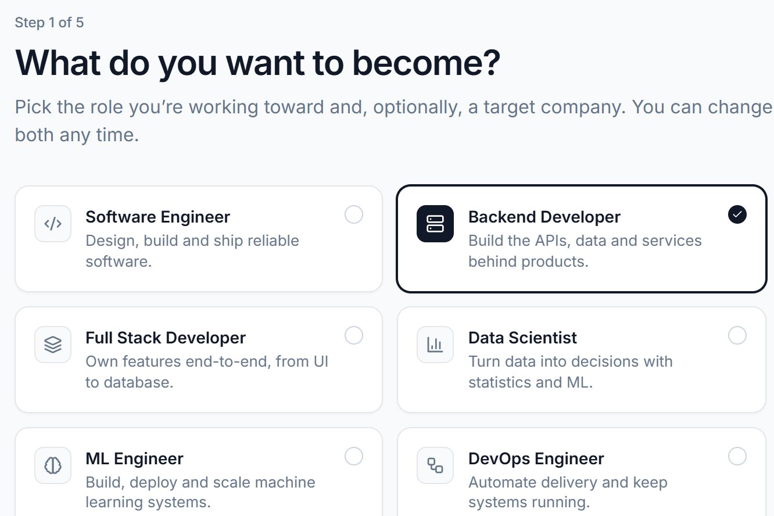
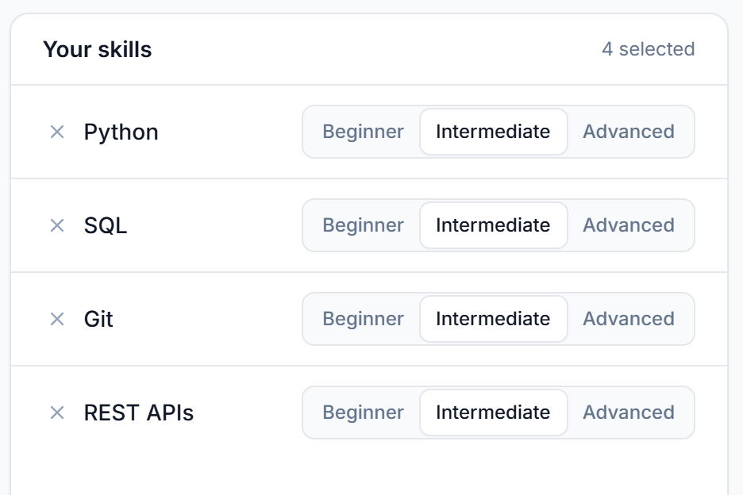
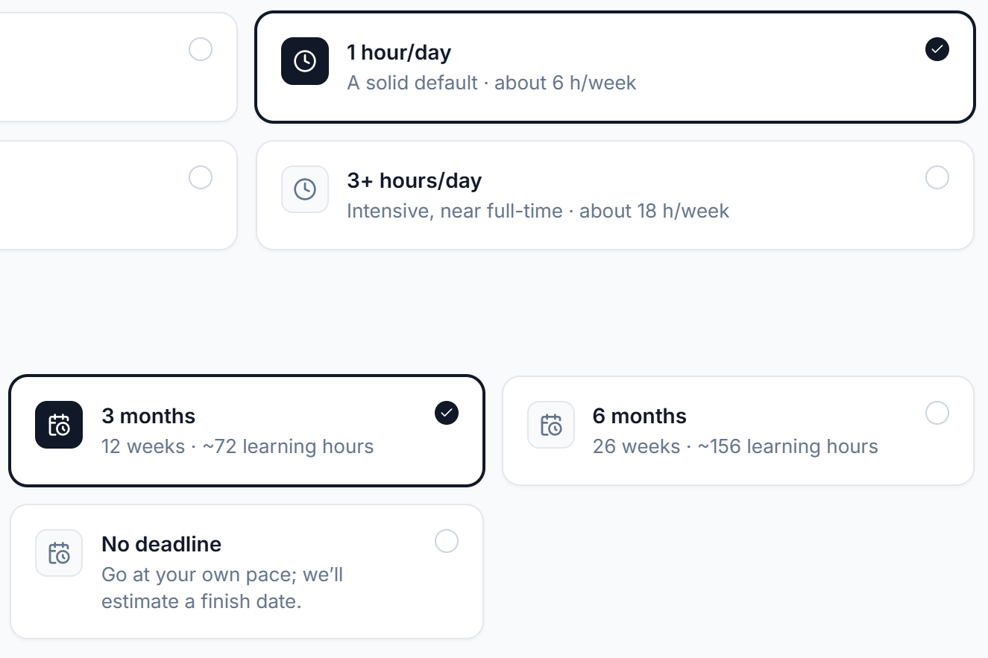
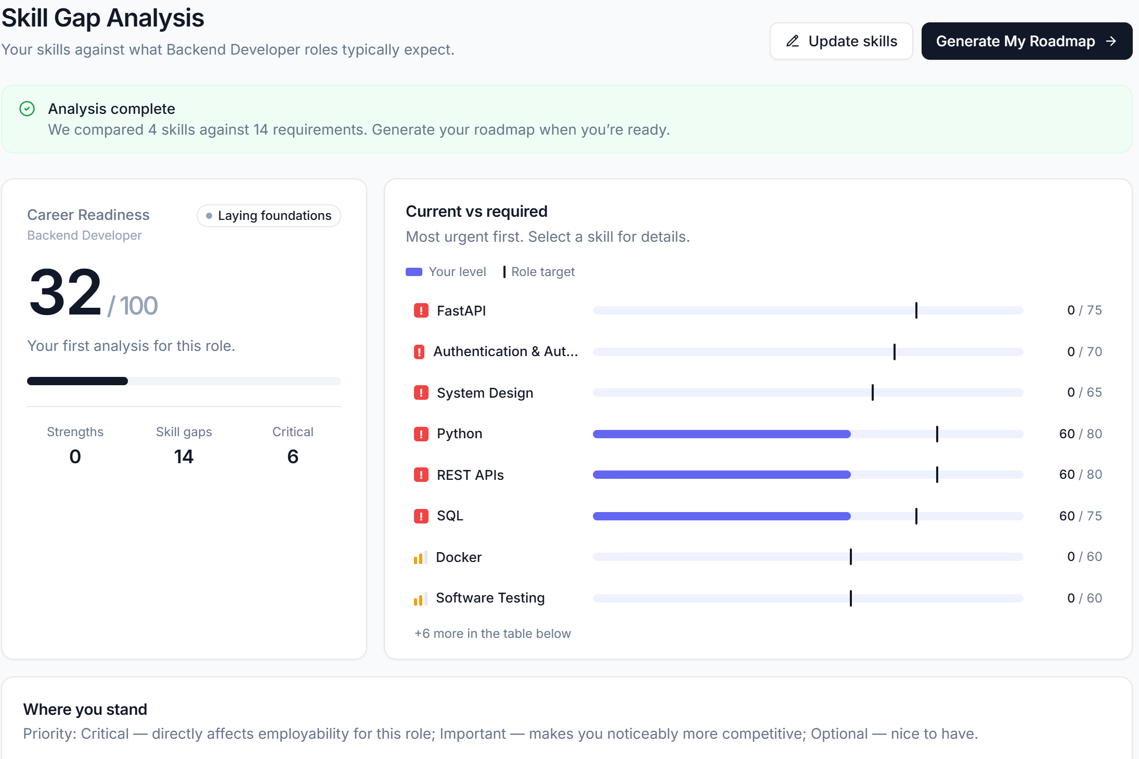
How the website works
The real flow on the live site. There is no sign-up: your data is saved in your browser.
1
2
3
4
Pick a target role
Onboarding step 1: one of 13 roles or a custom role; company optional.
Add and rate skills
Step 3: rate each skill Beginner, Intermediate or Advanced, or import a resume.
Set your study time
Step 5: hours per day and a timeline, then Analyze My Skill Gap.
Review the gaps
Readiness score and ranked gaps. Next: Generate My Roadmap.
Follow the plan. The Roadmap page holds every phase; the Dashboard shows this week’s tasks, sized to your weekly hours.
Not shown: step 2 asks your current level; step 4 reads an optional public GitHub profile.
5
Notes:
This is the exact journey on the website. You open the site and click Analyze My Skills. There is no sign-up. In step one you pick a target role, optionally with a target company. Step two asks your current level. Step three is where you add your skills and rate each one, or import them from a resume. Step four is an optional GitHub profile. Step five asks how much time you have per day and your timeline. Then you click Analyze My Skill Gap and see your results. From there, Generate My Roadmap builds the plan, and the dashboard shows this week’s tasks.

Slide 7
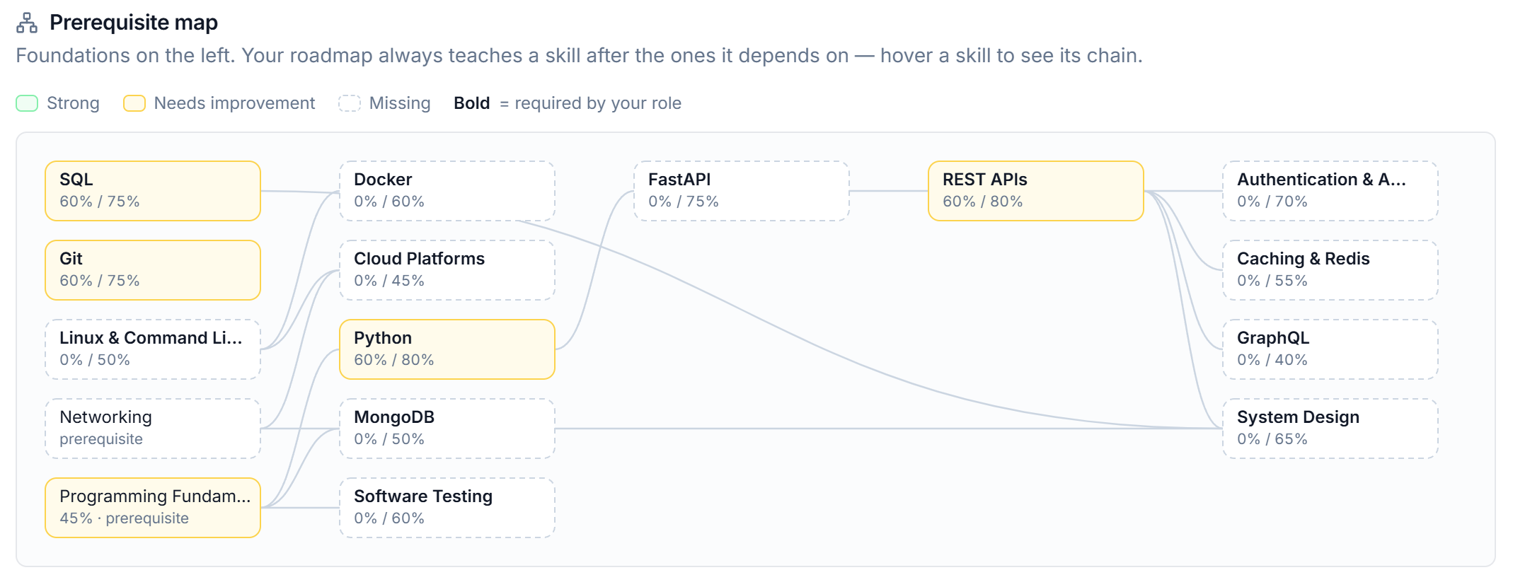
How the gap and the roadmap are calculated
1 Measuring the gap
2 Building the roadmap
Self-rating → level 0–100: Beginner 30 · Intermediate 60 · Advanced 85
Each role sets a target and a weight: Critical 4 · High 3 · Medium 2 · Low 1
Priority (Critical, Important, Optional) comes from weight and gap size
Ranked gaps
Add missing prerequisites
Order by dependency
Size hours to the gap
Fit to weekly time
Each skill then runs Learn → Practice → Build → Assess
Your level vs the role target, from our test run (Backend Developer)
9
125.5 h
~21
32 / 100
Readiness = the weighted share of the role’s targets you already cover.
Σ weight × min(1, level ÷ target) ÷ Σ weight × 100
roadmap phases
total effort
weeks at 6 h/week
readiness in the test run
Longer than the 12-week target, so the app warned about it and deferred 6 lower-priority skills.
Notes:
This slide shows the logic behind the results. A self-rating becomes a number: beginner is 30, intermediate 60 and advanced 85. Each role lists its skills with a target level and an importance weight. The chart shows our test run: teal is the level we entered, amber is the gap to the target. Readiness is the weighted share of targets covered, which came to 32 out of 100. For the roadmap, the planner adds missing prerequisites, orders skills so nothing comes before what it depends on, sizes the hours to the gap, and fits the plan to your weekly time. Here that gave nine phases and about 21 weeks, so the app warned that it would not fit three months.

Slide 8
Technology stack and architecture
User’s browser
Vercel
Hosts the built static files
Node.js API + Google Gemini
Optional rewording of roadmap phases. Not deployed: /api returns 404 on Vercel
React 18 UI
React Router · Tailwind CSS · built with Vite
Logic (src/lib)
Gap analysis, roadmap planner, resume and job-post parsing, GitHub scoring
Data (src/data)
93 skills with prerequisites, 13 roles, company profiles, question banks
GitHub REST API
Public repositories, read by the GitHub analyzer
Firebase Auth + Firestore
Optional accounts and sync. Not configured on the live site
localStorage
Profile, analysis, roadmap and progress; no login needed
Interface
Logic and data
Browser storage
External service (live)
In the code, not enabled live
Design choice: the analysis and the planner are plain functions with no randomness, so they run in the browser without a server and always give the same result for the same input.
Notes:
On the technical side, the colours show the kind of component. The navy box is the interface: React 18 with React Router, built with Vite and styled with Tailwind CSS. The teal boxes are the logic and data, and the key design decision is that the analysis and planner are plain JavaScript functions with no randomness, so they run entirely in the browser. The amber box is storage: on the live site, data is saved in the browser’s local storage. The app is hosted on Vercel, and the GitHub analyzer calls GitHub’s public API. The dashed boxes are in the code but not enabled live: Firebase accounts and an optional Gemini step that rewrites roadmap wording.

Slide 9



Impact, limitations and future scope
Expected impact
Current limitations
Future scope
Intended benefits, not yet measured
Found in the code and on the live site
Proposed, not built or not deployed yet
A vague goal becomes a ranked list of specific gaps
A clear order to learn in, sized to the time available
A quick fit check against a real job post before applying
Assessments turn self-ratings into evidence
Levels start as self-ratings until an assessment is taken
Role targets and company profiles are set by our team, not taken from live job data
Data stays in one browser; no accounts on the live site
Opening an inner page URL directly (e.g. /dashboard) shows a 404
Resume reader needs text-based PDFs; GitHub checks are rate-limited
Turn on accounts and sync (Firebase support is already in the code)
Deploy the API so the optional Gemini step works live
Add a Vercel rewrite rule so every page URL loads
Check role targets with placement-cell or recruiter input, then add more roles
Notes:
We expect the app to help students turn a vague goal into a specific list of gaps and a realistic order to learn in. These are intended benefits; we have not measured them with users yet. We also found real limitations. Skill levels start as self-ratings, the role targets are configured by us, data stays in one browser, and opening an inner page URL directly shows a 404 because the deployment is missing a rewrite rule. Our next steps follow from these: enable accounts, deploy the API, fix the routing, and check role targets with placement-cell or recruiter input.

Slide 10
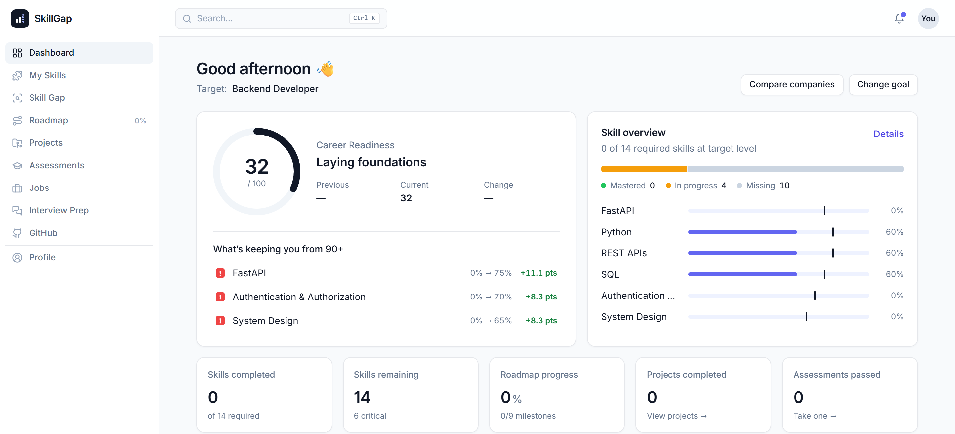
CONCLUSION
From a target role to a weekly plan, with every step explained.
The problem
Students know the role they want, not what they are missing or what to learn first.
What we built
A working web app covering 13 roles and 93 skills, live today.
Key takeaway
Recommendations come from role targets and a rule-based planner, not a black box.
Dashboard on the live site after our test run
In the demo
1
Pick a role and add a few skills
LIVE DEMO
2
See the readiness score and ranked gaps
skillgapanalyzer-alpha.vercel.app
3
Generate the week-by-week roadmap
Thank you. Questions?
[Team name] · [Member names] · [Institution]
10
Notes:
To conclude: students usually know the role they want but not what they are missing. SkillGap Analyzer measures their skills against that role, ranks the gaps, and builds a week-by-week plan that respects prerequisites and available time. The key takeaway is that every recommendation can be explained. It comes from the role’s targets and a rule-based planner, not a black box. I would now like to show it live: pick a role, add a few skills, see the gaps, and generate the roadmap. It takes about two minutes. Thank you, and we are happy to take questions.

