Slide 1

Major Project Presentation
Design and Implementation of an Automated
Retail Data Engineering Pipeline for
Analytical Processing & Business Intelligence Reporting
Submitted By:
Name: Aditya Bhardwaj
Roll No: 2424150039
MCA – Dept. of Computer Applications
Internal Guide: Dr. Pramod Kumar Soni (Assoc. Prof.)
External Guide: Industry Mentor / N/A
Manipal University Jaipur

Slide 2
Retail Data Engineering Pipeline for Analytical Processing & BI Reporting
Contents
1. Introduction / Background
2. Problem Statement
3. Specific Objectives
4. Literature Review
5. Proposed Workflow
6. Progress / Work Done
7. Results & Findings
8. Project Timeline
9. References
10. Thank You

Slide 3
Retail Data Engineering Pipeline for Analytical Processing & BI Reporting
Introduction / Background
Modern retail businesses generate massive volumes of transactional data daily — spanning sales, customers, products, and geography.
Raw data remains siloed, unprocessed, and unavailable for real-time decision-making without a structured data pipeline.
Business Intelligence (BI) tools require clean, transformed, and well-modelled data to produce actionable insights.
Traditional manual ETL processes are error-prone, slow, and difficult to scale across large datasets.
This project proposes an automated, end-to-end Retail Data Engineering Pipeline that ingests, transforms, models, and visualizes retail sales data — enabling smart BI reporting.

Slide 4
Retail Data Engineering Pipeline for Analytical Processing & BI Reporting
Problem Statement
Retail organizations lack a unified pipeline to process raw transactional data into analysis-ready formats.
No automated mechanism for data cleaning, deduplication, and quality validation across large CSV/Excel datasets.
Absence of a dimensional data warehouse model (star/snowflake schema) suited for BI query performance.
Existing dashboards are static — they cannot dynamically filter by city, date, product category, or customer segment.
No centralized, scalable platform integrating ingestion → transformation → modelling → visualization in one workflow.

Slide 5
Retail Data Engineering Pipeline for Analytical Processing & BI Reporting
Specific Objectives
To design and implement an automated ETL pipeline for ingesting and transforming raw retail sales data (99K+ records).
To perform systematic data cleaning: handling nulls, type casting, duplicate removal, and outlier detection.
To model a star-schema data warehouse with dimension tables (Customer, Product, Location, Date) and a central fact table.
To build an interactive Power BI dashboard with KPI cards, trend analysis, revenue/orders by city, and dynamic filters.
To enable real-time slicing of sales data by Order Date range and City Filter across all visual elements.
To document and deploy the pipeline with configuration management and reproducible execution via Python scripts.

Slide 6
Retail Data Engineering Pipeline for Analytical Processing & BI Reporting
Literature Review (In Progress)
Author / Source | Year | Contribution / Finding | Gap / Limitation
Kimball & Ross | 2013 | Defined star schema & dimensional modelling for data warehouses | No real-time pipeline automation covered
Kleppmann | 2017 | Described stream & batch data processing patterns for distributed systems | Retail-specific BI use cases not addressed
Provost & Fawcett | 2013 | Data-science pipeline design for actionable business insights | Limited to ML; ETL engineering not in scope
Microsoft Power BI Docs | 2024 | DAX measures, data modelling best practices for interactive reporting | Assumes clean data; no ingestion guidance
dbt Labs | 2023 | Transform-in-warehouse approach using SQL-based modelling | Requires cloud DWH; local pipeline not covered

Slide 7
Retail Data Engineering Pipeline for Analytical Processing & BI Reporting
Proposed Workflow
1. Raw Data
Ingestion
2. Data
Cleaning
3. Data
Modelling
4. Load to
Warehouse
5. BI
Dashboard
▶
▶
▶
▶
CSV / Excel
(99K+ records)
Nulls, types,
duplicates
Star Schema
Dim + Fact
PostgreSQL /
Local DB
Power BI
Reporting
Tools Used:
Python (Pandas, SQLAlchemy) | PostgreSQL + PostGIS | Power BI Desktop | Git / GitHub | Jupyter Notebooks

Slide 8
Retail Data Engineering Pipeline for Analytical Processing & BI Reporting
Progress / Work Done So Far
✅ Dataset sourced: 99K+ retail transaction records
✅ Data cleaning completed: nulls removed, types fixed, duplicates eliminated
✅ Star schema designed: Dim_Customer, Dim_Product, Dim_Location, Dim_Date, Fact_Sales
✅ ETL pipeline scripts written in Python (Pandas + SQLAlchemy)
✅ Database loaded into PostgreSQL with proper indexing
✅ Power BI dashboard connected and published (see Results)
✅ Project folder structure organized: src/, data/, config/, schema/, notebooks/
🔄 Research paper / documentation — in progress

Slide 9
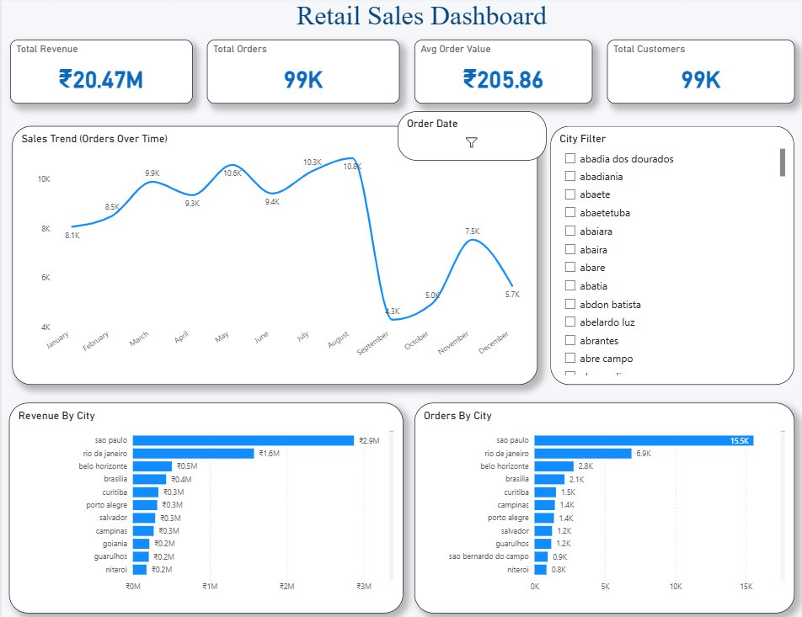
Retail Data Engineering Pipeline for Analytical Processing & BI Reporting
Results / Findings
Total Orders
Avg Order Value
Total Customers
99K
₹205.86
99K

Slide 10
Retail Data Engineering Pipeline for Analytical Processing & BI Reporting
Project Timeline
Week 1 | Requirements analysis, dataset sourcing, project folder structure
Week 2 | Data cleaning & preprocessing (nulls, types, duplicates, outliers)
Week 3 | Star schema design — dimension & fact table modelling
Week 4 | ETL pipeline coding (Python: Pandas, SQLAlchemy) + DB load
Week 5 | Power BI dashboard development — KPIs, trends, city charts, filters
Week 6 | Testing, validation, performance optimization, documentation
Week 7 | Research paper writing, final QA, GitHub cleanup
Week 8 | Final report, presentation slides, demo video, viva preparation

Slide 11
Retail Data Engineering Pipeline for Analytical Processing & BI Reporting
References
[1] Kimball, R. & Ross, M. (2013). The Data Warehouse Toolkit: The Definitive Guide to Dimensional Modelling, 3rd ed., Wiley.
[2] Kleppmann, M. (2017). Designing Data-Intensive Applications. O'Reilly Media.
[3] Provost, F. & Fawcett, T. (2013). Data Science for Business. O'Reilly Media.
[4] Microsoft. (2024). Power BI Documentation. Available: https://learn.microsoft.com/en-us/power-bi
[5] dbt Labs. (2023). dbt Documentation — Analytics Engineering. Available: https://docs.getdbt.com
[6] PostgreSQL Global Development Group. (2024). PostgreSQL 16 Documentation. Available: https://www.postgresql.org/docs
[7] McKinney, W. (2022). Python for Data Analysis, 3rd ed., O'Reilly Media.
[8] Pressman, R. S. (2015). Software Engineering: A Practitioner's Approach, 8th ed., McGraw-Hill Education.

Slide 12
Retail Data Engineering Pipeline for Analytical Processing & BI Reporting
Thank You
Aditya Bhardwaj | Roll No: 2424150039
MCA – Department of Computer Applications
Manipal University Jaipur
Under the Guidance of: Dr. Pramod Kumar Soni (Associate Professor)
Department of Computer Applications, SCSE, Manipal University Jaipur

