Slide 1

CMPE 281
Counter Burger Team – vCloud 9.0

Slide 2
Team Members
Aditi Kumari
Aditya Doshatti
Anand Kumar
Ramya Iyer
Sanjna Dhamejani

Slide 3
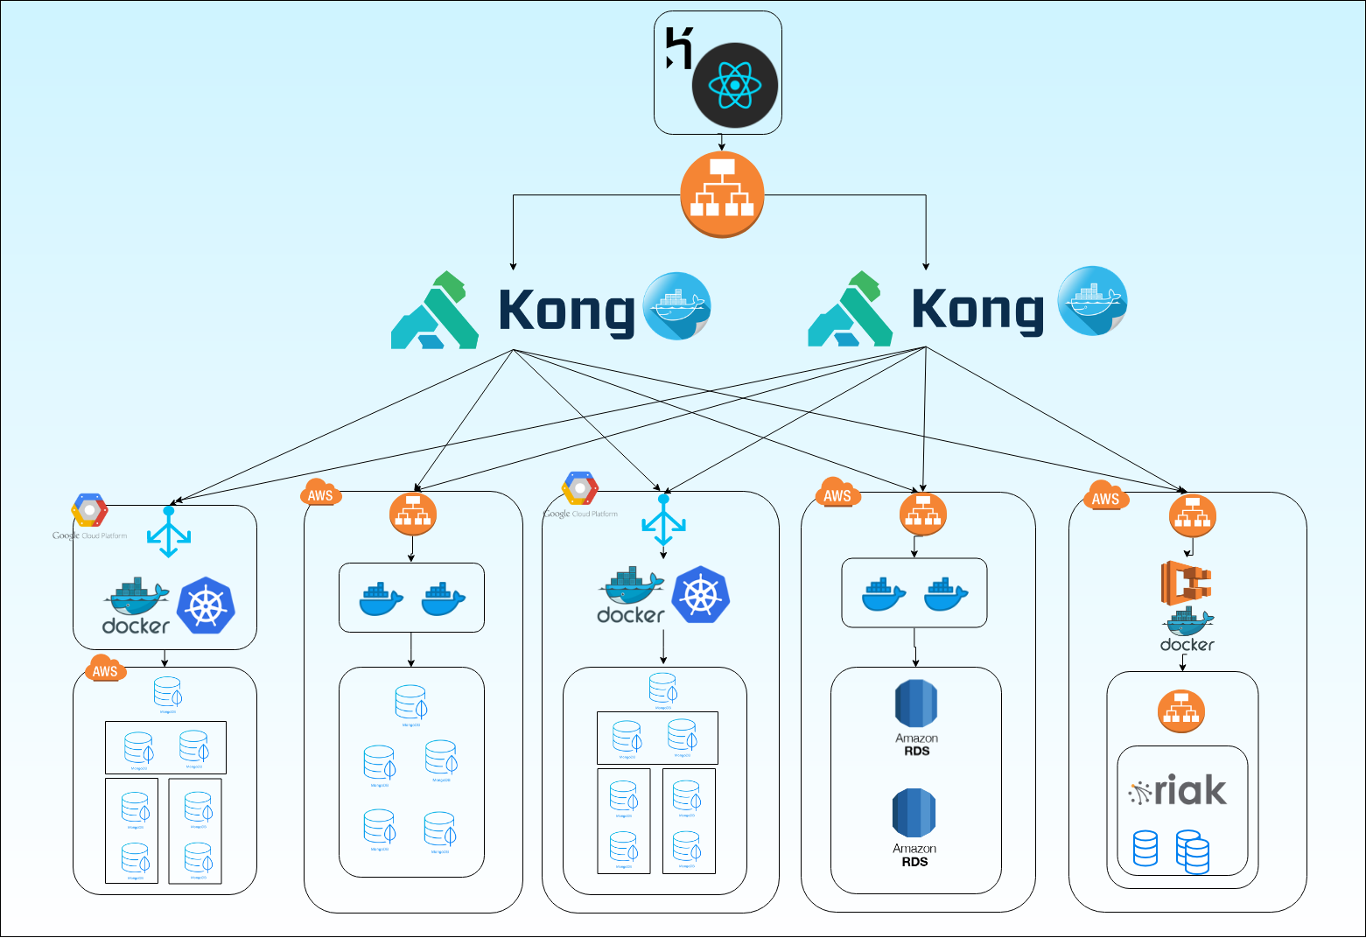
Architecture Diagram

Slide 4
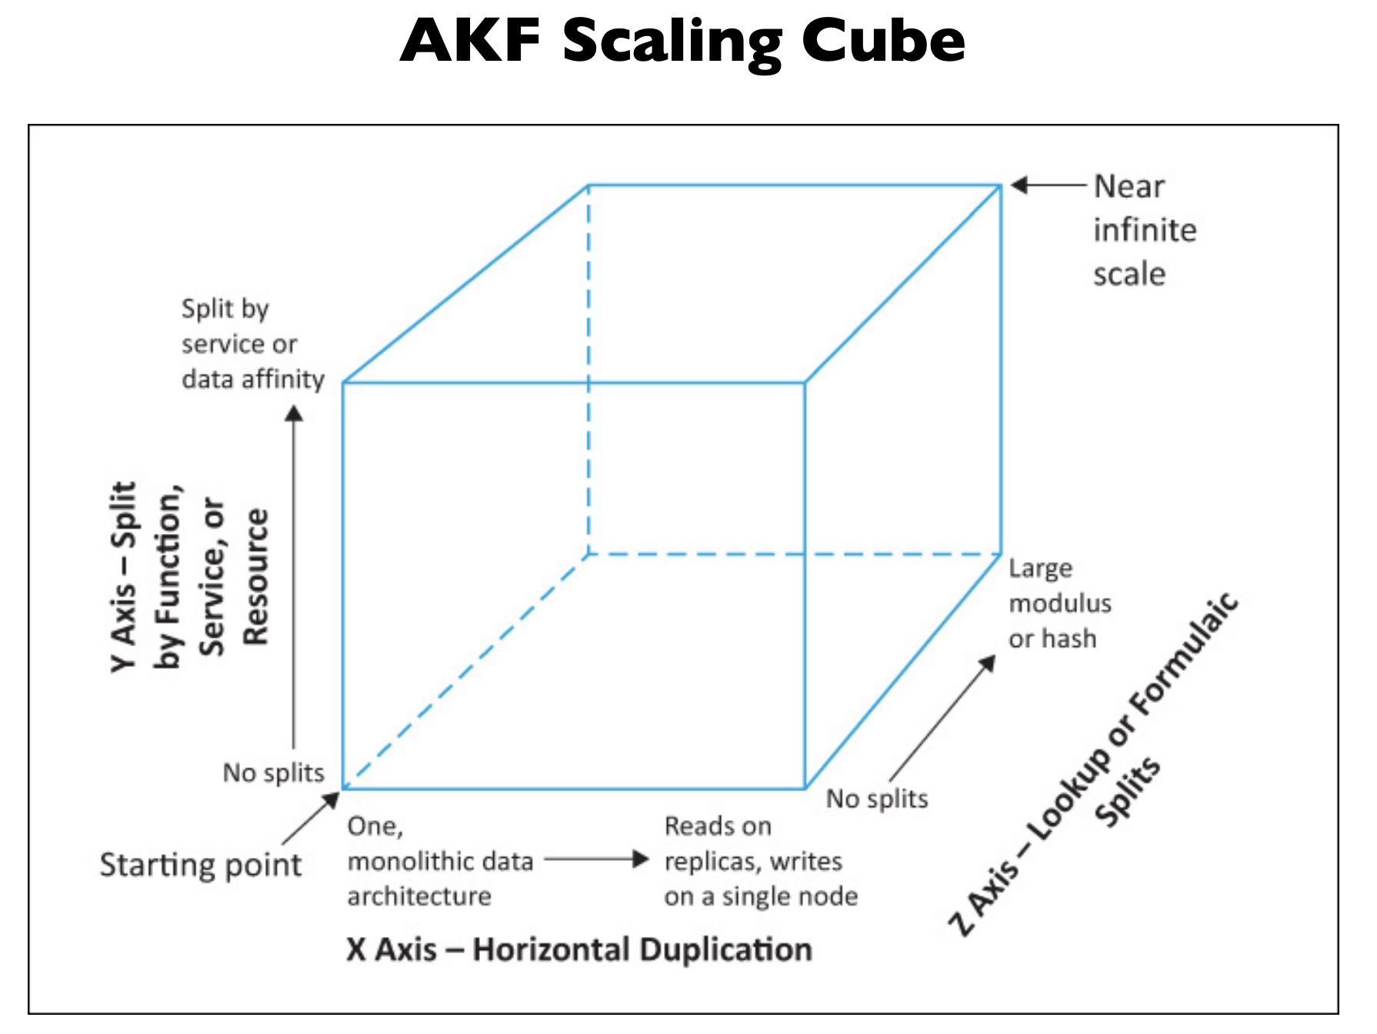
AKF Cube Scaling
X AXIS
Replication through multiple nodes.
No Single Point of Failure
Y AXIS
Split by function, service or resource
Z AXIS
Data Split (Sharding)

Slide 5
Features
Heroku – Cloud Application Platform
Kong – API Platform for Microservices
Wow Factors
MongoDB - Sharding, Riak KV - Resiliency, Aws RDS
Google Kubernetes Engine
Amazon ECS
Application Load Balancer
Google Cloud Platform

Slide 6

DEMO

