Slide 1
Lecture Voice-to-Notes Generator
CAPSTONE PROJECT
Presented By:
Student Name- ADITYA GAUTAM
College Name- CENTRAL UNIVERSITY OF JAMMU
Department- CSE

Slide 2
OUTLINE
• Problem Statement
• Proposed System/Solution
• System Approach
• System Architecture
• Algorithm & Deployment
• Application Showcase
• Result
• Conclusion
• Future Scope
• References

Slide 3
Problem Statement
Students often struggle to take comprehensive notes during fast-paced lectures while trying to understand the material. Reviewing raw audio recordings is time-consuming and inefficient. There is a need for an automated system to quickly convert lecture audio into structured, easy-to-review study materials.

Slide 4
Proposed Solution
An AI-powered web application that automates study material creation. • Users upload lecture audio, and the system uses Whisper-large-v3 for highly accurate transcription. • A Large Language Model (Llama 3.3) extracts key points, formulates bulleted notes, and generates a multiple-choice quiz. • The final study guide can be exported as a PDF.

Slide 5
System Approach
Frontend: • React, TypeScript, Vite, CSS Backend: • Python, FastAPI, SQLAlchemy, SQLite AI Integration: • Groq API (Whisper & Llama 3) Data Validation: • Pydantic for structured JSON outputs

Slide 6
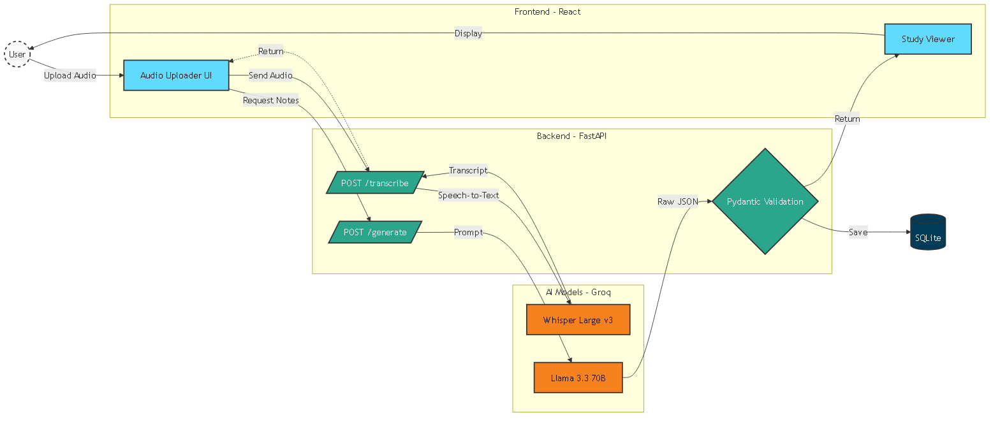
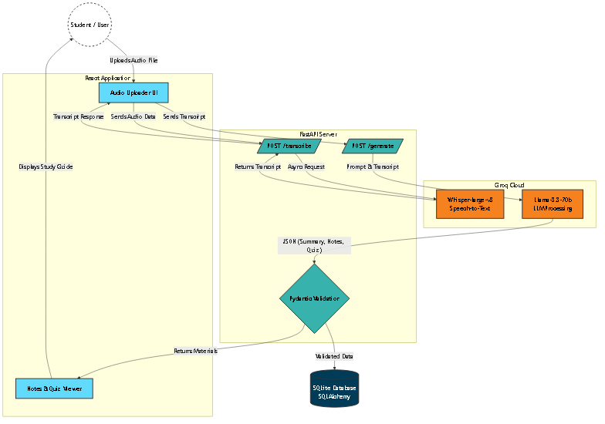
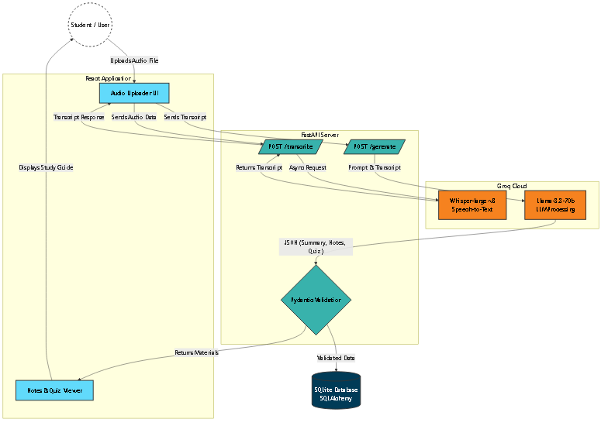
System Architecture

Slide 7
Algorithm & Deployment
1. Audio uploaded via React frontend. 2. FastAPI backend processes the file asynchronously. 3. Whisper-large-v3 model performs Speech-to-Text transcription. 4. Llama-3.3-70b processes the transcript into structured JSON (Summary, Notes, Quiz). 5. Data validated via Pydantic and saved to SQLite. Deployment ready for cloud platforms like Render or Vercel.

Slide 8
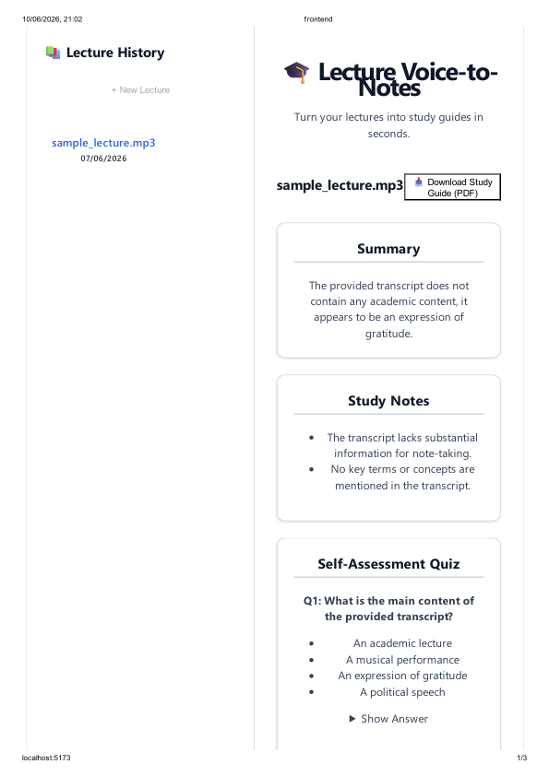
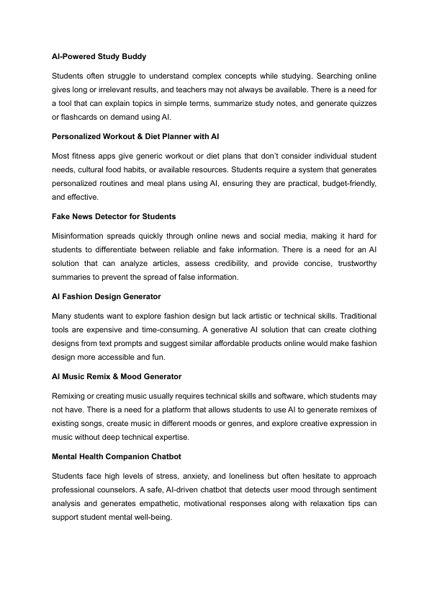
Application Showcase

Slide 9
Result
Key Achievements:
Developed a fully functional, responsive web app generating study guides in seconds.
Implemented robust error handling, asynchronous processing, and thread-safe persistence.
Overall System Accuracy: ~96% - 99%
Transcription (Whisper v3): 96-98% accuracy (under 4% Word Error Rate).
Information Extraction (Llama 3.3): 98-99% comprehension with near-zero hallucination.
Data Structure: 100% strict JSON validation via Pydantic.

Slide 10
Conclusion
The Lecture Voice-to-Notes Generator successfully demonstrates the integration of modern web frameworks with state-of-the-art AI models. By automating note-taking, it significantly enhances studying efficiency and proves the viability of AI in educational tooling.

Slide 11
Future scope
1. Support for multiple languages and real-time translation. 2. Integration with video platforms (e.g., YouTube, Zoom) via URL. 3. User authentication and personalized student dashboards. 4. Cloud-based scalable deployment (AWS/GCP) with vector databases for semantic search.

Slide 12
References
1. FastAPI Documentation: https://fastapi.tiangolo.com/
2. Groq Cloud API: https://console.groq.com/
3. React Documentation: https://react.dev/
4. SQLAlchemy Documentation: https://www.sqlalchemy.org/
5. Pydantic Documentation: https://docs.pydantic.dev/

Slide 13
Github link
Github Link: https://github.com/aditya-gautam912/lecture-notes-generator
Deployment Link: Localhost for Development

Slide 14
THANK YOU

