Slide 1
Vertex Cover Problem
Aditya Gupta | Ravi Maurya
170001002 | 170001039

Slide 2
About Vertex Cover Problem
The minimum vertex cover problem is the optimization problem of finding a smallest vertex cover in a given graph. Let G be a graph of order n with no isolated vertex. A vertex covering of the graph G is a set of vertices such that every edge of the graph is incident to at least one vertex of the set.
This problem is a known NP Complete problem, i.e., there is no polynomial time solution for this unless P = NP. There are approximate polynomial time algorithms to solve the problem though.

Slide 3
Goals
− To study or analyze the available algorithms in the basis of time and space complexity.
− To implement the existing algorithms and compare them in terms of efficiency.
− Intending to find the best/worst case scenarios for various approaches available. Also to try and find out where these algorithms might fail.

Slide 4
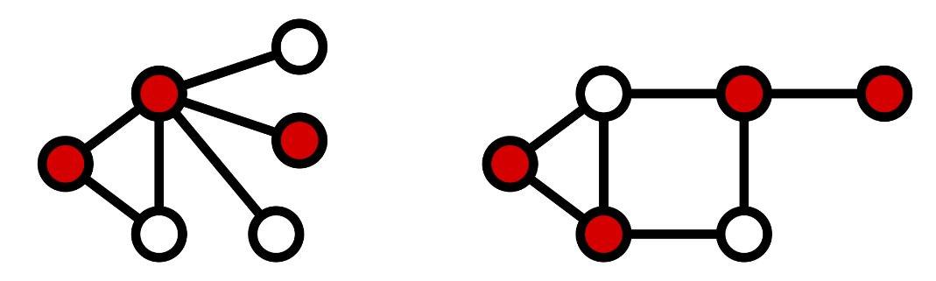
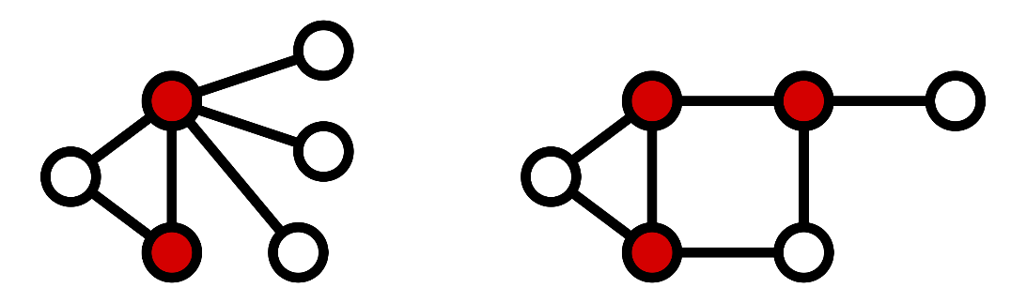
Definition
Formally, a vertex cover of an undirected graph G=(V,E) is a subset of V such that , that is to say it is a set of vertices V’ where every edge has at least one endpoint in the vertex cover V’. Such a set is said to cover the edges of G. The following figure shows two examples of vertex covers, with some vertex cover V’ marked in red.
A minimum vertex cover is a vertex cover of smallest possible size. The vertex cover number is the size of a minimum vertex cover, i.e.. The following figure shows examples of minimum vertex covers in the above graphs.

Slide 5
Algorithms Implemented/Analysed:
APPROXIMATE:
Approx principle procedure (2-approximation)
Greedy Technique
Alom’s Algorithm
EXACT:
For Trees
For Bipartite Graphs

Slide 6

Approximate Algorithms for Vertex Cover Problem

Slide 7
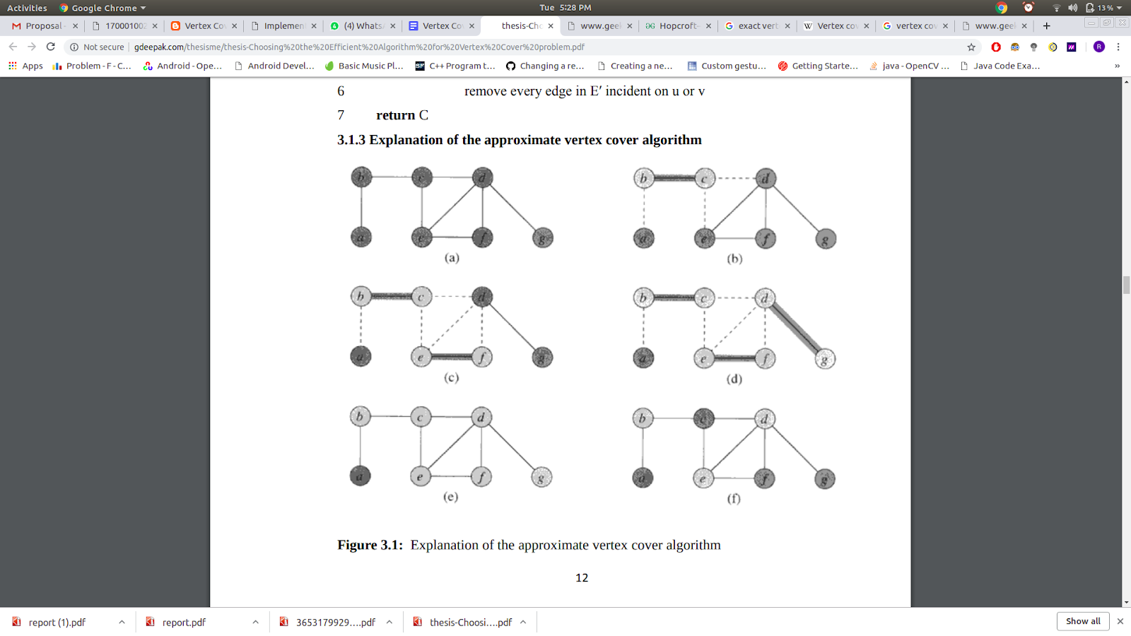
Approx principle procedure
(2-Approximation)
Pseudocode:
C = ∅
E'= G.E
while E'≠ ∅:
let (u, v) be an arbitrary edge of E'
C = C ∪ {u, v}
remove from E' every edge incident on either u or v
return C
Complexity: O(V + E)

Slide 8
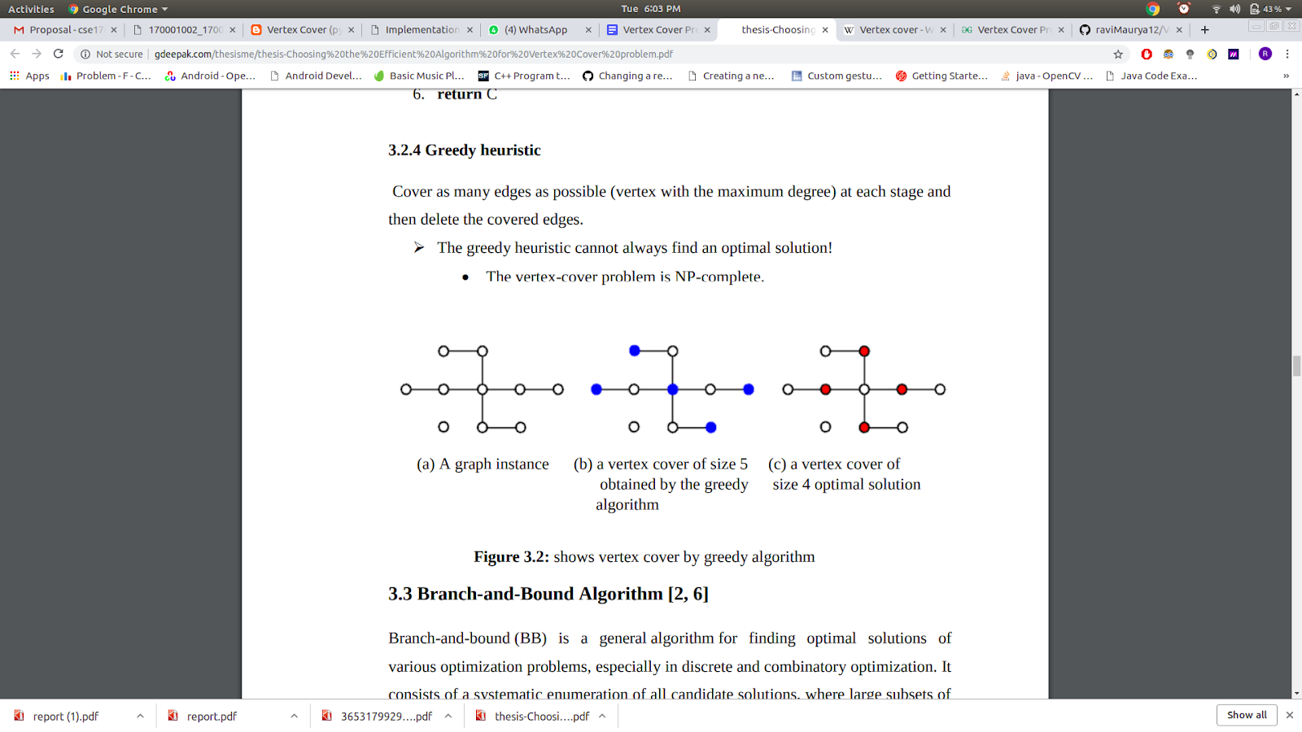
Greedy TEchnique
Pseudocode:
C ← Ø
while E ≠ Ø 3.
Pick any edge e ∈E and choose an end-point v of e
C ← C U {v}
E ← E \ {e ∈ E : v ∈ e}
return C
Time complexity of above algorithm is again O(V+E).
If the number of Edges is much larger than the number of vertices i.e, if the graph is of higher degree, then the complexity of clever implementation of Greedy algorithm will be less than linear. Therefore, this method is suitable for graphs of higher degree.

Slide 9
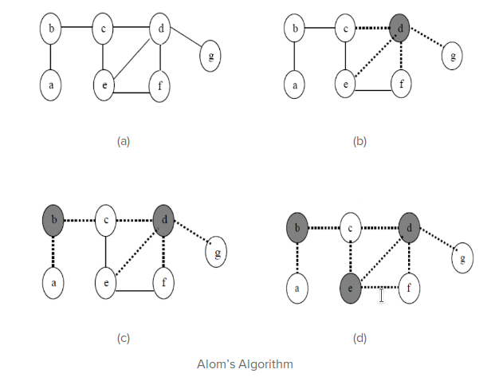
Alom’s Algorithm
Alom’s algorithm is the best algorithm in terms of time complexity among the above listed algorithms. In case of higher degree graphs, the algorithm runs even faster than the clever greedy.
Pseudocode:
OPTIMAL_VT_COVER (E, V) {// E is an edge and V is an vertex
V← Ф;
E′ ←E [G]
While (E′ ≠ ) {
M ← Choose vertex which has maximum incident edge; If (More than one vertex have maximum number of edges) then
M ← Choose that node which has at least one edge that is not covered by others Which have maximum number of edges.
V← V U M;
Remove the all incident edges at vertex M;
Count incident edge of new graph.}
Return V}
Complexity: O(V+E), where E is total no.of edges.

Slide 10
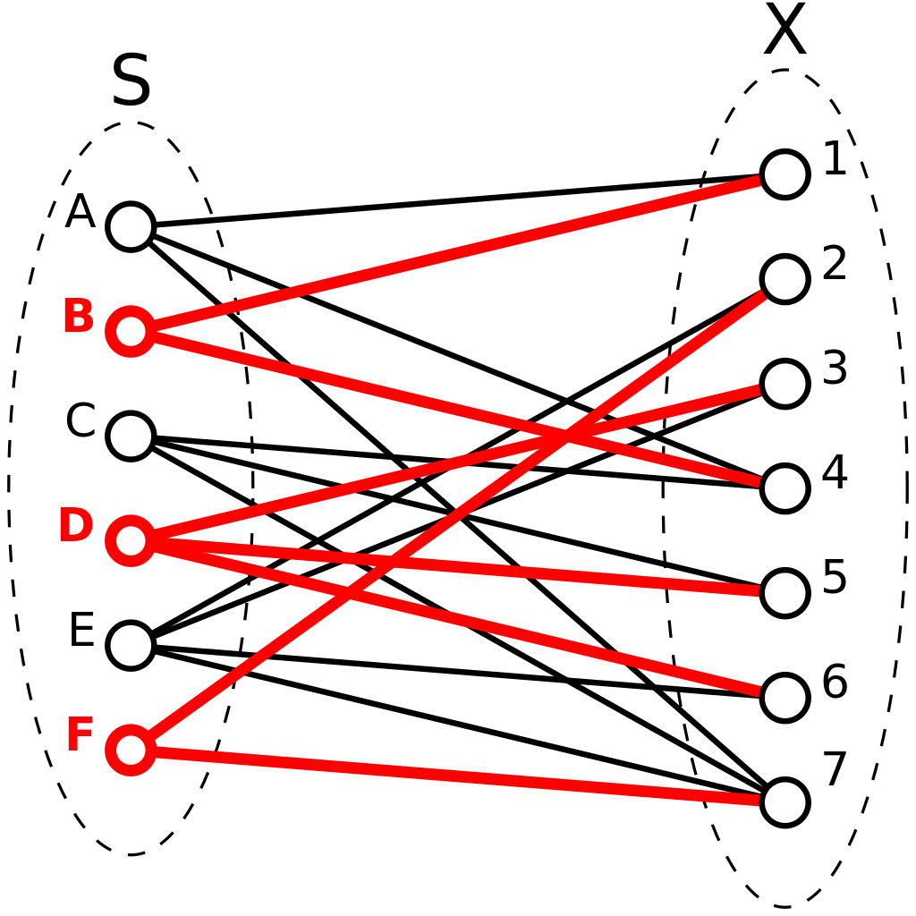
Exact Algorithms for
Vertex Cover Problem

Slide 11
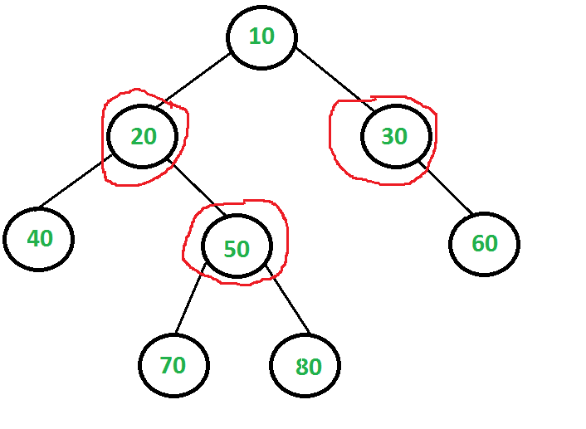
For Trees
Implementation: The idea here is to consider following two possibilities for root and recursively for all nodes down the root.
Root is part of vertex cover: In this case root covers all children edges. We recursively calculate size of vertex covers for left and right subtrees and add 1 to the result (for root).
Root is not part of vertex cover: In this case, both children of root must be included in vertex cover to cover all root to children edges. We recursively calculate size of vertex covers of all grandchildren and number of children to the result (for two children of root).
The naive implementation of the above algorithm takes exponential time i.e., O(2^n). However an efficient implementation of the above algorithm can be achieved using memoization (Dynamic Programming).

Slide 12
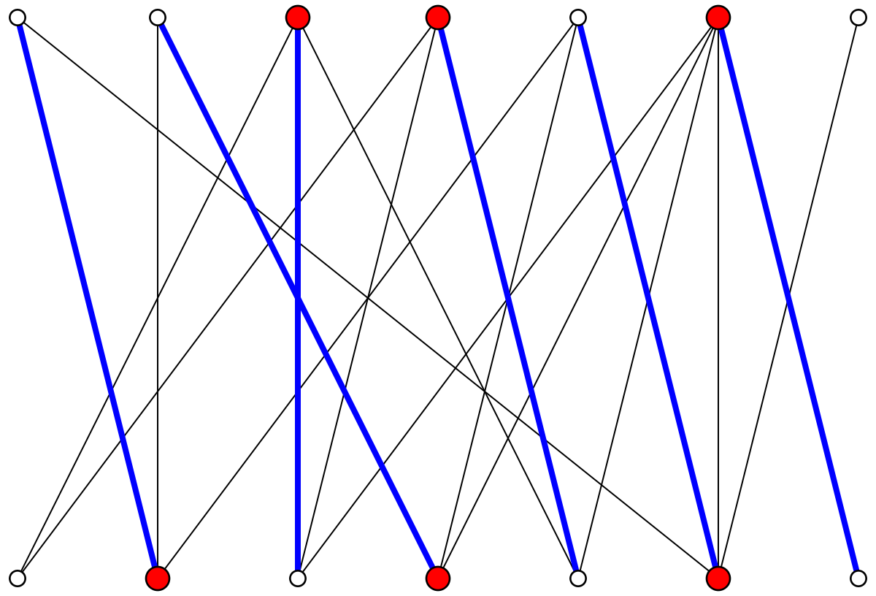
For Bipartite Graphs
Hopcroft Karp algorithm:
Initialize Maximal Matching M as empty.
While there exists an Augmenting Path p
Remove matching edges of p from M and add not-matching edges of p to M
This increases size of M by 1 as p starts and ends with a free vertex)
Return M.
Time complexity of above algorithm is O(sqrt(V)*E).
For sparse graphs, it runs in worst-case time.

Slide 13
References
https://en.wikipedia.org/wiki/Vertex_cover
https://pdfs.semanticscholar.org/85ae/36531799292fde4f705583bcf07145e4ff25.pdf
https://www.geeksforgeeks.org/hopcroft-karp-algorithm-for-maximum-matching-set-1-introduction/
K V R Kumar, Deepak Garg, ―Complete Algorithms on Minimum Vertex Cover‖ CIIT International Journal of Software Engineering and Technology, Issue May 2009 ISSN 0974 – 9748 & Online: ISSN 0974 – 9632.
Reshu Tyagi Muskaan Batra “Implementation and Comparison of Vertex Cover Problem using Various Techniques” International Journal of Computer Applications 144(10):26-31 · June 2016
Presented by:
Aditya Gupta (170001002) & Ravi Maurya (170001039)
Work: https://github.com/raviMaurya12/VertexCoverImplementations
Thanks!

