Slide 1

Customer and Workshop Data Analysis
Aditya Jagdev

Slide 2
Problem Statement
Mahindra First Choice (MFCS; a chain of multi-brand car workshops) wants to leverage its data to find trends among its customer base and workshops to realize improvements.
Analysis will be along the lines of:
Geolocation based customer analysis
Market segmentation
Customer Prediction
The analysis will be followed by Business / Marketing recommendation(s)

Slide 3
Why solve this problem?
Geolocation based customer analysis will decrease the probability of making ineffective changes.
Consequently, this will allow MFCS to optimize their marketing and business strategy, and increase returns on investment (ROI).

Slide 4
Data
The data-set contains the invoices of customers, customer data, the joint technical sheet and a plant master data sheet
The following were received:
Customer data
Invoice data
Joint Technical Data
Plant Master

Slide 5
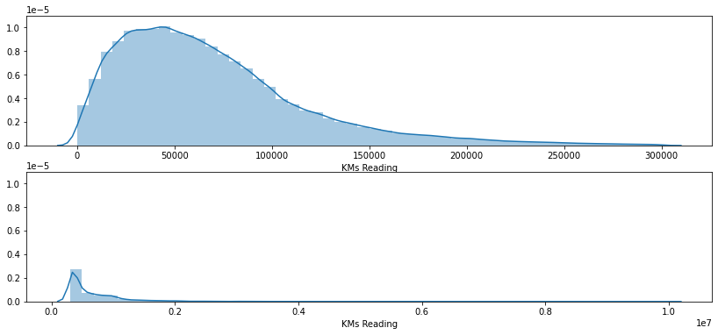
Data Analysis
KMs Reading
KMs Reading data was very dirty and contained values as high as 99,99,940.
Domain knowledge indicates that on an average, non commercial vehicles are driven till about 1,00,000 KM and commercial vehicles are driven till about 2,50,000 – 3,00,000 KM.
Adjusting for legitimate outliers, only values where KMs Reading was below 3,00,000 KM were used.

Slide 6
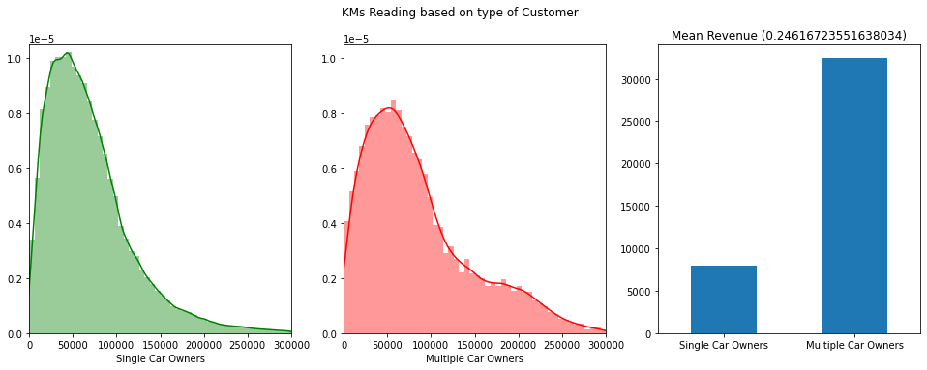
Data Analysis
Multiple car owners
Only 2.18% of customers own multiple cars but they account for 7.36% customer visits, indicating that they visit about 3.33 times more than customers who own a single car.
Customers with multiple cars have an increased number of visits with higher KMs Reading

Slide 7
Data Analysis
Multiple car owners
This may consist of customers that are fleet owners and loyal customers.
Note that the average revenue per visit by multiple car owners is about 4 times that of single car owners.

Slide 8
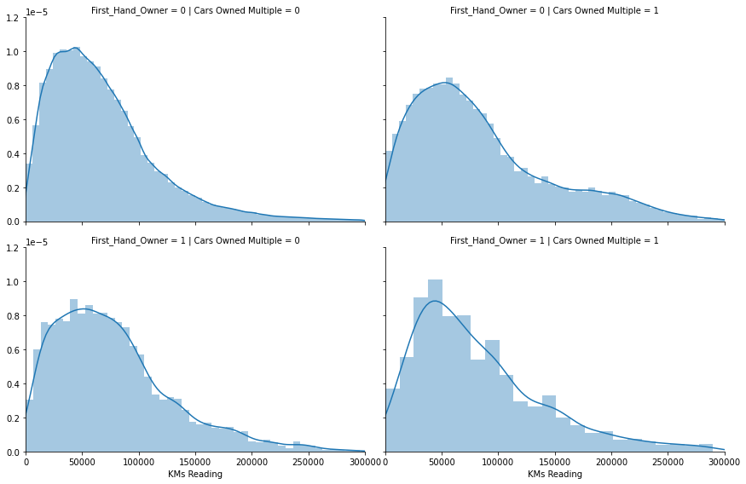
Data Analysis
First-hand and multiple cars
Given is customer visits based on KMs Reading with respect to if a customer has multiple vehicles and if customer has second hand vehicles.
Note that customers with first hand vehicles have a more uniform visits trend and visit more during lower KMs Readings.

Slide 9
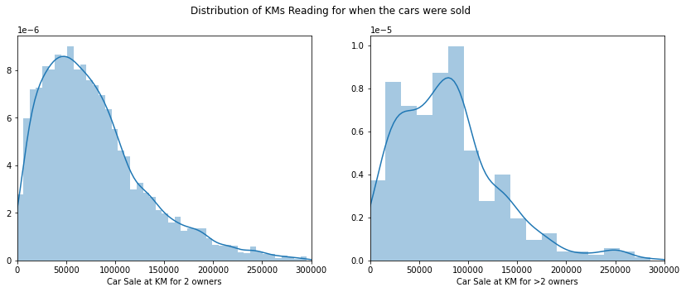
Data Analysis
Second hand cars
KMs Reading of cars sold the first time and second time onwards are plotted.
The given categories have a peak at 60,000 KM and 90,000 KM, respectively.
This may aid in offering better suited service packages to customers and buying good vehicles from willing customers to resell at competitive prices.

Slide 10
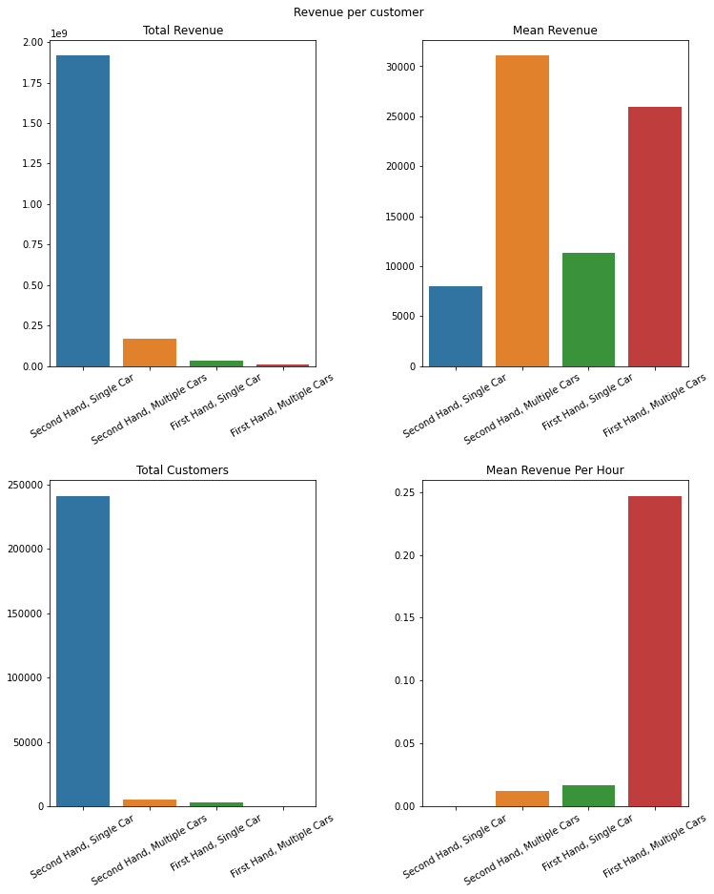
Data Analysis
Revenue based on customer type
Revenue insights based on customers and time.
Most revenue comes from single, second hand car owners.
Customers with multiple first hand cars offer the most lucrative opportunities.
This will aid in calculating CLTV and in improving marketing to attract better potential customers.

Slide 11
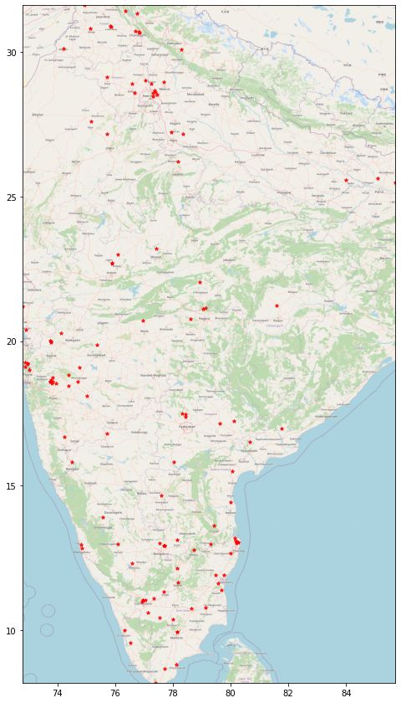
Data Analysis
Distribution of workshops
MFCS has a wider presence in southern India whereas has comparatively fewer workshops in the northern half.
Intuitively, it has a higher concentration of workshops near metro cities.
The eastern half contains very few workshops. It may be beneficial to look into expanding in the region.

Slide 12
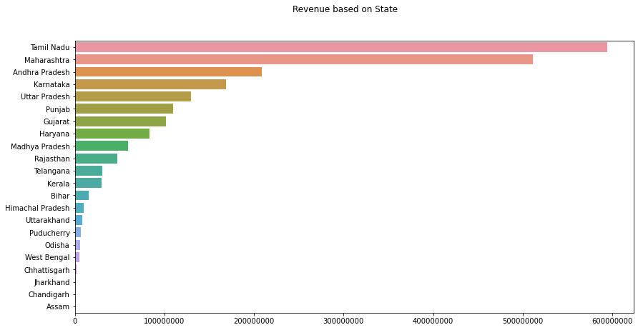
Data Analysis
Revenue based on State
Revenue based on state indicates that MFCS has a relatively bigger presence in southern and central India compared to other regions.
This may allow improving marketing to customers with a certain demographic.

Slide 13
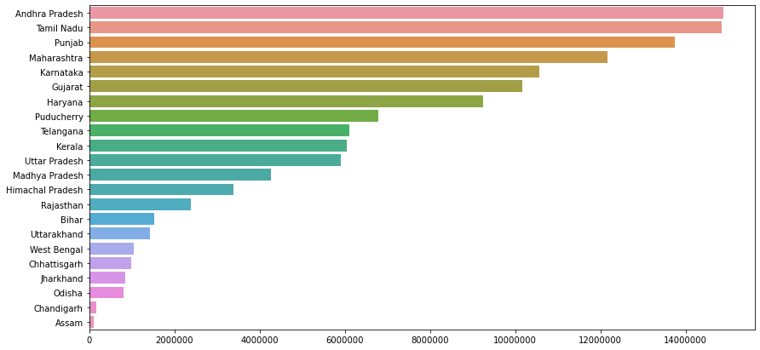
Data Analysis
Mean revenue based on State
Mean revenue per job based on state gives a similar ordering.
Revenue per job from AP, TN, PB, MH, KN, GJ and HR is significantly higher than other states.

Slide 14
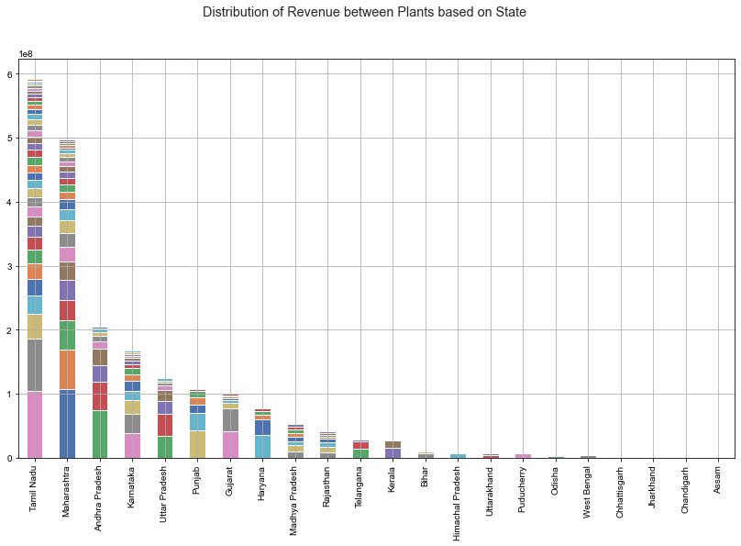
Data Analysis
High performing workshops
Certain workshops in states dominate the amount of revenue generated.
These workshops may prove to be good choices to test customer experience improvement programs.

Slide 15
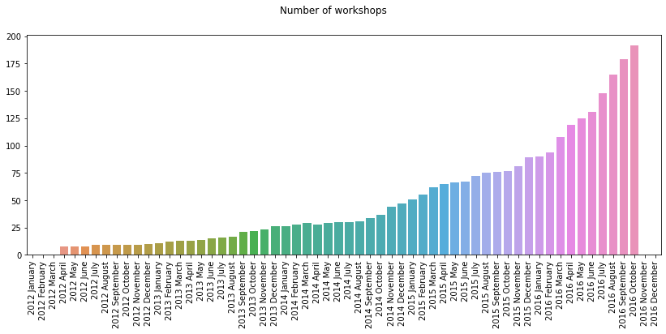
Data Analysis
Number of workshops
Total number of workshops has seen exponential growth.

Slide 16
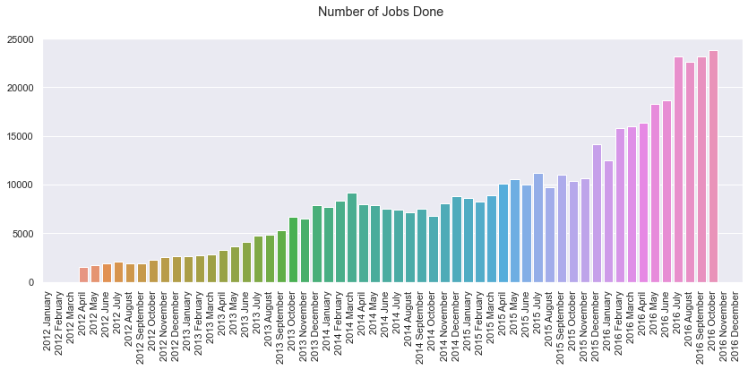
Data Analysis
Total number of jobs done
Intuitively, the number of jobs done has also increased.

Slide 17
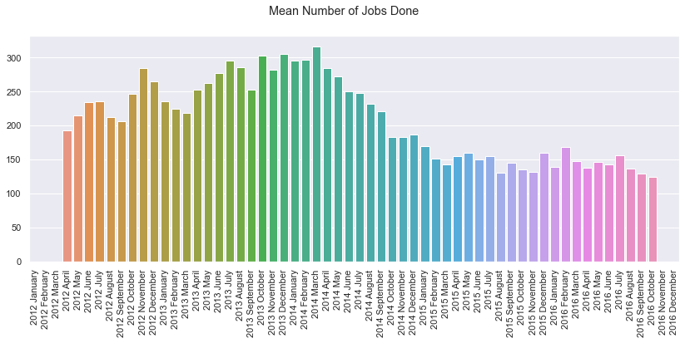
Data Analysis
Mean number of jobs per workshop
But the mean number of jobs done per workshops has decreased.
This indicates that the new workshops are either inefficient.

Slide 18
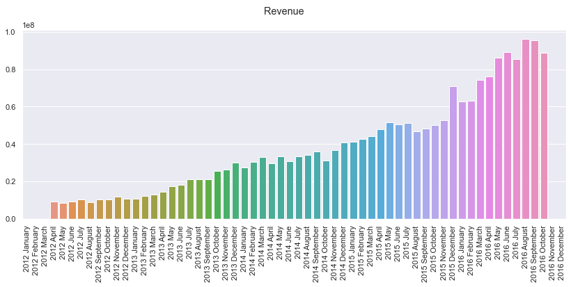
Data Analysis
Revenue
Revenue has increased rather linearly with exponential increase in number of workshops.

Slide 19
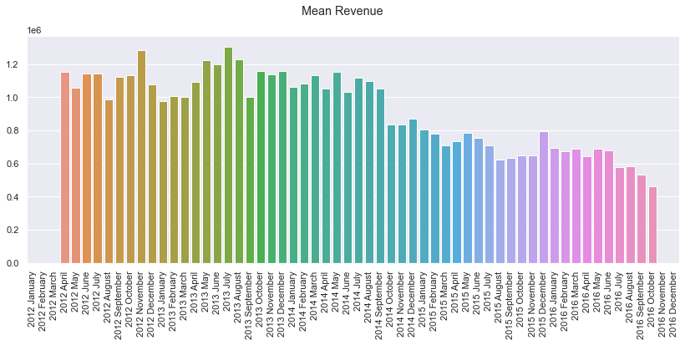
Data Analysis
Mean Revenue per workshop
Mean revenue has decreased by half.
This may be due to workshops not bringing in as much revenue as projected.
Note: On inspection, most new workshops were

Slide 20
Data Analysis
Mean Revenue per workshop
On inspection, most new workshops were observed to be located away from the previously existing workshops in their region and on the outskirts of the city/district.
This may be a contributor to the observed decrease in number of customers.

Slide 21
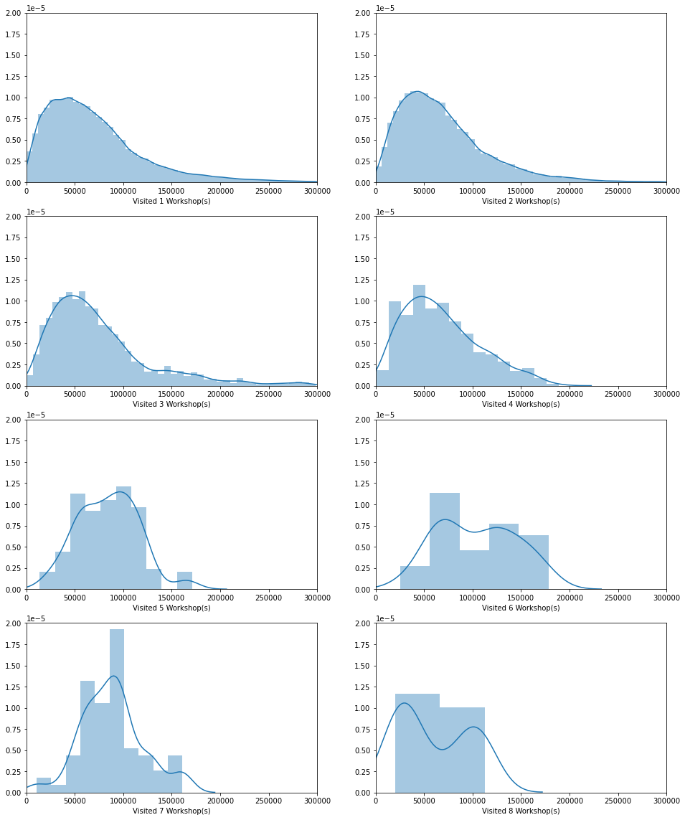
Data Analysis
No. of workshops visited
Cars that visited more than 3 MFCS workshops had a higher peak for KMs Reading.
This may suggest that these were commercial vehicles such as taxis, tourist vehicles, etc.

Slide 22
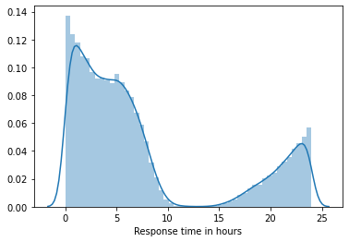
Data Analysis
Workshop response times
Response time is the time between a job card being registered and the car being brought to the workshop.
It has a U-shaped trend due to some customers registering for a service at nights and bringing in the car in the morning.
This graph can prove useful to observe customer experience and workshop throughput.

Slide 23
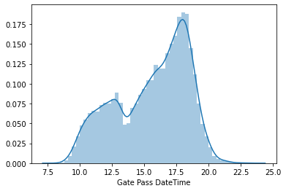
Data Analysis
Customer visit time of day
The time of day at which cars are brought to the workshops is left skewed.
Customers prefer coming in during the after or evening.
A drop around 2pm may indicate workshops not entertaining customers or customers unwilling to bring in vehicles at that time.
This can be used for customer prediction on workshop to workshop basis.

Slide 24
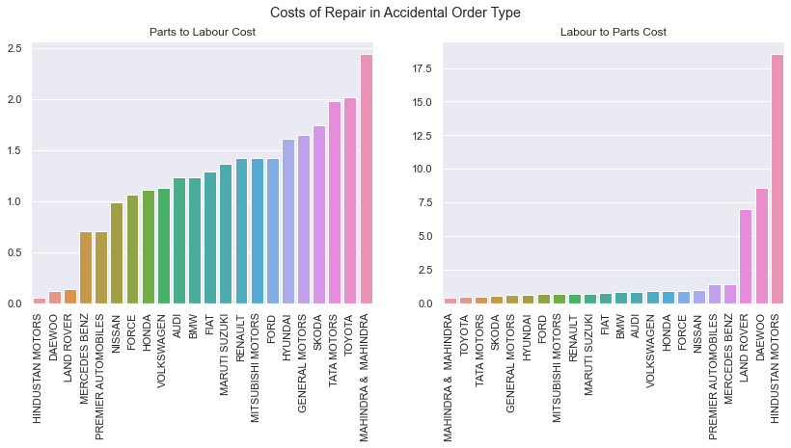
Data Analysis
Parts to Labor costs ratio
Parts to labor costs in accidental order type for different makes of cars has been plotted.
Note that makes at the extremes can be separated into two based on low parts cost to high labor costs with respect to time taken.
Older vehicles require more time but newer, premium vehicles can be serviced in lesser time but come at the cost of higher training and parts costs.

Slide 25
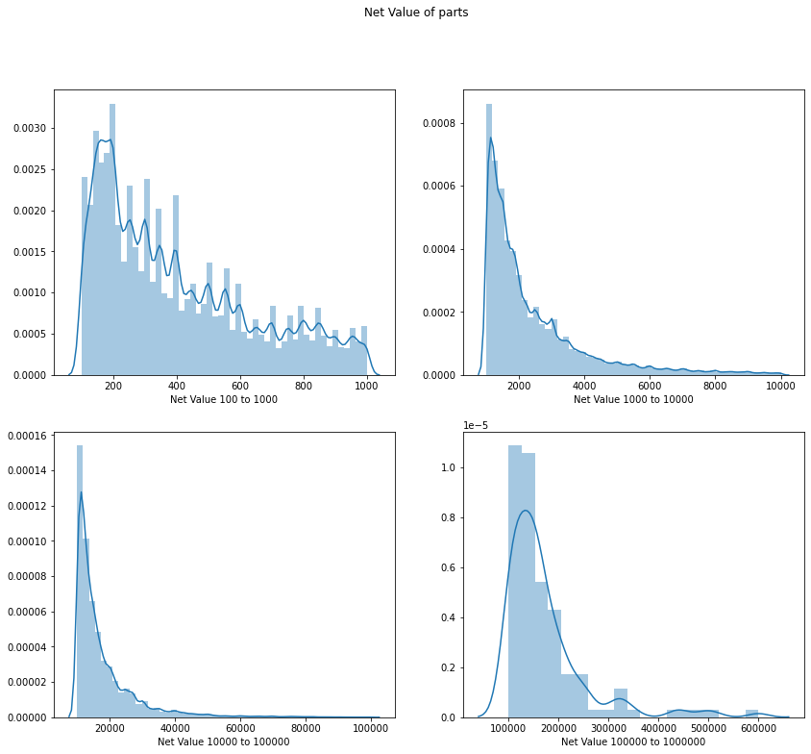
Data Analysis
Value of parts used
Net value of parts follows inverse exponential distribution.
This may aid in inventory management and deciding to keep an ‘X’ priced item in storage or order when required.
This would also require data on storage costs which is beyond the scope of provided data.

Slide 26
Data Analysis
Correlation between Parts and Labor costs
Correlation between parts costs and labor costs based on different order types was analyze.
It is concluded that focus on higher parts costs orders may yield higher revenue due to labor costs increasing by only 40% for increase in parts costs.
This may require further data for higher confidence.

Slide 27
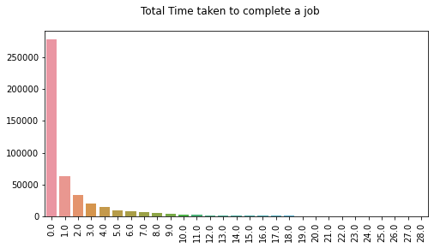
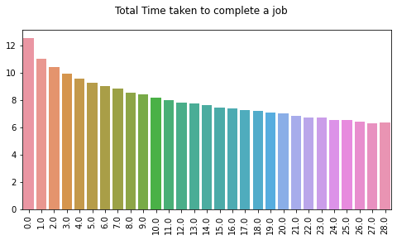
Data Analysis
Time taken to complete a job
Time taken (in days) to complete jobs is plotted. It follows an inverse exponential distribution.
Another plot in log scale is also presented.
This may help in improve scheduling of jobs and prioritize tasks.

Slide 28
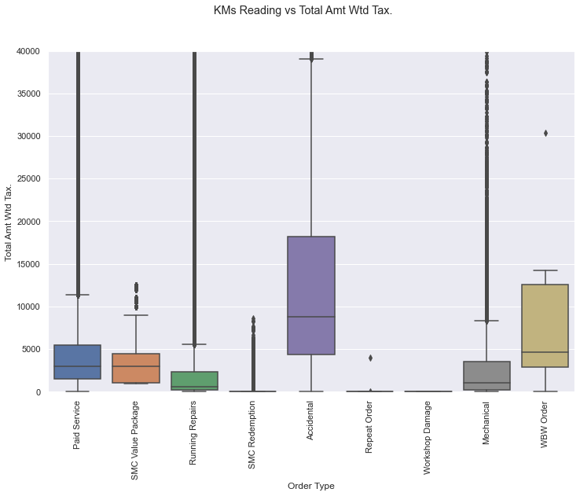
Data Analysis
Type of order and revenue
Total revenue based on job is higher for ‘Accidental Repairs’ order type.

Slide 29
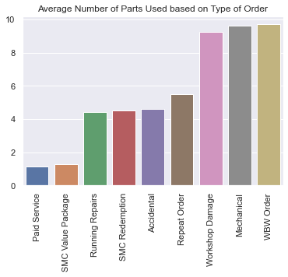
Data Analysis
Type of order and parts used
Average number of parts used per order shows that accidental repairs has a surprisingly lower ranking.
This may be due to only bigger, non mechanical parts being damage such as the bumpers.

Slide 30
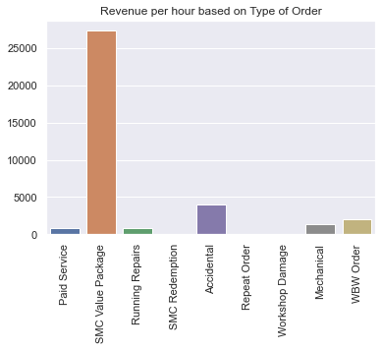
Data Analysis
Revenue per hour
Revenue generated per hour of work is highest for SMC Value Package, followed by accidental repairs and under warranty services.
This will prove crucial in job scheduling and consequently increasing the overall revenue.
Marketing focus on SMC Value Package may also prove fruitful.

Slide 31
Recommendations
Implementing protocols and practices (eg: six sigma) to make workshop processes streamlined may save man hours and increase revenue.
Prioritizing jobs with higher mean revenue per hour in areas with high customer throughput may result in a significant boost in revenue.
Targeted marketing to customers for SMC Value Package may result in significant boost in revenue.
Suggesting service packages or buying the vehicle from customers using KMs Reading as support may increase chances of favorable outcomes.
Future workshop locations should be carefully analyzed for regional factors such as other workshop locations and target demographic population density.

Slide 32
Next Steps
With more time, further data cleaning and clustering can be done to uncover previously unknown categories of customers and workshops.
With input from Mahindra, JTD can be made useful for inventory management. In its current state, JTD is dirty and contains no support features/data dictionary that would aid in making sense of the data.
Useful time series analysis to predict future trends in revenue and workshop jobs may be possible with further data cleaning. In its current state, the data is too noisy (increasing variance, heteroskedasticity) to make any meaningful predictions.

Slide 33
~fin~
Aditya Jagdev
github.com/aditya-jagdev
linkedin.com/in/aditya-jagdev/

