Slide 1


Market Basket Analysis and Apriori Algorithm

Slide 2

Agenda
Market Basket Analysis
Support
Confidence
Lift
Apriori Algorithm
Association Rules
02

Slide 3
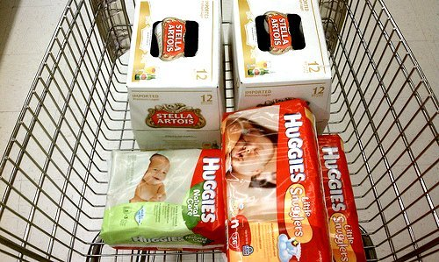
Market Basket Analysis
Provides insight into which products tend to be purchased together and which are most amenable to promotion.
03
Notes:
Explain market basket analysis and the example
The findings were that men between 30- 40 years in age, shopping between 5PM and 7PM on Thursdays and saturdays, who purchased diapers, were most likely to also have beer in their carts.

Slide 4
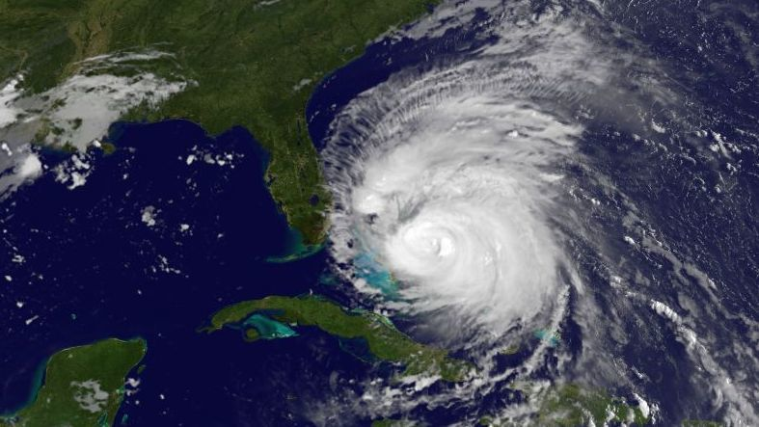
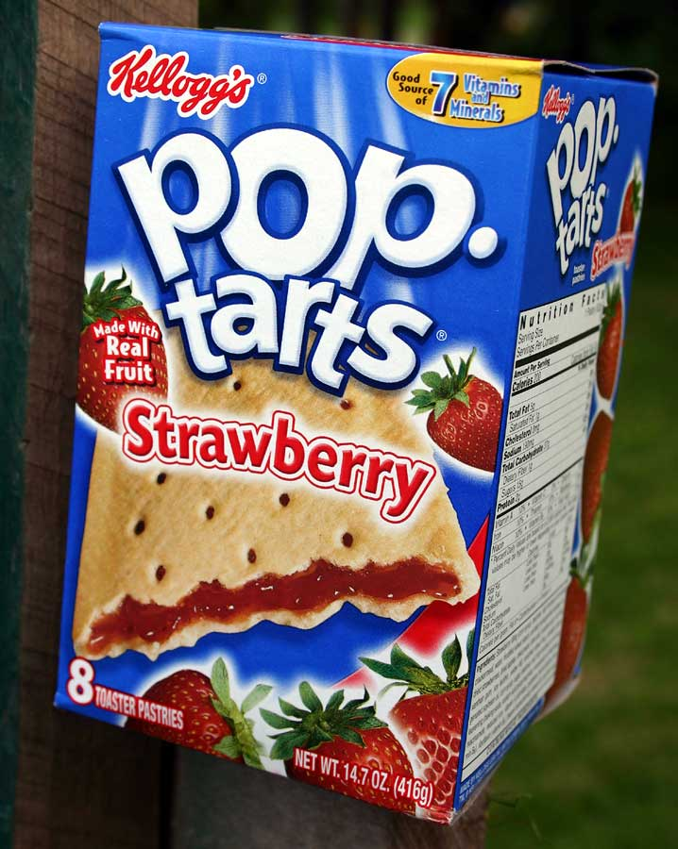
Interesting Discoveries
7 times
after 3-4 months`
04
Notes:
A major electronics store used association rule mining to find that customers who bought VHS players/recorders tended to return 3-4 months later to buy camcorders. They use discount coupons to successfully engage such customers.
Before hurricane it is found that pop tarts were brought excessively as it is consumed by every age, no need to heat etc.

Slide 5
Rules generated can be
Trivial
Inexplicable
People who brought dove soap also brought Barbie doll. What should the business do?
Seemingly interesting but actually not
People buying conference calling facility also buy call forwarding service
People who buy shoes also buy socks
People who buy shirts also buy milk
Actionable
05
Notes:
How rules generated can be and what actions can be taken after insights

Slide 6
Transform the data
ORDER ID | LINE ITEM ID | B
ORDER ID | LINE ITEM ID | C
 | PRODUCT A | PRODUCT B | PRODUCT C | PRODUCT D
ORDER ID | 0 | 1 | 1 | 0
 | Product A | Product B | Product C | Product D
Product A
Product B
Product C
Product C
06
Notes:
Creating market basket analysis
Straight forward Market basket analysis where we create matrix of product and product (co-occurrence table) and this matrix will be used for generating rules

Slide 7
Co-occurrence Table
Order ID | Products
1 | Orange juice, Soda
2 | Milk, orange juice, window cleaner
3 | Orange juice, detergent
4 | Orange juice, detergent, soda
5 | Window cleaner, soda
Product | Orange Juice | Window Cleaner | Milk | Soda | Detergent
Orange Juice | 4 | 1 | 1 | 2 | 2
Window cleaner | 1 | 2 | 1 | 1 | 0
Milk | 1 | 1 | 1 | 0 | 0
Soda | 2 | 1 | 0 | 3 | 1
Detergent | 2 | 0 | 0 | 1 | 2
07
Notes:
An Example of how purchasing is done and rules like
Orange juice and soda OR Orange juice and detergent are
more likely to be purchased together than any other two
items.
• Detergent is never purchased with window cleaner or milk.
• Milk is never purchased with soda or detergent.

Slide 8
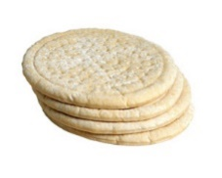
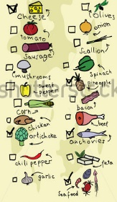
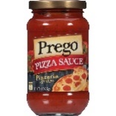
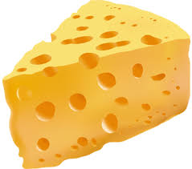
If-Then rule
Z (Sauce)
A (Pizza Crust)
B (Toppings)
C (Cheese)
A, B, C – Antecedents
Z - Consequent
08
Notes:
Moving into technical stuff of how these rules are generated
Explain if-then by the example
The length of a rule is the number of antecedents present

Slide 9
Support
If CCAvg= high, then loan =accept
ID | Age | Income | Family | CCAvg | Personal Loan
1 | Young | low | 2 | Low | No
2 | Old | high | 3 | High | Yes
3 | Middle | low | 1 | Medium | No
4 | Young | high | 2 | Low | No
5 | Middle | high | 3 | High | Yes
6 | Middle | low | 1 | High | Yes
7 | Old | high | 4 | Low | Yes
8 | Young | low | 2 | Medium | No
9 | Young | medium | 3 | Low | No
10 | Old | medium | 1 | High | Yes
11 | Middle | high | 3 | High | Yes
12 | Middle | low | 1 | Low | No
Support is the percentage of cases that contain both A and B. i.e both antecedent and precedent.
Support = 4/12 = 0.33
It is Joint probability P(A and B)
09
Notes:
To select interesting rules from the set of all possible rules, constraints on various measures of significance and interest can be used. The best-known constraints are minimum thresholds on support and confidence.
Explain support through this example.
Support is the percentage of cases that contain both A and B. i.e both antecedent and precedent.
4 in 12 are satisfied by this condition (Ccavg is high and personal loan is yes). Therefore the support is 25%
It is the Joint probability P(A and B) of occurring the condition.

Slide 10
Confidence
If CCAvg= high, then loan =accept
ID | Age | Income | Family | CCAvg | Personal Loan
1 | Young | low | 2 | Low | No
2 | Old | high | 3 | Medium | Yes
3 | Middle | low | 1 | Medium | No
4 | Young | high | 2 | Low | No
5 | Middle | high | 3 | High | Yes
6 | Middle | low | 1 | High | Yes
7 | Old | high | 4 | Low | Yes
8 | Young | low | 2 | Medium | No
9 | Young | medium | 3 | Low | No
10 | Old | medium | 1 | High | Yes
11 | Middle | high | 3 | High | Yes
12 | Middle | low | 1 | Low | No
Confidence is the percentage of cases containing A that also contains B.
Confidence = 4/4 =1
It is Conditional probability P(A|B)
10
Notes:
Confidence is the percentage of cases containing A that also contains B.
It is the conditional probability P(A|B). Probability of occurrence of A when B has occurred.
Records containing Ccavg as high = 4
Out of records that have ccavg as high number of records that have loan is yes are = 4
Confidence = 4/4 =1

Slide 11
If rule is Switched
If loan =accept, then CCAvg=high
ID | Age | Income | Family | CCAvg | Personal Loan
1 | Young | low | 2 | Low | No
2 | Old | high | 3 | High | Yes
3 | Middle | low | 1 | Medium | No
4 | Young | high | 2 | Low | No
5 | Middle | high | 3 | High | Yes
6 | Middle | low | 1 | High | Yes
7 | Old | high | 4 | Low | Yes
8 | Young | low | 2 | Medium | No
9 | Young | medium | 3 | Low | No
10 | Old | medium | 1 | High | Yes
11 | Middle | high | 3 | High | Yes
12 | Middle | low | 1 | Low | No
Support = 4/12
Confidence = 4/6
Support remains same where as confidence changes when rule is switched
11
Notes:
What happens when rule is switched?
Calculate confidence and support for the new rule
Support remains same whereas confidence changes

Slide 12
Obvious Attribute
Obvious Attribute
If CCAvg=low then loan=Accept
ID | Age | Income | Family | CCAvg | Personal Loan
1 | Young | low | 2 | Low | No
2 | Old | high | 3 | Low | Yes
3 | Middle | low | 1 | Low | No
4 | Young | high | 2 | Low | No
5 | Middle | high | 3 | Low | Yes
6 | Middle | low | 1 | Low | Yes
7 | Old | high | 4 | Low | Yes
8 | Young | low | 2 | Low | No
9 | Young | medium | 3 | Low | No
10 | Old | medium | 1 | Low | Yes
11 | Middle | high | 3 | low | Yes
12 | Middle | low | 1 | Low | No
Support = 6/12
Confidence = 6/6=1
Confidence is always going to be high in case of obvious attribute
12
Notes:
If there is an obvious class then the confidence will always be high
In this case both have confidence 100%. So confidence is not the ultimate metric to go for.
There will be no real relation when obvious class is present. So we go for lift.

Slide 13
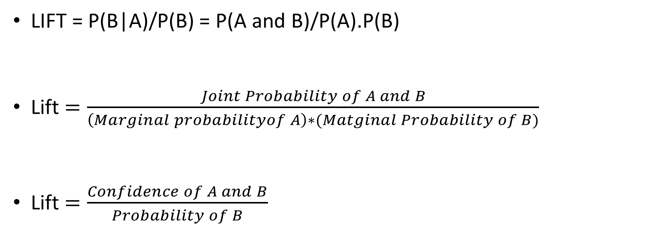
Lift as a Goodness metric
LIFT = P(B|A)/P(B) = P(A and B)/P(A).P(B)
Lift $=\frac{Joint Probability of A and B}{\left(Marginal probabilityof A\right)∗(Matginal Probability of B)}$
Lift $=\frac{Confidence of A and B}{Probability of B}$
13
Notes:
Lift signifies the likelihood of the itemset A being purchased when item B is purchased while taking into account the popularity of B
LIFT is the ratio of the confidence to the % of cases containing B

Slide 14
Case 1
If X is present in 25 transactions out of 100 transactions. If Y is an obvious class (e.g., does not have cancer), it is present in all records. What are Support and Confidence and Lift?
Support = 25/100 = 25%
Confidence=25/25=100%
P(Y) = 1
Lift = Confidence/P(Y) = 1/1=1
14
Notes:
Understanding support, confidence, lift with example

Slide 15
Case 2
Total transactions are 100. Y occurs in 20 where X also occurred (recall X occurred 25 times) and does not occur elsewhere. What are Support, Confidence and Lift now?
- Support of X->Y: 20/100 = 20% (where X and Y occur)
Confidence of X->Y: 20/25 = 80%
P(Y) = 20/100 =20%
Lift = 0.8/0.2 = 4
15
Notes:
Understanding support, confidence, lift with example

Slide 16
Case 3
Y occurs in 20 records where X occurs and 70 transactions where X does not occur. What are Support, Confidence and Lift now(X=25 and total transactions=100)?
– Support of X->Y: 20/100 = 20% (where X and Y occur).
– Confidence of X->Y: 20/25 = 80%.
– P(Y) = 90/100 = 90%.
– Lift = 0.8/0.9 (confidence/probability of Y) = 0.89
16
Notes:
Understanding support, confidence, lift with example

Slide 17
Interpreting Lift
Lift > 1
Lift = 1
X and Y are positively correlated (Case 1)
Lift < 1
X and Y are independent (Case 2)
X and Y are negatively correlated (Case 3)
17
Notes:
Depending upon lift value we can prioritize how good is the rule

Slide 18
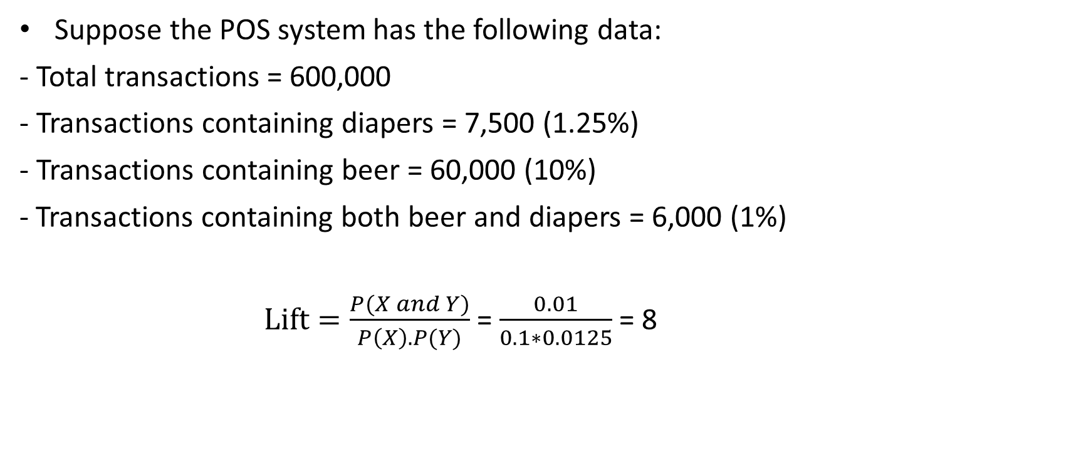
Market Basket Analysis
Suppose the POS system has the following data:
- Total transactions = 600,000
- Transactions containing diapers = 7,500 (1.25%)
- Transactions containing beer = 60,000 (10%)
Transactions containing both beer and diapers = 6,000 (1%)
$Lift=\frac{P(X and Y)}{P\left(X\right).P(Y)}$ = $\frac{0.01}{0.1∗0.0125}$ = 8
18
Notes:
Getting back to market basket analysis and calculating lift and 8 is very high and this rule is highly recommended

Slide 19
Apriori Property
Downward Closure Property
Closed Operation
Association Rule
The key idea behind the algorithm is called apriori property or downward closure property.
Downward closure property: Any subset of a frequent itemset is also a frequent itemset.
A set is said to be closed under an operation, if the operation produces another number of the set.
19
Notes:
The two step process of Association rule
1- downward closure
2- closed property

Slide 20
Natural Number (Whole, Non-negative)
Closed under
- Addition (e.g., 3+5 = 8)
- Multiplication (e.g., 3*5 gives 15)
Not closed under
- Subtraction (e.g., 3-5 gives a negative number)
- Division (e.g., 3/5 gives a fraction)
20
Notes:
Closed property practical example

Slide 21
Downward Closure
3 Itemsets
ABC ABD ACD BCD
AB AC AD BC BD CD
A B C D
2 Itemsets
1 Itemset
21
Notes:
Downward closure example
If ABD is frequent then AB, AD,, BD should be frequent
In turn A, B, D should be frequent

Slide 22
The Apriori Algorithm - Example
TID | Items
100 | 1 3 4
200 | 2 3 5
300 | 1 2 3 5
400 | 2 5
Itemset | Sup
{1} | 2
{2} | 3
{3} | 3
{4} | 1
{5} | 3
Itemset | Sup.
{1} | 2
{2} | 3
{3} | 3
{5} | 3
Minsupport = 0.5
Itemset | Sup
{1 3} | 2
{2 3} | 2
{2 5} | 3
{3 5} | 2
Itemset
{1 2}
{1 3}
{1 5}
{2 3}
{2 5}
{3 5}
Itemset | sup
{1 2} | 1
{1 3} | 2
{1 5} | 1
{2 3} | 2
{2 5} | 3
{3 5} | 2
Itemset
{1 2 3}
{1 3 5}
{2 3 5}
Itemset | Sup
{2 3 5} | 2
22
Notes:
Step by step elimination and rule generation using downward closure and closed set property
235 is frequent means {2,3},{3,5},{2,5} are frequent which means 2,3,5 are frequent

Slide 23


