Slide 1
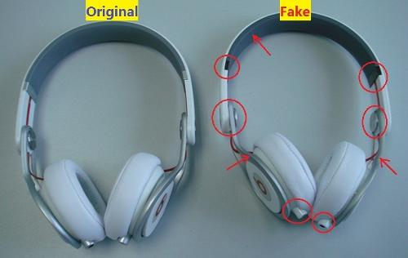
Real or Fake
Notes:
Often we believe a fake cause it is fabricated in such a way that one believes it as true
During us elections many news articles were published and there were instances in social media where many believed the posts.
A study at Stanford declared that the fake news did not effect the us elections.
Understanding how a fake news is generated and classifying real news and fake news is what I have done here

Slide 2
Logic
“A lie gets halfway around the world before the truth has a chance to get its pants on.”
A | B | C | D | outcome
0 | 1 | 0 | 0 | point
1 | 1 | 0 | 0 | Line
1 | 1 | 1 | 1 | Square
1 | 1 | 1 | 1 | Square
0 | 0 | 1 | 1 | Line
0 | 1 | 1 | 1 | Triangle
1 | 1 | 1 | 0 | Triangle
Notes:
So there was an extension developed by chrome which has classified the article as fake or real depending upon many parameters. Now I am going to extend It further using ml techniques
What is machine learning?
If suppose u want to write a code to find the type of polygon then either you can start writing the code like if sides are 3 then it is triangle etc etc
Or you can create a data of several such examples and throw a model which inherently learns that two there are three ones in a record then it is a triangle.
In this way a machine can learn and classify news weather it is real or fake depending upon the words it contains

Slide 3
Doc 1 | The cat sat on the wall
Doc 2 | The cat was roaming around kitchen
Doc 3 | The cat was chased by dog
Doc 4 | The dog was running in the balcony
Doc 5 | The dog has been barking
TF-IDF
Term Frequency – Inverse Document Frequency
 | The | Cat | Dog | Was
Doc 1 | 2 * 5/5 | 1 * 5/3 | 0 * 5/3 | 0 * 5/3
Doc 2 | 1 * 5/5 | 1 * 5/3 | 0 * 5/3 | 1 * 5/3
Doc 3 | 1 * 5/5 | 1 * 5/3 | 1 * 5/3 | 1 * 5/3
Doc 4 | 2 * 5/5 | 1 * 5/3 | 1 * 5/3 | 0 * 5/3
Doc 5 | 1 * 5/5 | 0 * 5/3 | 1 * 5/3 | 0 * 5/3
Notes:
It is ok with numbers but how to classify if words are present
For this first we convert words into numerical values so that the model can understand.
In this way we can change words into numeric

Slide 4
Naïve Bayes
Calculates reverse probabilities
The models learns like the word “urgent,urgent,urgent” came in 80% spam messages and now if the word “urgent” is seen it has 80% probability of classifying the message as spam.
In this way a machine is going to learn how frequent each word has come in spam and no-spam messages and then use this knowledge to classify new message as spam or no-spam.

Slide 5

Calculating Probabilities
Probability of occurring a spam = 0.3
Probability of occurring a ham = 0.7
Probability of occurring the word “congratulations” in spam messages = 0.4
Probability of occurring the word “congratulations” in ham messages = 0.01
Given the word “congratulation” occurred find probability of it in spam and ham messages
P(ham/congrats)$=\frac{P\left(ham\right)∗P(congrats/ham)}{P\left(ham\right)∗P\left(\frac{congrats}{ham}\right)+P\left(spam\right)∗P(congrats/spam)}$ = $\frac{0.7 ∗0.001}{0.7 ∗0.001 + 0.3∗0.4}$ = 8.3%
P(spam/congrats)$=\frac{P\left(spam\right)∗P(congrats/spam)}{P\left(spam\right)∗P\left(\frac{congrats}{spam}\right)+P\left(ham\right)∗P(congrats/ham)}$ = $\frac{0.3 ∗0.4}{0.3∗0.4+0.7 ∗0.01}$ = 91.7 %

Slide 6
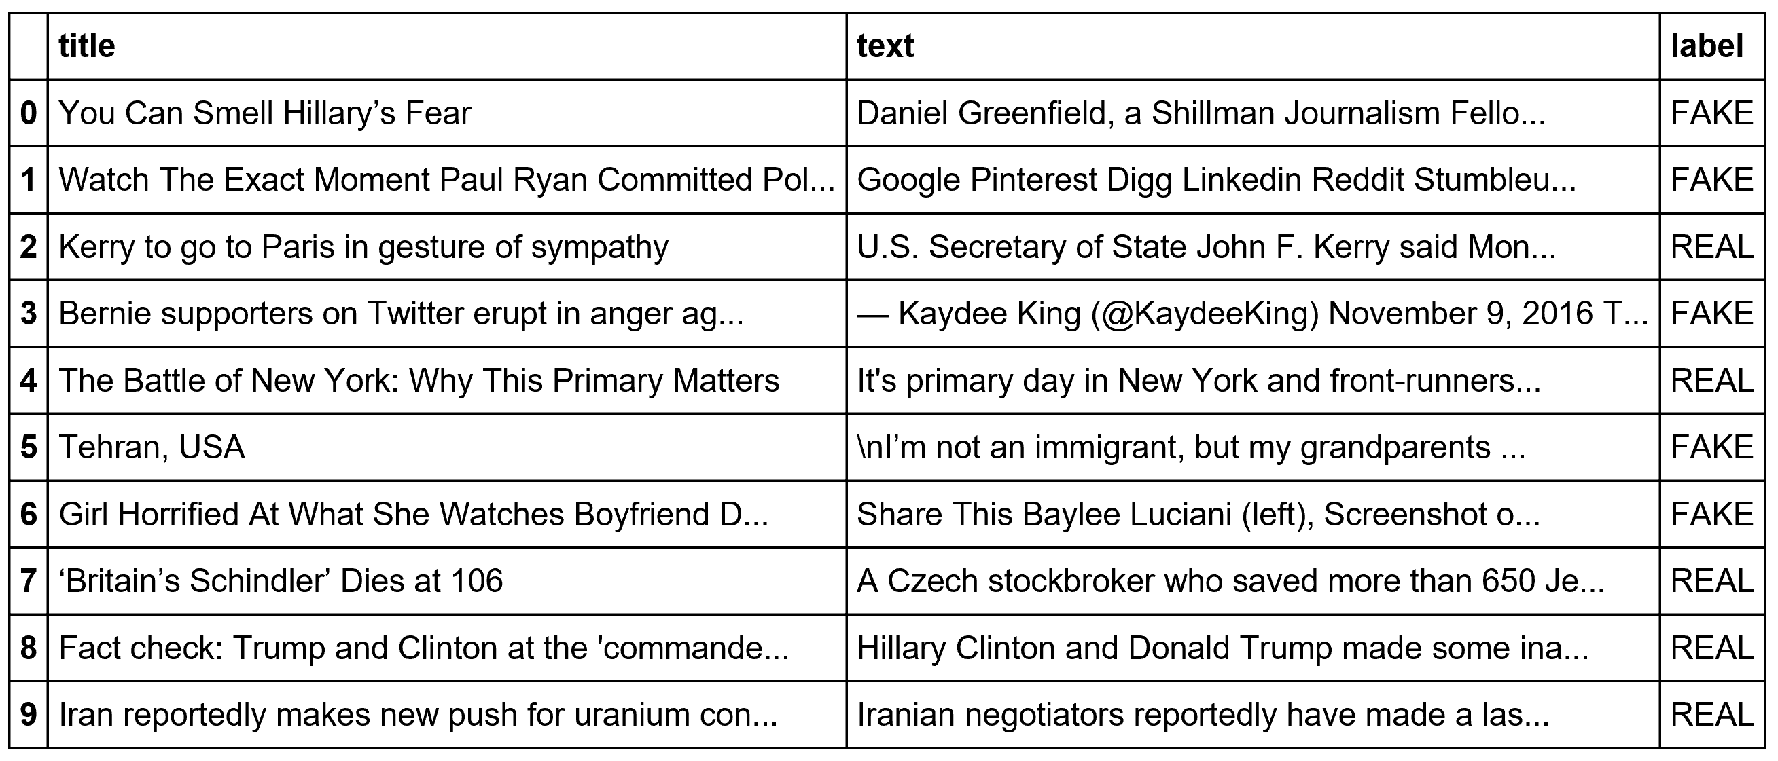
Data
Combined two columns and cleaned data into a neat format.
Before Cleaning
After Cleaning
new senate majority leader xe2\x80\x99s main goal gop: don\xe2\x80\x99t scary mitch mcconnell unusual admonition new
senate majority leaders main goal gop dont scary mitch mcconnell unusual admonition republican majority takes senate

