Slide 1

Toxic Text Classification
Notes:
Being online and anonymous can make us say nasty things that we don’t usually. One such problem is toxic text classification.
The Wiki has gathered few professionals to classify the data from a site into 6 categories like if the message is clean, toxic, insult, threat etc.
Now we have to create a machine learning model that will classify a new message into one of the following category.

Slide 2
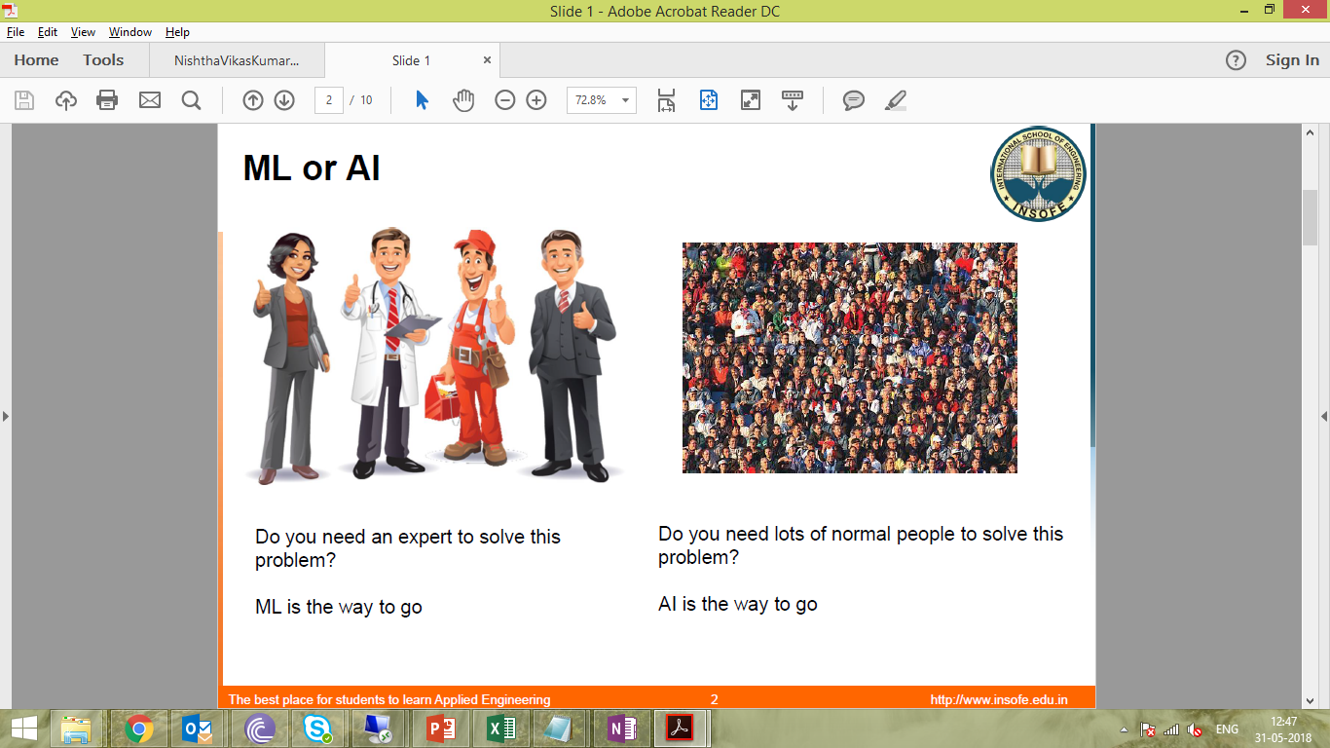
Notes:
What is ML. and AI
Machine learning and AI are both based on the fact that they learn from the data. The way they learn from the data is what differentiates them.
Simply put ML can solve the problems only a professional can solve. Lets take the example of Bank manager.
So in order to train ML we have to fine tune the data, make it in an understandable format for it to learn.
AI can solve the problems that c common man can do. For example in our childhood we learnt that a particular animal is a dog. We did not expli

Slide 3
Logic
A | B | C | D | outcome
0 | 1 | 0 | 0 | point
1 | 1 | 0 | 0 | Line
1 | 1 | 1 | 1 | Square
1 | 1 | 1 | 1 | Square
0 | 0 | 1 | 1 | Line
0 | 1 | 1 | 1 | Triangle
1 | 1 | 1 | 0 | Triangle
Notes:
What is machine learning?
If suppose u want to write a code to find the type of polygon then either you can start writing the code like if sides are 3 then it is triangle etc etc
Or you can create a data of several such examples and throw a model which inherently learns that two there are three ones in a record then it is a triangle.
In this way a machine can learn and classify text depending upon the words it contains

Slide 4
Doc 1 | The cat sat on the wall
Doc 2 | The cat was roaming around kitchen
Doc 3 | The cat was chased by dog
Doc 4 | The dog was running in the balcony
Doc 5 | The dog has been barking
TF-IDF
Term Frequency – Inverse Document Frequency
 | The | Cat | Dog | Was
Doc 1 | 2 * 5/5 | 1 * 5/3 | 0 * 5/3 | 0 * 5/3
Doc 2 | 1 * 5/5 | 1 * 5/3 | 0 * 5/3 | 1 * 5/3
Doc 3 | 1 * 5/5 | 1 * 5/3 | 1 * 5/3 | 1 * 5/3
Doc 4 | 2 * 5/5 | 1 * 5/3 | 1 * 5/3 | 0 * 5/3
Doc 5 | 1 * 5/5 | 0 * 5/3 | 1 * 5/3 | 0 * 5/3
Notes:
It is ok with numbers but how to classify if words are present
For this first we convert words into numerical values so that the model can understand.
In this way we can change words into numeric

Slide 5
Naïve Bayes
Calculates reverse probabilities
The models learns like the word “urgent,urgent,urgent” came in 80% spam messages and now if the word “urgent” is seen it has 80% probability of classifying the message as spam.
In this way a machine is going to learn how frequent each word has come in spam and non-spam messages and then use this knowledge to classify new message as spam or non-spam.

Slide 6
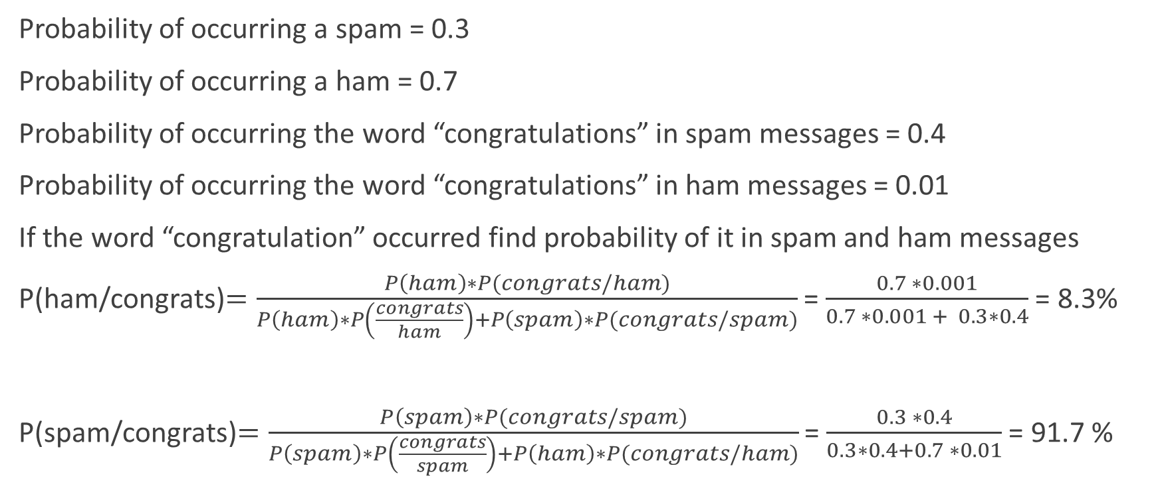
Calculating Probabilities
Probability of occurring a spam = 0.3
Probability of occurring a ham = 0.7
Probability of occurring the word “congratulations” in spam messages = 0.4
Probability of occurring the word “congratulations” in ham messages = 0.01
If the word “congratulation” occurred find probability of it in spam and ham messages
P(ham/congrats)$=\frac{P\left(ham\right)∗P(congrats/ham)}{P\left(ham\right)∗P\left(\frac{congrats}{ham}\right)+P\left(spam\right)∗P(congrats/spam)}$ = $\frac{0.7 ∗0.001}{0.7 ∗0.001 + 0.3∗0.4}$ = 8.3%
P(spam/congrats)$=\frac{P\left(spam\right)∗P(congrats/spam)}{P\left(spam\right)∗P\left(\frac{congrats}{spam}\right)+P\left(ham\right)∗P(congrats/ham)}$ = $\frac{0.3 ∗0.4}{0.3∗0.4+0.7 ∗0.01}$ = 91.7 %

Slide 7
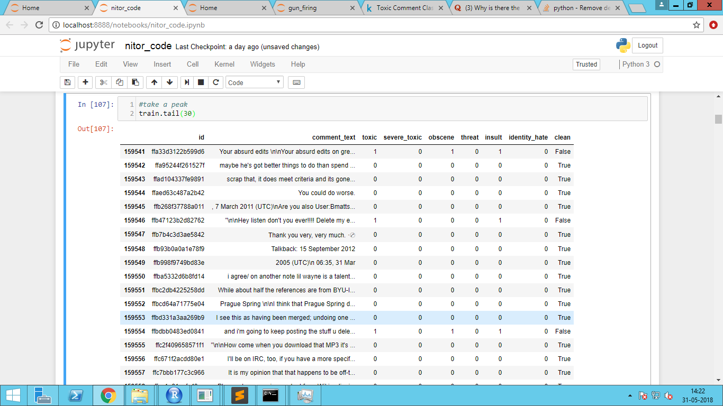
Data Info
Comment_text
Toxic
Severe_toxic
Obscene
Threat
Insult
Identiy_hate
Clean

Slide 8
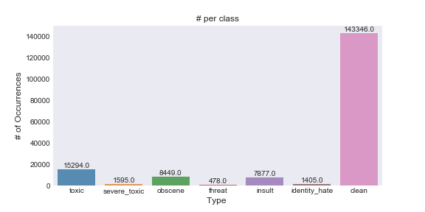
The Data
Dimensions of dataset: 312735
Dimensions of training records: (159571,9)
Testing data dimensions: (153164,2)

Slide 9
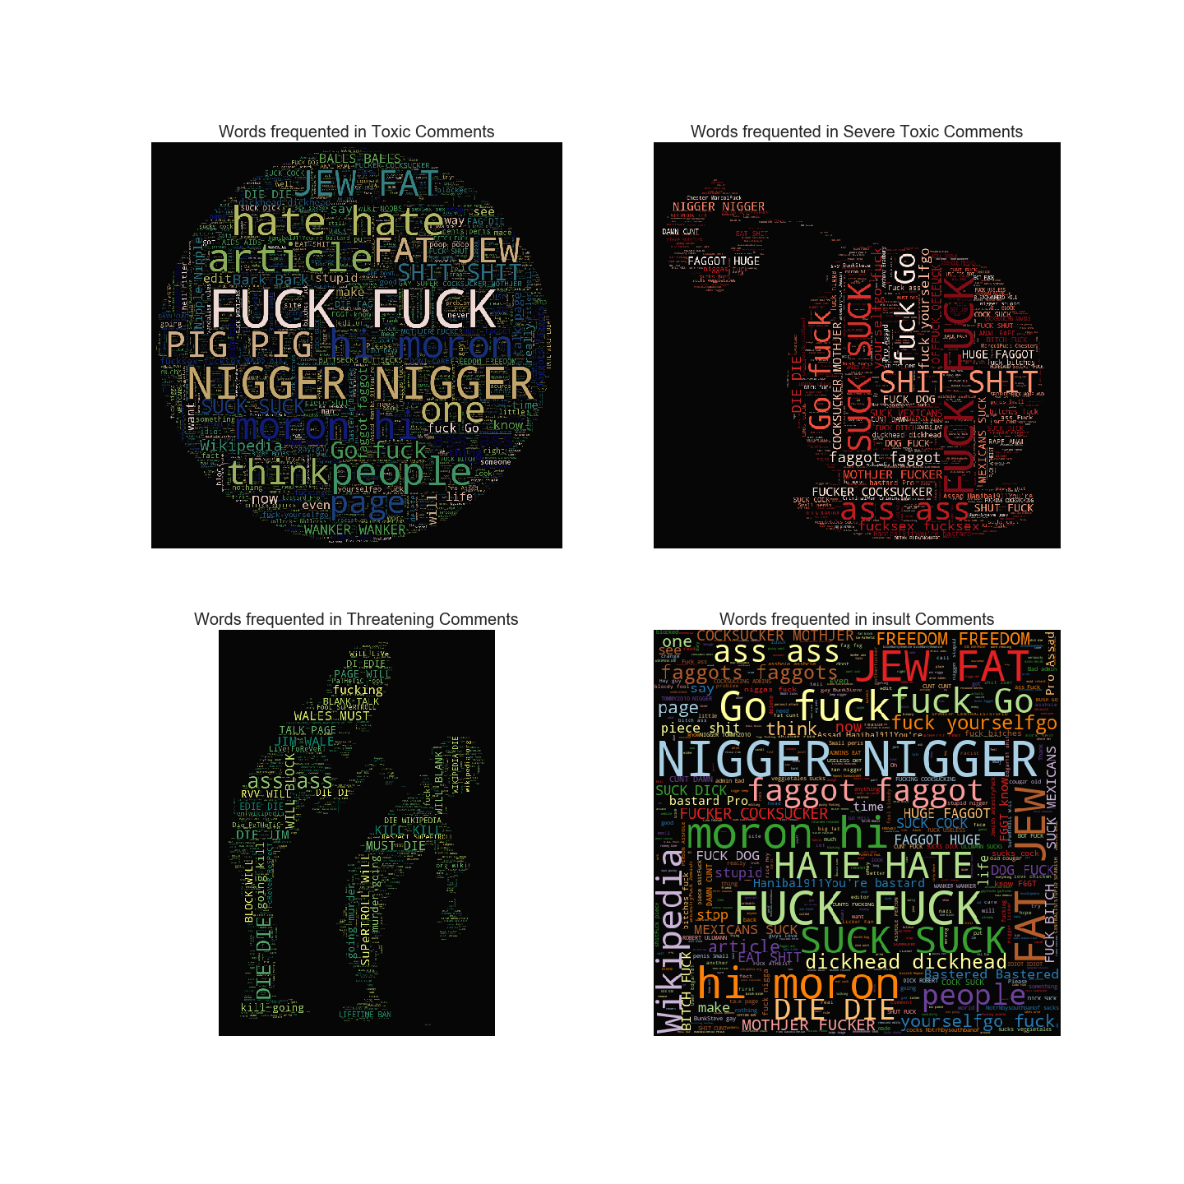
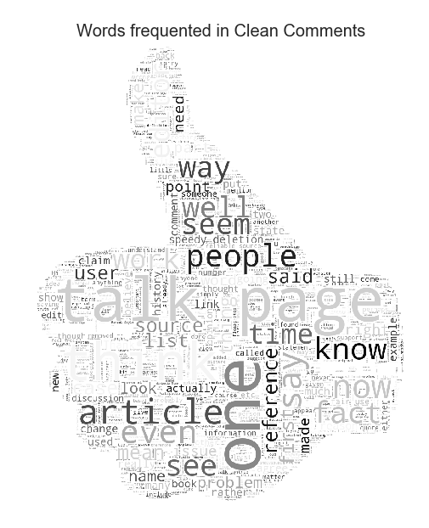
Clean vs Toxic

Slide 10
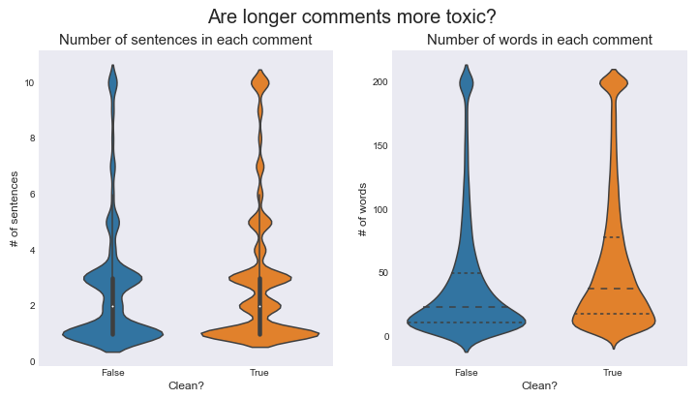
Feature Engineering
Some more experimental
features.
* count of sentences
* count of words
* count of unique words
* count of letters
* count of punctuations
* count of uppercase words
* count of stop words
* Avg length of each word

Slide 11
Data Cleaning
Lowercase, unnecessary characters, tokenize, lemmatize and stop word removal
Before Cleaning
Maybe you should look up what harassment is. Please change the reasoning for my block to something respectable that deals with the situation at hand. I did not harrass you in any way, shape, or form. I asked you to fuck off in the context of my user talk page. And I repeat again my statement, fuck off my talk page when this issue is over. It is my right to ask you to fuck off my talk page. It is not my right to block you from this page, but again it is my right to ask you to fuck off this user talk page. Bits andPieces'
After Cleaning
'maybe look harassment is. please change reason block something respectable deal situation hand. harrass way , shape , form. ask fuck context user talk page. repeat statement , fuck talk page issue over. right ask fuck talk page. right block page , right ask fuck user talk page. bits andpieces'

Slide 12
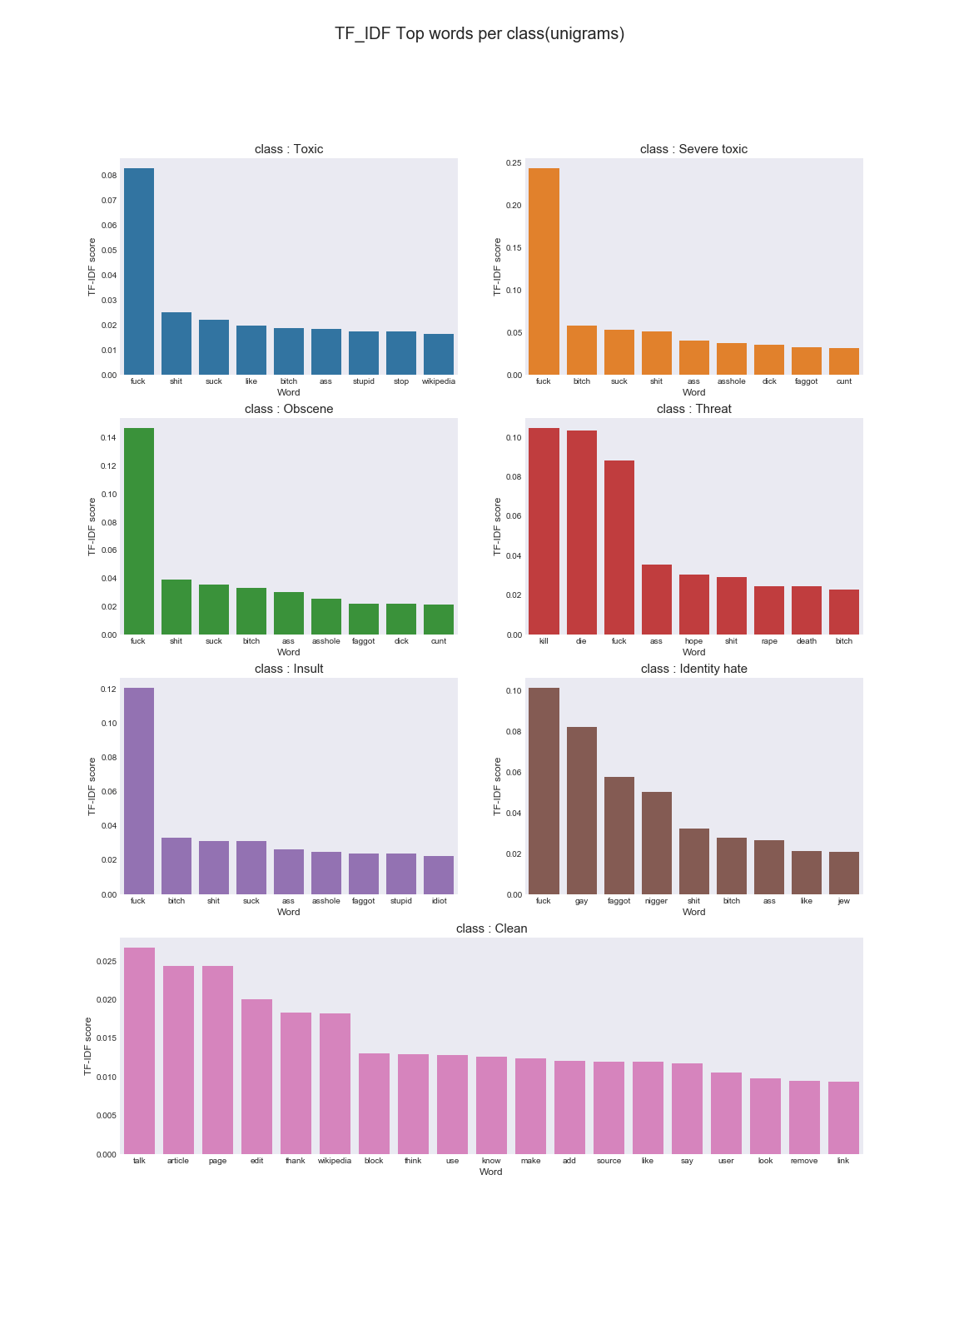
High TF-IDF Score words

Slide 13
High TF-IDF Score words

Slide 14
Evaluation
Class:= toxic
Trainloss=log loss: 0.217043723877
Validloss=log loss: 0.215407788877
Class:= severe_toxic
Trainloss=log loss: 0.037016773706
Validloss=log loss: 0.0374890010374
Class:= obscene
Trainloss=log loss: 0.135790166029
Validloss=log loss: 0.135707525478
Class:= threat
Trainloss=log loss: 0.016509595197
Validloss=log loss: 0.0159350389506
Class:= insult
Trainloss=log loss: 0.135880904458
Validloss=log loss: 0.136335652205
Class:= identity_hate
Trainloss=log loss: 0.0371163468534
Validloss=log loss: 0.0393481741255
mean column-wise log loss:Train dataset 0.0965595850201
mean column-wise log loss:Validation dataset 0.0967038634455
Accuracy
Toxic:0.8049445184809623
Severe_toxic: 0.9636923867885527
Obscene: 0.8730423561203243
Threat: 0.983671309933783
Insult: 0.8729961918308683
Identity_hate:0.9636276730380013

Slide 15
