Slide 1
CampusCompute: Intelligent Job Scheduling & Resource Management
TEAM MEMBER-1: NAME - ADITYA KUMAR P | SRN: PES1UG25CS036
TEAM MEMBER-2: NAME - AKSHAY SWAMY S B | SRN: PES1UG25CS047
Operating Systems (UE25CS242A) — Level 3 Mini-Project | Screenshots S01–S24

Slide 2
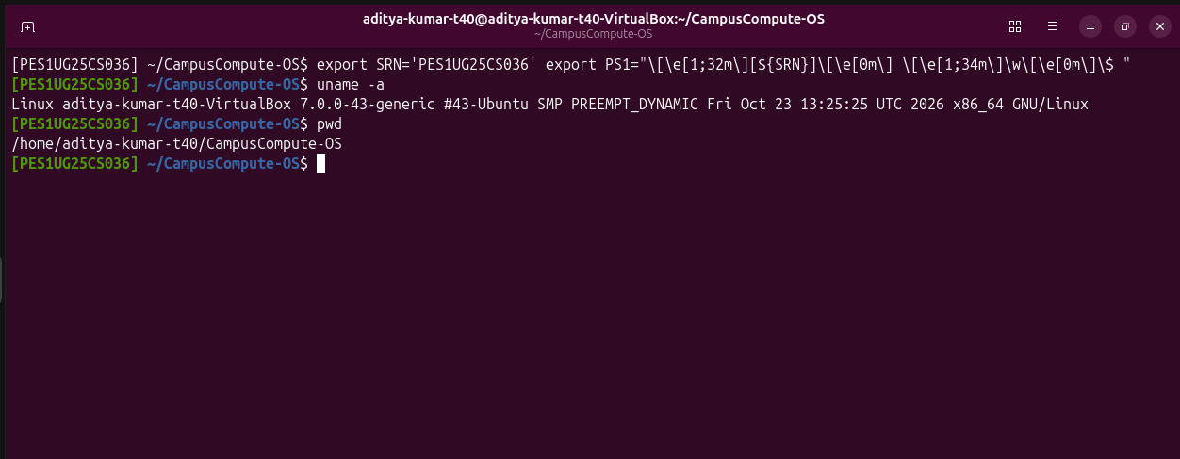
S01 – Environment and SRN prompt
S01 – Shows the Ubuntu Linux terminal environment, the student's complete SRN (PES1UG25CS036) configured in the shell prompt, and the CampusCompute working directory.

Slide 3
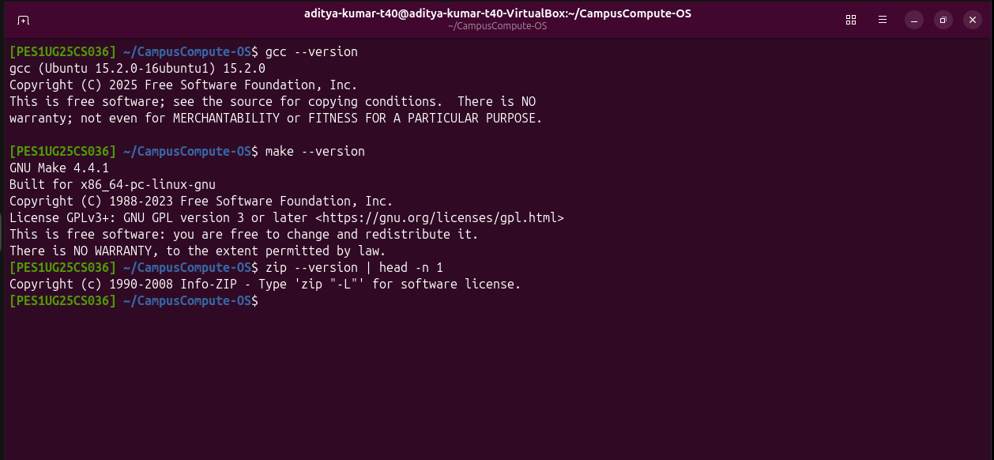
S02 – Compiler and build tools
S02 – Confirms that GCC, GNU Make, and required build tools are installed and available in the Ubuntu environment.

Slide 4
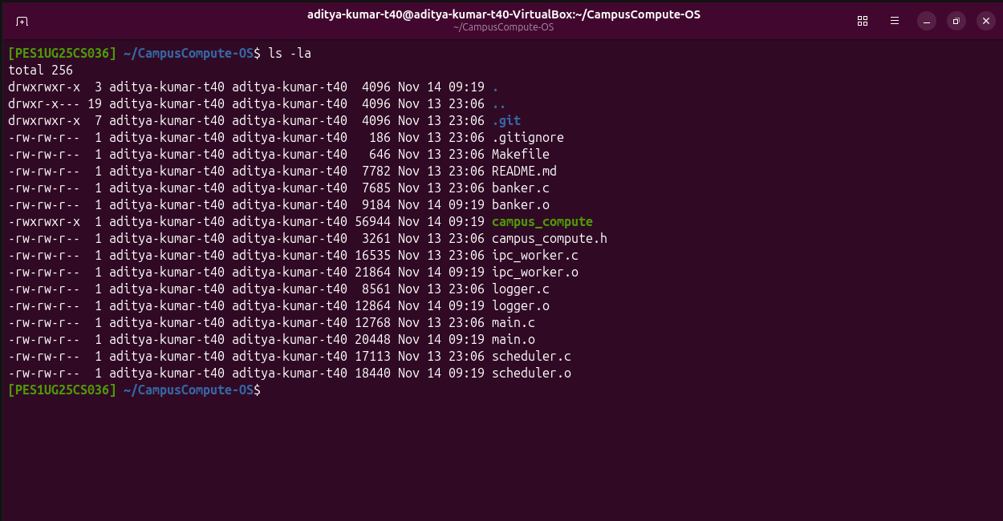
S03 – Project files
S03 – Displays the CampusCompute project directory containing all modular C source files, header file, Makefile, and README.

Slide 5
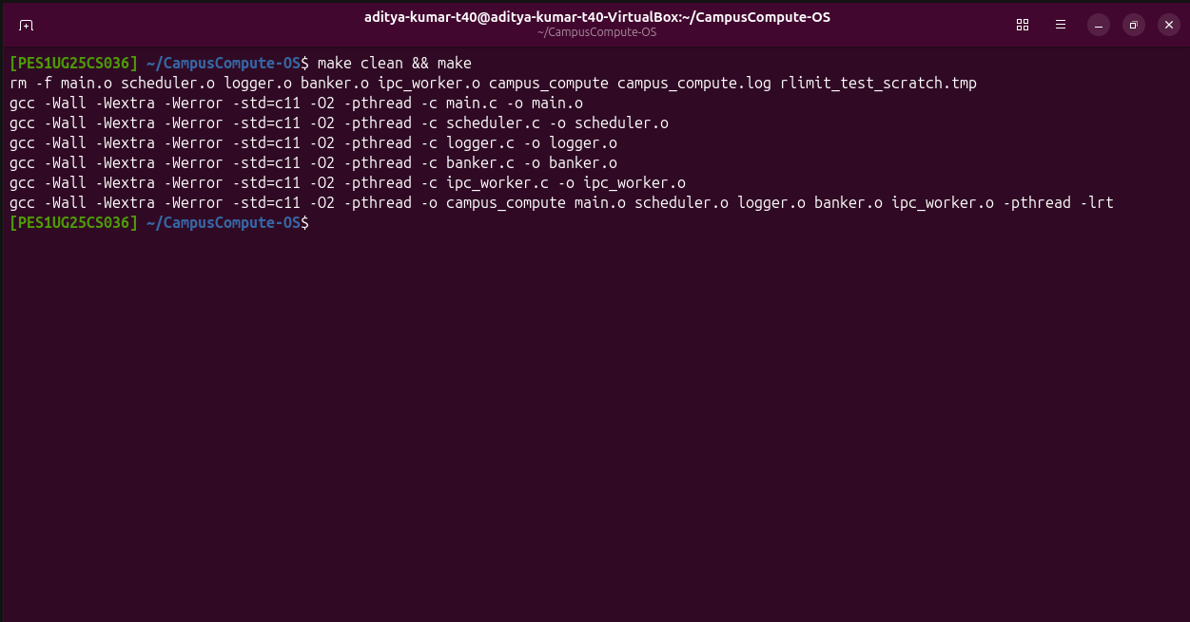
S04 – Clean build
S04 – Demonstrates the CampusCompute program compiling cleanly from source using Make with zero warnings or compiler errors.

Slide 6
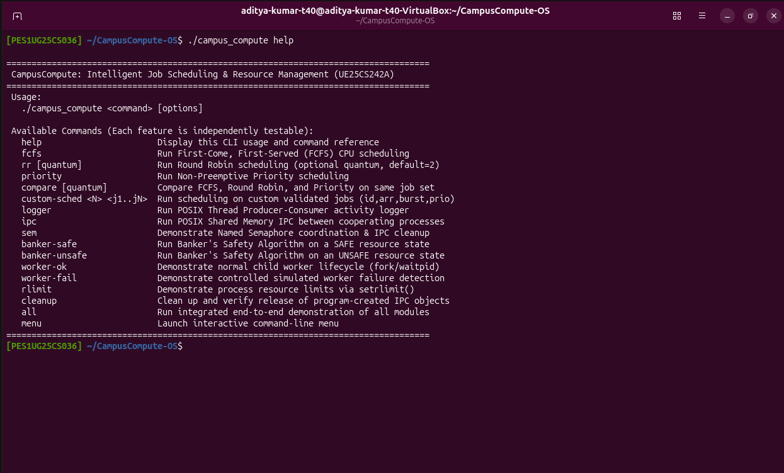
S05 – CLI help/usage
S05 – Shows the command-line interface help output listing all available commands, syntax, and interactive menu options.

Slide 7
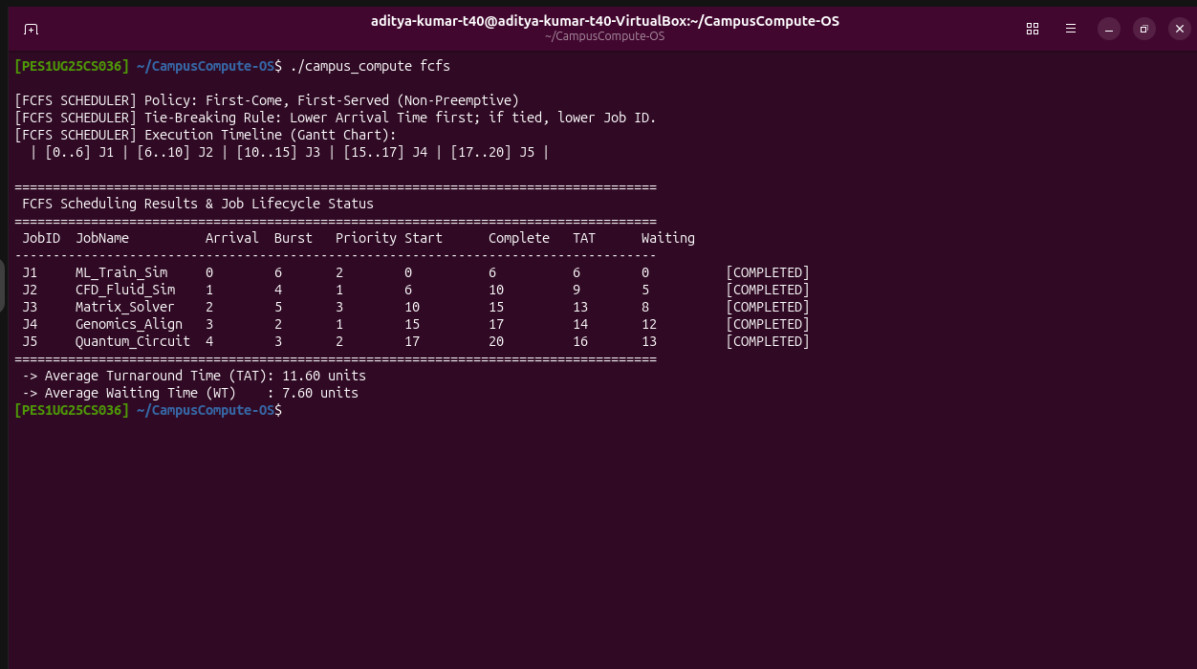
S06 – FCFS scheduling
S06 – Demonstrates First-Come, First-Served (FCFS) CPU scheduling with its execution order timeline, tie-breaking rule, and calculated turnaround and waiting times.

Slide 8
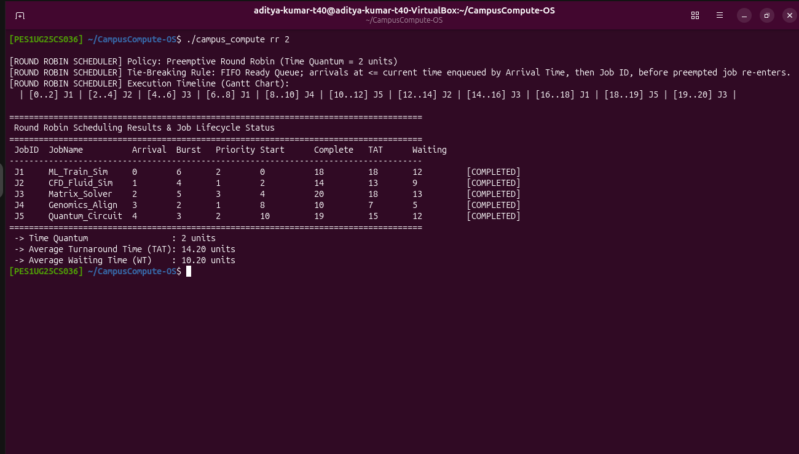
S07 – Round Robin scheduling
S07 – Demonstrates preemptive Round Robin scheduling with a time quantum of 2 units, Gantt execution timeline, and per-job scheduling metrics.

Slide 9
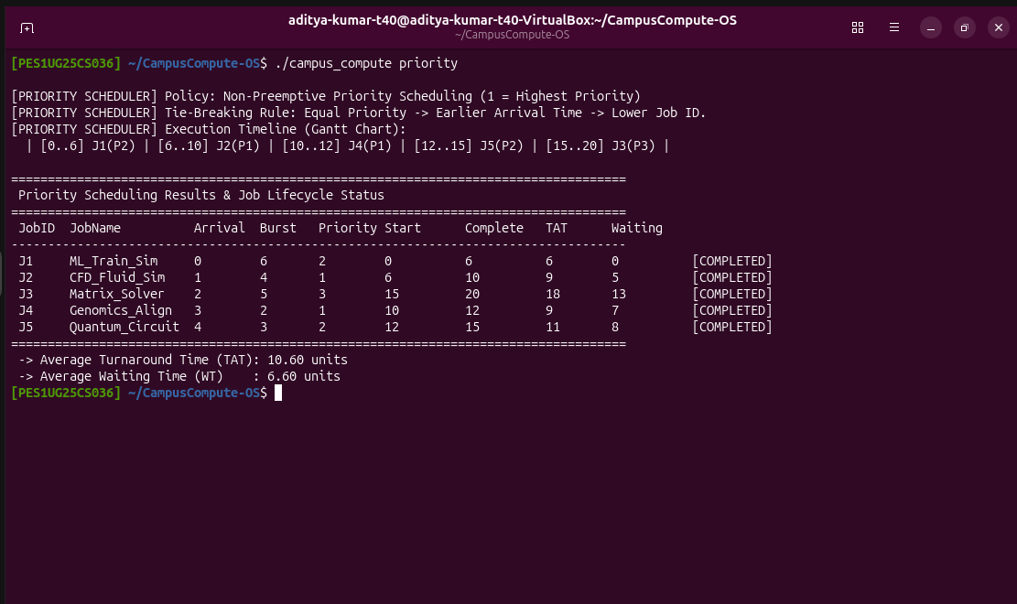
S08 – Priority scheduling
S08 – Shows non-preemptive Priority Scheduling (where lower number indicates higher priority), tie-breaking rule, and calculated scheduling metrics.

Slide 10
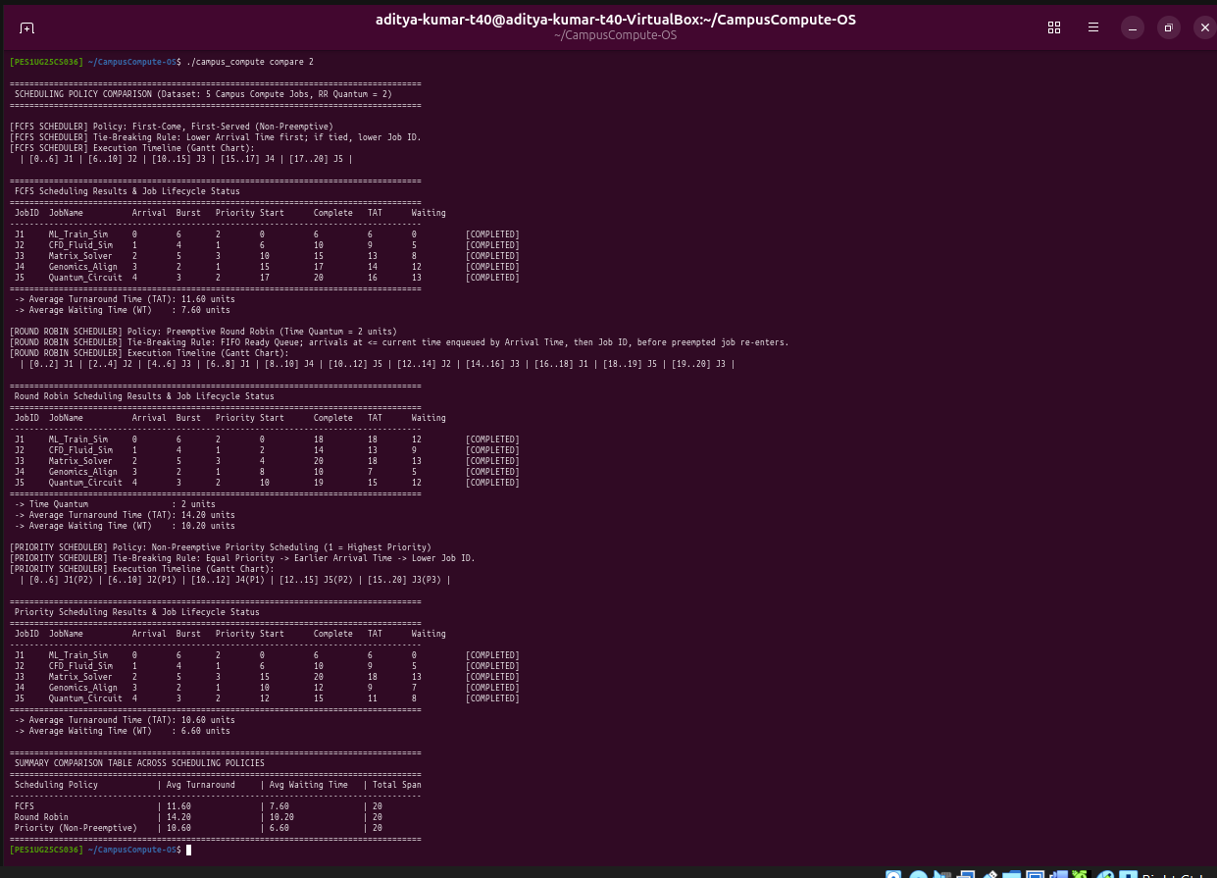
S09 – Scheduling comparison
S09 – Compares FCFS, Round Robin (Quantum = 2), and Non-Preemptive Priority scheduling side-by-side on the identical 5-job workload.

Slide 11
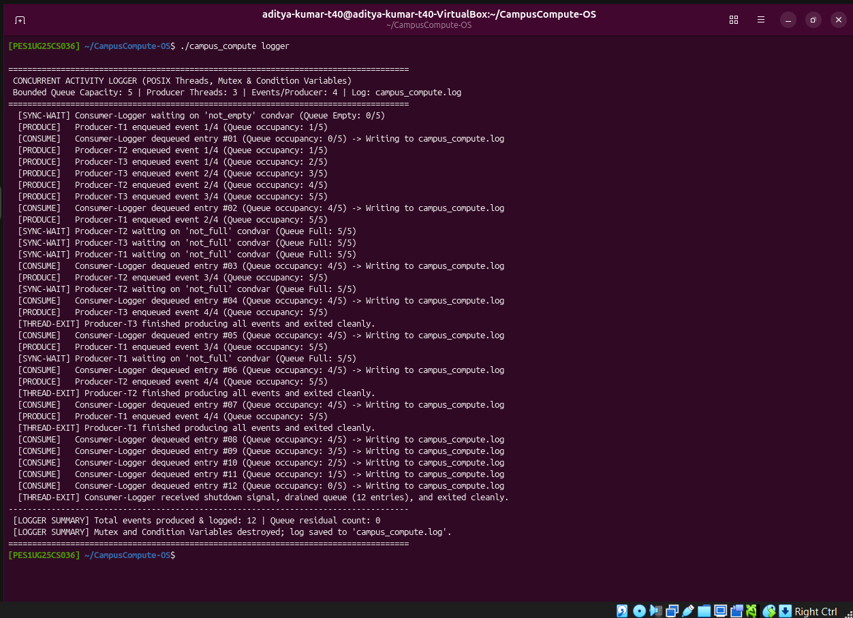
S10 – Producer-consumer logger
S10 – Shows concurrent producer threads enqueuing job events and the consumer logger thread dequeuing entries from the bounded queue (capacity 5) into campus_compute.log.

Slide 12
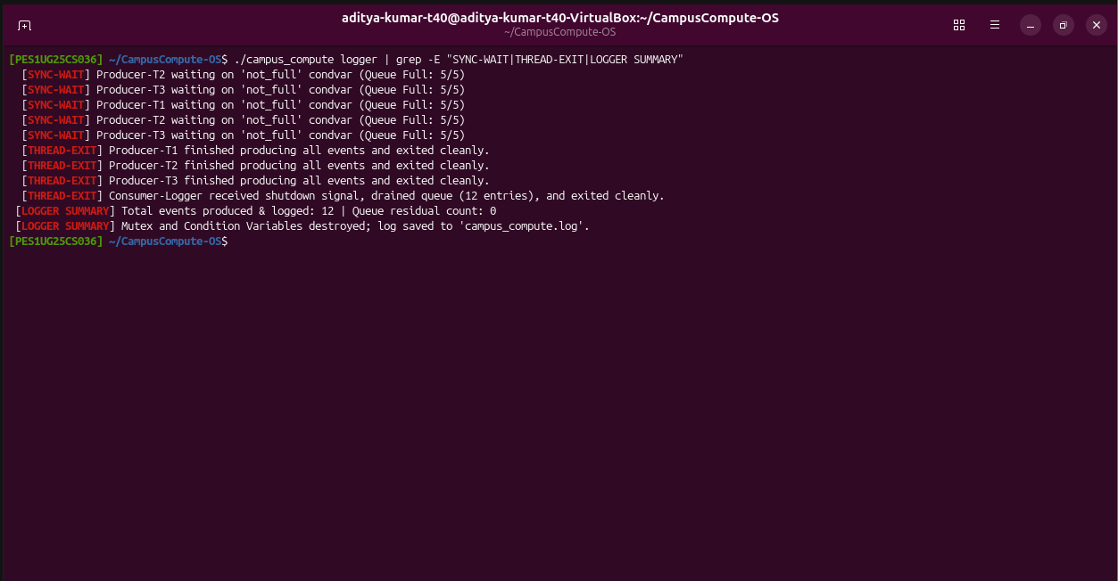
S11 – Thread synchronization and termination
S11 – Demonstrates condition-variable synchronization (waiting on full/empty queue states) and orderly termination of all producer and consumer threads.

Slide 13
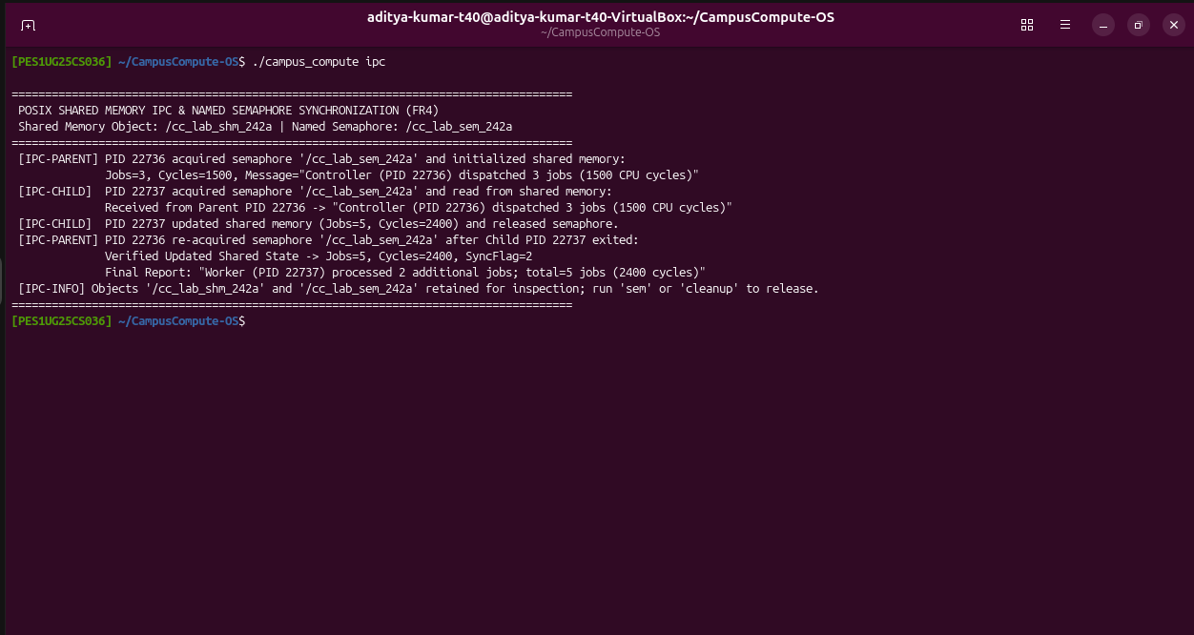
S12 – Shared-memory IPC
S12 – Demonstrates cooperating parent and child processes exchanging cluster telemetry through POSIX shared memory (/cc_lab_shm_242a).

Slide 14
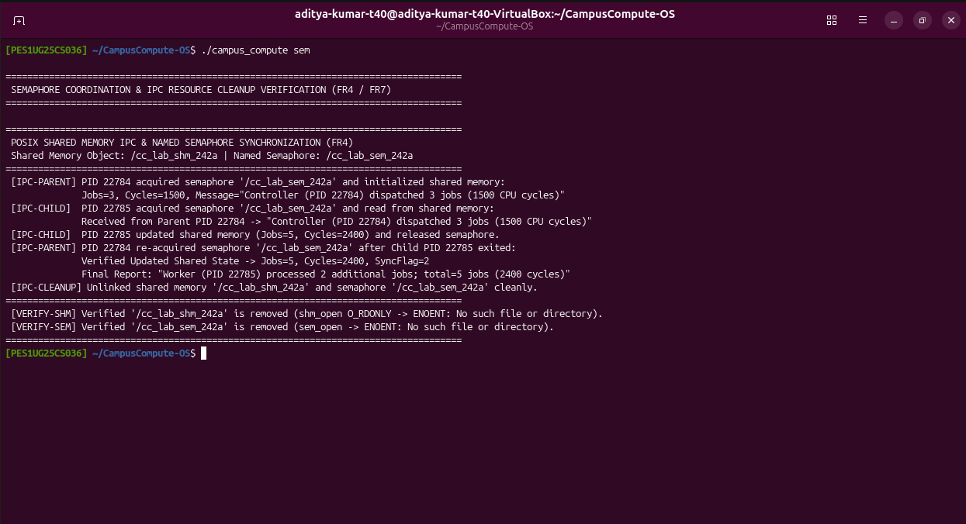
S13 – Semaphore coordination and cleanup
S13 – Shows mutual exclusion using the POSIX named semaphore (/cc_lab_sem_242a) and verifies complete unlinking and cleanup of created IPC resources.

Slide 15
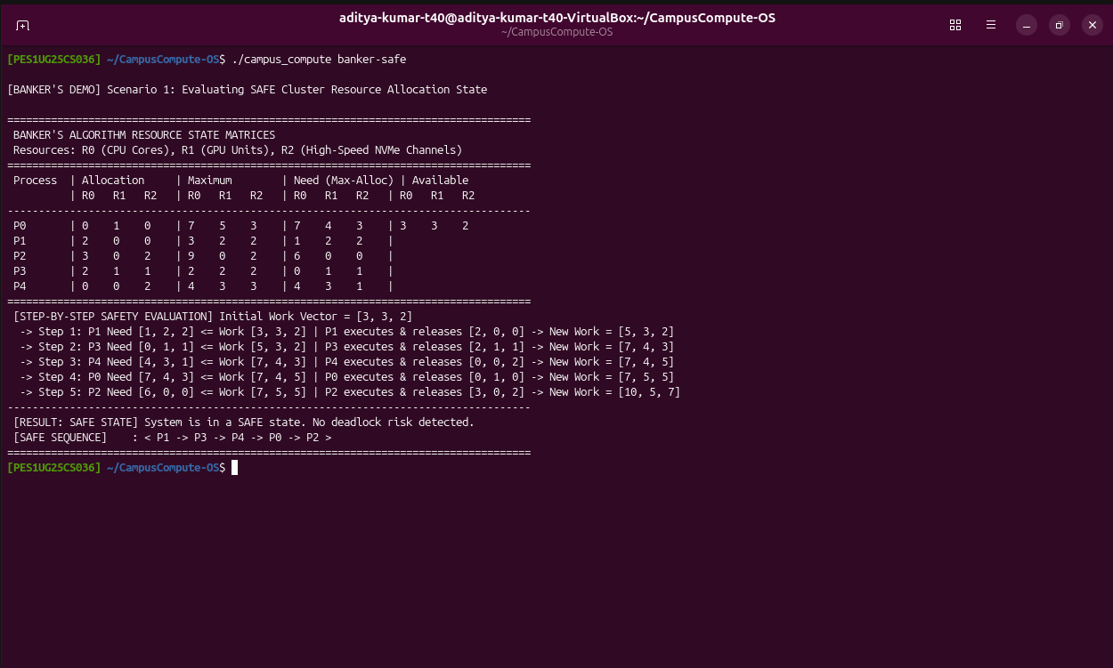
S14 – Banker's safe state
S14 – Demonstrates the Banker's safety algorithm evaluating a safe resource state and producing the valid safe execution sequence <P1 -> P3 -> P4 -> P0 -> P2>.

Slide 16
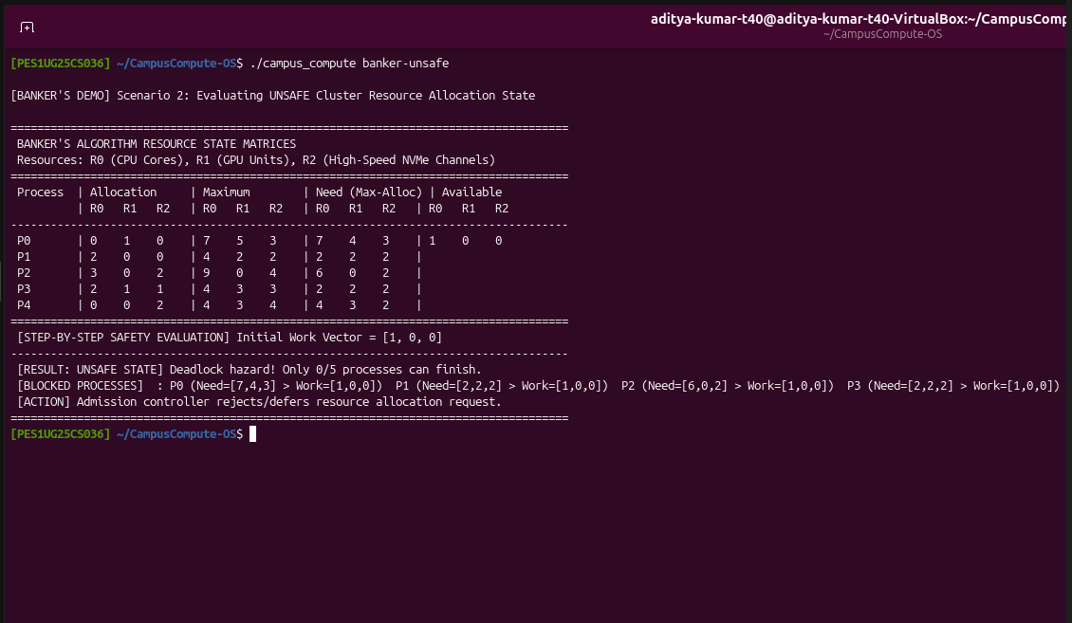
S15 – Banker's unsafe state
S15 – Shows the Banker's safety algorithm detecting an unsafe resource state where remaining process needs exceed available work, preventing deadlock.

Slide 17
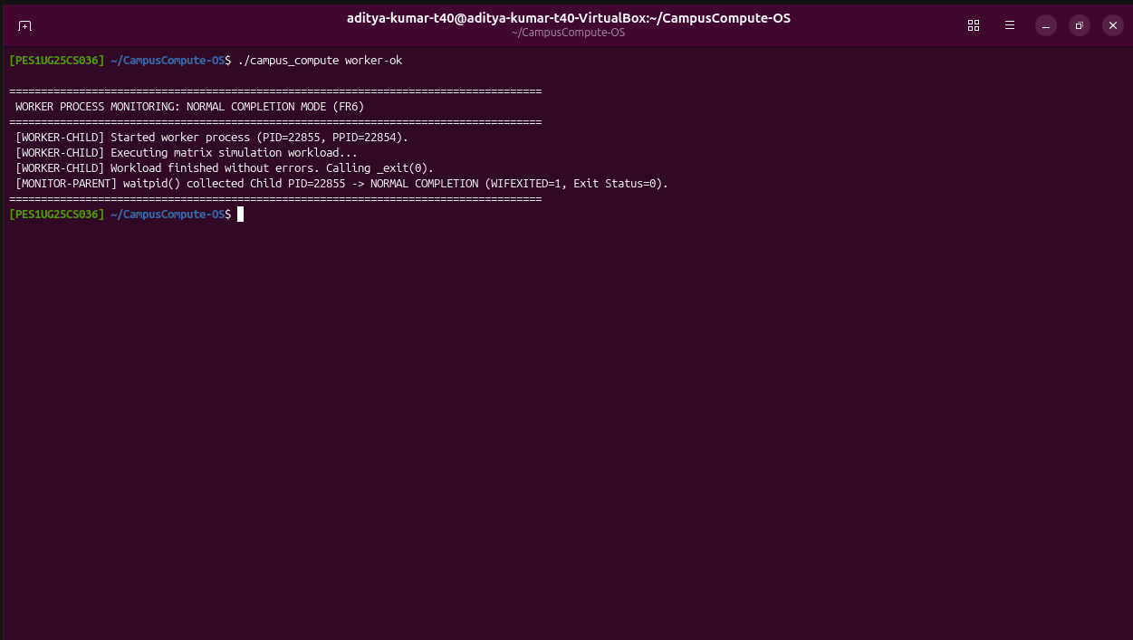
S16 – Normal worker process
S16 – Shows child worker process creation via fork() and parent collection of normal completion status (exit status 0) via waitpid().

Slide 18
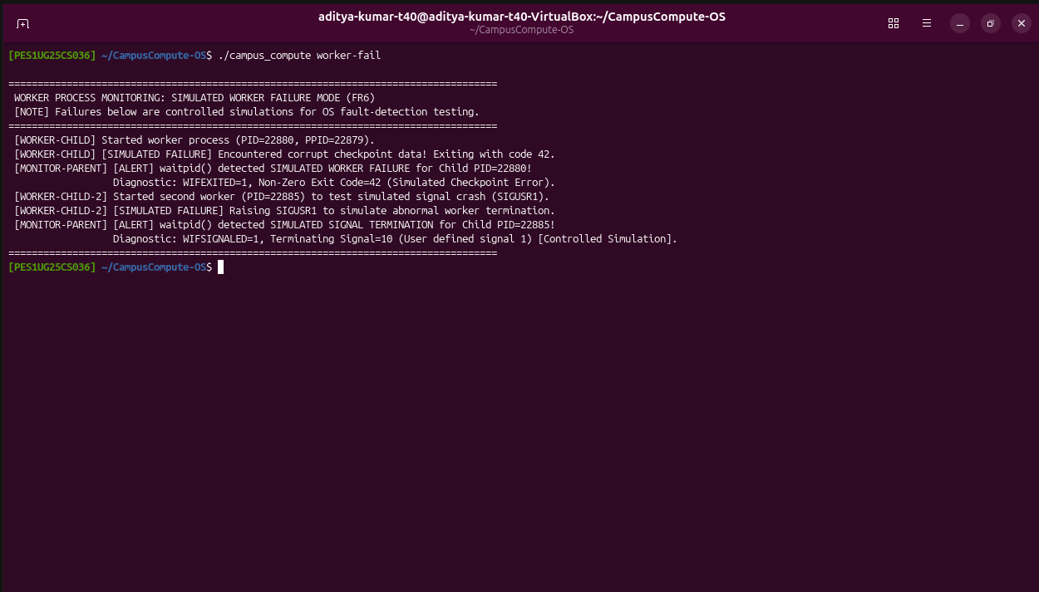
S17 – Simulated worker failure
S17 – Demonstrates controlled simulated worker failures (non-zero exit code 42 and SIGUSR1 termination) and accurate parent-side failure detection.

Slide 19
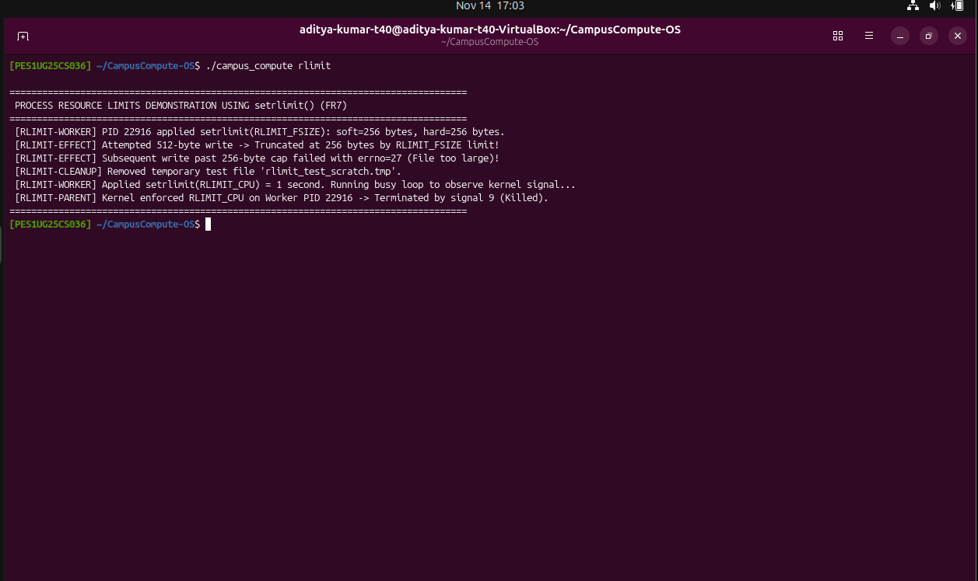
S18 – Resource-limit demonstration
S18 – Demonstrates applying process resource limits via setrlimit() (RLIMIT_FSIZE = 256B and RLIMIT_CPU = 1s) and shows the observed kernel enforcement.

Slide 20
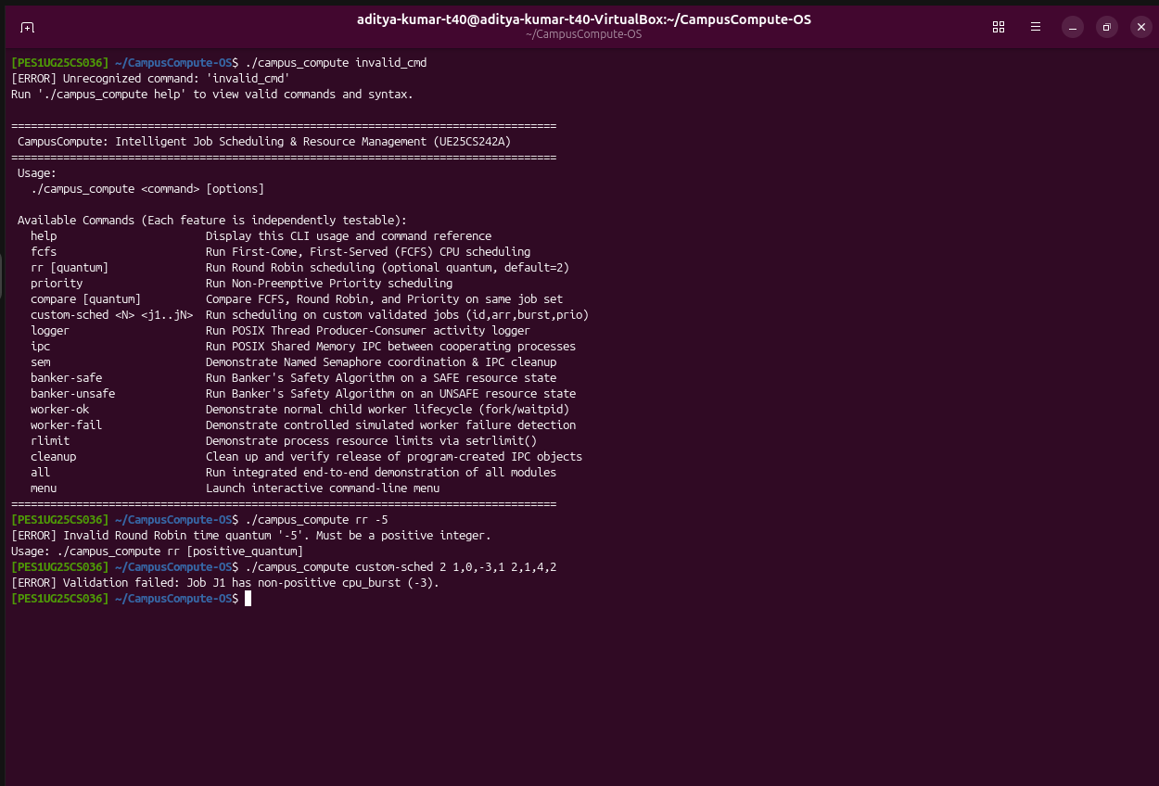
S19 – Invalid input/command
S19 – Shows error handling and usage messages when an unrecognized command, negative time quantum, or invalid job burst is provided.

Slide 21
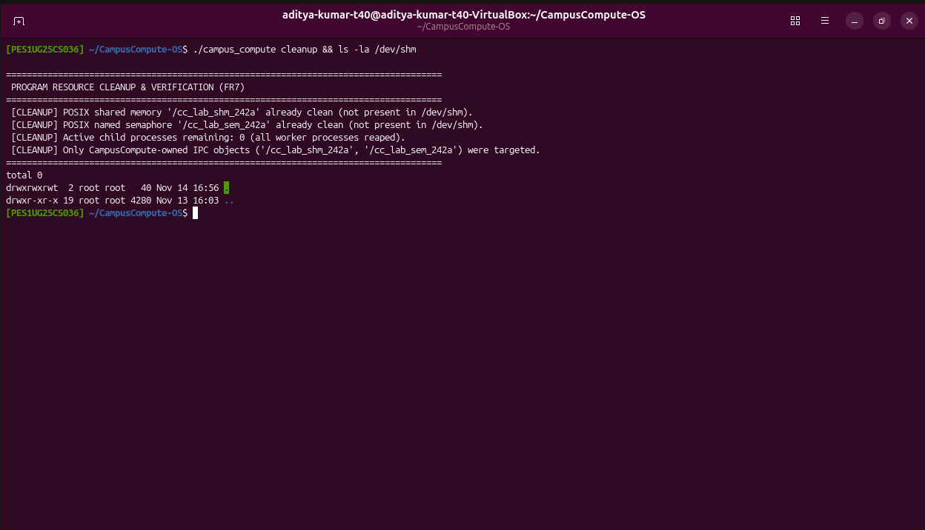
S20 – Cleanup verification
S20 – Confirms that all worker processes have ended and all CampusCompute-created shared memory and semaphore objects are released from /dev/shm.

Slide 22
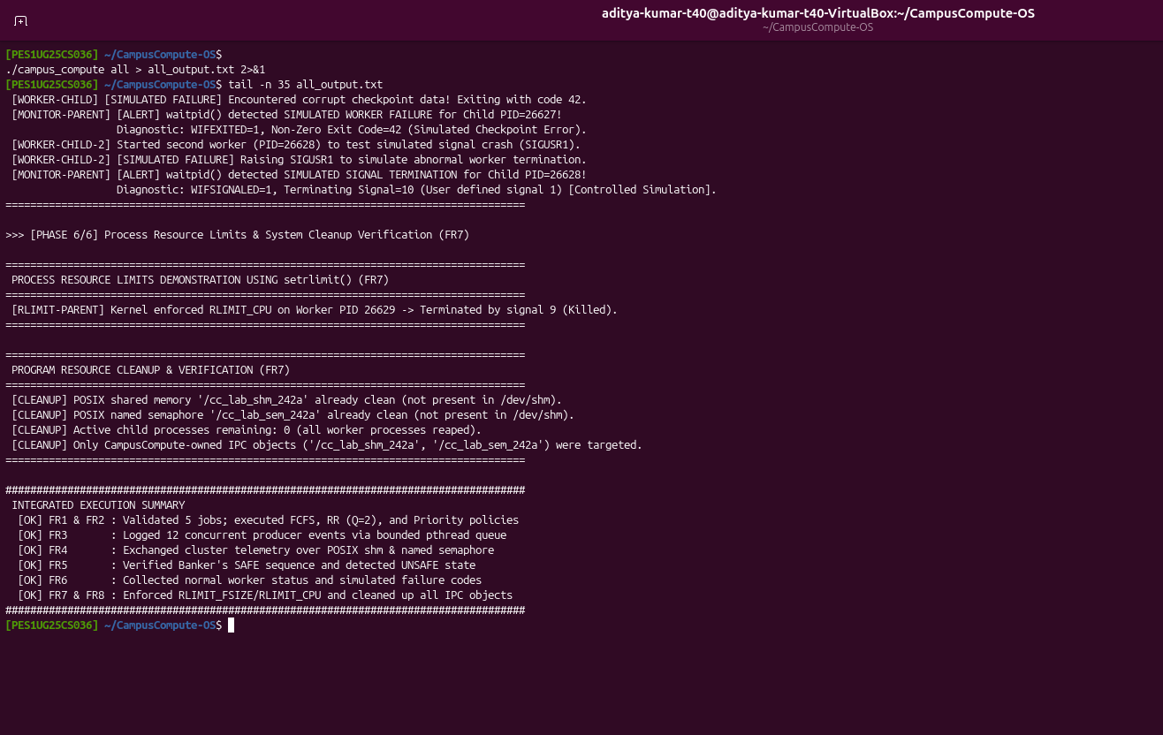
S21 – Integrated execution
S21 – Shows the end-to-end integrated execution across all six CampusCompute subsystems and prints the final verification summary.

Slide 23
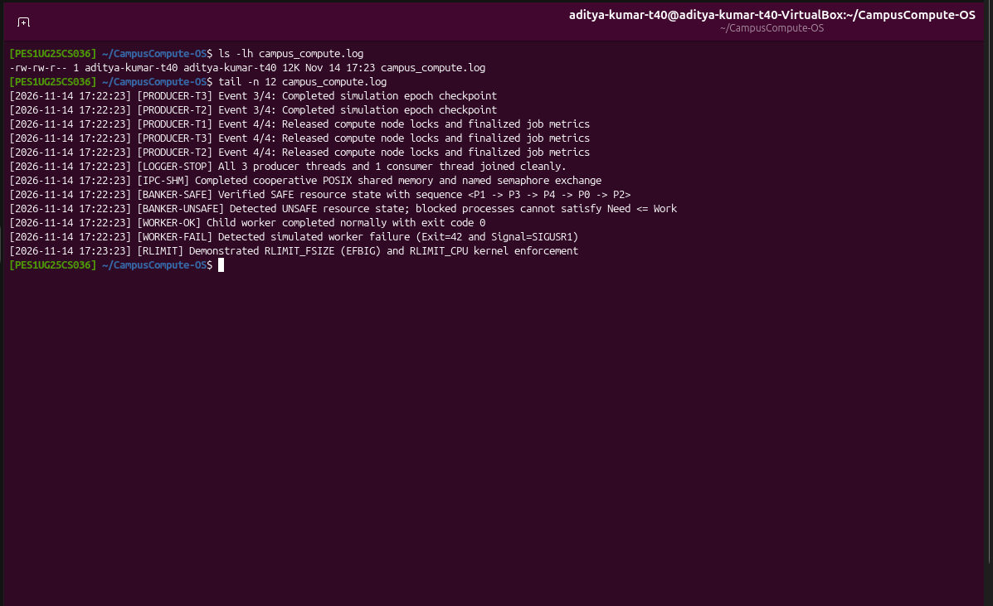
S22 – Generated logs
S22 – Displays the campus_compute.log file generated by the program along with a sample of its timestamped producer-consumer and subsystem log entries.

Slide 24
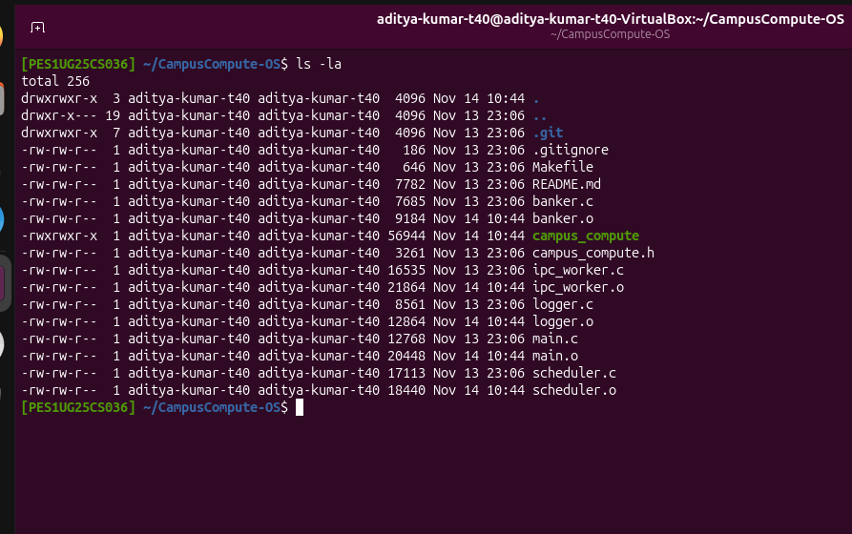
S23 – Final source and build files
S23 – Shows the final source files, header, Makefile, README, and compiled campus_compute executable in the project directory.

Slide 25
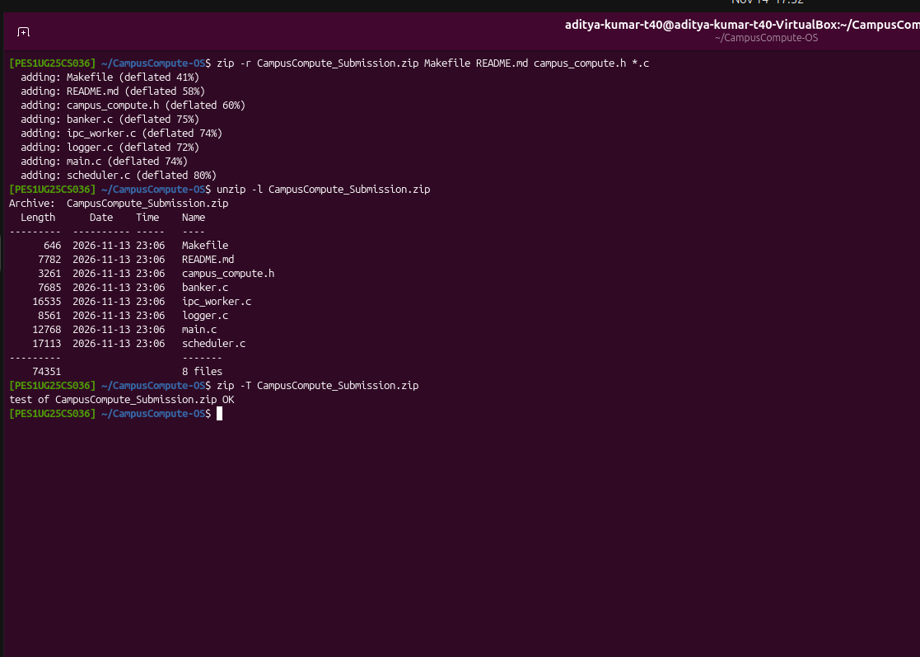
S24 – Submission ZIP
S24 – Shows the contents of the CampusCompute_Submission.zip archive and confirms a successful archive integrity check.

Slide 26
Thank You
TEAM MEMBER-1: NAME - ADITYA KUMAR P | SRN: PES1UG25CS036
TEAM MEMBER-2: NAME - AKSHAY SWAMY S B | SRN: PES1UG25CS047
CampusCompute: Intelligent Job Scheduling & Resource Management

