Slide 1
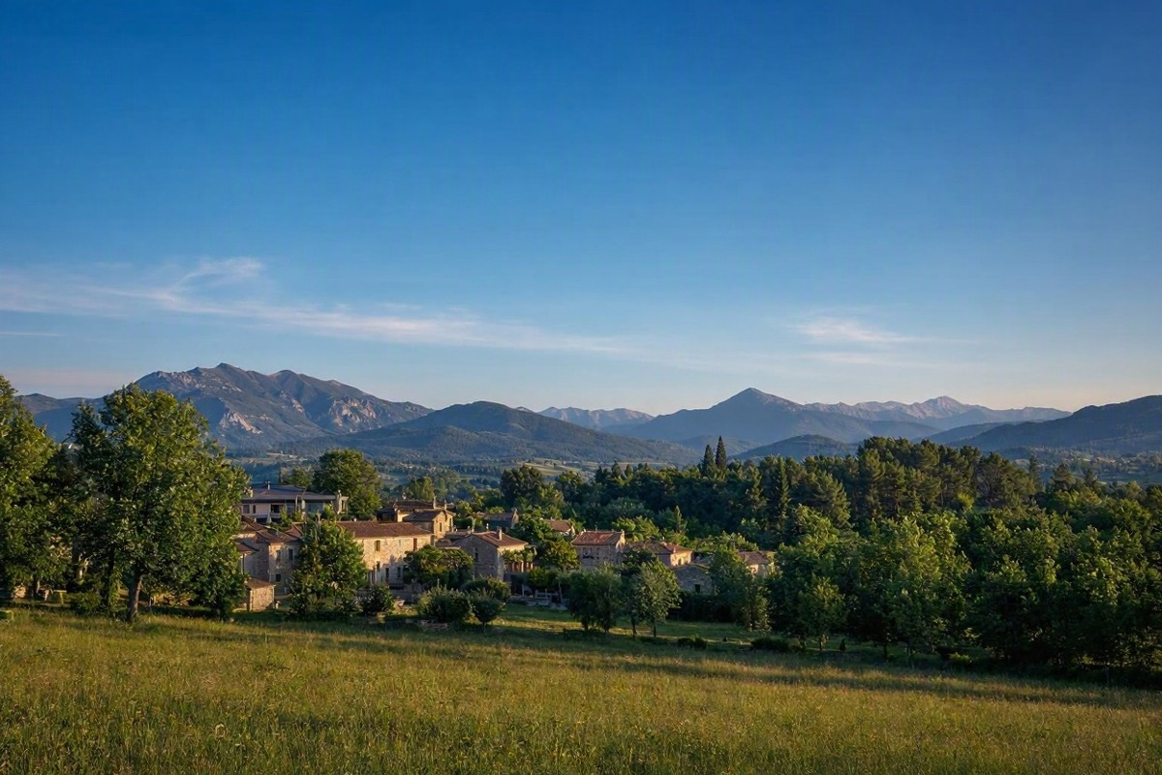
MATHEMATICAL FOUNDATION FOR AI & DATA SCIENCE
Matrix Multiplication,
Inversion & Photo Filters
A Python-based mini-project
PES UNIVERSITY, BENGALORE
Course Code: UE25MA242A
Aditya Kumar P | PES1UG25CS036
A B Sharvesh | PES1UG25CS001
Abhinav Akinepalli | PES1UG25CS013
Mini-Project Presentation

Slide 2
Introduction
02
Matrices are grids of numbers. In digital images, pixel colour values can be stored as numerical arrays.
MATRIX OPERATIONS
PIXELS & RGB
IMAGE FILTERS
Multiply matrices and calculate the inverse of a suitable square matrix.
Represent each colour pixel using Red, Green and Blue intensity values.
Change pixel values mathematically to produce a visual effect.
Core idea: Photo → Pixels → Numbers → Mathematical operations → Filtered photo
PES UNIVERSITY • UE25MA242A • Mathematical Foundation for AI & Data Science

Slide 3
Project Objectives
03
Implement matrix multiplication using NumPy.
Calculate a matrix inverse and verify A × A⁻¹ ≈ I.
Load a real photograph and inspect its numerical representation.
Apply brightness, negative and contrast transformations to pixel values.
Compare the original image with the filtered outputs.
Tools used: Python • NumPy • Pillow
PES UNIVERSITY • UE25MA242A • Mathematical Foundation for AI & Data Science

Slide 4
Matrix Multiplication
04
Example
Each output entry is calculated by taking a row of A and a column of B, multiplying matching values, then adding them.
A = [[2, 1], [1, 1]]
B = [[3, 2], [4, 5]]
C = A × B = [[10, 9], [7, 7]]
C = A @ B
print(C)
In NumPy, @ performs matrix multiplication.
PES UNIVERSITY • UE25MA242A • Mathematical Foundation for AI & Data Science

Slide 5
Matrix Inversion & Verification
05
For A = [[2, 1], [1, 1]]
A_inv = np.linalg.inv(A)
check = A @ A_inv
print(np.round(check, 10))
A⁻¹ = [[1, −1], [−1, 2]]
A × A⁻¹ = I
I = [[1, 0], [0, 1]]
A matrix inverse exists only when the matrix is square and nonsingular (det(A) ≠ 0).
PES UNIVERSITY • UE25MA242A • Mathematical Foundation for AI & Data Science

Slide 6
How Is an Image Stored?
06
Image size: 1248 × 832 pixels (width × height)
Array shape: 832 × 1248 × 3
Each colour pixel stores three intensity values:
R = Red G = Green B = Blue
For 8-bit RGB images, each channel is in the range 0–255.
Our input image
image_array = np.array(image)
PES UNIVERSITY • UE25MA242A • Mathematical Foundation for AI & Data Science

Slide 7
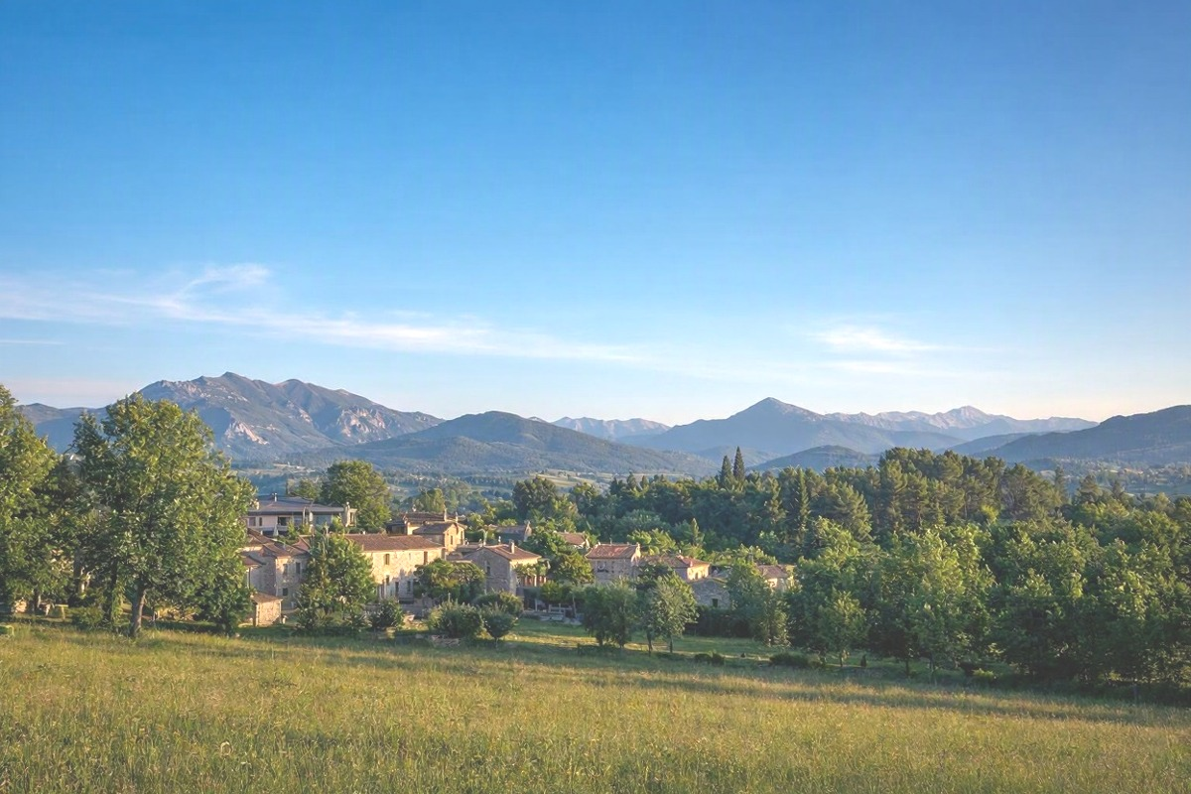
Photo Filter 1: Brightness
07
Original image
Brightness +50
Formula: I_new = min(I + 50, 255)
bright = np.clip(image_array.astype(np.int16) + 50, 0, 255)
PES UNIVERSITY • UE25MA242A • Mathematical Foundation for AI & Data Science

Slide 8
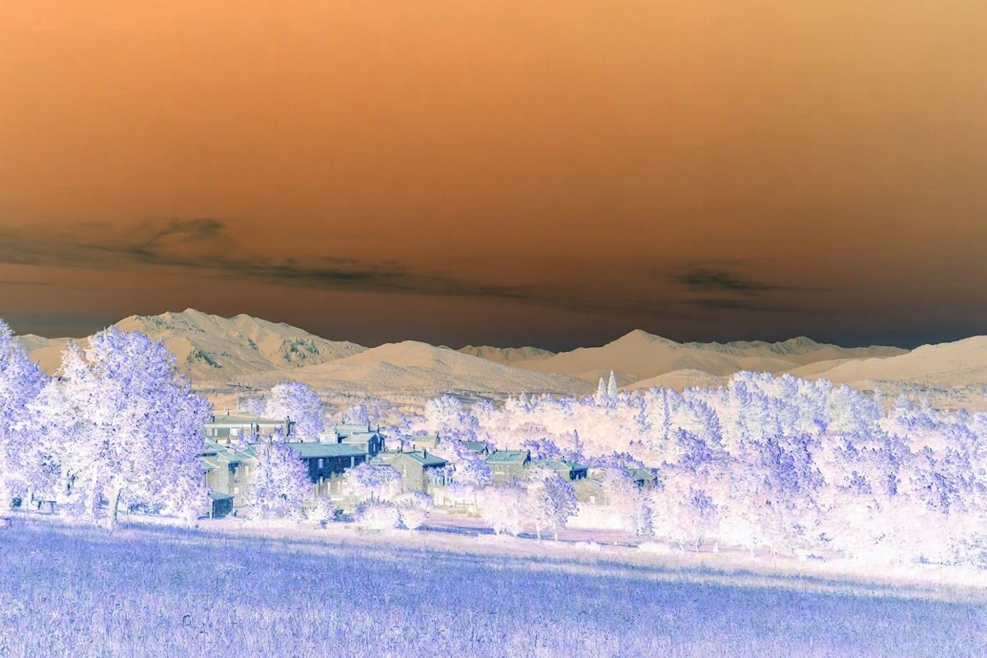
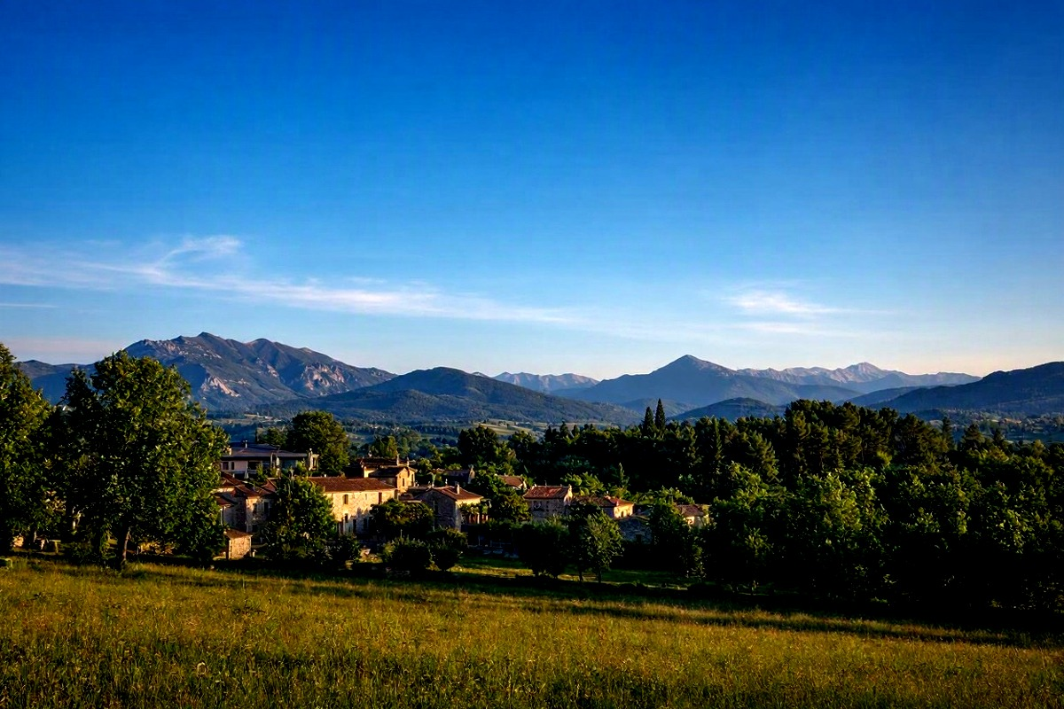
Photo Filters 2 & 3
08
Negative
Contrast
Original
Negative: I_new = 255 − I
Contrast: I_new = 128 + 1.5(I − 128)
Pixel values are clipped to the valid range [0, 255].
PES UNIVERSITY • UE25MA242A • Mathematical Foundation for AI & Data Science

Slide 9
Results & Applications
09
Matrix multiplication and inverse were computed successfully with NumPy.
The inverse was verified by checking that A × A⁻¹ is approximately the identity matrix.
Three image transformations were produced: brightness, negative and contrast.
The same pixel-wise operation is applied to each RGB channel.
Applications
Photo editing
Image enhancement
Computer vision preprocessing
Digital photography
PES UNIVERSITY • UE25MA242A • Mathematical Foundation for AI & Data Science

Slide 10
Conclusion
This mini-project connects mathematical matrix operations with a practical Python application.
NumPy makes matrix calculations straightforward.
A colour image can be represented as an array of RGB pixel values.
Changing pixel values mathematically creates visible photo filters.
Thank you
Questions?

