Slide 1
Smart Greenhouse System using IOT
Amit Chakma
Evrad Leuteu
Jires Donfack
Aditya Kumar

Slide 2
01
02
Technology
Introduction
03
Scenarios
04
Implementations

Slide 3
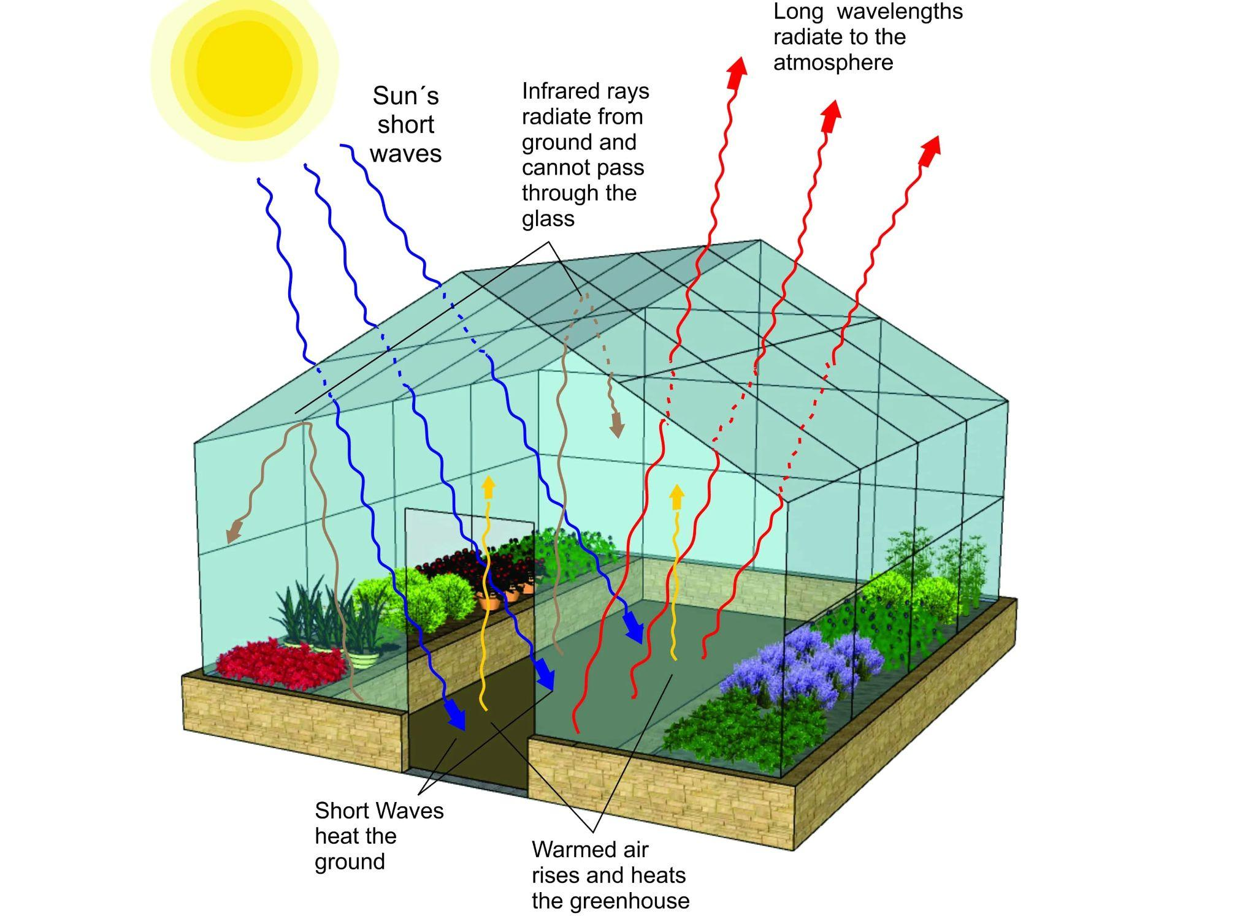
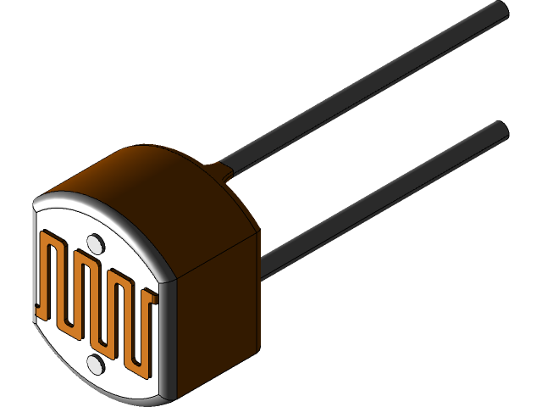
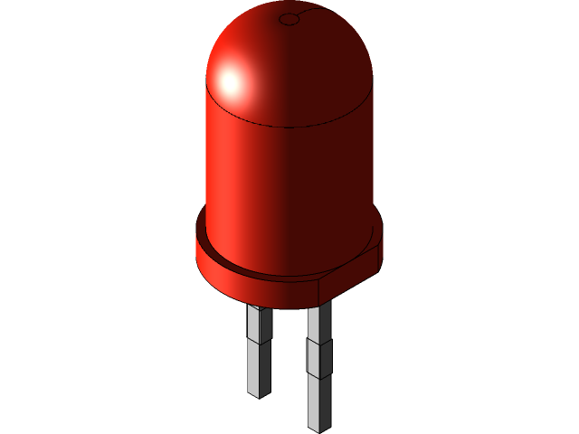
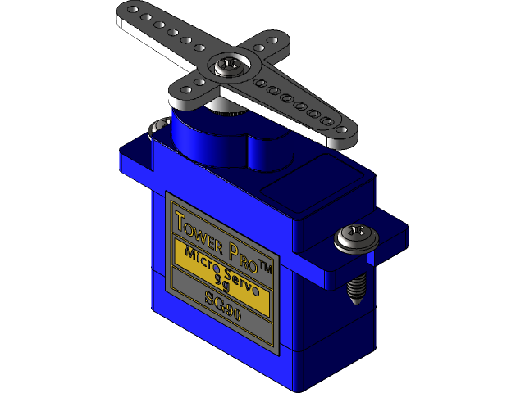
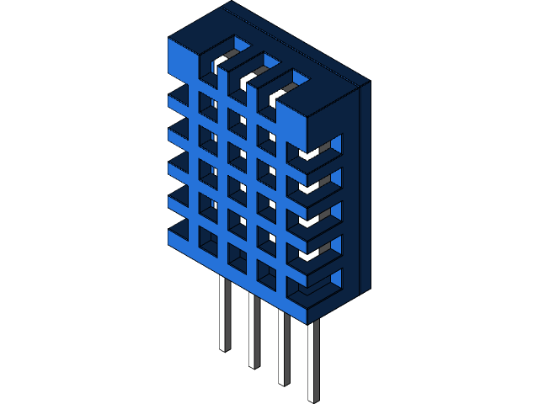
Introduction

Slide 4
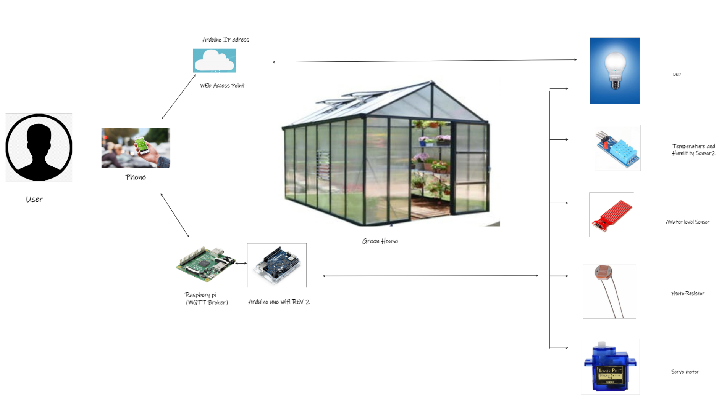
Technology

Slide 5
Communication Protocols
MQTT
WI-FI

Slide 6
Scenarios
Requirements | Scenario 1 | Scenario 2 | Scenario 3
Arduino uno wifi R2 | Temperatur | Photoresistor | Smart phone
Raspberry pi 3 | Humidity | Servo motor | LED
Sensors | Water | LED

Slide 7
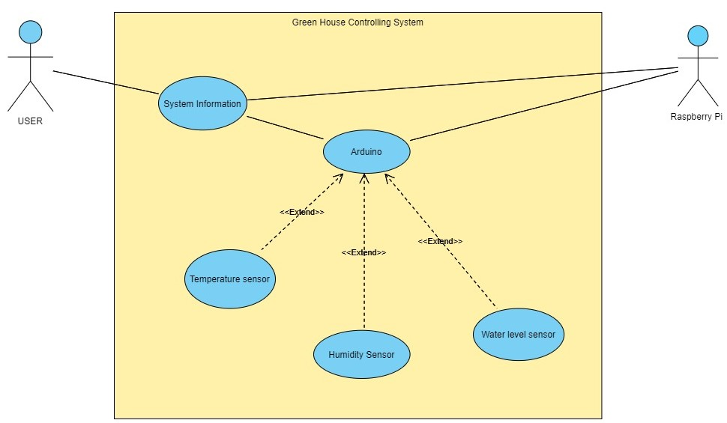
Scenario 1: Monitoring Temperature/Humidity and water level

Slide 8
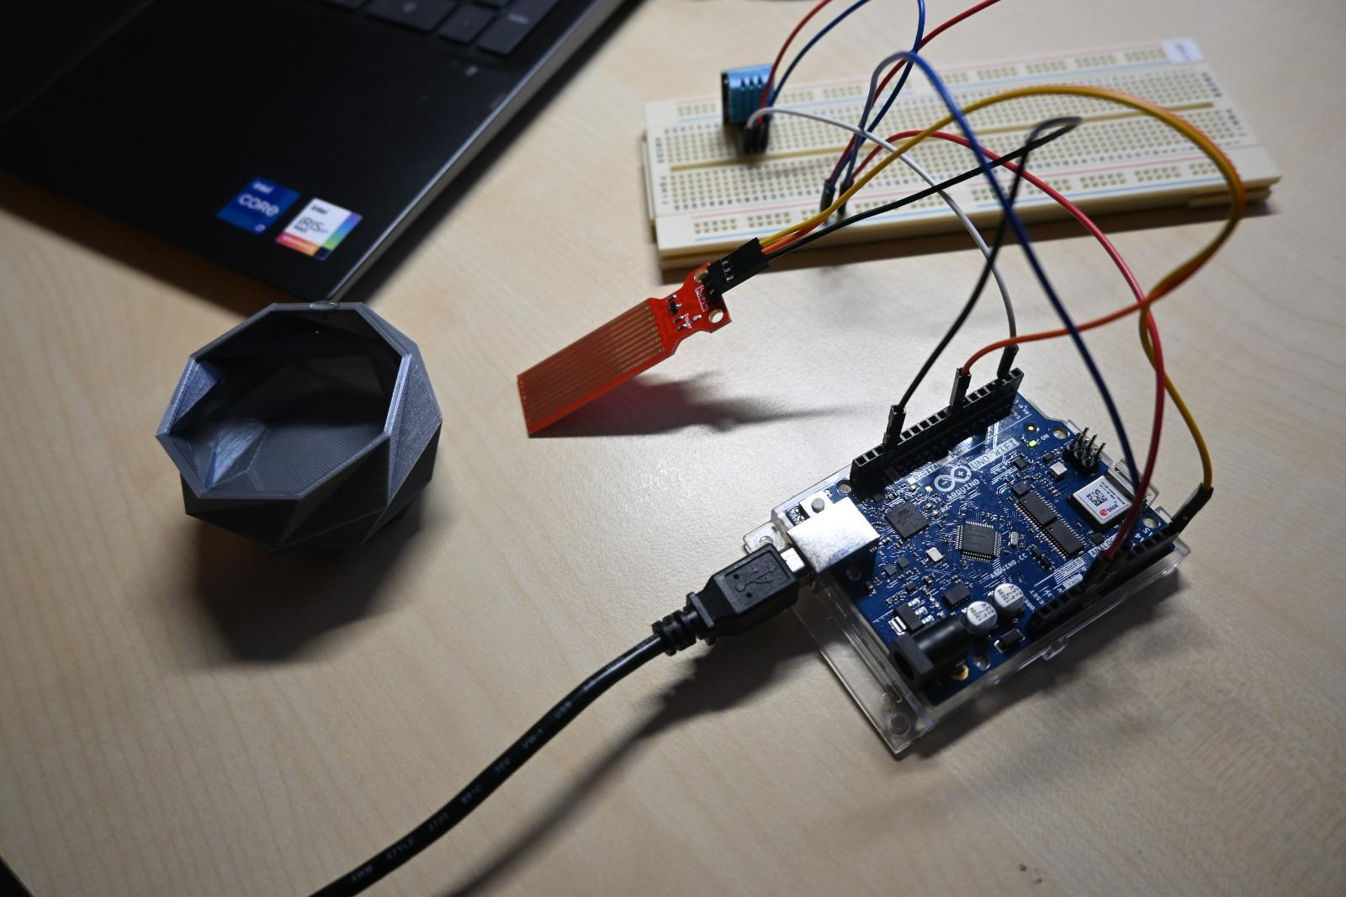
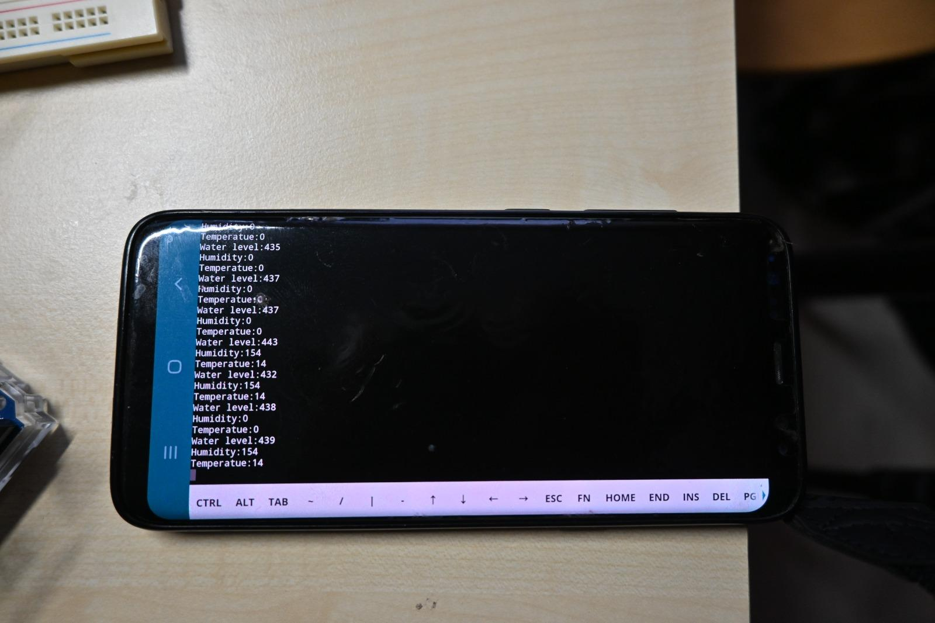
Scenario 1
Implementation
Output(Subscriber)

Slide 9
Simulation 1
https://docs.google.com/presentation/d/1bnIOXp3jjrVgozw8oYwH33jjW0aOwu85GynzHD9OaL4/edit#slide=id.p

Slide 10
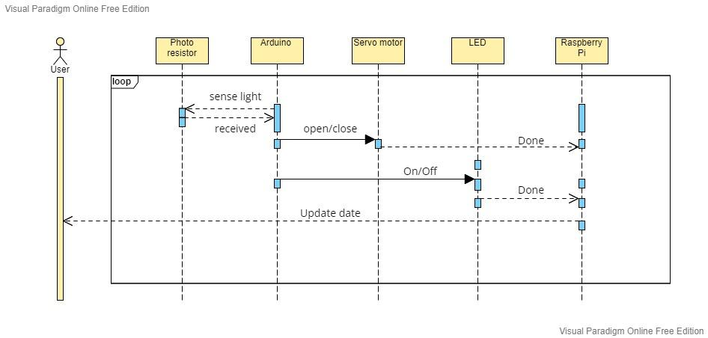
Senario 2: Autonomous LED and Motor control

Slide 11
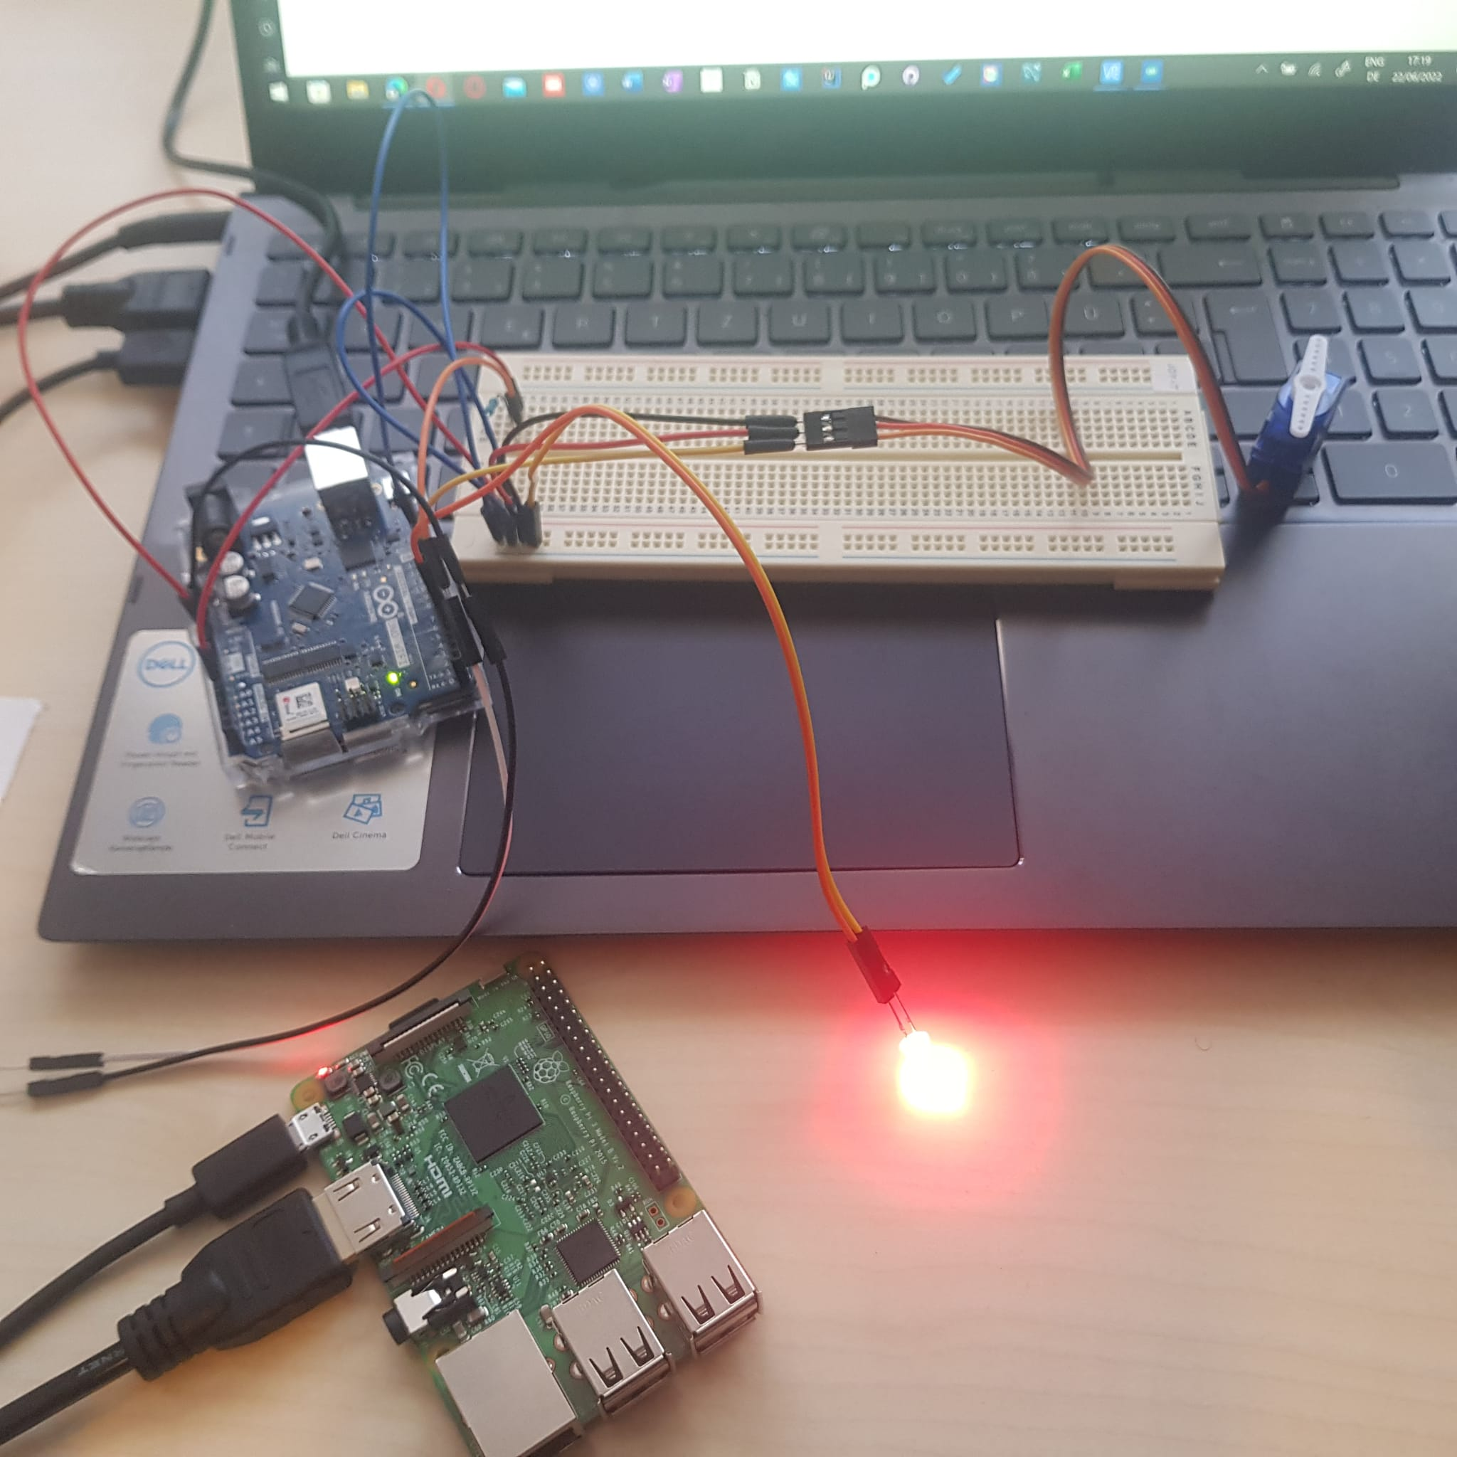
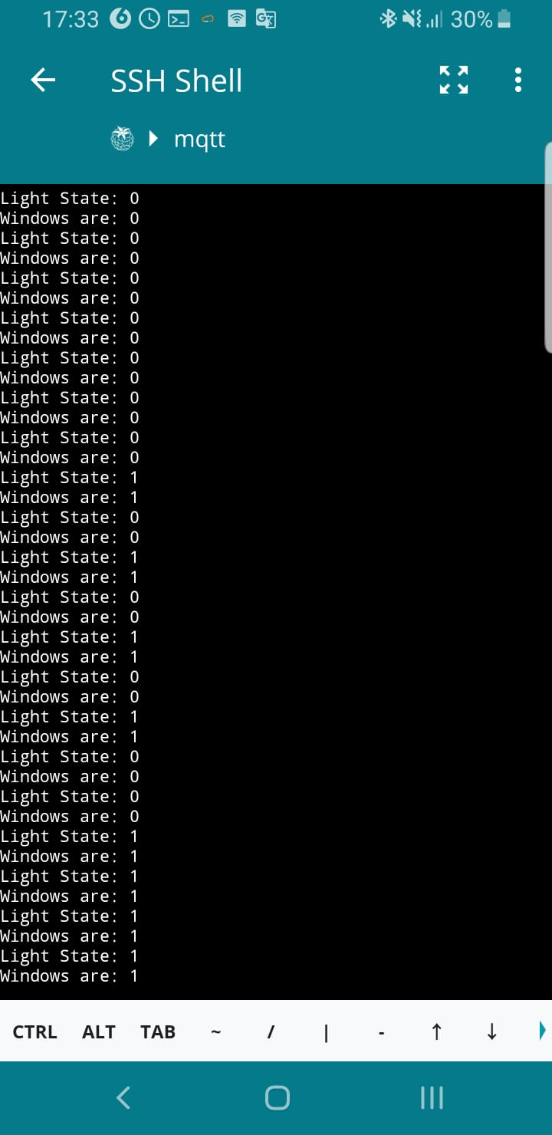
Scenario 2
Implementation
Output(Subscriber)

Slide 12
Simulation 2
https://docs.google.com/presentation/d/1bnIOXp3jjrVgozw8oYwH33jjW0aOwu85GynzHD9OaL4/edit#slide=id.p

Slide 13
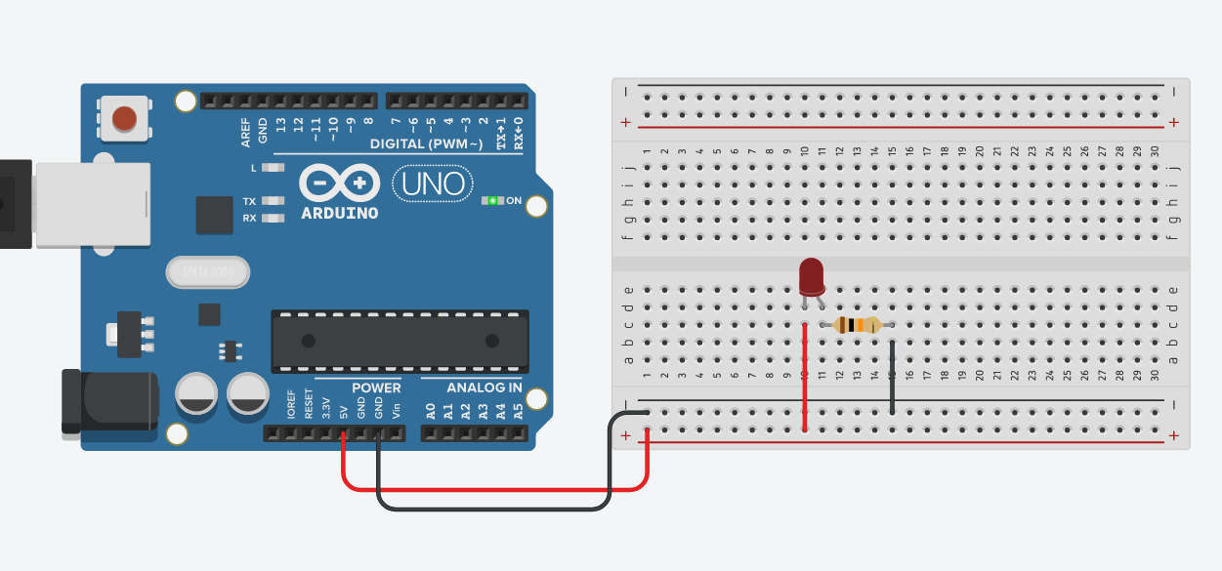
Scenario 3: Controlling a LED

Slide 14
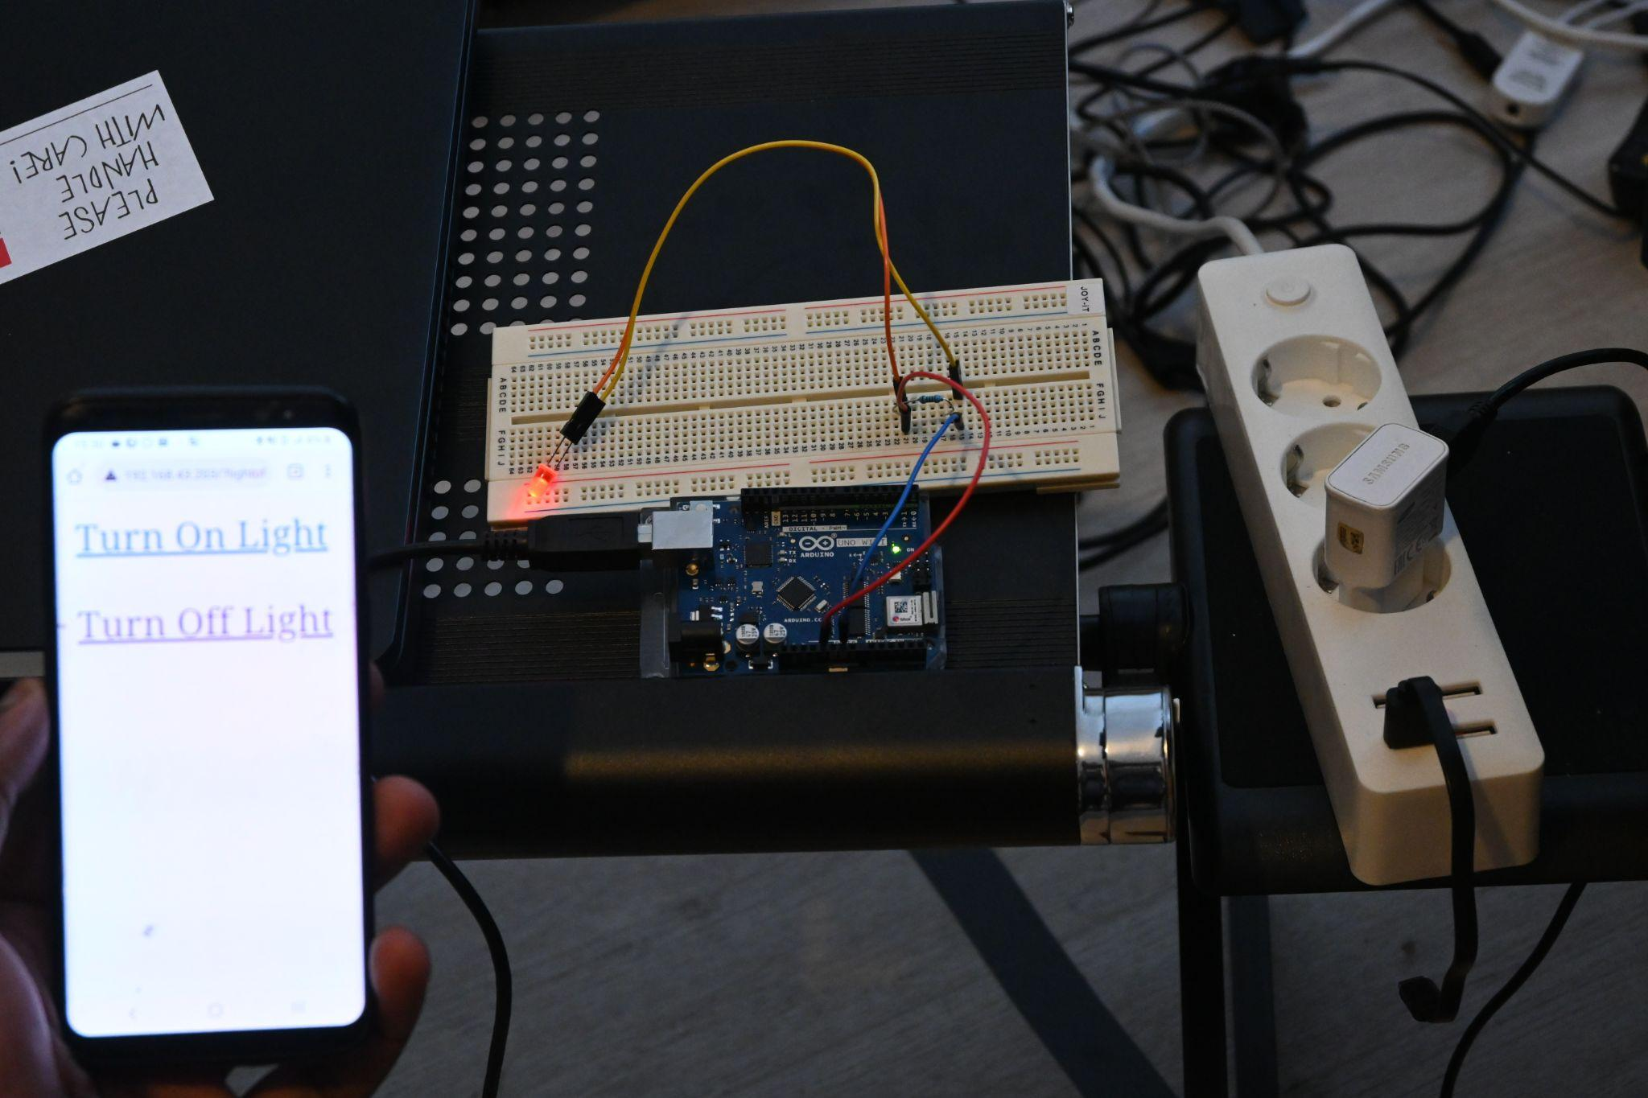
Senario 3: Simulation

Slide 15
Project Implementation
Key Elements
Sensor Node
Raspberry Pi
Digital Device

Slide 16
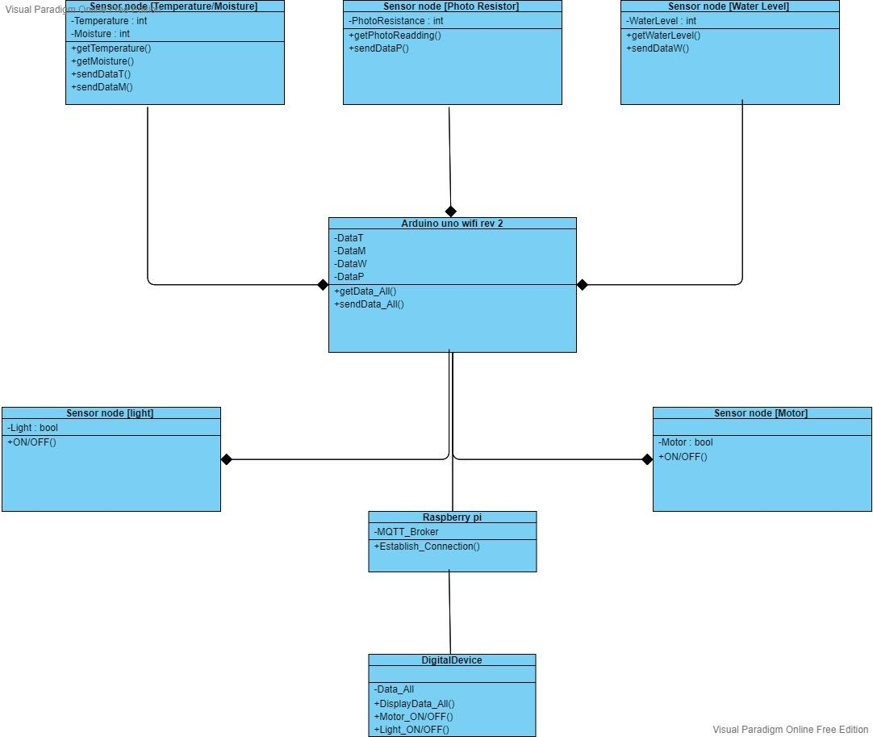

Slide 17
Alternative Resources
PHOTOS:
References Images:
user - Bing images
photo resistor sensor - Bing
servo motorsensor - Bing
water level sensor - Bing
ledtemperature sensor - Bing
led - Bing

