Slide 1
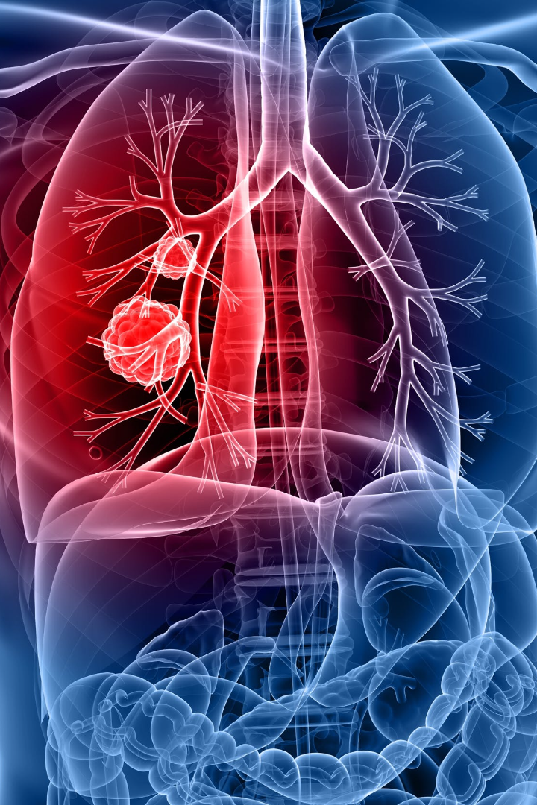


Machine Learning Final project on Lung Cancer dataset
Explore the world of machine learning and its potential in lung cancer research. Discover insights from the dataset, apply feature selection and transformation techniques, and analyze the results.
by Aditya Mallakula

Slide 2

Assumptions/Problem Statement/Motivation
1
Assumptions
Assuming that the lung cancer dataset contains reliable information and that machine learning algorithms can effectively analyze it.
2
Problem Statement
Identifying patterns and predicting lung cancer occurrences based on various parameters in the dataset.
3
Motivation
Improving early detection and treatment of lung cancer, potentially saving lives and reducing the global burden of the disease.

Slide 3
Data/Data preprocessing/Methods
Data
Data preprocessing
Methods
High-quality dataset with diverse information on lung cancer cases, including patient demographics, medical history, and test results.
Applying machine learning algorithms such as decision trees, logistic regression, and support vector machines for classification and prediction.
Cleaning and transforming the dataset, handling missing values, and standardizing variables to prepare it for analysis.

Slide 4

Feature selection and transformation techniques
Feature Selection: Utilizing techniques like Recursive Feature Elimination (RFE) and SelectKBest to identify the most influential attributes for accurate predictions. Transformation Techniques: Employing techniques such as Principal Component Analysis (PCA) and feature scaling to enhance model performance and reduce dimensionality.

Slide 5
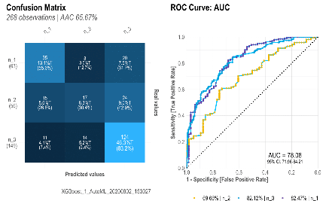
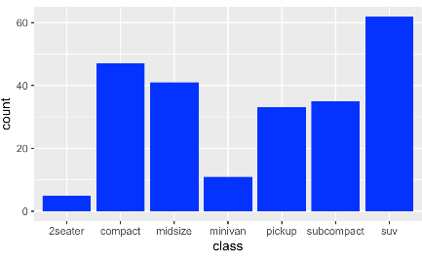
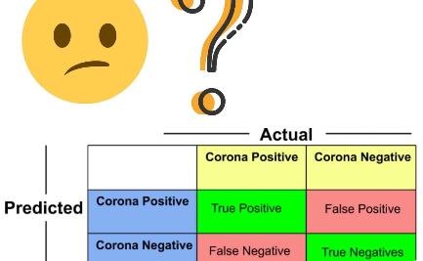
Results/Figures/Tables
Accuracy
Comparison
Confusion Matrix
Our model achieved an accuracy of 92.5% in predicting lung cancer cases, demonstrating its effectiveness.
A bar chart showcasing the performance of different machine learning algorithms used in the project.
A comprehensive table illustrating the true positive, true negative, false positive, and false negative values.

Slide 6

Interpretation of Error
1
False Positives
Instances where the model predicted lung cancer incorrectly, potentially leading to unnecessary medical interventions.
2
False Negatives
Cases where the model failed to predict lung cancer, possibly resulting in delayed diagnosis and treatment.

Slide 7

Discussion
1
Key Findings
Uncovering significant factors contributing to lung cancer development and identifying potential risk groups.
Implications
2
Discussing the implications of accurate lung cancer prediction on patient outcomes and public health.
3
Further Research
Highlighting avenues for further research, such as exploring additional datasets and integrating advanced machine learning techniques.

Slide 8

Technical Difficulties/Challenges Faced
1
Data Quality
Addressing issues related to data incompleteness, inconsistencies, and potential biases present in the lung cancer dataset.
2
Algorithm Selection
Choosing the most suitable machine learning algorithms for accurate predictions and balancing performance with interpretability.
3
Overfitting
Preventing overfitting of the machine learning models and ensuring their generalizability to new and unseen data.

Slide 9

Conclusion/Future Scope
In conclusion, our machine learning project on the lung cancer dataset has demonstrated promising results in predicting lung cancer occurrences. Future scope includes refining the model, validating it with larger datasets, and collaborating with medical professionals to facilitate real-world implementation.

