Slide 1

BANK LOAN ANALYTICS PROJECT

Slide 2

BANK LOAN ANALYTICS PROJECT
Group MEMBERS
ARSHIYA PATIL
MRUNAL MORE
ADITYA MOHAN MUKHOPADHYAY
SRUSHTEE KOKATE
VISHNU KADAM

Slide 3
Bank Loan Portfolio Analysis
Insights from Customer Data
Introduction to the Project
Project Context: Brief explanation about the importance of analyzing bank loan data and how it helps in risk assessment and financial planning.
Objective: The main goals of the analysis, which include extracting meaningful insights from the data through the defined KPIs.
Impact: We are discussing about the potential implications of the analysis in terms of financial strategy and customer relationship management.

Slide 4
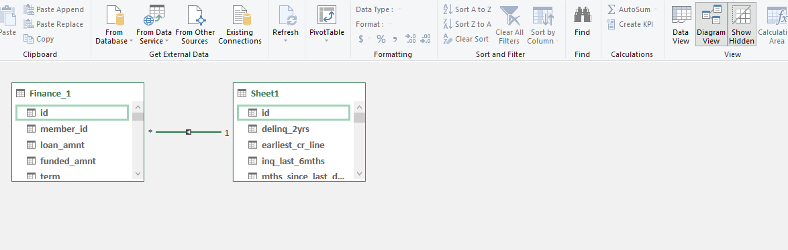
Data Modelling Technique Used
We have used data modelling technique in Power Pivot to connect Finance sheet 1 with Finance Sheet 2.
In diagram view we have connected the two sheets using ID column.
Now the two sheets are connected.

Slide 5
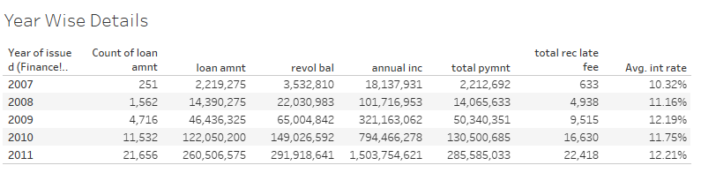
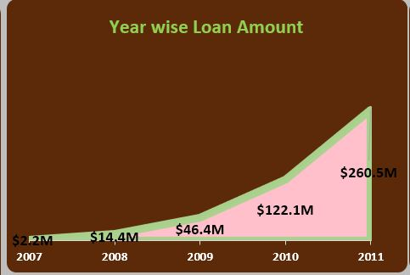
Bank Loan Stats by Year
The bank loan statistics from 2007 to 2011 exhibit a substantial and consistent upward trend, reflecting a significant increase in lending activities over the years.
Starting from 2.2 million in 2007, the loan portfolio surged to 14.4 million in 2008, marking a notable growth trajectory.
Despite the global financial crisis in 2008, which adversely affected lending practices worldwide, the bank managed to maintain its upward trajectory, with loans reaching 46.2 million in 2009. This resilience suggests effective risk management strategies and adaptability to challenging economic conditions.
The subsequent years saw even more remarkable expansion, with loans soaring to 122.1 million in 2010 and peaking at 260 million in 2011.
Such exponential growth indicates a robust demand for credit, potentially driven by various factors such as economic recovery, increased consumer spending, and business expansion.
Analyzing this data reveals the bank's capacity to capitalize on market opportunities and effectively cater to the evolving financial needs of its clients.
Additionally, it underscores the importance of continuous monitoring and strategic planning to sustain growth momentum while mitigating associated risks.
Moreover, a detailed examination of lending patterns across different sectors and borrower profiles could provide valuable insights for optimizing loan portfolio management and enhancing overall financial performance.

Slide 6
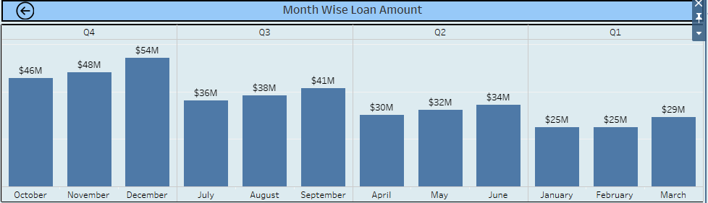
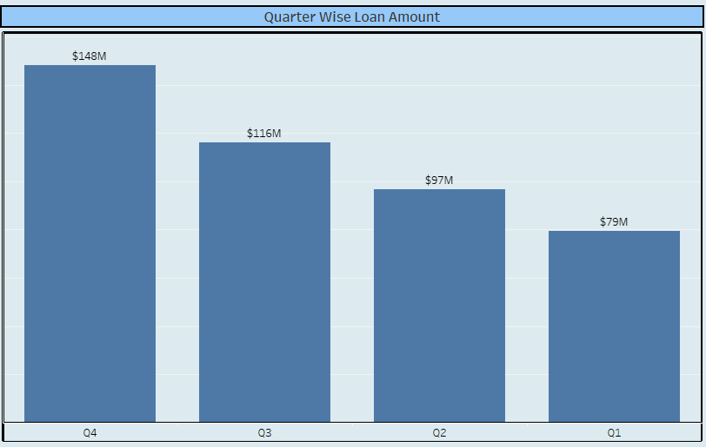
Month and Quarter Wise Loan Amount
We can see that December has loan amount of $54M followed by November and October.
January and February have lowest loan amount of $25M each.
Q4 has highest loan amount with $148M whereas Q1 has lowest loan amount of $79M.

Slide 7
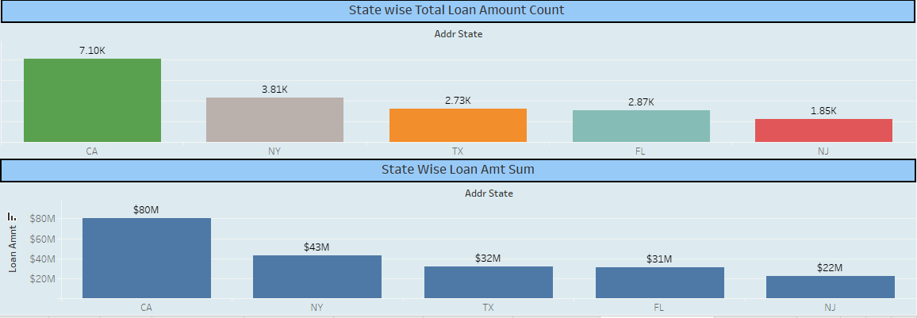
State Wise Loan Amount Details

Slide 8
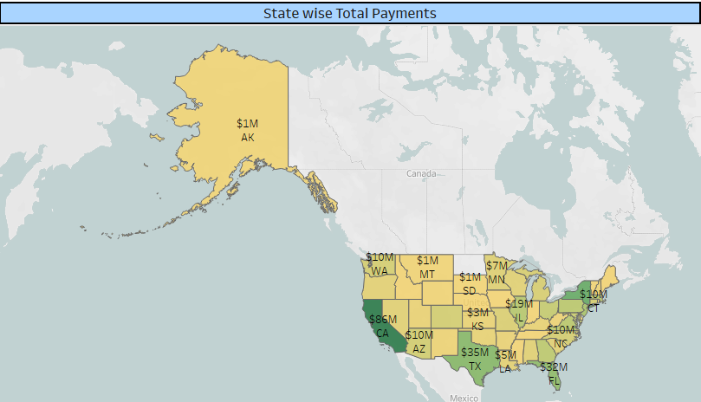
State Wise Loan Amount Details
We can see that people from states of CA,NY,TX,FL and NJ have applied for the most number of loans. CA being the highest state with more than 7000 loan applications
In terms of State Wise Loan Sum Amount also we can see that states of CA,NY,TX,FL and NJ have applied for maximum sum loan amount with CA applying for $80M loan amount followed by NY at $43M.
Also CA has the highest payment received with $86M followed by NY at $47M.

Slide 9
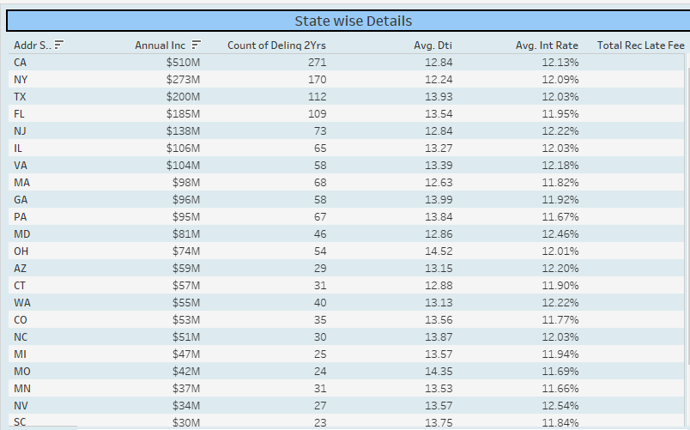
State Wise Details
Here we can see the details for each state separately. We can see state wise Annual Income,Count of Delinquency for 2 years,Avg dti,Avg Int Rate,Total Payments

Slide 10

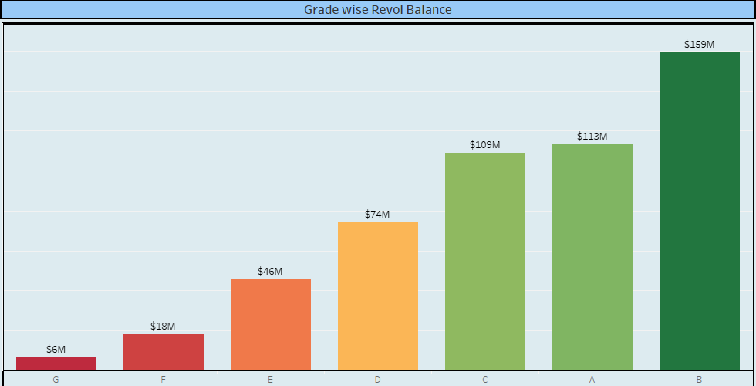
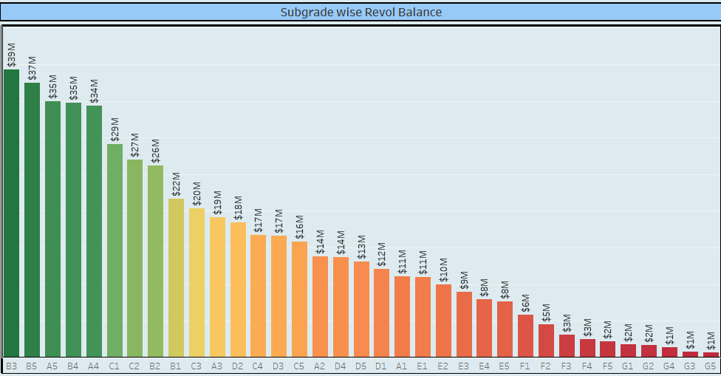
Grade and Sub Grade Wise Revolving Balance
Lower Risk Grades: 'A' and 'B' appear to have higher revolving balances, suggesting that these grades include borrowers who are considered lower risk. They have a substantial portion of the revolving credit, indicating the institution's trust in their ability to repay.
Higher Risk Grades: 'F' and 'G' show smaller revolving balances, indicating these are higher-risk grades. The smaller balances could be a result of either fewer borrowers in these grades, lower credit limits due to higher perceived risk, or a combination of both.
Grade B has highest revolving balance with $159M while Grade G has lowest revolving balance with $6M.
In Sub Grade B3 is highest with $39M while G5 is lowest with $1M.

Slide 11
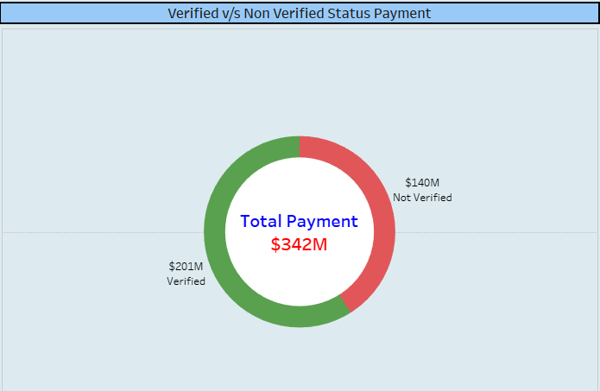
Verified vs Non Verified Status Payment

Slide 12
Verified And Not Verified Status
1. Payment status refers to the state or condition of a financial transaction. 2. “verified” payment status indicates that the payment has been successfully processed and confirmed by the relevant parties. 3. It implies that the funds have been transferred or received without any issues. 4. “Not Verified” payment status suggests that the transaction pending or incomplete. 5. Reasons for “not Verified” status can include insufficient funds, technical issues, or pending verification processes.

Slide 13
Verified And Not Verified Status
We can see that Payments made by Verified Sources $ 201M is more than payment made by Non Verified Sources $140M.
58% people have preferred to make payments through verified Sources whereas 42% people have preferred to make payments through Non verified Sources.
We can imply that more people have chosen to pay through Verified Sources of Payment thus reducing chances of risk and ensuring safety.

Slide 14
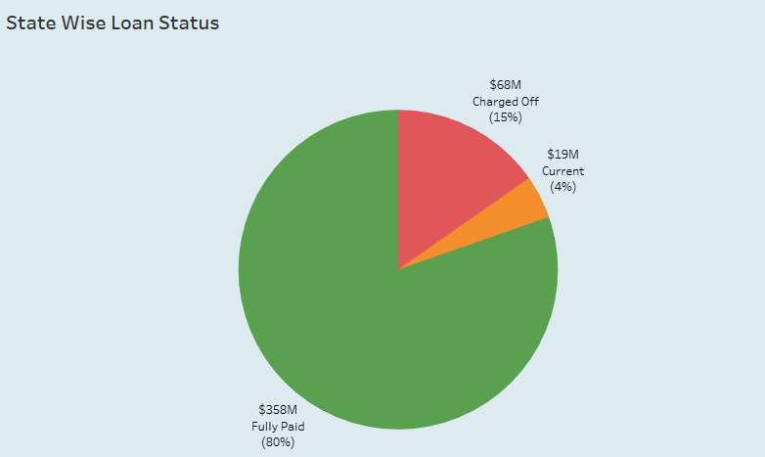
State wise loan status
There are three loan status in the bank analysis project.
Charged off: the lender or creditor has written the account off as a loss, and the account is closed to future charges.
Fully paid: Fully paid is the term applied to instalment accounts, like car loans, after the last payment is made and you have completed repayment of the loan as agreed.
Current: a Loan as to which all payments of principal and interest then due have been paid, except for the most recent payment then due of principal and interest.

Slide 15
State Wise Loan Status
We can see that 80% of the Loans are Fully Paid,15 % are charged off and 4 % Loans are Current.
We can imply that almost majority of the people have paid their loan and completed their payment process. They don’t have any balance amount remaining.
Only 4% Loan is remaining with amount of $19M.So a few percent of amount is balance and yet to be paid fully.
This shows most of the loans in dataset are good loans and very few bad loans.

Slide 16
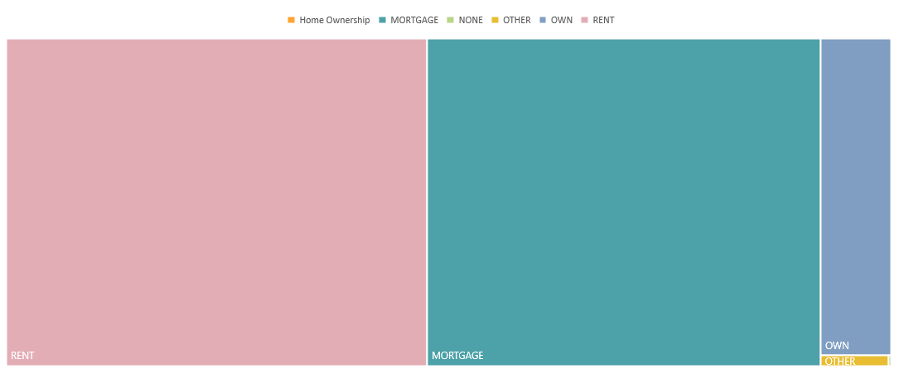
HOME OWNERSHIP VS LAST PAYMENT DATE STATS

Slide 17
Insights from Homeownership
Mortgage Homeowners
Mortgage holders are likely to have a consistent monthly payment due date, typically aligned with their mortgage agreement.
Renters
Renters may have less stable housing costs compared to homeowners, as rent payments can fluctuate due to lease terms, rental market conditions, or changes in income.
Homeowners
Homeowners who own their homes outright may have more flexibility in managing their finances compared to those with mortgages.

Slide 18
HOME OWNERSHIP VS LAST PAYMENT DATE STATS
We can see that most people are on mortgage or rent. The percent of people who have their own home is very few.
So we can conclude that might be very expensive to own a house , better to mortgage or rent the house.

Slide 19
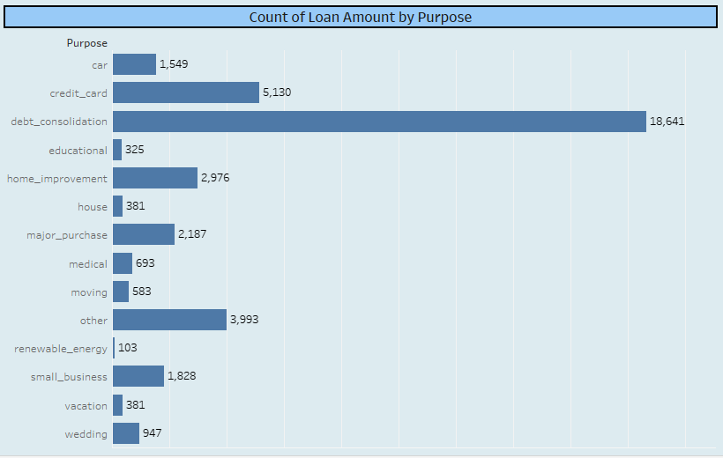
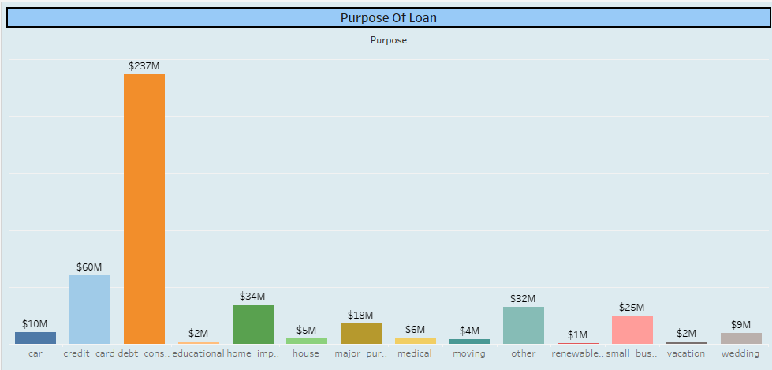
Purpose Wise Loan Amount
We can see that maximum people who have applied for loan have applied for Debt Consolidation (18,641) followed by credit card (5130) and home improvement(2976).
Debt Consolidation has the highest sum of loan amount $237M followed by credit card $60M and home improvement $34M.
Least people have applied for renewable energy (103) and sum is also least $1M.

Slide 20
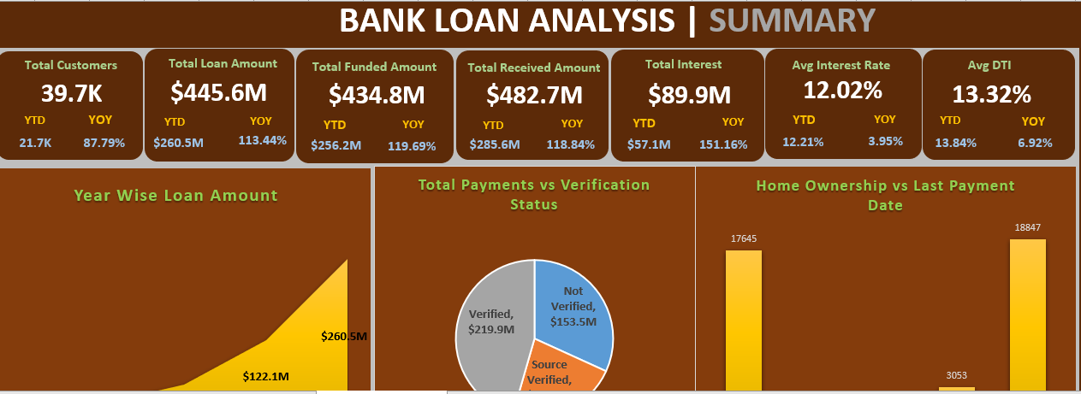
Excel Dashboard

Slide 21
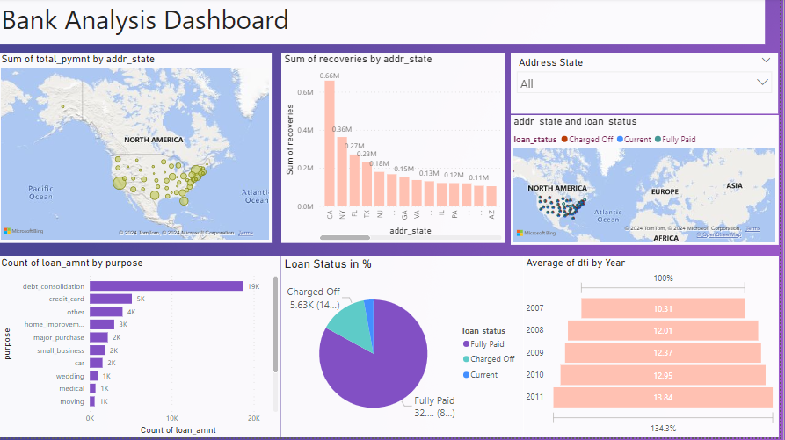
Power BI Dashboard

Slide 22
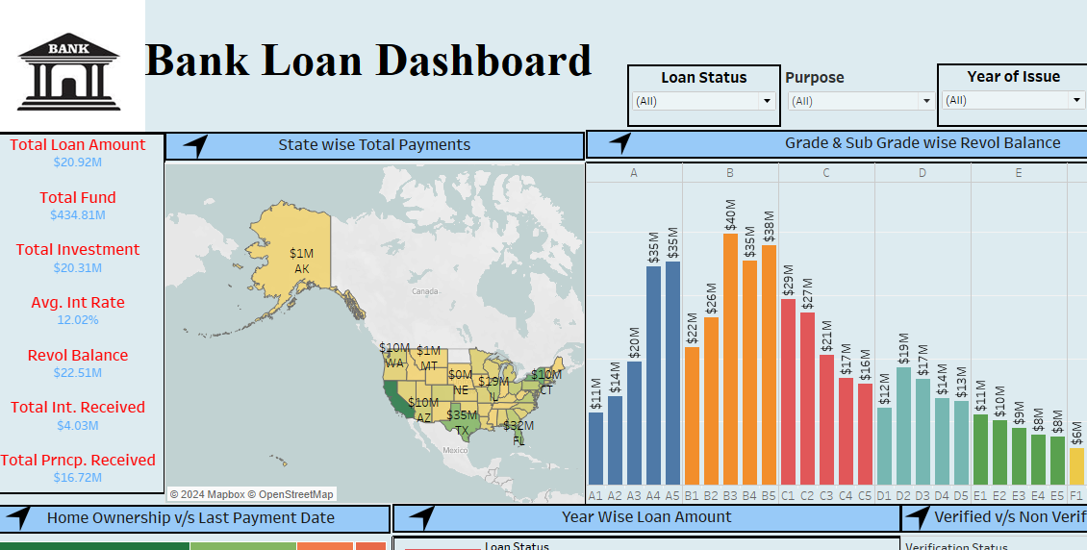
Tableau Dashboard

Slide 23
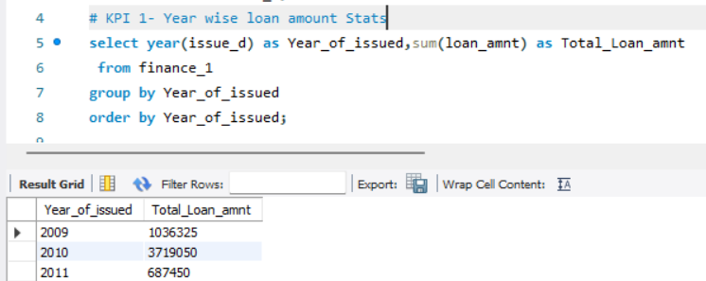
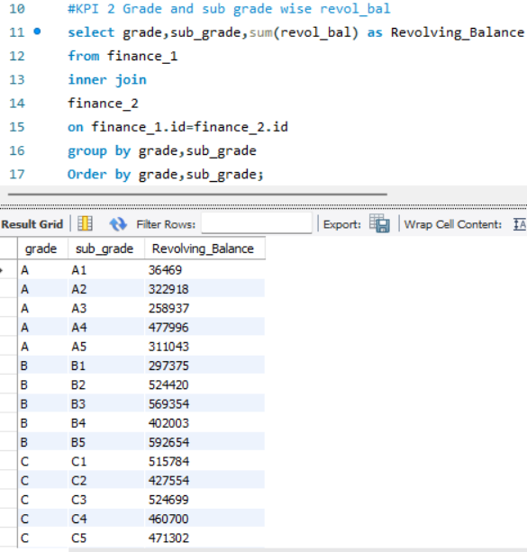
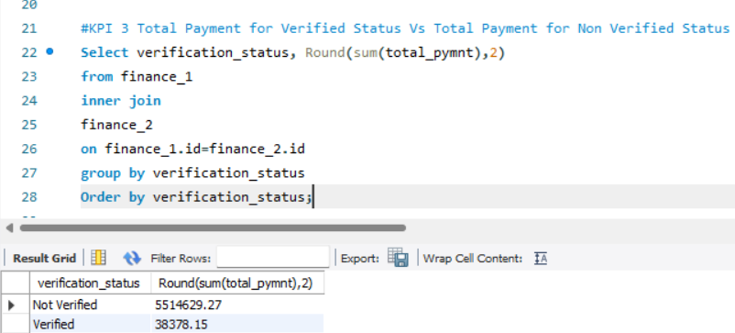
SQL Queries
KPI 1 -Year wise loan amount Stats
KPI 2 -Grade and sub grade wise revol_bal
KPI 3- Total Payment for Verified Status Vs Total Payment for Non-Verified Status

Slide 24
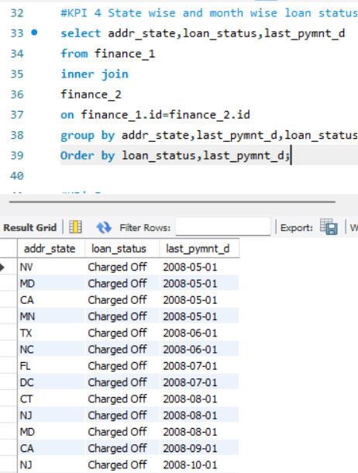
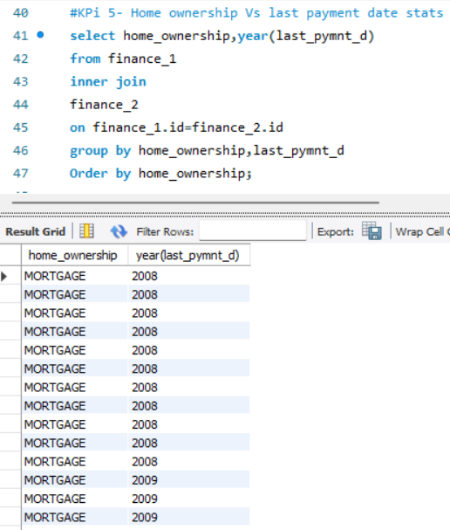
SQL Queries
KPI-4 State wise and month wise loan status
KPI-5- Home ownership Vs last payment date stats

Slide 25
CONCLUSION
We can see that Purpose Wise, the states of California(CA),New York(NY),Florida(FL),Texas(TX) and New Jersey(NJ) have applied for the maximum number of loans. The sum of loans of these 5 states is highest. If we look at Annual Income of these states they are the highest so there is a co-relation between Annual Income and Sum of Loans .Higher the Annual Income, Higher the Loan applied and vice versa.
We can see that Year Wise, the states of California(CA),New York(NY),Florida(FL),Texas(TX) and New Jersey(NJ) have applied for the maximum number of loans. There is a co-relation between Yearly Annual Income and Yearly Loan Details. More the Annual Income more the Loan applied more the payments made and vice versa. People’s annual income is increasing yearly so loan amount is also increasing.
Most of the Loans are Good Loans,80% of them have been fully paid.
People have relied more on Verified Source of Payments rather than Unverified Source of Payments.
The interest rate for 60 months is higher than that of 36 months

Slide 26
SUMMARY
we played a key role in conducting comprehensive financial analysis for bank loan applications, ensuring accurate risk assessment for decision-making. By analyzing the bank loan portfolio, we have categorized loans into fully paid, current, and charged off categories, demonstrating proficiency in loan analysis. our exploratory data analysis revealed significant yearly trends, highlighting notable growth trajectories in loan portfolio size over the years. Additionally, we classified total revolving balances into various creditworthiness grades and analyzed patterns in loan terms, identifying insights regarding repayment periods and interest rates. Leveraging SQL, Excel, and Power BI, we investigated bank loan data to assess the creditworthiness of defaulters versus good loans. Furthermore, we developed and maintained data visualization dashboards to efficiently track key metrics, enhancing business insights.

Slide 27
Thank you

