Slide 1
Anamorphic Image Steganography: Enhancing Data Security through Visual Distortion Techniques
Submitted by:
ADITI JHA (21BCE1198)
Aditya NARAYAN (21BCE1166)
Kushagra Goyal (21BCE1157)

Slide 2
introduction
In this digital age, a vast amount of data is shared using images.
Steganography is the process of embedding text in an image without altering the quality of the image.
This way, data is shared under the pretext of a regular image without arousing any suspicion.

Slide 3
Problem statement
Despite being a secure method, sophisticated techniques and machine-learning algorithms can be used to detect data hidden using steganography in regular images.
Several tools like Steganalysis can be used to detect the presence of data in regular images.
As a result, data manipulation becomes simpler in regular images.

Slide 4
Research objective
This research aims to add another layer of security by implementing steganography in anamorphic images.
Anamorphic images are generated by transforming regular square images into stretched, trapezoidal shaped images using mathematical transformations that leads to the formation of interpolated pixels, known only to valid users.
This addition makes it more complex to extract data embedded in the image, thereby improving data security.

Slide 5
Proposed system introduction
Anamorphic images are produced by stretching the original image into a trapezoidal-shaped image.
This stretching results in the formation of gaps in the image which must be filled with appropriate intensity values for the image to appear normal using the process of Interpolation.
Our research aims to use these interpolated pixels to embed user data.
These pixels can only be calculated using the viewing angle, height and distance which adds a layer of security to the system.

Slide 6
Proposed system architecture
Sender Side

Slide 7
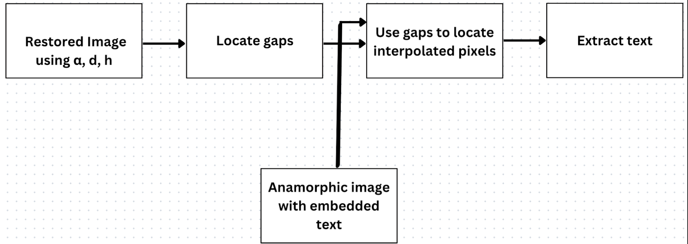
Receiver Side

Slide 8
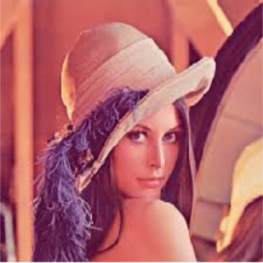
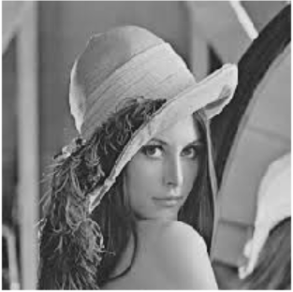
Original Color Image
Grey Image

Slide 9
anamorphic images
Anamorphic Images are distorted images that appear regular only when viewed from a particular viewpoint.
They are created by transforming the original image into a larger image where the original image is represented in a trapezoidal shape.
The transformation results in formation of gaps in the image which are filled using interpolation techniques such as nearest neighbor, sample and hold, linear interpolation, etc.

Slide 10
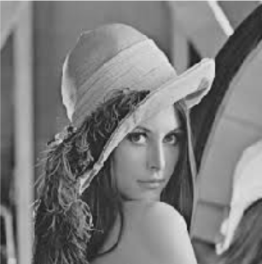
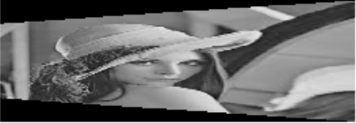
ORIGINAL IMAGE
ANAMORPHIC IMAGE

Slide 11
Steganography
Steganography refers to the practice of embedding text within an image without affecting the quality of the image.
This research aims to implement steganography in anamorphic images using the Last-Significant Bit (LSB) method.
It also aims to find the maximum length of text that can be embedded within an anamorphic image.

Slide 12
Implementing steganography in anamorphic images
The transformation of the original image to an anamorphic image depends on three factors – the viewing angle, the height and distance between the viewer and the original image.
Once transformed, a viewer can obtain the position of the interpolated pixels only using the above three factors.
This research locates the interpolated pixels of an anamorphic image and implements Least-Significant Bit Steganography in the interpolated pixels.
This way, only users with knowledge of the viewing angle, the height and distance will be able to extract the text back from the transformed image.

Slide 13
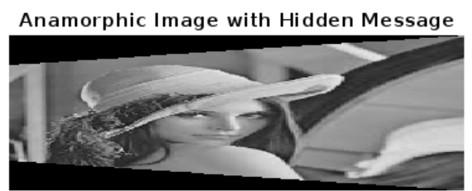
As observed, the quality of the image remains unaffected after steganography.
The Anamorphic Image after steganography

Slide 14
Restoring the original image
Once the text has been embedded, the anamorphic image is transformed back to the original image.
The restored image is found to be exactly identical to the original image.
The embedded text is extracted back from the image and is verified.
Additionally, we calculate the maximum number of characters that can embedded within the anamorphic image.

Slide 15

Restored Image
Result after Extraction:

Slide 16
Analysis
The research is evaluated using three metrics - Structural Similarity Index (SSIM), Peak Signal-to-Noise Ratio (PSNR), and Mean Squared Error (MSE) between the originally generated anamorphic image and the anamorphic image after steganography to verify how far the image has changed.
An SSIM value of 1 indicates that the two images are exactly identical and a value of 0 indicates that they are completely dissimilar.
Additionally, an MSE value of 0 indicates that there is very slight change between the two images.

Slide 17

Our system is able to obtain an SSIM Value close to 1 which indicates that there is a very slight change in the anamorphic image after steganography, making it very difficult to detect the presence of data in the image.
The MSE and PSNR values also support the above argument.

Slide 18
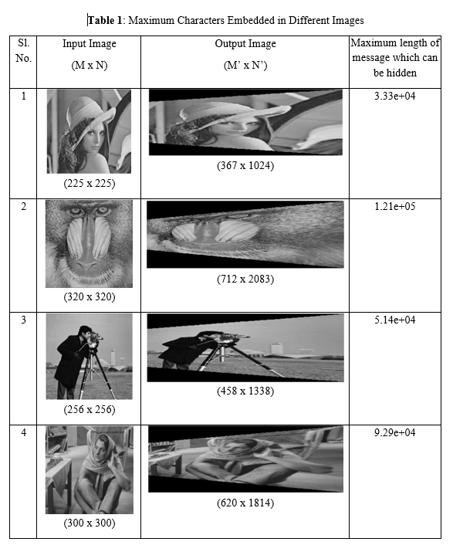
Our system is able to embed text and provide the maximum length of text for a variety of images

Slide 19
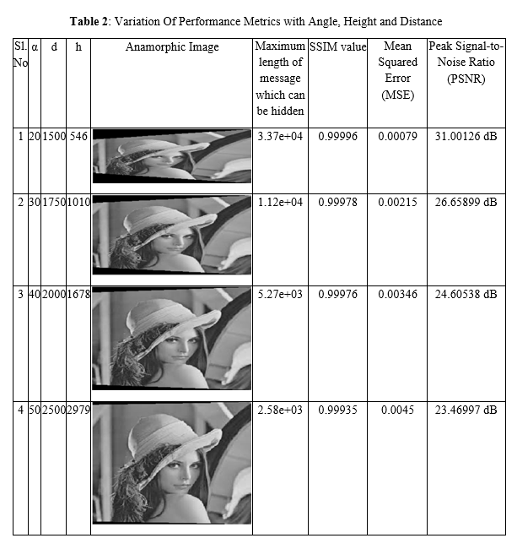
Variation in the performance metrics with the viewing angle, height and distance is also analyzed

Slide 20
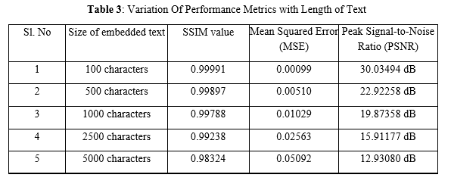
Length of the text affects the Performance Metrics as follows

Slide 21
Conclusion
The proposed system adds a layer of security to conventional steganography by leveraging the use of non-uniform, interpolated pixels in anamorphic images.
The maximum length of text that can be embedded in an image is calculated and demonstrated for a variety of images.
The change in quality of the image is analysed using various performance metrics which shows minimal change after embedding text in the image.

Slide 22
Future work
The proposed system can be extended to the use of color images in the future
Different types of steganography can be implemented in the system and analyzed for improved security.
System can be made more optimal and computationally less-complex.

Slide 23
references
L. K. Pavithra, R. Srinivasan, and T. Sree Sharmila. 2022. Optimum anamorphic image generation using image rotation and relative entropy. Multimedia Tools Appl. 81, 27 (Nov 2022), 38971–39001
S. Rahman et al.: Comprehensive Study of Digital Image Steganographic Techniques
J.Fridrich,SteganographyinDigitalMedia:Principles,Algorithms,and Applications. Cambridge, U.K.: Cambridge Univ. Press, 2009.
R.J.AndersonandF.A.P.Petitcolas,‘‘Onthelimitsofsteganography,’’ IEEE J. Sel. Areas Commun., vol. 16, no. 4, pp. 474–481, May 1998.
N. Sofian, A. Wicaksana and S. Hansun, "LSB Steganography and AES Encryption for Multiple PDF Documents," 2019 5th International Conference on New Media Studies (CONMEDIA), Bali, Indonesia, 2019, pp. 100-105, doi: 10.1109/CONMEDIA46929.2019.8981842. keywords: {Portable document format;Encryption;Tools;Standards;Password;Informatics;AES;LSB;PDF;Steganography;Tj Operator}

