Slide 1



DATA-DRIVEN INSIGHTS FOR BUSINESS GROWTH
Optimizing Revenue per User through Smart Data Management
Data Management

Slide 2

TABLE OF CONTENT
Business Overview
Operations
Revenue Analysis
4.City Popularity Analysis
6. Market Analysis
7. Challenges and Solutions
8. Conclusion

Slide 3



What is UKStay
A UK-exclusive property rental platform connecting hosts and guests.
Focused on enhancing user experience and maximising revenue.
Business Goals
Optimise pricing & occupancy rates, thus increasing the overall revenue generated.
Improve host & guest satisfaction.
BUSINESS OVERVIEW

Slide 4
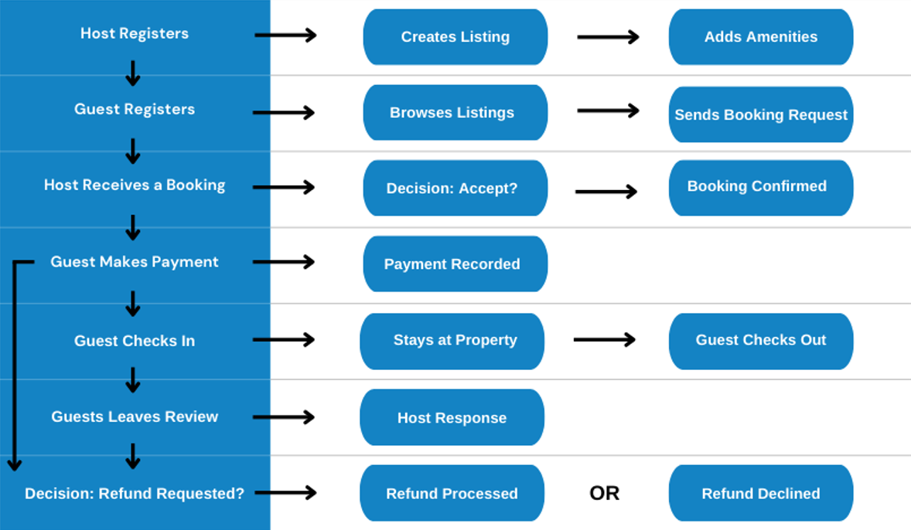
OPERATIONS
BOOKING JOURNEY
Guests search & browse properties.
Hosts list and manage properties.
Guests book & pay securely.
Guests leave reviews, driving trust & reputation.
KEY BUSINESS FUNCTIONS
User Management (Hosts & Guests)
Listings & Bookings management (Property rentals)
Payments & Refunds (Financial transactions)
User Engagement & Reviews

Slide 5
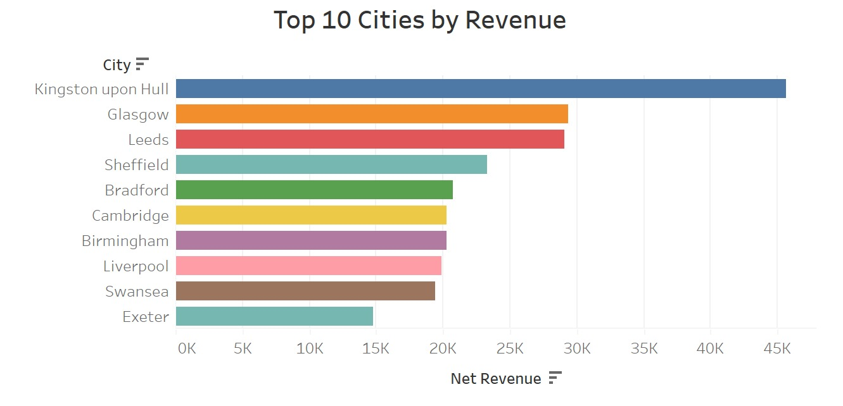
REVENUE ANALYSIS

Slide 6
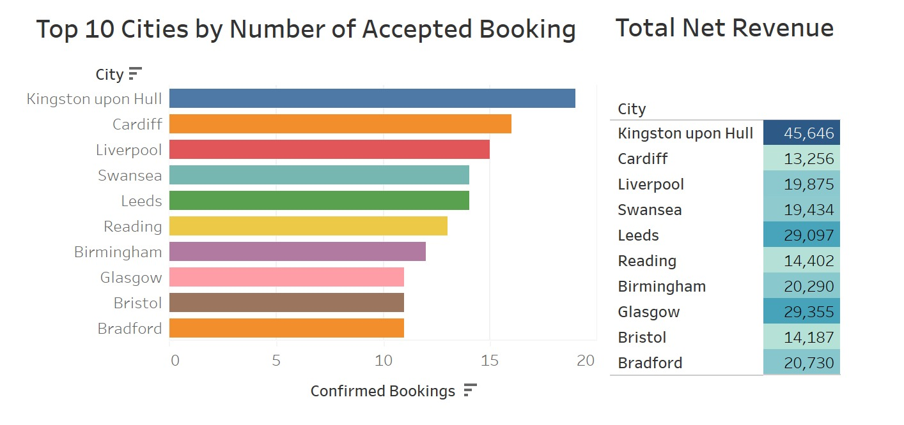
CITY POPULARITY ANALYSIS

Slide 7
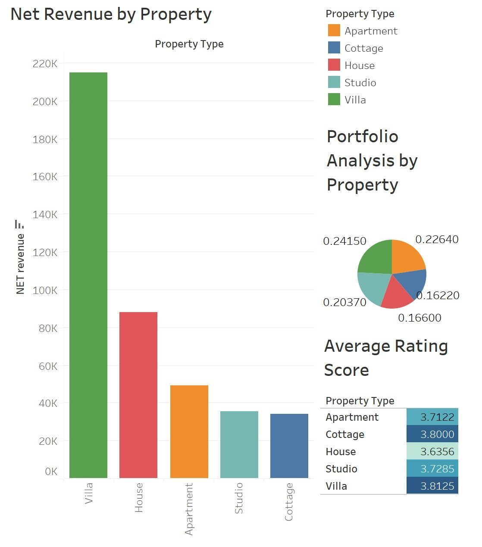
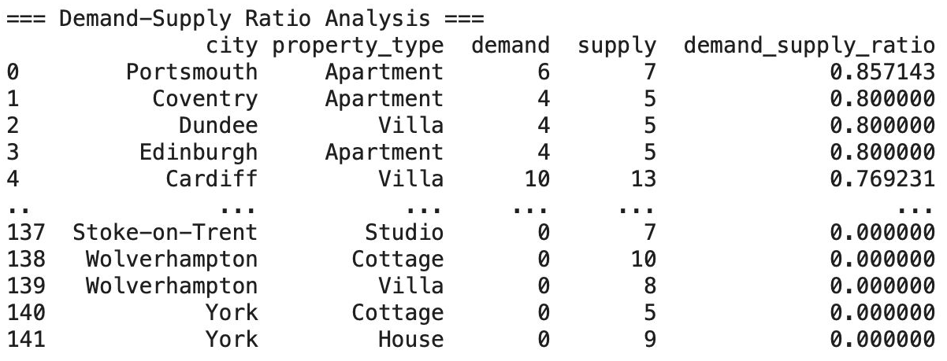
MARKET ANALYSIS

Slide 8
CHALLENGES AND SOLUTIONS
RIGID REFUND POLICIES
Currently full refunds are only issued if the host cancels a booking. If a guest cancels or the host response is pending, a refund request is partially satisfied or rejected.
LIMITED USER ACTIVITY TRACKING
UKStay lacks a robust system to track user activity such as search, views and host-guest interactions etc. This makes it difficult to monitor customer behaviour and analyse patterns.
SCALABILITY AND DATA LIMITATIONS
As a startup, UKStay operates with a limited dataset from the past year, making it hard to detect trends and customer behaviour.
ADVANCED USER TRACKING & MARKETING STRATEGY
Implement event-based analytics for real-time user activity tracking.
Establish a marketing team to analyse trends and drive personalised promotions and tailored recommendations to increase user loyalty
EXPANDING UKSTAY’S INFRASTRUCTURE
As the company expands and collects more data, transitioning to a cloud-based database will ensure scalability, improve data security and allow for data analysis and trend detection.
OPTIMISE REFUND POLICIES
Introduce new policy based on cancellation timings.
Offer redeemable points, cashbacks, or future booking discounts to retain customers.

Slide 9
CONCLUSION
By addressing these challenges through data expansion, enhanced tracking, refund optimisation, and cloud scalability, UKStay will create a more efficient, profitable, and customer-friendly platform—ensuring long-term success in the UK rental market.
THANK YOU!

