Slide 1
VERSION 2 — PILOT / DEVELOPMENT STAGE · CELLS A–D
BORG Datacenter Cooling Optimization
Official Google Borg 2019 Workload and Power Traces with Workload
Forecasting, Thermal Modeling and Safe Multi-Agent Reinforcement Learning
Research Progress Presentation · git: v2-official-google-data @ b83ce2a
Notes:
SAY (30-45s): This project asks whether we can build a workload-aware cooling controller for a datacenter, using REAL Google workload and power traces instead of assumptions, and whether learned multi-agent control (MAPPO) can beat classical control on the energy/safety trade-off. We are presenting PROGRESS, not a finished result: this is the pilot stage, built and validated on 4 of the 8 official Google Borg cells while the remaining 4 are waiting on a free-tier data quota. Every number in this deck is pilot evidence, not a final claim -- that distinction is repeated on every results slide.

Slide 2
The Core Engineering Problem
PILOT RESULT — CELLS A–D — NOT FINAL
Datacenter workload
The control conflict
Server utilization
Too much
cooling
→ wastes energy
Electrical power
Too little
cooling
→ thermal safety risk
Heat generation
Temperature
The research objective:
ENERGY EFFICIENCY
THERMAL SAFETY
CONTROL STABILITY
Cooling requirement
Cooling energy
Balance all three at once — not just minimize energy, and not
just eliminate risk by over-cooling.
Causal chain from workload to cooling energy; the trade-off this whole project studies.
Notes:
SAY: Follow the left-hand chain top to bottom: workload creates utilization, utilization draws power, power becomes heat, heat raises temperature, and once temperature is high enough the cooling system has to work, which costs energy. The panel on the right is the actual conflict: cool too aggressively and you waste energy for no safety benefit; cool too little and you risk exceeding a safe operating temperature. The entire rest of the deck is about building a system that can make this trade-off well, using real workload and power data instead of guesses. LIKELY QUESTION: 'Isn't this just always cool to the max to be safe?' ANSWER: cooling capacity itself costs continuous energy -- our own thermal calibration (slide 21) shows full cooling all the time uses roughly 3x more energy per episode than a well-tuned PID, for no additional safety benefit under normal load.

Slide 3
Why This Is a Feedback Control Problem
PILOT RESULT — CELLS A–D — NOT FINAL
State / Observations
Controller
Cooling Action
feedback
loop
Thermal Response
Next State
• Dynamic: today's cooling decision changes tomorrow's starting temperature.
• Lagged: heat takes time to raise temperature, and cooling takes time to remove it.
• Workload varies over time — a controller that only reacts to the CURRENT state is always a step behind.
• Forecasting (next section) gives the controller information about near-future workload, ahead of time.
Notes:
SAY: This is a classic feedback control loop, not a one-shot prediction problem. The controller looks at temperatures/workload NOW, picks a cooling action, that action plus the incoming workload determines the NEXT temperature, and the loop repeats. Because heat has thermal inertia (it takes time to build up and time to remove), a controller that only reacts to what has already happened will lag behind. That is exactly the motivation for adding a forecaster: if the controller knows workload is about to rise, it can start cooling proactively instead of reactively. LIKELY QUESTION: 'Why not just always look at current temperature, isn't that enough?' ANSWER: our own pilot data shows a reactive PID controller still violates the safety limit 34% of the time (slide 22) specifically because of this lag -- that's the motivating evidence for this slide, not a hypothetical.

Slide 4
Version 1: The Original System
• Dataset: Kaggle export of a Google Borg trace (“muzairbair/borg-traces-data”), not the official Google release — no uploader documentation.
• Workload: 405,894 real records pooled across all 8 Borg clusters, binned to 15 minutes; zones were 3 SYNTHETIC groups from hash(machine_id) % 3.
• Power: NO real power measurements existed. Heat was computed from an ASSUMED linear CPU→power formula.
• Thermal model: 3-zone lumped-parameter simulation, numerically validated (9/9 tests) but never claimed to be physically calibrated.
• Controllers: Fixed, Threshold, PID, random-shooting MPC, single-agent PPO, and a from-scratch CTDE MAPPO.
• V1's own headline finding: classical PID beat both PPO and MAPPO on energy efficiency, under a CPU-only compute budget — reported honestly, not hidden.
V1 result, verbatim (docs/final_validation_report.md)
Controller | Energy (kWh/ep) | Violations
Fixed | 17.93 | 0.0%
Threshold | 7.20 | 0.0%
PID | 6.43 | 0.0%
MPC | 7.92 | 0.0%
PPO (best) | 6.47 | 0.0%
MAPPO (best) | 19.15 | 0.0%
V1 is complete and preserved (tag v1-kaggle-baseline, branch main). It is the reason this project reports negative/mixed results honestly — it already found that PID beat RL, and did not suppress that.
Notes:
SAY: V1 is a completed, honestly-reported baseline, not a failure to be embarrassed about. Its most important property is methodological: when RL lost to classical control, that result was kept and published, not hidden or re-tuned away. That discipline is what V2 inherits and this deck follows the same rule -- if V2's PPO/MAPPO lose to PID again on the final 8-cell data, that will also be reported as-is. LIKELY QUESTION: 'Why build V2 at all if V1 already has a full result?' ANSWER: V1's workload came from an undocumented Kaggle re-export with no real power data at all; V2 replaces both with official, documented Google sources so any claim (positive or negative) rests on stronger evidence.

Slide 5
Why Version 1 Wasn't Enough for the Research Goal
V1 limitation | Why it matters | V2 response
Undocumented Kaggle re-export | Provenance/join method unknown; can't defend as 'the official trace' | Switch to official ClusterData2019 — DONE (pilot)
No real power measurements | Power model was a pure assumption, never validated | Fit an empirical model against real PowerData2019 — DONE (pilot)
Sparse workload (94% zero bins) | Forced 15-min bins and cross-cluster pooling to get signal | Cell-level aggregation is naturally dense — DONE (pilot)
Thermal params never recalibrated on real data | Risk of a vacuous (never-violating) safety problem | Dense 251-window recalibration — DONE (pilot); full re-check planned for 8 cells
Only 3 development seeds, reduced RL budget | Can't rule out noise driving the PID-wins finding | Full multi-seed budget — PLANNED for final 8-cell run
Single population (one Kaggle export) | No held-out, differently-sourced population to test on | 8 real Borg cells, split train/val/test — 4 done (pilot), 4 PLANNED
Notes:
SAY: Read this as three columns per row: what was limited in V1, why that limitation actually mattered scientifically (not just 'it was old'), and exactly what V2 does about it -- with an explicit DONE/PLANNED tag, never both claimed as finished. LIKELY QUESTION: 'Has V2 already fixed everything in this table?' ANSWER: No -- read the right column carefully. Several rows say 'DONE (pilot)' meaning validated on 4 cells only, and two rows are explicitly 'PLANNED', not done.

Slide 6
Research Objective and Questions
Develop and evaluate a workload-aware datacenter cooling control framework using official Google Borg workload and power traces, workload forecasting, thermal modeling, classical controllers, PPO, MAPPO, and explicit safety constraints.
RQ1
Can workload telemetry provide useful short-horizon forecasts?
RQ2
Can measured power data support an empirical workload→power model?
RQ3
Can the resulting thermal simulation support meaningful cooling-control experiments?
RQ4
How do classical controllers, PPO and MAPPO compare under common thermal constraints?
RQ5
Does forecasting and/or safety intervention materially affect control performance?
None of these questions have a predetermined answer — the evidence decides, including if the answer is negative.
Notes:
SAY: These five questions frame everything that follows. Note we do NOT state an expected answer for any of them -- RQ4 in particular could come back 'classical control wins again', and V1's own result suggests that's a live possibility, not something to explain away in advance. LIKELY QUESTION: 'What's the actual novel contribution here?' ANSWER: honestly, at this pilot stage the contribution is the validated infrastructure (real-data pipeline, fitted power model, tested MAPPO) plus early evidence on RQ1-RQ3; RQ4/RQ5 need the full 8-cell run before a defensible answer exists.

Slide 7
Official Dataset 1: ClusterData2019
• Source: official Google “cluster-data” GitHub release (google/cluster-data, ClusterData2019.md), not a third-party re-export.
• Coverage: eight independent, concurrent Borg cells, for the month of May 2019.
• Resolution: per-task/per-machine CPU and memory usage, at 5-minute native granularity (instance_usage table).
• What V2 actually uses: start_time, average_usage.cpus, average_usage.memory, and machine_id — aggregated per cell, per 5-minute bucket.
• Access method: BigQuery public dataset, queried with column-pruned, cost-estimated SQL — the raw table is ~2.0–2.4 TB per cell, never downloaded whole.
Why this matters vs. a generic/synthetic trace
• Documented schema and units — no guessing what a column means.
• Real inter-service, inter-machine correlation structure that a synthetic generator would not reproduce.
• Directly pairs with an official Google power dataset (next slide) — a synthetic trace would have no real power counterpart at all.
Notes:
SAY: This is the real fix from V1's Kaggle export -- same underlying Google system, but now the official, documented release. The number that matters operationally: each cell's raw table is 2-2.4 terabytes, which is why every extraction script in this project dry-runs its query cost first and never downloads the raw table. LIKELY QUESTION: 'Is this the same data as V1?' ANSWER: same underlying system (Google Borg) and same rough scale (8 cells), but a completely different, officially documented export -- V1's Kaggle file had zero uploader documentation of its join/sampling method.

Slide 8
Official Dataset 2: PowerData2019
• Source: official Google “cluster-data” release, PowerData2019.md — same GitHub repository as ClusterData2019.
• Coverage: 57 power domains (Power Distribution Units, PDUs) during May 2019.
• Google's own documentation: “two of these power domains are from cells with the new medium voltage power plane design; the remainder belong to the eight cells featured in the 2019 Cluster Data trace.”
• Fields actually used: cell, pdu, measured_power_util, production_power_util, and two data-quality flags — utilization FRACTIONS of PDU capacity, not watts.
• 50 PDU tables were found in the public BigQuery mirror (documented discrepancy vs. the 55 implied by Google's text — disclosed in the alignment audit, not hidden).
Three different things — do not conflate them
WORKLOAD DATA
real, official (ClusterData2019)
MEASURED POWER DATA
real, official (PowerData2019)
SIMULATED THERMAL DATA
a simulation abstraction, not measured
Notes:
SAY: PowerData2019 is Google's own measured power reference -- the thing V1 never had at all. Two important honesty points here: first, the utilization values are FRACTIONS of a PDU's rated capacity, not absolute watts, because no capacity-in-kW field exists in the public schema -- so our power model's output is a normalized quantity, not literal watts. Second, we found and documented a real discrepancy: Google's text implies 55 domains should belong to the 8 cells, but the public BigQuery mirror only exposes 50 tables -- we reported that gap rather than quietly assuming it away. LIKELY QUESTION: 'Are the three-zone temperatures real Google measurements?' ANSWER: No -- see the right-hand panel. Workload and power are real official data; the thermal environment itself is a simulation built ON TOP of that real data, explained fully on slide 20.

Slide 9
The Central Question: Workload ↔ Power Alignment
“How can workload and power be combined if they were never recorded at the same machine?”
Workload records
(per machine, per task)
Power-domain (PDU)
measurements
Borg-cell aggregation
COMMON KEY:
Borg CELL (a–h)
PowerData2019's own
“cell” column
NOT DONE:
machine A → arbitrary power domain B
DONE:
workload → documented Borg-cell → measured power
• No machine-to-PDU mapping exists anywhere in either schema — it was not invented.
• Google's own PowerData2019.md documents that (most) power domains belong to the eight ClusterData2019 cells — the cell is the finest key both datasets actually share.
• Cost: per-machine and per-PDU resolution is lost. The unit of prediction is one of 8 Borg cells, not a machine or a rack.
Notes:
SAY: This is the single most scrutinized design decision in the whole pipeline, so take the time here. Workload records get aggregated up to the Borg-cell level; power measurements already carry an explicit 'cell' column in their own schema. The cell is therefore not a convenience choice -- it is the finest join key that is actually supported by both datasets' own structure plus Google's documentation sentence. LIKELY QUESTION: 'How do you know workload and power actually belong together?' ANSWER: we verified it three ways -- (1) Google's own text says most PDUs belong to the 8 ClusterData cells, (2) every PowerData2019 row already carries a 'cell' field matching those same 8 labels, (3) we cross-checked the time axes (both ~31 days, 5-minute cadence) line up. We do NOT claim a machine-level mapping, and we found and disclosed a real discrepancy (50 vs. 55 PDU tables) rather than smoothing it over.

Slide 10
Data Audit and Validation — Why This Comes Before ML/RL
Check | What was verified
Official source verification | gcloud/BigQuery access, dataset+table listing confirmed live
Schema validation | every field used (cell, pdu, machine_id, average_usage.*) read from the live schema
Timestamp / epoch check | power row-count (8,928) matches a 5-min grid over ~31 days; cross-checked ranges
Duplicate check | zero duplicate (cell, time-bucket) rows after the join
Cell/zone consistency | zone code = deterministic alphabetical index of cell; asserted, not assumed
Workload/power join coverage | ≥ 95% of workload buckets matched a power bucket per cell (assert, not silently drop)
Chronology / leakage | train < validation < test bucket ranges enforced; GRU windows never cross a split
Config consistency | single source of truth for active cell set; n_zones derived from data, not configured
Extraction dry-run | every non-trivial BigQuery query cost-estimated before running for real
Notes:
SAY: Before any model gets trained, the pipeline has to pass structural checks -- this table is the actual list, not a generic 'we did QA' claim. All nine of these are backed by a specific assertion or test in the codebase (tests/test_v2_pipeline.py and tests/test_v2_config_consistency.py). LIKELY QUESTION: 'What happens if one of these fails?' ANSWER: the pipeline raises an assertion error and stops rather than silently producing a wrong result -- e.g. the join coverage check literally throws if any cell falls below 95% match rate.

Slide 11
Current Data Availability
A
✓
B
✓
C
✓
D
✓
E
⏳
F
⏳
G
⏳
H
⏳
✓ = workload extracted & validated ⏳ = blocked by current BigQuery free-tier scan quota
Cell | Workload | Power | Status
A | available | available | PILOT
B | available | available | PILOT
C | available | available | PILOT
D | available | available | PILOT
E | blocked | available | WAITING
F | blocked | available | WAITING
G | blocked | available | WAITING
H | blocked | available | WAITING
This is a quota wait, not a data problem
• BigQuery Sandbox (free tier) caps monthly bytes scanned; cells A–D already used most of it.
• By explicit project decision: stay on the free tier and wait for the monthly reset, rather than enable billing.
• The extraction query for E–H is written, cost-estimated (~627 GiB combined), and tested live — it needs zero code changes once the quota resets.
• No synthetic or substitute data has been created for E–H at any point.
Notes:
SAY: All 8 cells' POWER data and machine metadata are already fully extracted -- it is only the workload table for cells E-H that is blocked, and only because of a free-tier query quota, not because the data doesn't exist or is hard to get. We deliberately chose not to pay for BigQuery access; we're waiting for the free monthly allowance to reset. LIKELY QUESTION: 'Why not just pay the few dollars to unblock it?' ANSWER: that was an explicit project decision to stay fully on the free tier; the optimized query already fits comfortably inside one reset cycle, so paying isn't necessary, just slower.

Slide 12
End-to-End Version 2 Architecture
PILOT RESULT — CELLS A–D — NOT FINAL
ClusterData2019 (official)
PowerData2019 (official)
Read this diagram as:
Cell-level workload aggregation
Workload ↔ power alignment
• Two independent official Google traces feed the pipeline from the top.
• They meet only at the thermal model, through heat generation.
• Every controller runs on the SAME environment — required for a fair comparison.
• The safety shield sits between every controller and the physics, always.
• Orange boxes are the machine-learned components (GRU, power model, PPO, MAPPO).
Temporal preprocessing + split
Empirical power model
GRU forecasting
Heat generation
Three-zone thermal environment
Fixed
Threshold
PID
MPC
PPO
MAPPO
Safety shield
Evaluation → ablations + robustness → results
Notes:
SAY: This is the whole system in one picture. Two real data sources come down two parallel tracks (workload/forecast on the left, power on the right), they physically meet only inside the thermal model as a heat input, and from there every controller -- classical or learned -- is evaluated through the identical safety shield and evaluation harness. That 'same environment for every controller' property is what makes the comparisons on later slides fair. LIKELY QUESTION: 'Which parts of this are actually built vs. planned?' ANSWER: every box in this diagram has working code today, validated on cells A-D; the orange PPO/MAPPO boxes are currently smoke-test scale, not final.

Slide 13
Workload Preprocessing, Step by Step
PILOT RESULT — CELLS A–D — NOT FINAL
• 1. Extract workload data (BigQuery, column-pruned, cost-estimated query)
• 2. Identify relevant resource features (average_usage.cpus, average_usage.memory)
• 3. Aggregate at Borg-cell level (sum across all active machines per cell, per bucket)
• 4. Construct the temporal sequence (5-minute buckets, one row per cell per bucket)
• 5. Handle missing values correctly (join-coverage assertion ≥ 95%, no silent fill)
• 6. Normalize features (min-max fit on TRAIN split only, applied unchanged to val/test)
• 7. Chronological train/validation/test split (60% / 20% / 20%, never shuffled)
Why NOT a random split?
A random split lets the model see data from AFTER a test timestamp during training — information leakage. For a temporal forecasting problem, only a chronological split guarantees the model never learns from its own future.
Raw workload
records
Cell-level
feature table
Time-series
matrix
Model
sequences
raw records → features → sequences → model input
Notes:
SAY: Walk down the 7 steps on the left -- this is the literal order of operations in src/data/v2_build_timeseries.py and v2_split.py. The one step worth pausing on is #7: unlike a typical ML pipeline, we never shuffle before splitting, because that would let the model implicitly learn from the future. LIKELY QUESTION: 'How do you know there's no leakage?' ANSWER: it's not just a design intent -- tests/test_v2_pipeline.py programmatically checks the split ranges are disjoint and chronologically ordered, and a separate test checks the GRU's forecast windows never cross a split boundary.

Slide 14
The Temporal Forecasting Problem
PILOT RESULT — CELLS A–D — NOT FINAL
Past workload window
(48 steps = 4 hours of history)
Exact pilot configuration
Setting | Value
Input history (lookback) | 48 steps × 5 min = 4 hours
Forecast horizon | 6 steps × 5 min = 30 minutes
Temporal resolution | 5 minutes (native BigQuery extraction)
Target / feature | sum_cpu (summed CPU demand, per cell)
Hidden size / layers | 32 / 1 (GRUForecaster)
Normalization | min-max, fit on TRAIN only
GRU
Future workload
(6 steps = 30 minutes ahead)
Why forecast at all? A controller with a 30-minute early warning of rising workload can start cooling proactively instead of reacting after temperature has already climbed (slide 3).
Notes:
SAY: The GRU's job is narrow and specific: given the last 4 hours of a cell's summed CPU demand, predict the next 30 minutes. That's it -- it does not forecast power or temperature directly, only workload; power and temperature are computed downstream from that forecast plus the fitted power model. LIKELY QUESTION: 'Why 4 hours in, 30 minutes out?' ANSWER: chosen to mirror V1's real-world time spans (V1 used 4h lookback / 30min horizon at a coarser 15-min resolution); at V2's native 5-minute resolution that becomes 48 and 6 steps respectively.

Slide 15
Why a GRU?
PILOT RESULT — CELLS A–D — NOT FINAL
Input sequence
(workload history)
What a GRU actually gives us
• Handles sequential dependence: today's prediction can depend on a pattern seen several hours back, not just the last data point.
• Gating (“update/reset”) lets it keep relevant history and discard noise, instead of treating every past step equally.
• Fewer parameters than an LSTM (no separate cell state) — a reasonable, well-understood choice for a pilot-scale forecasting problem.
• NOT claimed to be universally optimal — it is compared against two simple, transparent baselines on the very next slide, and has to beat them to be worth using at all.
Update / reset gating
Hidden state
(compressed memory)
Future workload prediction
Notes:
SAY: A GRU (Gated Recurrent Unit) is a recurrent neural network cell -- it reads a sequence one step at a time and keeps a running 'hidden state' summary, with gates that decide what to keep and what to forget. It's a well-established, moderate-complexity choice: simpler than an LSTM, more expressive than a plain RNN. LIKELY QUESTION: 'Why not a Transformer or something more modern?' ANSWER: at this sequence length (48 steps) and pilot data volume, a small GRU is appropriate and sufficient -- and importantly it DOES beat the simple baselines on the next slide, which is the actual justification, not the architecture's reputation.

Slide 16
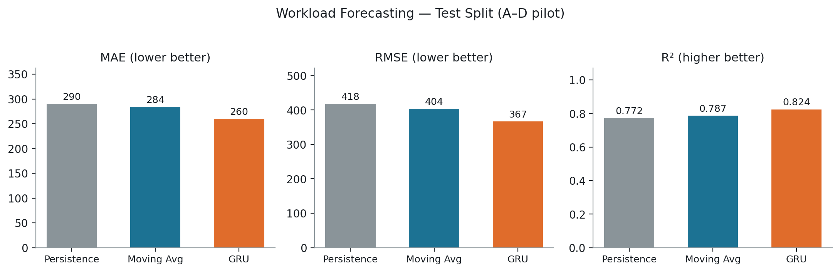
Forecasting Baselines — Does the GRU Add Value?
PILOT RESULT — CELLS A–D — NOT FINAL
The real question isn't ‘is R² high?’ — it's whether the GRU adds predictive value over simple strategies. Here it does: lower MAE/RMSE and higher R² than both persistence and moving-average, on the untouched test split.
Notes:
SAY: 'Persistence' just repeats the last observed value; 'moving average' averages the last few steps. Both are trivial to compute and set the bar the GRU has to clear. On this test split it does: MAE 260 vs 290/284, RMSE 367 vs 418/404, R-squared 0.824 vs 0.772/0.787 -- read exact numbers from results/pilot/forecasting/metrics.json. LIKELY QUESTION: 'Is 0.824 a good R-squared?' ANSWER: for a real, noisy operational workload signal, yes -- and more importantly it beats the baselines by a clear, consistent margin on every metric, which is the more meaningful bar than an absolute threshold.

Slide 17
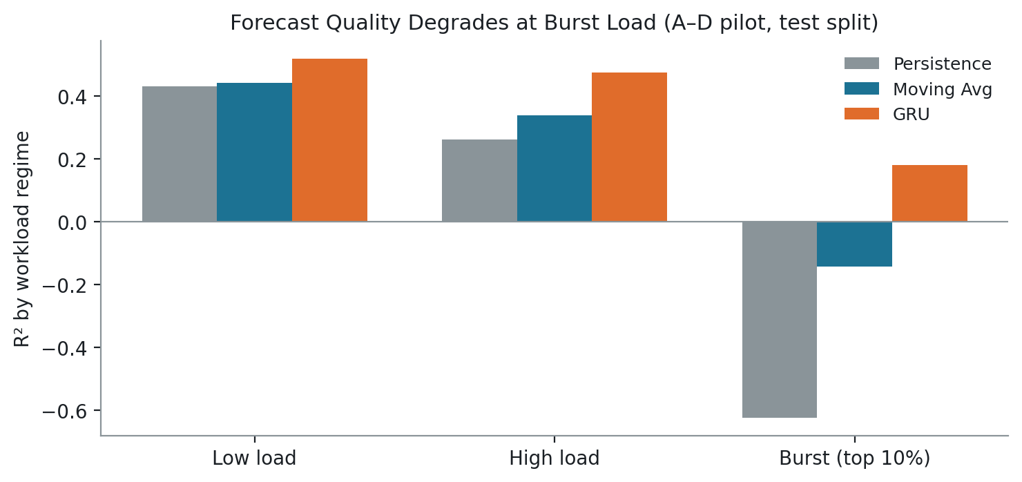
What the Pilot GRU Result Actually Means
PILOT RESULT — CELLS A–D — NOT FINAL
• The workload contains real, learnable temporal structure — it is not noise.
• GRU currently outperforms both pilot baselines on every metric on the held-out test split.
• This is substantially stronger than V1's forecasting result (R² near zero on the sparse Kaggle signal).
• Forecast quality degrades at burst load (top decile) — GRU R² drops to 0.18 there, still ahead of persistence's -0.62.
• A–D is not the final 8-cell population — this is evidence of FEASIBILITY, not the final research claim.
Notes:
SAY: Two things are true at once here: the forecaster genuinely works, and it works less well exactly where it matters most for safety -- sudden bursts. That's an honest limitation, not something to gloss over: proximity events near the safety limit correlate with exactly the regime (burst load) where the forecast is weakest. LIKELY QUESTION: 'So is forecasting actually useful for control, or not?' ANSWER: this slide only establishes forecast QUALITY; whether it changes CONTROL behavior is a separate question tested by the forecast on/off ablation, which is planned for the final 8-cell run (V1's own forecast ablation found no measurable control benefit, so this is a real open question, not assumed to be positive).

Slide 18
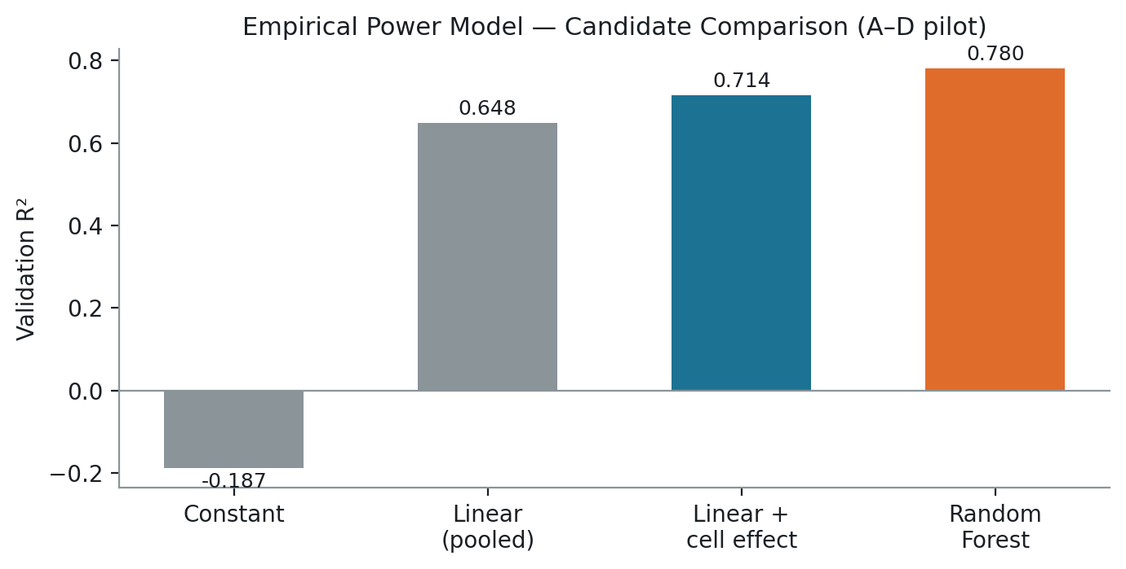
Empirical Power Model
PILOT RESULT — CELLS A–D — NOT FINAL
Workload (sum_cpu, sum_mem, per cell)
Empirical model
(fitted on TRAIN)
Estimated power utilization
Heat generation (× heat_scale_kw)
V2 anchors this model to OFFICIAL MEASURED Google power data (PowerData2019) — V1 had none and used a pure assumption. Four candidates were compared, selected on VALIDATION only: a Random Forest (sum_cpu, sum_mem, cell) wins with R² ≈ 0.780, MAE ≈ 0.014, RMSE ≈ 0.018 (fraction of PDU capacity). Residuals show a modest positive bias at high load (mean +0.015) — disclosed, not hidden.
Notes:
SAY: This is a genuinely new capability V2 has that V1 never did: a REAL empirical relationship between workload and measured power. We tried four candidates in increasing complexity -- a constant baseline, a pooled linear model, a linear model with a per-cell fixed effect, and a random forest -- and picked the winner purely on validation RMSE, never touching the test split. LIKELY QUESTION: 'Why does a per-cell fixed effect help so much (0.648 to 0.714 R2)?' ANSWER: different cells likely have different numbers of PDUs / baseline power draw; the feature-importance breakdown in the appendix shows cell identity carries real predictive weight (36.7%), almost as much as CPU itself (58.4%).

Slide 19
Why Real Power Data Matters
PILOT RESULT — CELLS A–D — NOT FINAL
VERSION 1
VERSION 2
CPU / workload utilization
Official Google workload
ASSUMED linear formula
(never measured)
Empirical model
(fitted, R²≈0.780)
Simulated power
Official MEASURED power
reference (PowerData2019)
• The power model is now anchored to measured Google power data, not an assumption.
• This does NOT automatically make the thermal model physically measured — model quality still has to be evaluated on its own (previous slide's residuals).
Notes:
SAY: Side by side, the difference is that V1's middle step was a guess and V2's is a fitted model checked against real measurements. That is the specific scientific upgrade this slide is making, no more and no less. LIKELY QUESTION: 'Does this mean the thermal simulation is now realistic?' ANSWER: no -- that's exactly the caution in the panel below. A better power model does not automatically validate the downstream thermal simulation; that's addressed separately, next.

Slide 20
Three-Zone Thermal Model
PILOT RESULT — CELLS A–D — NOT FINAL
Per zone, every step:
Zone 2
(cell b)
• workload → power/heat (from the fitted model)
• heat + cooling action → temperature update
• coupling with neighboring zones (heat can move between them)
• cooling action reduces temperature, at an assumed max rate
Zone 1
(cell a)
Zone 3
(cell c)
(4th zone, cell d, omitted here for clarity)
Why zones, why 4 (not a fixed 3)?
Zones enable spatially distributed control and a genuine multi-agent formulation. V2 sets zones = Borg cells directly (4 in the pilot, 8 in the final run) instead of V1's fixed, synthetic 3-zone split — because cells are a real partition, not an invented one.
The zones are LOGICAL SIMULATION zones — NOT claimed to represent three (or four) known physical Google rooms or racks.
Notes:
SAY: The diagram shows the general topology -- each zone has its own heat and cooling, plus a coupling term with its neighbors so heat can spread. The genuinely new decision in V2 is using the Borg CELL as the zone unit instead of V1's synthetic hash-based split -- because we now have a real partition to use, re-inventing an arbitrary one would be a step backward. LIKELY QUESTION: 'Are these real Google temperature measurements?' ANSWER: No. The workload and power references are official Google data, but the three/four-zone thermal environment itself is a simulation abstraction built to study the control problem -- there is no real temperature data anywhere in either Google trace.

Slide 21
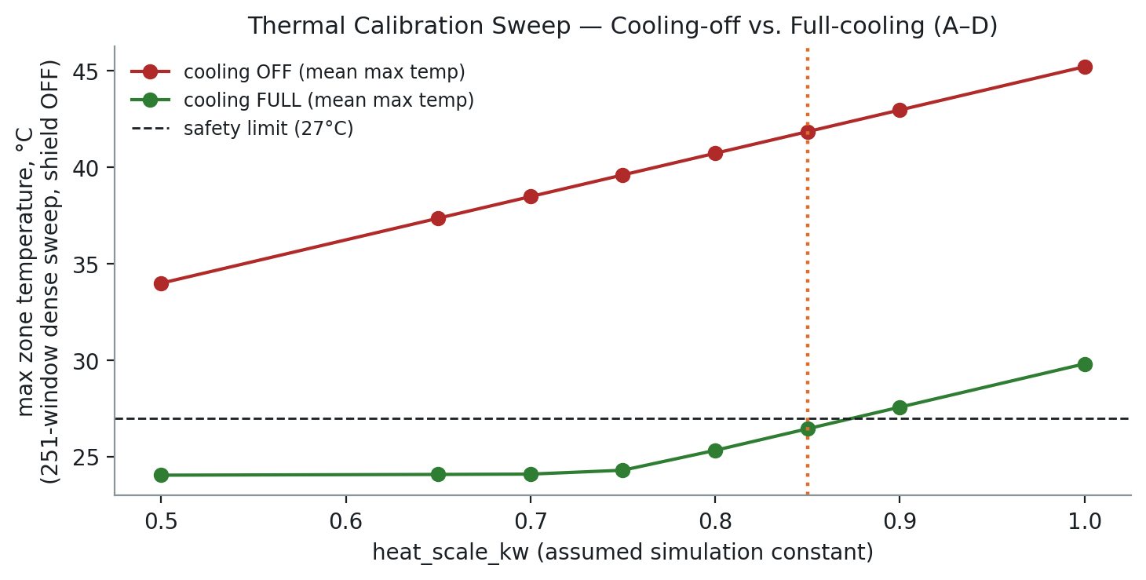
Thermal Calibration
PILOT RESULT — CELLS A–D — NOT FINAL
• Selected value: heat_scale_kw = 0.85 — the smallest tested value where cooling OFF already violates the safety limit, while cooling FULL stays comfortably safe (a genuinely non-trivial control problem).
• A real bug was found and fixed during calibration: the first attempt measured “cooling off” with the safety shield still silently active, which secretly corrected the “off” action.
• After disabling the shield explicitly, the sweep was repeated on a dense, 251-window scan (vs. the original 14 points) — same conclusion, on much stronger evidence.
• A regression test now locks this in (test_open_loop_cooling_off_is_invariant_to_cooling_max_kw).
Notes:
SAY: This chart is read left to right as we turn up an assumed heat-intensity parameter. The red line (cooling off) crosses the safety limit almost immediately; the green line (full cooling) stays safe until about 0.9, where it also starts failing -- meaning the cooling capacity itself becomes insufficient beyond that point. 0.85 sits right at the edge: violates when off, safe when full. LIKELY QUESTION: 'Why should I trust a self-reported bug fix?' ANSWER: because we're showing you exactly how it was caught -- an impossible symptom (the 'off' trajectory changing when a cooling-capacity parameter was varied, which should be physically impossible for action=0) -- and the fix is now a permanent automated test, not just a one-time patch.

Slide 22
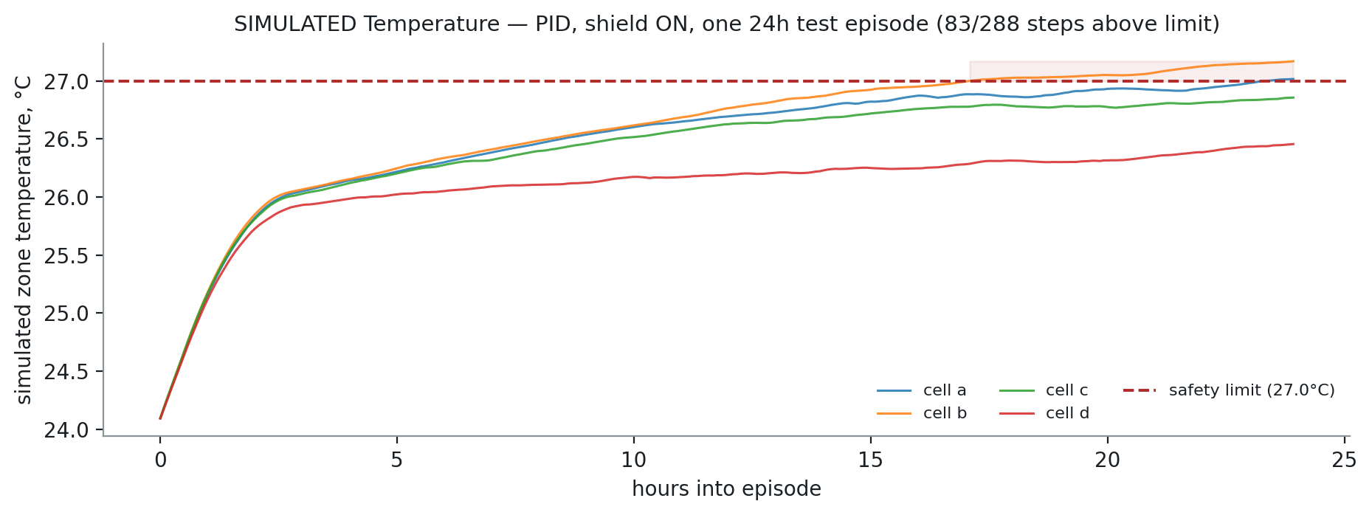
Important Thermal Finding: PID Still Violates 34% of Steps
PILOT RESULT — CELLS A–D — NOT FINAL
• With the safety shield ON, a well-tuned PID controller still spends 33.9% of test-split steps above the 27°C safety limit (results/pilot/controllers/classical_controller_comparison.json).
• Why: thermal dynamics have lag, the actuator is rate-limited (max change per step), PID only responds once temperature error is already large (reactive, not proactive), and the safety shield is a ONE-STEP-AHEAD correction — it cannot undo several steps of prior lag in a single move.
• This result was KEPT, not tuned away. Re-calibrating the thermal parameters until PID showed zero violations would have altered the evidence to fit a preferred story.
Notes:
SAY: This is a finding we're choosing to show you plainly rather than hide. The chart is one real simulated 24-hour test episode: four cell temperatures over time, the dashed red line is the safety limit, and the shaded band marks where at least one zone is over it. 83 of 288 steps in this specific episode are above the line. LIKELY QUESTION: 'Why didn't you simply tune the model until PID had zero violations?' ANSWER: because that would alter the evidence to obtain a desired result. The dense calibration (previous slide) showed this behavior is tied to the actual thermal/control dynamics -- reactive lag plus a myopic one-step shield -- so it was retained and documented, exactly as the instructions for this project require.

Slide 23
The Control Problem, Formally
PILOT RESULT — CELLS A–D — NOT FINAL
OBSERVATION
(temps, workload, forecast, margin to limit, prev action, time-of-day)
Constraints
• Action bounds: cooling ∈ [0, 1] per zone
• Rate limit: |a_t − a_{t-1}| ≤ 0.3 per step
• Thermal safety limit: 27°C (soft penalty from 4°C below; safety shield near the limit)
CONTROLLER
ACTION
(cooling level per zone, in [0, 1])
ENVIRONMENT TRANSITION
(heat + cooling → next temperature)
The trade-off
• energy (minimize)
• thermal safety (respect the limit)
• smoothness (avoid chattering actions)
Notes:
SAY: Every controller in this project — classical or learned — is solving exactly this loop with exactly these constraints; that shared definition is what makes the comparisons on the next few slides apples-to-apples. LIKELY QUESTION: 'What exactly is in the observation?' ANSWER: current temperatures, current workload, the GRU's forecast, the safety margin remaining, the previous action (for smoothness), and a sine/cosine time-of-day encoding -- listed in full in the appendix.

Slide 24
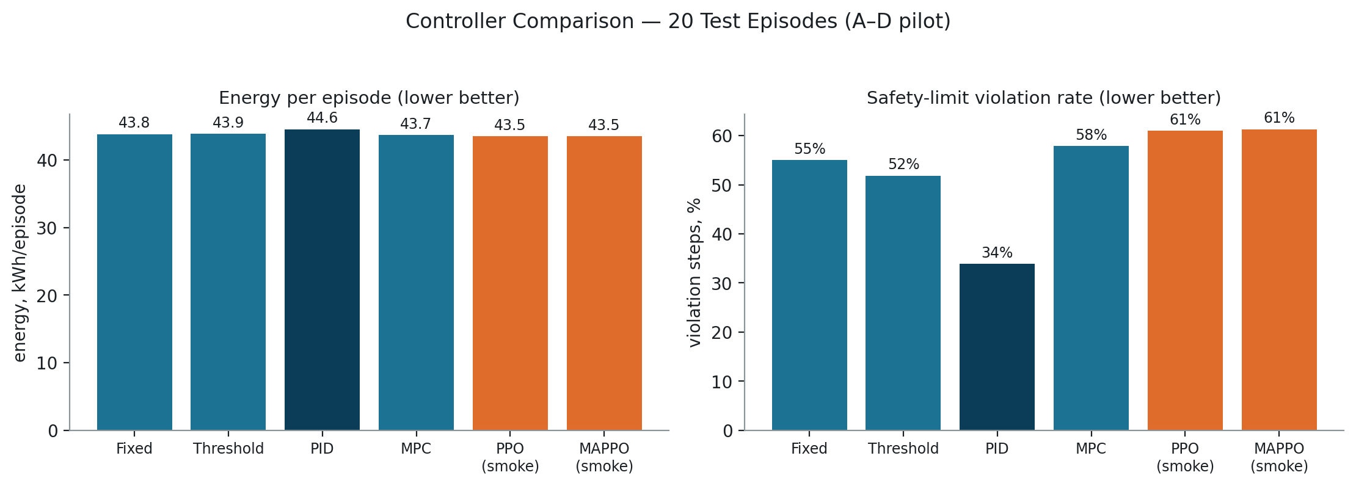
Classical Controllers
PILOT RESULT — CELLS A–D — NOT FINAL
Fixed
Threshold
PID
MPC
Constant cooling level, regardless of state.
Switches cooling on/off when temperature crosses fixed points.
Cools proportional to error, its accumulated history, and its rate of change.
Simulates several candidate action sequences ahead and picks the best.
Notes:
SAY: Four classical controllers, ordered roughly by sophistication. PID is the strongest of the four (lowest violation rate at 33.9%, per the chart) because it responds to error, the trend of that error, and its accumulated history, not just an instantaneous threshold. MPC here is a documented random-shooting search over 64 candidate action sequences per step, not a full gradient/CEM solver -- a disclosed simplification, not hidden. LIKELY QUESTION: 'Why does MPC not obviously beat PID here?' ANSWER: MPC's heat forecast over its horizon is held constant (a documented simplification, since the fitted power model needs a memory-usage feature that isn't forecasted) -- so it isn't exploiting future information the way a full model-predictive approach ideally would.

Slide 25
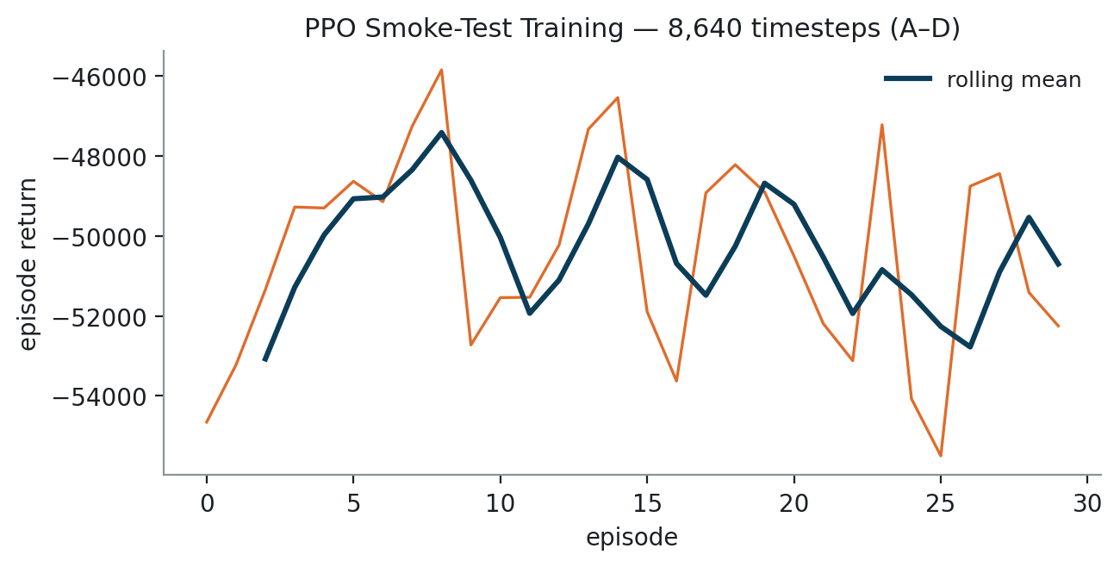
PPO — Proximal Policy Optimization
State
Core idea:
Update the policy toward actions with higher-than-expected return (the ‘advantage’), but CLIP how far a single update can move it — keeps training stable.
Policy
Action
Environment
Reward
Policy update (clipped)
SMOKE TEST ONLY — 8,640 timesteps (V1 used 100,000). This validates the code path executes correctly on real data; it is NOT a final PPO result.
Notes:
SAY: PPO is single-agent here: one policy observes and controls ALL zones jointly. The training curve on the right is genuine data from this pilot run, but at 8,640 timesteps it's a small fraction of a real budget -- read it as 'the wiring works', not 'this is how good PPO is'. LIKELY QUESTION: 'What's the clipping math?' ANSWER: the objective clips the probability ratio between new and old policy to [1-epsilon, 1+epsilon] (epsilon=0.2 here) before multiplying by the advantage -- full formulation in the appendix.

Slide 26
MAPPO — Multi-Agent PPO with CTDE
GLOBAL STATE (training only)
CENTRALIZED CRITIC
Agent 1
(actor, shared weights)
Agent 2
(actor, shared weights)
Agent 3
(actor, shared weights)
Agent 4
(actor, shared weights)
Action 1
Action 2
Action 3
Action 4
Zone 1 (cell a)
Zone 2 (cell b)
Zone 3 (cell c)
Zone 4 (cell d)
TRAINING:
centralized critic sees the concatenated
global state of all 4 zones
EXECUTION:
each agent acts from its OWN local
observation only — no global info
CTDE = Centralized Training, Decentralized Execution. This is genuine multi-agent MAPPO — NOT one PPO policy with four output values.
SMOKE TEST ONLY — 30 updates (V1 used 300). NOT a final result.
Notes:
SAY: Each of the 4 agents (one per cell) has its own actor network with SHARED weights, and sees only its own zone's local observation when acting -- that's decentralized execution. During TRAINING ONLY, a separate centralized critic sees the concatenation of all four zones' observations, so it can learn how the zones interact even though the actors themselves never do at execution time. LIKELY QUESTION: 'How do you know this is real MAPPO and not just relabeled PPO?' ANSWER: it's structurally verified by test -- the actor's input dimension (9, one zone) is asserted to differ from the critic's input dimension (36, all four zones concatenated) in tests/test_marl.py, and each agent's action is confirmed to depend only on its own local observation, never the others'.

Slide 27
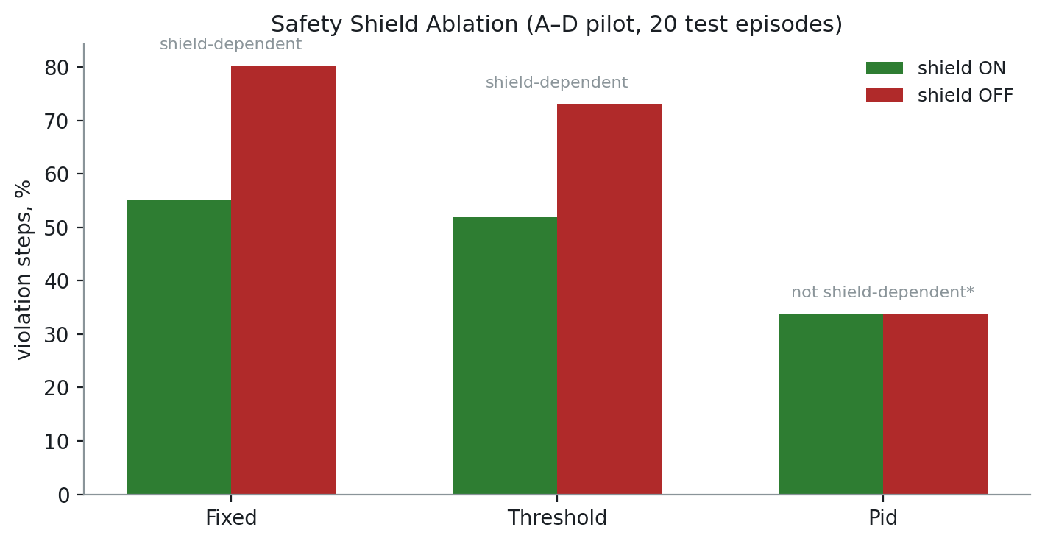
The Safety Shield
RL / controller
proposed action
What it does
SAFETY CHECK
(predicted next temp vs. limit)
• One-step-ahead, closed-form check: would the proposed action leave a zone above (limit − margin)?
• If so, raises cooling to the minimum needed to reach that threshold (bounded by actuator limits) — not a general MPC solver.
• Every intervention is logged: which zone, how much correction, resulting temperature.
Safe action
(possibly corrected)
Thermal environment
“Shield intervention” ≠ “intrinsically safe policy”
Fixed/Threshold need the shield heavily.
PID's shield-on/off results are IDENTICAL —
not because PID is proactively safe, but
because cooling is already saturated (slide 22).
Notes:
SAY: The shield sits between every controller's decision and the physics -- it never changes the reward function, only the applied action, and every correction is logged so reliance on it can be measured, not assumed. LIKELY QUESTION: 'Does the shield eliminate all safety problems?' ANSWER: no, and that's the point of the ablation chart -- Fixed and Threshold lean on it heavily (25 and 21 percentage points worse without it), while PID shows no change either way. Read that last one carefully: it does NOT mean PID is inherently safe -- our thermal calibration shows PID's cooling is already maxed out in the regime that causes its violations, so the shield literally has nothing left to give it.

Slide 28
Software / Research Validation
62 / 62
tests passing
Category | What's checked
Join integrity | no duplicate (cell, bucket) rows; ≥ 95% workload/power match
Chronological split | train < val < test bucket ranges, verified disjoint
Causality / leakage | forecast windows never cross a split; degenerate bins zeroed
Heat-generation correctness | heat = predicted_power_util × heat_scale_kw, asserted exactly
Configuration consistency | single source of truth for active cell set (new, see below)
Active-cell / n_zones consistency | n_zones DERIVED from loaded data, not configured
Pilot/final artifact separation | results/<cell_set>/... and models/v2/<cell_set>/...
Extraction readiness | 8-cell extraction script verified live, no code changes needed
A real bug this caught:
configs/v2_config.yaml independently duplicated the active-cell-set setting and manually set n_zones=4. Fixed: one source of truth, n_zones derived from data, pilot/final paths isolated — all locked in by new regression tests.
Notes:
SAY: This slide exists to show engineering rigor, not just a pass/fail count. The specific bug called out on the left is real: before a final-pipeline readiness audit, two config files could disagree about which cells were active, and the final run could have silently overwritten pilot results at the same file path. It was found, fixed, and turned into a permanent test rather than a one-off patch. LIKELY QUESTION: 'Do these 62 tests include anything about PPO/MAPPO correctness?' ANSWER: yes, inherited from V1 -- 8 dedicated tests verify MAPPO's actor only sees local observations while the critic sees the full global state, and that the PPO importance-sampling ratio is computed correctly (a real bug found and fixed during V1).

Slide 29
Current Results: What Has Actually Been Proven
Component | Current evidence | Status
Data alignment | Borg-cell join validated, ≥ 95% coverage per cell | PILOT PIPELINE
GRU forecasting | test R² ≈ 0.824 (vs. 0.772 / 0.787 baselines) | PILOT
Empirical power model | validation R² ≈ 0.780 (Random Forest) | PILOT
Thermal model | calibrated + validated, with a disclosed limitation | PILOT
Classical control | Fixed/Threshold/PID evaluated, 20 test episodes | PILOT
MPC | implemented, evaluated (documented simplification) | PILOT
PPO | runs correctly end-to-end | SMOKE TEST — NOT FINAL
MAPPO (CTDE) | runs correctly end-to-end, structurally verified | SMOKE TEST — NOT FINAL
Safety shield | implemented + ON/OFF ablation with reliance analysis | PILOT
Engineering tests | 62 / 62 passing | VERIFIED
Notes:
SAY: This table is the honest summary of the whole deck so far -- read the STATUS column carefully, it is not uniform. Most rows say PILOT, meaning validated on 4-of-8 cells; two rows (PPO, MAPPO) are explicitly downgraded further to SMOKE TEST because their training budget is a small fraction of even V1's reduced budget. LIKELY QUESTION: 'Which of these numbers would you bet on holding up on 8 cells?' ANSWER: the data-alignment and engineering-test rows are structural, not statistical -- they should hold. The GRU/power-model R2 values are real pilot measurements but the final ones must be re-measured on the complete population, not assumed unchanged.

Slide 30
What Is Done / What Is Not Yet Final
COMPLETED
NOT YET FINAL
• Official data audit + alignment audit
• Cells A–D extraction
• All 8 cells' power + machine data extraction
• Preprocessing pipeline
• GRU forecaster
• Empirical power model
• Thermal calibration (pilot)
• Classical controllers (Fixed/Threshold/PID)
• MPC
• Safety-shield infrastructure + ablation
• Robustness infrastructure
• 62/62 engineering tests
• Git/GitHub version control (V1 preserved)
• Cells E–H workload extraction
• Complete A–H dataset
• Final model selection (on val, all 8 cells)
• Full PPO training budget
• Full MAPPO training budget
• Final multi-seed evaluation (≥ 5 seeds)
• Full ablations (forecast on/off, shield on/off) on final data
• Final robustness study
• Final untouched test-set evaluation
• Final independent audit
• Final research report (DOCX) and final PPTX
Notes:
SAY: Two honest columns, no overlap. Everything on the left is genuinely finished engineering work you can inspect in the repository today; everything on the right requires the complete 8-cell dataset and has not been attempted on 4-of-8 cells as a substitute. LIKELY QUESTION: 'What's the single biggest remaining risk?' ANSWER: that PPO/MAPPO, even with a full training budget, don't beat classical control -- V1 already found exactly that outcome once, so it's a live possibility we're not assuming away.

Slide 31
Why We Are Not Claiming Final Results Yet
A–D is 4 of 8 cells — half the intended final population.
• Repeatedly tuning thermal parameters, rewards, and hyperparameters against A–D and then reporting that as the final research conclusion would risk OVERFITTING to the pilot population.
• Model/controller selection decisions made only on A–D could be BIASED in ways that don't hold on E–H.
• Presenting pilot smoke-test PPO/MAPPO numbers as a real comparison would be MISLEADING — they used a fraction of a real training budget.
A–D
DEVELOPMENT
A–H
FINAL EVALUATION
Notes:
SAY: This is a methodology safeguard, not a hedge. If we let ourselves tune everything against the same 4 cells we then report results on, any positive finding becomes suspect -- indistinguishable from fitting to that specific pilot population. Keeping A-D strictly as development data and reserving A-H for one final, frozen evaluation is what keeps the eventual final claim defensible. LIKELY QUESTION: 'Isn't this overly cautious for a progress presentation?' ANSWER: this same discipline is exactly what let V1 report an honest negative result (PID beating RL) instead of an inflated one -- it's a deliberate scientific-integrity choice, not delay for its own sake.

Slide 32
Final Experiment Plan (Once Cells E–H Are Available)
E–H extraction (script ready, verified live)
A–H dataset validation (same checks as slide 10, all 8 cells)
Final chronological train / validation / test split
Training/validation model selection (forecaster, power model, thermal recalibration)
Freeze the final configuration
Untouched final test evaluation (once)
Fixed / Threshold / PID / MPC
PPO / MAPPO, ≥ 5 seeds where computationally feasible
Forecast ablation · shield ablation · reward sensitivity · thermal sensitivity
Workload robustness · forecast-noise robustness
Independent final audit
Notes:
SAY: This is the exact sequence, in order, that fires once the BigQuery quota resets -- not a vague future plan. Two rules govern it: model selection only ever touches train/validation, and the final test split is evaluated exactly once, after everything else is frozen. LIKELY QUESTION: 'How long will this take once E-H unblocks?' ANSWER: the mechanical steps (extraction, preprocessing, refitting the forecaster/power model) are fast (all pilot equivalents ran in minutes); the RL training at a REAL budget (5 seeds x PPO and MAPPO) is the dominant cost, matching V1's own multi-hour CPU training time.

Slide 33
Current Research Status
The Version 2 pipeline has been implemented and technically validated on a real-data pilot using Google Borg cells A–D. The pilot demonstrates feasible workload forecasting, empirical power modeling, thermal-control infrastructure, and a tested PPO/MAPPO pipeline. However, the complete eight-cell experiment is not yet finished, so the current numerical results are development evidence rather than final research conclusions.
IMMEDIATE NEXT STEP
Complete E–H extraction and re-run the entire final experiment on all eight cells.
v2-official-google-data @ b83ce2a · 62/62 tests passing
Notes:
SAY: read the paragraph on this slide close to verbatim -- it is the deliberately precise summary of where the project actually stands, phrased to avoid overclaiming. LIKELY QUESTION: 'So what's the headline result of this project?' ANSWER: there isn't one yet, by design -- the headline result is deferred until the full 8-cell run completes; what exists today is validated infrastructure and early feasibility evidence.

Slide 34
References
• Google. ClusterData2019 documentation. google/cluster-data, GitHub. https://github.com/google/cluster-data/blob/master/ClusterData2019.md
• Google. PowerData2019 documentation. google/cluster-data, GitHub. https://github.com/google/cluster-data/blob/master/PowerData2019.md
• Google. cluster-data repository (BigQuery public datasets, schema). https://github.com/google/cluster-data
• Kaggle dataset “muzairbair/borg-traces-data” — the Version 1 data source (superseded in V2 by the official traces above).
• Project internal documentation: docs/official_data_alignment_audit.md, docs/version2_research_design.md, docs/final_pipeline_readiness_audit.md, docs/final_validation_report.md (V1), results/model_selection_history.csv.
A structured literature review (target: ~20 papers on datacenter cooling control, MARL, and safe RL) is PLANNED for the final research phase and has not yet been conducted — no papers are cited here that were not actually reviewed.
Notes:
SAY: Every source listed here is one this project actually used or produced -- nothing is a placeholder citation. LIKELY QUESTION: 'Where's the related-work / literature review?' ANSWER: honestly, not done yet at this pilot stage -- it's explicitly planned for the final phase (see the master project plan), and we chose not to fabricate a reading list to fill this slide.

Slide 35
Appendix
Architecture, formulation, and configuration detail for follow-up questions
Notes:
SAY: Hold here unless a specific technical question calls for one of these slides.

Slide 36
DETAIL
Appendix A — GRU Architecture
Setting | Value
Cell type | GRU (Gated Recurrent Unit), 1 layer
Hidden size | 32
Input | 1-D sequence, 48 steps (sum_cpu, per cell, normalized on TRAIN)
Output | 6-step forecast (30 minutes ahead)
Loss | MSE, Adam optimizer, lr = 0.001
Early stopping | patience = 5 epochs, on validation loss
Training result | converged (early-stopped before 30 epochs)
GRU update equations (per step t):
z_t = σ(W_z x_t + U_z h_{t-1}) (update gate)
r_t = σ(W_r x_t + U_r h_{t-1}) (reset gate)
h̃_t = tanh(W_h x_t + U_h (r_t ⊙ h_{t-1}))
h_t = (1 − z_t) ⊙ h_{t-1} + z_t ⊙ h̃_t
x_t: workload at step t. h_t: hidden state. σ: sigmoid. ⊙: elementwise product.

Slide 37
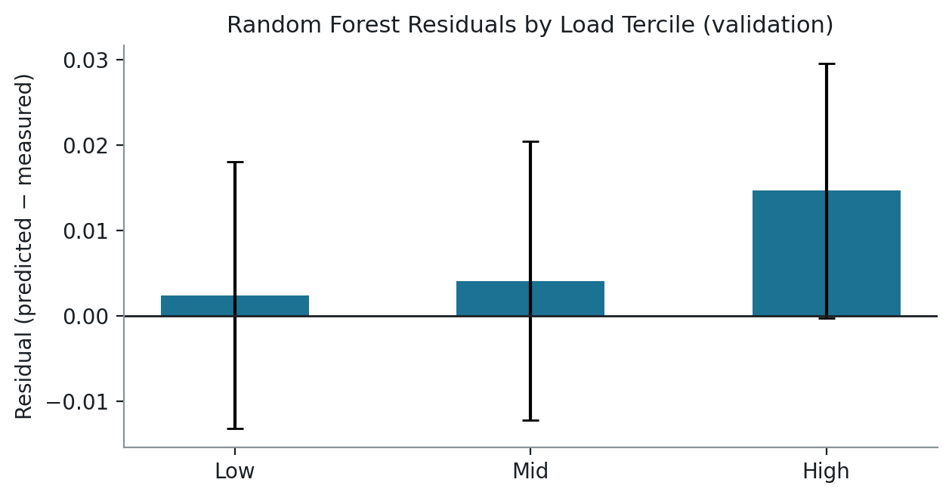
DETAIL
Appendix B — Power-Model Features
Feature | Random Forest importance | Meaning
sum_cpu | 0.584 | sum of average_usage.cpus, active machines, per cell/bucket
cell_code | 0.367 | categorical cell identity (captures per-cell baseline draw)
sum_mem | 0.049 | sum of average_usage.memory, active machines, per cell/bucket
Target: mean_measured_power_util (fraction of PDU rated capacity, NOT watts — no PDU capacity-in-kW field exists in the public PowerData2019 schema).
Residuals show a modest positive bias at high load (underprediction) — disclosed as a limitation, not corrected by re-fitting against the same data it would be tested on.

Slide 38
DETAIL
Appendix C — Thermal Model Equations
Per zone i, discretized with explicit (forward) Euler at dt = 5 minutes:
T_i[t+1] = T_i[t] + (dt_hours / C_i) × ( Q_i[t] − a_i[t]·P_cool·η + Σ_j K_ij (T_j[t] − T_i[t]) + K_amb (T_amb − T_i[t]) )
Term | Meaning | Status
Q_i | heat input to zone i | FITTED (empirical power model × heat_scale_kw)
C_i | thermal mass | ASSUMED simulation constant (0.5 kWh/°C)
K_ij | inter-zone coupling | ASSUMED (0.05 kW/°C, line-graph topology)
K_amb | ambient coupling | ASSUMED (0.02 kW/°C)
a_i, P_cool, η | cooling action, max cooling power, efficiency | ASSUMED (a∈[0,1], 0.5 kW, 1.0)
T_amb | ambient temperature | ASSUMED (22°C)

Slide 39
DETAIL
Appendix D — PPO / MAPPO Objective
Clipped surrogate objective (shared by PPO and MAPPO's per-agent update):
L(θ) = E[ min( r_t(θ)·A_t , clip(r_t(θ), 1−ε, 1+ε)·A_t ) ]
Term | Meaning
r_t(θ) | π_θ(a_t|s_t) / π_θ_old(a_t|s_t) — importance-sampling ratio
A_t | advantage estimate (Generalized Advantage Estimation, λ = 0.95)
ε | clip range (0.2 here) — bounds how far one update can move the policy
PPO critic | single value function over the joint (21-dim) observation
MAPPO critic | single centralized value function over the concatenated global (36-dim, 4 zones × 9-dim local) state — training only
MAPPO actor | parameter-shared, per-zone, 9-dim local observation → 1-dim action

