Slide 1
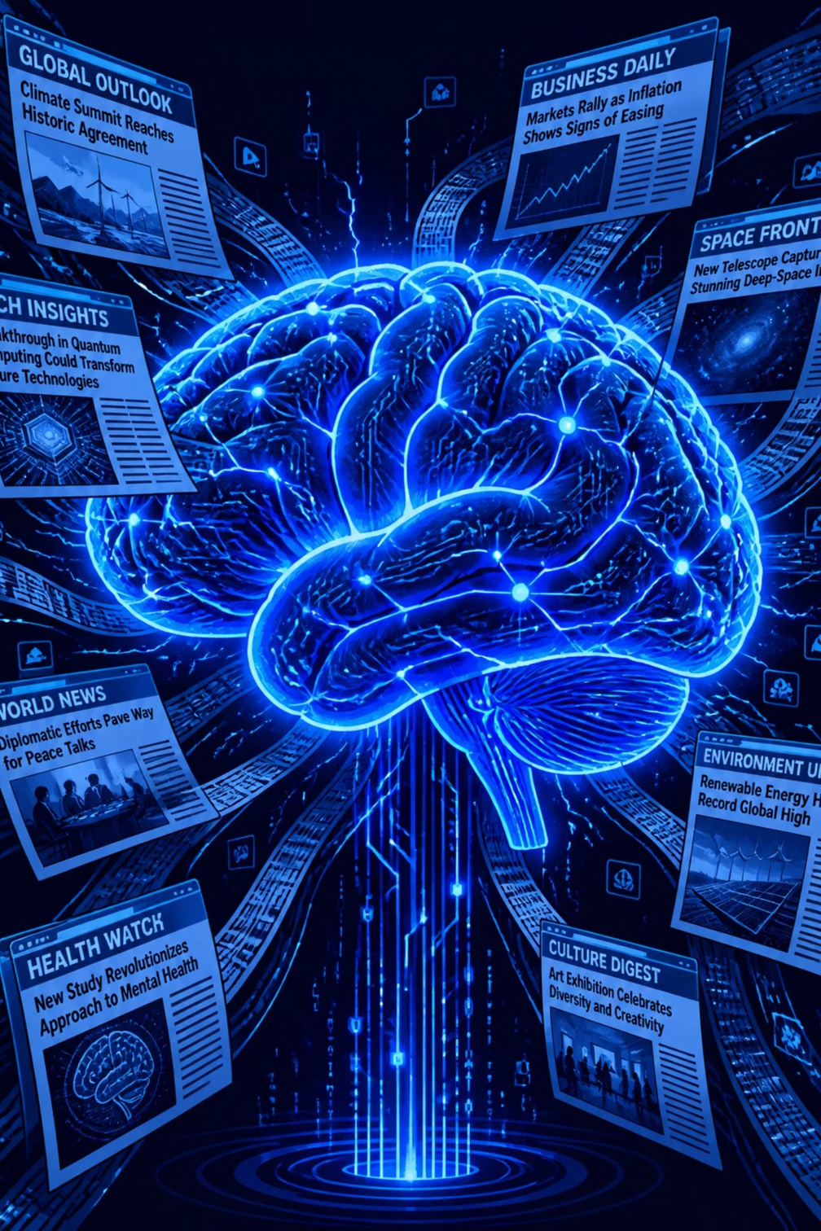

Fake News Detection with Machine Learning
IBM PBEL Virtual Internship 2026 — Artificial Intelligence
Presented by
Aditya Prajapati
B.Tech CSE
Batch 4
Notes:
1

Slide 2

Introduction
What Is Fake News?
Why It Matters
False or misleading content passed off as real news.
It spreads fast on social media and shapes opinions and elections.
Our Approach
We use ML and NLP to classify articles as Real or Fake.
Notes:
2

Slide 3

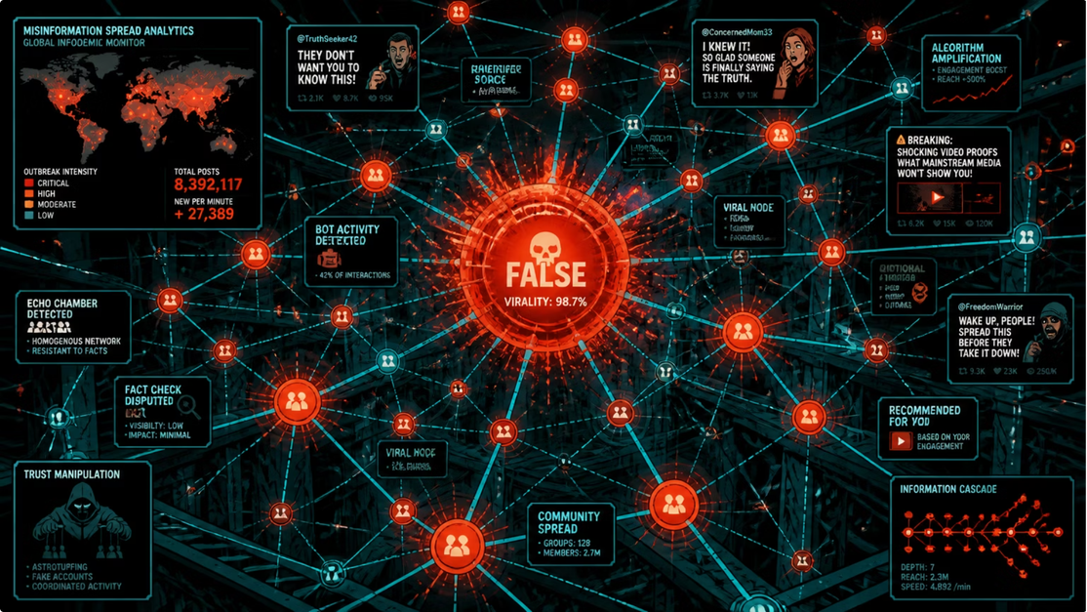
The Challenge
⚡ Fast Spread
False claims reach millions in minutes
🔍 Manual Checks
Too slow to scale
🌐 Real Impact
It shapes elections, markets, and trust
✅ Why It Matters
We need accurate automated detection
Notes:
3

Slide 4





Project Objectives
Fake News Detection
1
TF-IDF Features
Detect fake news with machine learning and NLP.
2
Convert text into numbers.
Performance Evaluation
4
Compare Classifiers
Measure results with standard metrics.
3
Test multiple models.
Notes:
4

Slide 5

Data Preprocessing
Text Cleaning Steps
This sequence prepares raw text for modeling.
Lowercase text
Remove URLs
Strip punctuation
Remove special characters
Remove numbers
Remove extra spaces
Notes:
5

Slide 6







Technologies Used
Python
Pandas
NumPy
Core language
Load and clean data
Fast numerical computing
NLTK
TF-IDF
Matplotlib
Text processing
Text feature extraction
Data visualization
Jupyter
Build and test notebooks
Notes:
6

Slide 7

Methodology
NLP Preprocess
TF-IDF Features
Train Logistic
Predict Real/Fake
Collect Data
Each stage turns raw text into a clear classification signal — collect, clean, vectorize, train, predict.
Notes:
7

Slide 8




Machine Learning Models
Logistic Regression
Decision Tree
Fast and effective
Strong for text classification
Rule-based
Easy to interpret
Random Forest
Gradient Boosting
Ensemble method
Helps reduce overfitting
Builds sequentially
High accuracy
Notes:
8

Slide 9

Results & Performance
Accuracy
Precision
90% — 90 correct predictions out of 100 total
87.5% — 35 true positives out of 40 predicted fakes
Recall
F1-Score
90% — 45 true positives out of 50 actual fakes
84.7% — harmonic mean of precision and recall
TF-IDF improved performance on unseen articles.
Notes:
9

Slide 10
Thank You
Notes:
10

