Slide 1

WASTEWISE AI
“From waste to resource, with proof.”
An offline AI waste scanner and campus collection system that counts only verified recovery.
Team Name: Team WasteWise
Team Members: Aditya Ranjan · Krishnansu Mohanty

Slide 2
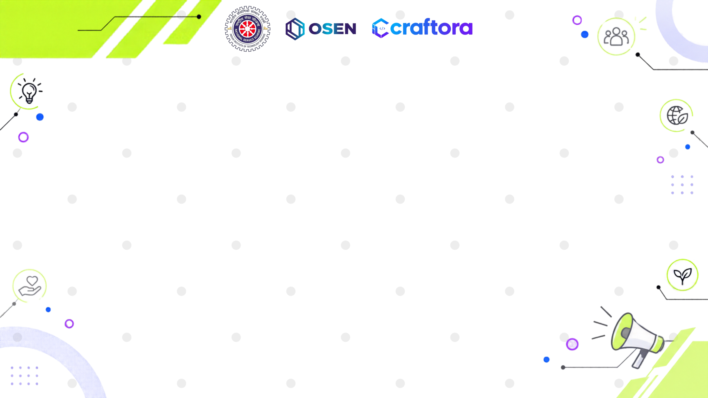
THE PROBLEM
Colour-coded bins everywhere, yet waste is still mixed and recovery is never proven.
Confusion at the bin
Contaminated streams
No proof of recovery
A greasy pizza box, a used tissue, a dead power bank: people genuinely don’t know if it is wet, dry, sanitary or special-care.
One wrong item spoils a whole bin. Mixed waste cannot be composted or recycled, so it goes to landfill.
Once waste leaves the bin, nobody tracks whether it was collected, let alone recycled. Impact figures are guesses.
Segregation at source is mandatory under India’s Solid Waste Management Rules, 2016, but campuses have no simple tool to guide it or to measure what actually gets recovered.

Slide 3
THE IDEA
WasteWise AI
One app that closes the loop from “what is this?” to “it was recovered, and here is the proof.”
1. Scan
2. Segregate
3. Request pickup
4. Verify recovery
Snap a photo. A pretrained vision model, running fully offline, suggests the material and shows its confidence honestly.
Two quick context checks map the item to India’s four streams, with handling steps and hazard flags.
One tap books a campus pickup with location and weight, pre-filled from the scan.
The collector accepts, weighs and confirms recovery only with evidence such as a weighment slip.
Reported → Accepted → Collected → Recovery Confirmed

Slide 4
KEY FEATURES
Offline AI scanner
Four-stream guidance
Campus pickup requests
EfficientNet-Lite0 on CPU via ONNX Runtime. Shows the material score and raw top-5 classes as evidence.
Wet, dry, sanitary and special-care, with rinse, sharp-handling and hazard steps per item.
Hostel or location, category, weight and notes, tracked by request number.
Collector workflow
Evidence-backed recovery
Impact analytics
Reported, Accepted, Collected, Recovery Confirmed. Status order is enforced at every step.
A receipt or slip is required. Recovered kg can never exceed collected kg. Full audit trail.
Reported vs collected vs verified kg per stream, hotspots, trends, funnel and CSV export.

Slide 5
INNOVATION
“Most apps stop at identification. We follow the waste all the way to verified recovery.”
THE DIFFERENTIATOR
Honest AI
Material is not the stream
Proof, not estimates
Low scores are flagged “please confirm” or “not recognised”. Every decision is logged as AI-confirmed, AI-corrected or manual, which becomes training data.
A camera cannot see food on a cup or past hygiene use. We ask two questions and a rules engine decides the stream.
We report three numbers: reported, collected and verifiably recovered. Simulated and demo data are counted separately, and sanitary waste is never counted as recovered.

Slide 6
TECH STACK
App & UI
AI model
Python + Streamlit. Runs on any laptop; students open it on their phones over the campus LAN.
Pretrained EfficientNet-Lite0 (ImageNet), ONNX Runtime on CPU, 18 MB. About 150 classes mapped to materials.
Rules engine
Data & analytics
Python context rules map material plus contamination and use to wet, dry, sanitary or special-care.
SQLite with audit log and demo flag. Pandas + Plotly for KPIs and charts. NumPy and Pillow for images.
No cloud, no API keys, no new hardware. Photos are processed in memory and never stored.

Slide 7
IMPACT & SCALABILITY
Impact
Scalability
• Cleaner segregation at source, so more waste is compostable or recyclable
• Campuses report verified kilograms recovered, not estimates
• Safe handling of sanitary, sharp and hazardous items
• Near-zero cost: an existing PC, a QR code at each bin cluster, housekeeping staff as collectors
• Campus to ward to city: SQLite to Postgres, role-based logins, per-site location lists
• Metrics map directly to urban local body reporting and plastic EPR tracking
• Model-agnostic: swap in a model fine-tuned on Indian waste images (TrashNet / TACO) with a one-file change

Slide 8
FROM IDEA TO IMPACT
“The greatest threat to our planet is the belief that someone else will save it.”
— Robert Swan
WasteWise AI puts the power in every hand. Scan it. Sort it. Collect it. Prove it.
WasteWise AI · Team WasteWise · Aditya Ranjan & Krishnansu Mohanty

Slide 9
