Slide 1
Towards Explainable Artificial Intelligence (XAI): A Data Mining Perspective
Authors: Haoyi Xiong, Xuhong Li, Xiaofei Zhang, Jiamin Chen, Xinhao Sun, Yuchen Li, Zeyi Sun, and Mengnan Du
Publication Date: Jan 05, 2024
Presented By: Aditya Rajpurohit

Slide 2
Introduction
Artificial Intelligence (AI) has revolutionized decision-making across various domains, from diagnosing diseases to optimizing financial systems. However, the opaque nature of many AI models raises concerns about accountability and trust. Explainable AI (XAI) emerges as a solution, enabling users to understand and validate AI-driven decisions while bridging the gap between technical complexity and human comprehension.

Slide 3
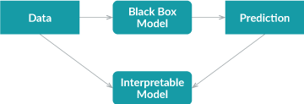
The Black-Box Problem in AI
Many state-of-the-art AI systems, particularly deep learning models, operate as black boxes, offering little insight into their decision-making processes. This opacity can lead to mistrust, especially in critical applications like healthcare and criminal justice, where understanding the "why" behind decisions is as important as the decisions themselves.

Slide 4
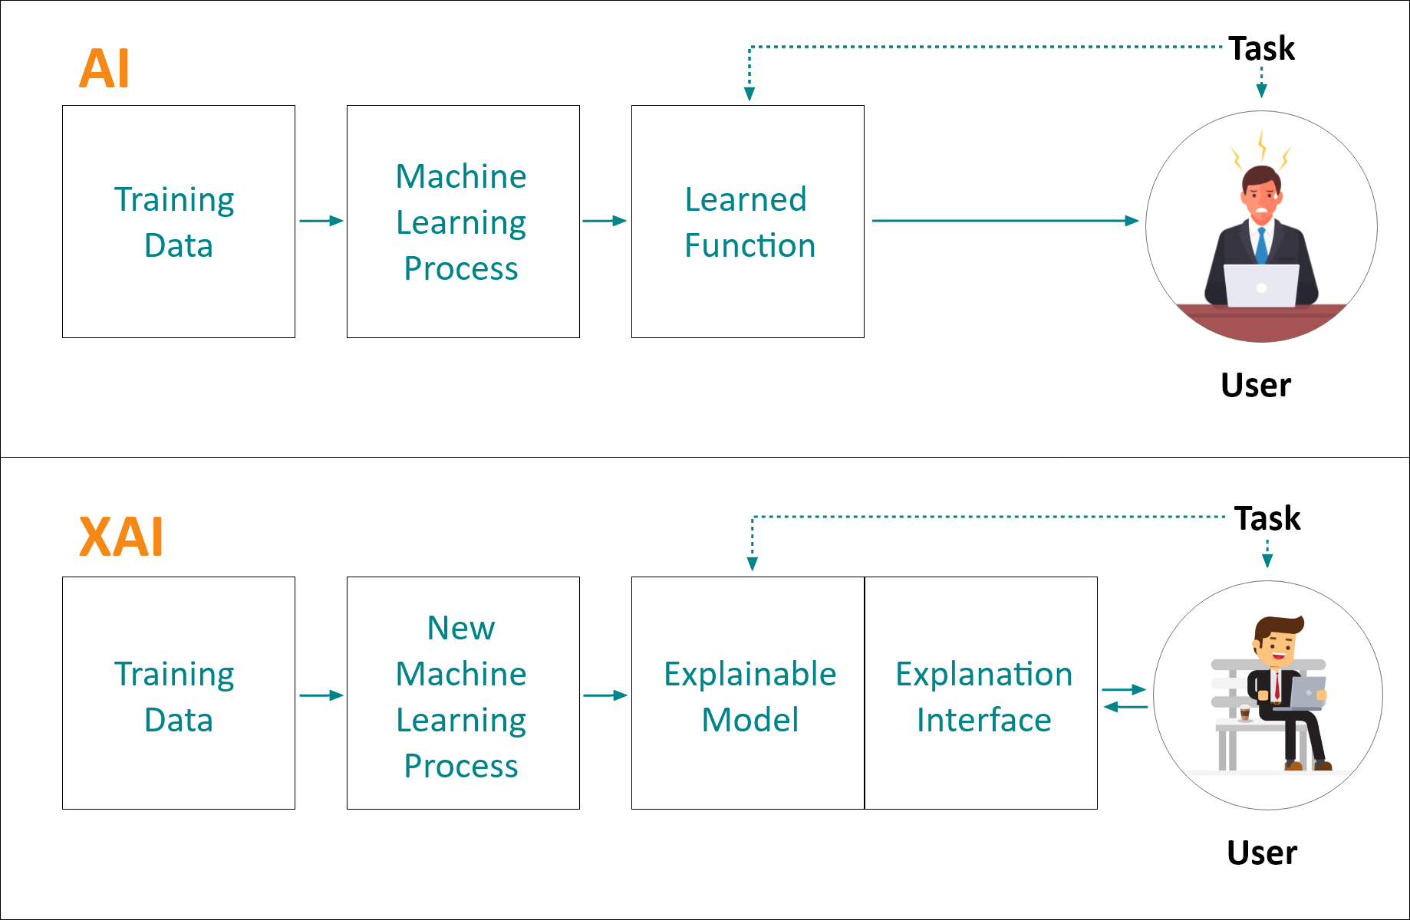
What is Explainable AI (XAI)?
Explainable AI refers to methodologies and tools designed to make AI decisions understandable to humans. It ensures that AI systems provide not only predictions but also insights into how those predictions are made, fostering accountability, fairness, and trust in automated systems.

Slide 5
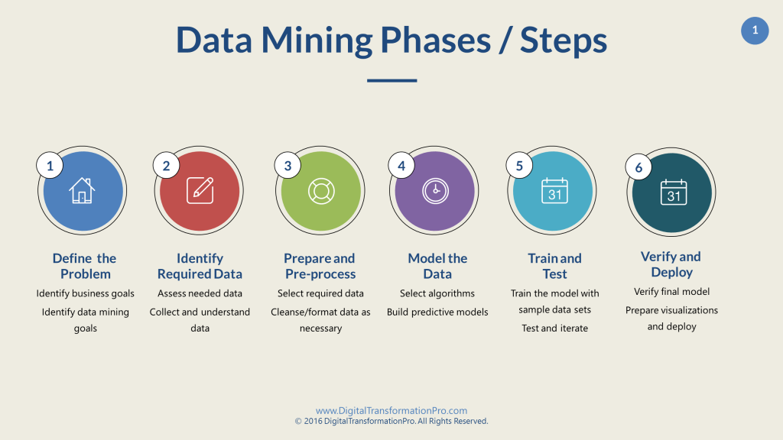
Importance of XAI in Data Mining
Data mining involves extracting meaningful patterns and insights from vast datasets. XAI ensures that the insights derived from complex AI models are interpretable and actionable. By enhancing transparency, XAI enables stakeholders to trust and validate AI-driven conclusions, making data mining more ethical and practical for real-world decision-making.

Slide 6
Model-Agnostic Techniques
Model-agnostic techniques like LIME (Local Interpretable Model-Agnostic Explanations) and SHAP (SHapley Additive exPlanations) provide explanations for any AI model. LIME simplifies a model locally around a prediction, while SHAP attributes importance to each feature, showing its influence on the output. These methods empower users to understand decisions regardless of the underlying model complexity.
Model-specific techniques focus on building inherently interpretable models, such as decision trees and linear models, or incorporating interpretability mechanisms like attention layers in neural networks. These approaches strike a balance between accuracy and transparency, catering to domain-specific requirements for explainability.

Slide 7

LIME Formula:
f: The Original black-box model.
g: A simpler interpretable model.
L: Loss function measuring the difference between 𝑓 and 𝑔.
πx​: Weighting function that gives higher weight to samples near 𝑥.
Ω(g): Complexity penalty for 𝑔.

Slide 8
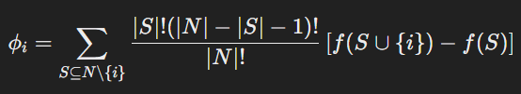
SHAP Formula:
ϕi: Shapley value for feature 𝑖.
𝑆: Subset of features.
𝑁: Total set of features.
𝑓(𝑆): Model output when only features in 𝑆 are included.

Slide 9
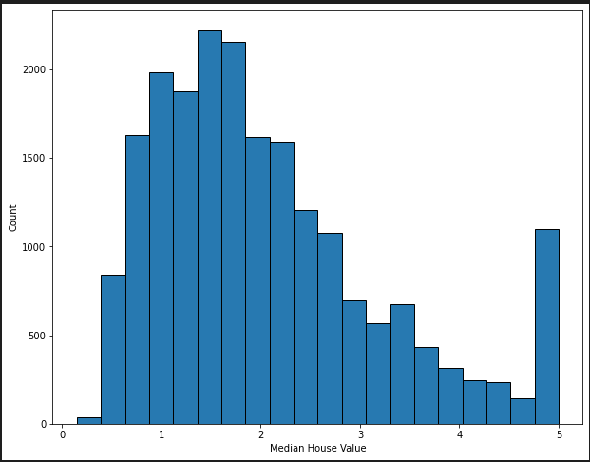
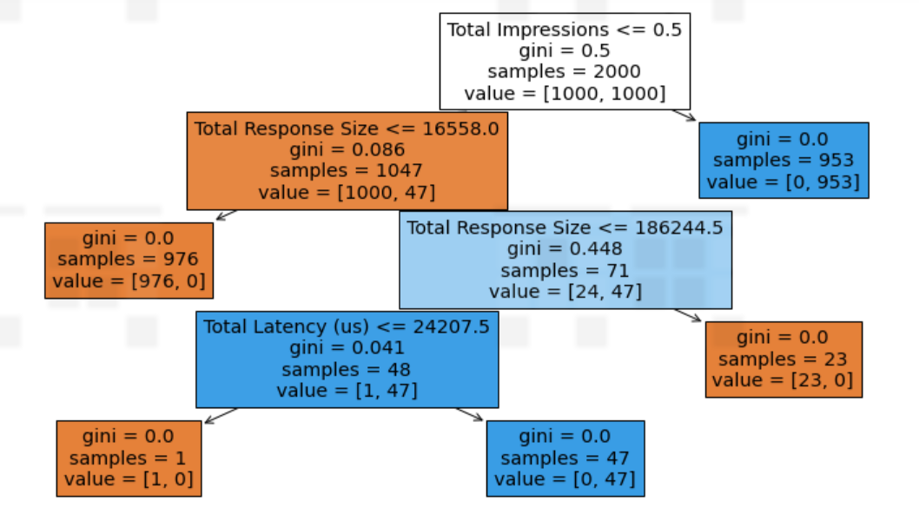
Visualization Tools in XAI
Visual tools like feature importance plots, decision trees, and counterfactual explanations make AI decisions more tangible. By visually illustrating how different inputs affect outputs, these tools bridge the gap between abstract algorithms and user understanding, fostering informed decision-making.

Slide 10
Applications of XAI
In healthcare, XAI aids in diagnosis and treatment planning by explaining AI-driven predictions. For example, SHAP can highlight which symptoms or test results most influenced a diagnosis, enabling doctors to make informed decisions while understanding the AI's reasoning process.
XAI enhances transparency in financial systems, particularly in credit scoring and fraud detection. By explaining why a loan was approved or denied, or how a transaction was flagged as fraudulent, XAI helps institutions maintain accountability and build customer trust.
Predictive policing and criminal justice systems benefit from XAI by ensuring fairness and transparency. For instance, explaining why an individual is flagged as high-risk ensures that decisions are not biased or discriminatory, promoting ethical AI use in law enforcement.

Slide 11

Challenges in Implementing XAI
Balancing model accuracy with interpretability remains a key challenge. Additionally, users may misinterpret explanations, or explanations may inadvertently expose sensitive information. Ethical concerns, such as ensuring fairness and avoiding bias, add further complexity to deploying XAI effectively.
Accuracy-Interpretability Trade-off Formula:
α: Weight assigned to accuracy (0 ≤ 𝛼 ≤1).
Accuracy and interpretability are balanced based on application requirements.

Slide 12

Interpretations of Deep Models
Deep learning models are often criticized for their opacity. XAI techniques like feature attribution address this by highlighting which input features contributed most to a decision. For example, in image recognition, XAI can visualize the specific regions of an image that influenced the model's classification.
Gradient Formula:
f(𝑥): Model function.
𝑥𝑖: Input feature.
Attribution measures the sensitivity of the output to changes in 𝑥𝑖.

Slide 13

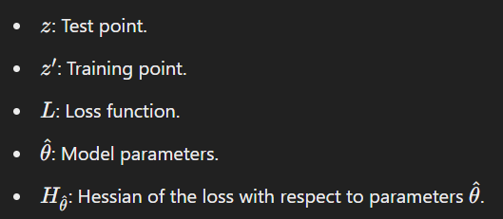
Case Study: Influences of Training Data
Training data profoundly affects AI decisions. XAI tools can uncover biases or errors in data by showing how they impact model predictions. This insight helps developers refine datasets, ensuring fairer and more accurate outcomes.
Influence Function Formula:

Slide 14
Ethical Considerations & Future Direction of XAI
XAI empowers domain experts to uncover hidden patterns and extract actionable insights. For example, in scientific research, XAI can reveal previously unnoticed correlations, enabling discoveries that advance knowledge and benefit society.
Ethical XAI ensures that explanations are not only accurate but also respect user privacy and confidentiality. It avoids revealing proprietary model details while addressing issues of fairness, bias, and accountability, making AI deployment socially responsible.
The future of XAI lies in developing more intuitive explanation methods, integrating ethical frameworks, and creating domain-specific tools. Innovations in XAI will ensure that AI systems remain transparent, equitable, and trustworthy as their capabilities expand.

Slide 15
Conclusion
Explainable AI (XAI) bridges the gap between advanced AI systems and the human need for transparency and trust. It addresses the opacity of "black-box" models by providing tools like LIME, SHAP, and model-specific methods to clarify decision-making processes. By making AI interpretable, XAI empowers stakeholders to make informed decisions in critical domains such as healthcare, finance, and law enforcement.
Beyond interpretability, XAI upholds ethical standards by fostering accountability and fairness. With visualization tools and data-centric approaches, it ensures AI systems are accurate, understandable, and socially responsible. By aligning AI capabilities with societal values, XAI builds trust and focuses on human-centric goals, promoting the ethical development and deployment of AI.

Slide 16
References
"Explainable AI in Data Mining: Bridging Transparency and Decision-Making". Link
"Explainable AI: Current Status and Future Directions". Link
"Survey on Explainable AI: From Approaches, Limitations, and Applications to Evaluation Methods". Link
"Explainable Artificial Intelligence: A Comprehensive Review". Link
"Explainable Artificial Intelligence: A Systematic Review". Link

Slide 17
Thank You!

