Slide 1
A New Era in Computational Pathology: A Survey on Foundation and Vision-Language Models
Authors: Dibaloke Chanda, Milan Aryal, Nasim Yahya Soltani and Masoud Ganji
Publication Date: Sept 18, 2024
Presented By: Aditya Rajpurohit

Slide 2
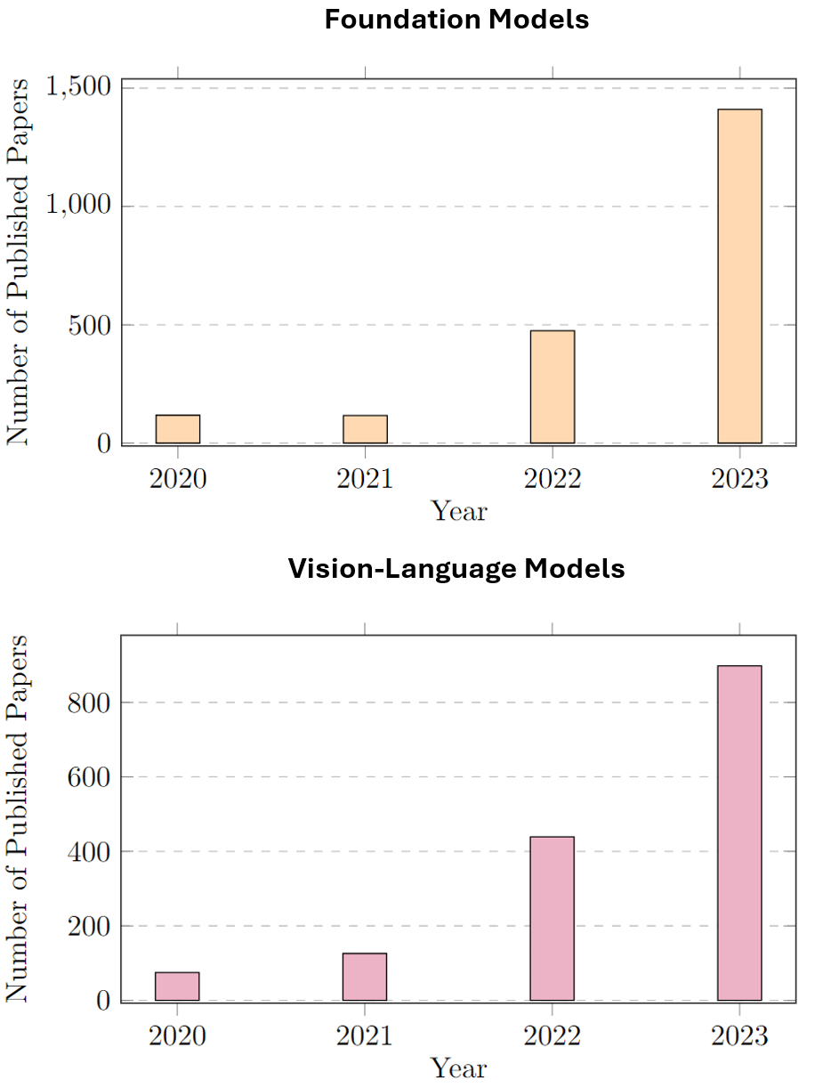
A New Era in Computational Pathology
In this presentation, we're diving into how the latest stuff in artificial intelligence—like foundation models and vision-language systems—is really shaking up the world of pathology. Instead of just manually looking at slides, today's pathologists have AI tools right by their side that can scan, analyze, and even explain tissue images. This isn’t just a small upgrade; it’s a major shift that could totally change how medical diagnoses are made. Based on a detailed survey from 2024, we'll go over the key trends, models, datasets, and real-world uses you should know about.

Slide 3
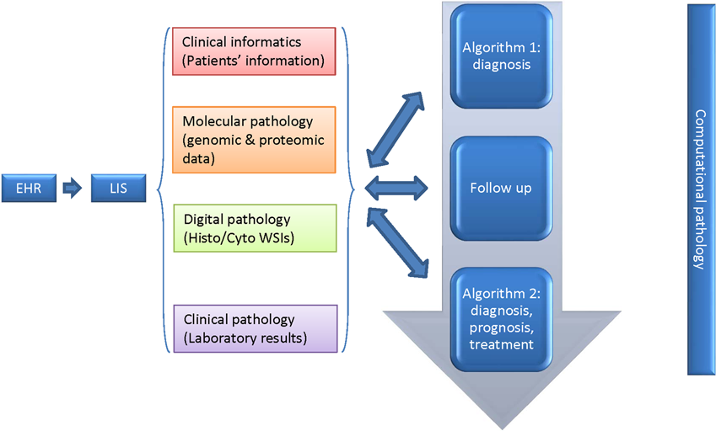
What is Computational Pathology (CPath)?
Computational Pathology, or CPath, is all about using AI to analyze digital images of pathology slides. Instead of a pathologist peering through a microscope, we now scan these slides into super-high-res images called Whole Slide Images (WSIs) that computers can understand. These images are huge—think 100,000 by 100,000 pixels—making them perfect for computer vision tools. By converting traditional glass slides into digital pixels, CPath makes diagnosis faster, more consistent, and easier to scale up. It’s not just about replacing human work; it’s about boosting what experts can do with the help of machine intelligence.

Slide 4
AI and Deep Learning in Pathology
Deep learning models have been used for image classification, tumor detection, and segmentation in pathology. However, early models relied heavily on labeled data and struggled to generalize across different hospitals, scanners, or disease types. Despite these limitations, they laid the groundwork for today’s more powerful, adaptable models. Think of these early models as narrow experts—great at one task but brittle outside their training data.

Slide 5
Limitations of Traditional AI Approaches
Traditional AI tools for pathology often run into a big challenge: they rely heavily on having tons of expertly labeled slides. That’s a real pain because labeling takes a lot of time and costs a lot too. Plus, these models tend to break down when faced with new staining methods or rare types of cancer — it’s like they’re not very adaptable. And let’s not forget, they’re pretty much black boxes—you never really know how or why they make their decisions. That’s where foundation models come into play: they’re designed to understand images without needing labels upfront and can be repurposed easily across different tasks, making everything a lot more flexible.

Slide 6
Introduction to Foundation Models (FMs)
Foundation Models, or FMs, are really large neural networks that get trained on huge amounts of unlabeled data using a technique called self-supervised learning. In CPath, these models learn to 'understand' tissue by predicting parts of an image that are masked out or by comparing different image patches. Once they've been trained, they can be tweaked for specific tasks like telling whether tissue is cancerous or grading a tumor. The coolest thing about them is how flexible they are — they’re not just built to solve one problem but can adapt to many with just a little extra training. Basically, think of them as the 'GPTs' of pathology—super versatile and ready to take on a bunch of different challenges.

Slide 7
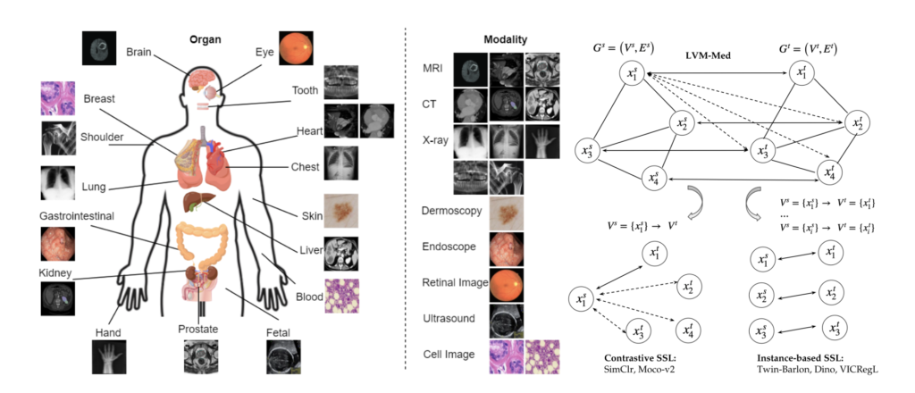
Foundational Models Use cases

Slide 8
Working of Vision-Language Models (VLMs)
Imagine a system called Vision-Language Models (VLMs) that connects visual info, like images of tissue slides, with text, like pathology reports. These models learn to map both images and their descriptions into a shared space, so they’re aligned. This makes it possible to do cool stuff like automatically generate reports, answer questions about images, or even find images just by describing what you're looking for. One popular example, CLIP, works by making sure that matching images and texts are close together in this shared space. In pathology, this tech helps machines 'see' and 'understand' tissue slides just like a trained pathologist would.

Slide 9
Challenges in CPath and How FMs/VLMs Help
CPath runs into a few challenges like dealing with different data types—different organs, stains, scanners—and limited labels and making sense of the results. Flexible models, or FMs, help out by learning from lots of varied, unlabeled data and are pretty good at adapting to new situations. Then there are vision-language models, or VLMs, which take things a step further by weaving in textual reports and existing knowledge to make better sense of what they see. For example, if a slide shows a rare cancer, these models can connect the visual clues with similar cases or descriptions found in medical literature. Basically, they’re tackling the issues of not having enough data and closing the gap between what the images show and the actual medical meaning.

Slide 10
Computational Pathology Dataset
There's a wide variety of datasets that fuel the development of FMs and VLMs in pathology. Public resources like TCGA (The Cancer Genome Atlas), CPTAC, and PubMed are really useful—they provide image-text pairs, whole slide images (WSIs), and clinical reports. On top of that, datasets like PathGen-1.6M, which has 1.6 million WSI-caption pairs, WSI-VQA for question answering tasks, and Quilt-1M, which links educational videos to QA pairs, are also pretty important. Many models also rely on private hospital data. All these datasets, given their diversity and large size, are key to training solid models that can work well across different settings.

Slide 11
How These Datasets Are Built and Annotated
Putting together these datasets is a bit of a balancing act—combining some automation with expert input. Sometimes, people use GPT-4 or ChatGPT to quickly generate captions or summaries from raw pathology reports. Other times, they stick to carefully crafted templates and rules they've made themselves. Detecting objects in images, like with YOLO, helps break down pictures into meaningful parts. Tools like CLIP and cosine similarity are handy for filtering out the irrelevant data. But here’s the thing: the more you automate, the easier it is to scale up, but that can introduce more noise. The best datasets find that sweet spot—something shaped by experts and carefully curated to ensure quality.

Slide 12
Self-Supervised Pretraining Strategies in FMs
FMs are trained without labels using cool strategies like DINO, which is all about self-distillation, MAE that uses masked autoencoders, and MoCo, a type of contrastive learning. For example, with MAE, a big part of the input image is masked out, and the model learns to fill in the missing pieces — so it gets really good at understanding the visual context. DINO trains the model to match its own representations from different augmented versions of the same image. These methods help FMs grab onto high-level semantic features from millions of image patches, and that’s what makes them useful for downstream pathology tasks.

Slide 13
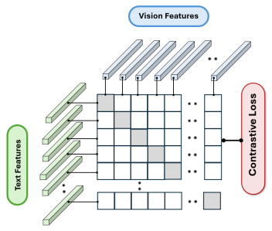
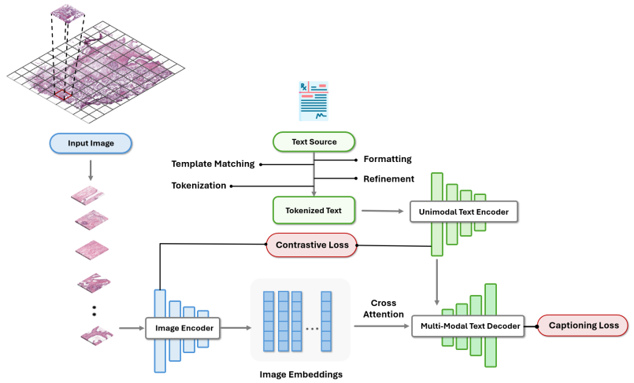
Vision-Language Pretraining: CLIP & CoCa
CLIP (Contrastive Language–Image Pretraining) works by matching up images and text descriptions in a shared space using a contrastive loss. Basically, it pulls together images and captions that match and pushes apart those that don't. CoCa (Contrastive Captioner) mixes this approach with generative techniques—using captioning to boost the model’s understanding of language. In the field of pathology, these tools help models connect what they see in slides with the words that pathologists use. That means better diagnostics, clearer explanations, and easier retrieval of relevant info.

Slide 14
Instruction Tuning: Making Models Interactive
Instruction tuning helps foundational models understand and respond to natural language prompts more effectively. Inspired by LLaVA (Large Language and Vision Assistant), models like PathChat and PathAsst are trained using data where images are paired with detailed instructions and expected responses. For example, you might ask, 'Describe abnormalities in this slide,' and the model responds smoothly in clear medical English. This approach makes it easier for clinicians to use AI directly—you don’t need coding skills—turning AI into a real assistant rather than just a behind-the-scenes tool.

Slide 15
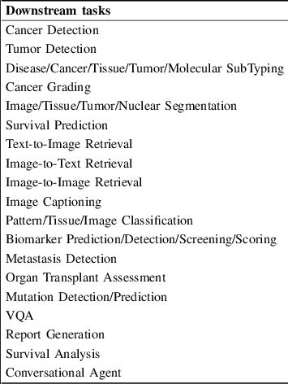
Downstream Tasks: From Diagnosis to Reporting
Once these models are pretrained, you can fine-tune them for a bunch of specific things like classifying cancer subtypes, predicting patient survival, segmenting tumors, spotting biomarkers, or even creating full reports. Some tasks just need a simple step called linear probing, where you add a basic classifier on top, while others need you to do a full fine-tuning of the whole model. One pretty cool thing they can do is weakly supervised learning, which means you only give the model slide-level labels, and it still learns to find the important regions without detailed annotations. Overall, these models are pretty flexible workhorses that handle lots of different pathology tasks with ease.

Slide 16
Evaluation Strategies and Benchmarks
FMs and VLMs are usually checked out using zero-shot, few-shot, and fine-tuned ways. In zero-shot, you test the model on a task it hasn’t seen before—this is a good way to see how well it can handle new stuff. Few-shot means giving it just a few examples to learn from. When they test these models, they often use public datasets like CAMELYON16 for tumor detection, PANDA for grading prostate cancer, and BACH for breast cancer histology. Lots of studies also compare how these models perform with different stain types, scanner settings, and even rare disease subtypes.

Slide 17
Future Directions and Open Challenges
Even though we've made some good progress, there's still a lot to work through. We really need models that can explain their decisions better—this is super important for medical AI. Privacy worries are a big deal too, especially when hospitals’ patient data is involved. We also need more varied datasets so that we can minimize bias, especially for less common diseases. Bringing in other types of data, like genomics, could really help us get deeper insights. Lastly, close collaboration between engineers and doctors is important to move these models from research labs into real clinics. The road ahead is full of potential, but we have to move carefully.

Slide 18
Conclusion
Bringing together Foundation Models and Vision-Language Models really marks a big step forward in how we’re advancing computational pathology. These models aren’t just tackling old problems like running out of data or dealing with differences in how things are presented; they’re also starting to interpret complex medical images so that feels quite human. Whether it’s classifying tumors without any prior examples or helping doctors generate reports with AI, we’re heading toward systems that are scalable, reliable, and fit more naturally into clinical routines. As this field keeps growing, it’s important to focus more on making these tools transparent, fair, and proven in real-world settings. If experts from different areas keep working together, these models could become essential partners—boosting the skills of pathologists rather than replacing them.

Slide 19


