Slide 1
Fantasy Football Team Optimization
Final Presentation
24-785 Engineering Optimization
Jaydutt Kulkarni
Aditya Rathi
Aditya Joglekar
Jeffrey Wang

Slide 2
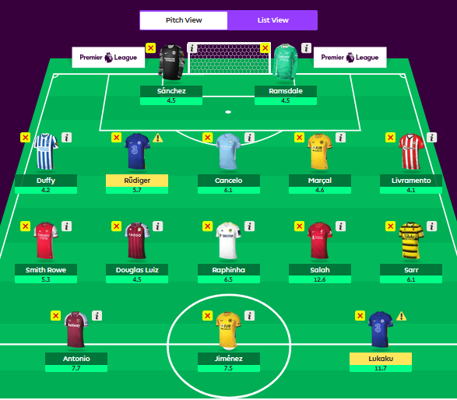
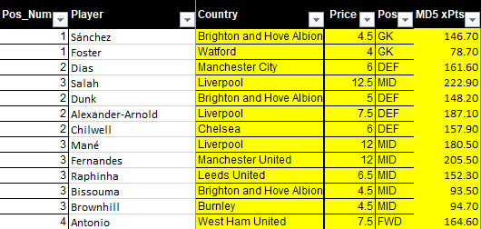
Introduction
The objective is to select 15 players, which includes 11 starters, 4 bench players, and 1 captain such that the fantasy team ends up scoring the most points throughout the season.
The game starts off with a fantasy team budget of $100m.
The goal of this optimization project is to maximize the Expected Value of the fantasy football team for a week.
Expected value and expected minutes are the key components of FPL.
Notes:
With over 8 million players, Fantasy Premier League is the biggest Fantasy Football game in the world. It essentially assigns points for actions that are undertaken by football players in real life
The squad of 15 includes 2 GKs, 5 defenders, 5 midfielders, and 3 forwards. A starting lineup can be compromised of any feasible combination of players from these positions.
Expected Value model using Machine Learning algorithm is the starting point.
Finding the optimal EV team for each week is the end goal, with the first step being trying to optimise a reduced NLP version of this problem

Slide 3
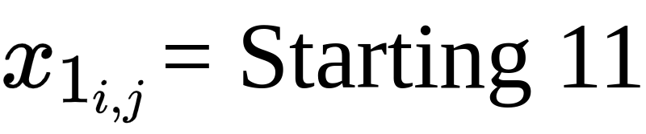
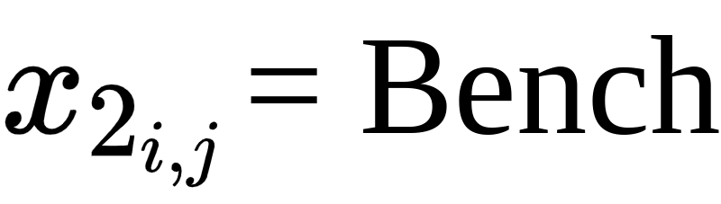
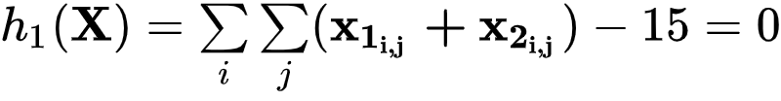


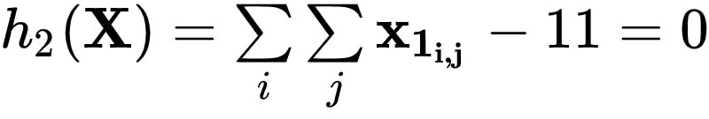






Constraints
Budget:
j | Position
1 | Goalkeeper
2 | Defender
3 | Midfielder
4 | Forward
Squad:
Starting Lineup:
Club:

Slide 4
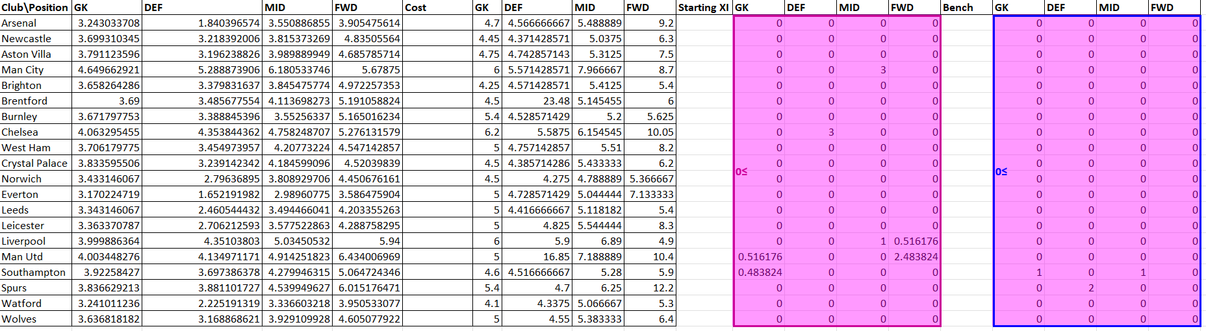
Excel solution - LP problem
LP Solver: Simplex
Objective function = -55.28
NLP Solver: Generalized Reduced Gradient
Objective function = -39.8

Slide 5
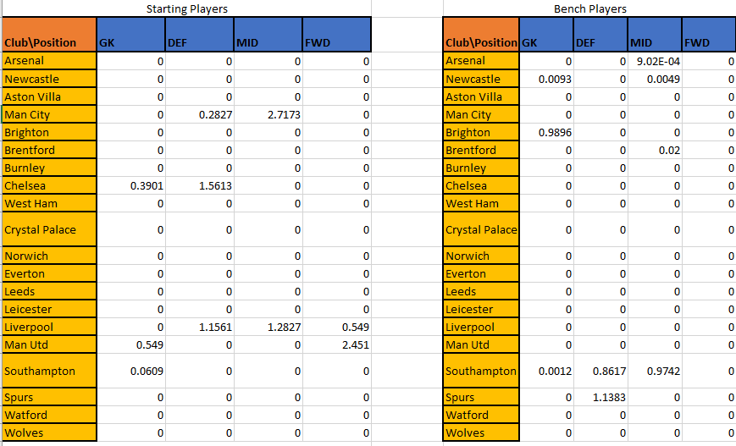
MATLAB Solution - LP Problem
Algorithm: SQP
Objective Function Value: -55.1672

Slide 6
MATLAB solution - LP problem
 | SQP | active-set | Interior point
X0 = zeros | -55.0464, Exit Flag 2 | -55.0139, Exit Flag 0 | -54.6048, Exit Flag 0
X0 = ones | -55.1672, Exit Flag 0 | -55.0346, Exit Flag 5 | -54.576, Exit Flag 0
X0 = zeros, maxFunEval = inf maxIter = inf | -55.0464, Exit Flag 2 | -54.3787, Exit Flag 5 | -55.2512, Exit Flag 2
Notes:
While results are close, fmincon never finds a 1st order optimal solution. This is due to linear nature of problem (no 2nd order information)
1
First-order optimality measure was less than options.OptimalityTolerance, and maximum constraint violation was less than options.ConstraintTolerance.
0
Number of iterations exceeded options.MaxIterations or number of function evaluations exceeded options.MaxFunctionEvaluations.
-1
Stopped by an output function or plot function.
-2
No feasible point was found.
All algorithms except active-set:
2
Change in x was less than options.StepTolerance and maximum constraint violation was less than options.ConstraintTolerance.
trust-region-reflective algorithm only:
3
Change in the objective function value was less than options.FunctionTolerance and maximum constraint violation was less than options.ConstraintTolerance.
active-set algorithm only:
4
Magnitude of the search direction was less than 2*options.StepTolerance and maximum constraint violation was less than options.ConstraintTolerance.
5
Magnitude of directional derivative in search direction was less than 2*options.OptimalityTolerance and maximum constraint violation was less than options.ConstraintTolerance.
interior-point, sqp-legacy, and sqp algorithms:
-3
Objective function at current iteration went below options.ObjectiveLimit and maximum constraint violation was less than options.ConstraintTolerance.
Con

Slide 7


NLP Additions
Introduction of Expected minutes matrix to replace static probability model
New Objective Function:
New Constraints:
Notes:
In total, 195 constraints!

Slide 8
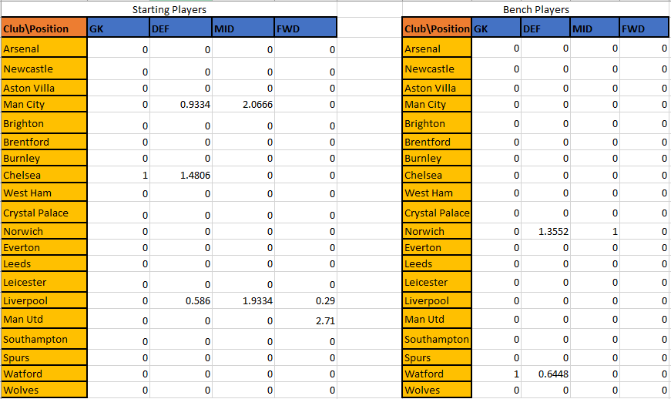
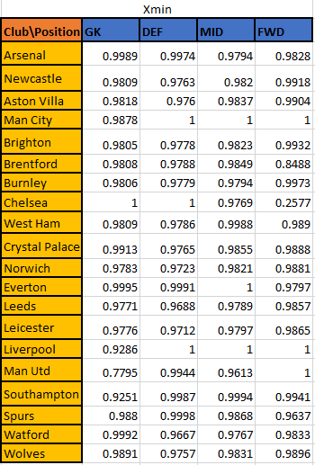
MATLAB Solution: NLP Problem
Algorithm: SQP
Objective Function Value: -59.6611
Notes:
All teams with great players like ManU, Liverpool, Chelsea, Man City have the maximum representation in the result. The bench players are from teams with lesser expected value players. The optimizer finds a global solution with similar distribution of players and expected value for initialization closer to and greater than 1, while local minima are found for initialization closer to zero and lesser than zero.

Slide 9
Sensitivity Analysis-Selected Active Constraints
Constraint | Expected Point Increase | Change in constraint
g1: Budget constraints: | 0.88 expected points | 1 dollar increase
g3: Minimum Starting Defenders | 2.04 expected points | 1 fewer starting defender
g13: Man City Maximum Players on Squad | 1.50 expected points | 1 more player on squad
g29: Man Utd Maximum Players on Squad: | 0.05 expected points | 1 more player on squad

Slide 10
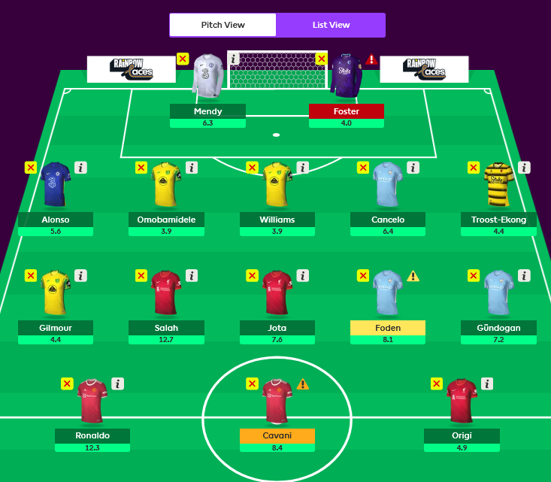
Interpretation & Conclusion
Expected Minutes: The solution provided validates our expectations that the ideal scenario involves probability of all starting XI players near or equal to one.
Expected Value: Expected Value for the NLP version is better than that for the LP version. The optimum ends up targeting all the right fixtures to maximize EV.

Slide 11
Future Scope
Chips: Consider the impact of utilizing chips such as Wildcard, FreeHit on the optimal solution
Price changes: Incorporate a dynamic player price change model
Multiple Match Week Optimization: Consider the impact of transfers across multiple weeks

Slide 12
Questions?

