Slide 1

Energy Efficient Approximate Multipliers for Neural Networks
UNDER THE SUPERVISION OF: PRESENTED BY:
MR. EDIGA RAGHUVEERA ADITYA SREERAM K S(621105)
DEPARTMENT OF ECE KOUSHIK TEJA V(621268)
KANCHI YUVARAJ (621156)
VIKAS V (621267)

Slide 2
LITERATURE REVIEW
TITLE | METHODOLOGY | REMARKS
IEEE Xplore: TLED Training-Based Approximate Layer Exploration in DNNs IEEE Xplore: HEAM High-Efficiency Approximate Multiplier Optimization for DNN | An efficient optimization approach based on specific application, and increasing accuracy by integrating parameterized approximate multipliers into NN layers. | (+) Suitable for ASIC based DNN accelerators. (-) Requires deeper knowledge in Neural Networks.
IEEE Xplore: Energy and Quality-Efficient Approximate Multipliers for NN and Image Processing IEEE Xplore: FPGA-Based Approximate Multiplier for Efficient Neural Computation | Utilizes architectural optimization and proposes novel approximate compressors. Other paper exploits both algorithm and architectural approximation | (+) Detailed review on FPGA implementation. (-) Doesn’t address the accuracy loss during integration with NN
IEEE Xplore: Approximate Computing: An Emerging Paradigm for Energy Efficient Design | Analyzed the existing approximation technique by using accuracy metrics, and proposed areas for further optimization and approximation | (+) Comparative study of accuracy and efficiency of existing approximation technique (-)Major focus on ASIC based on approximation

Slide 3
PROBLEM STATEMENT
Neural networks rely heavily on energy-intensive multiply-and-accumulate (MAC) operations, posing challenges for deployment in resource-constrained environments like edge devices. Traditional multipliers, designed for high precision, increase power consumption and hardware complexity, despite neural networks being inherently tolerant to small inaccuracies.
This project is to design energy-efficient approximate multipliers that reduce power consumption and hardware overhead while maintaining minimal impact on neural network performance. These multipliers must achieve an optimal trade-off between energy savings and accuracy degradation, ensuring scalability and compatibility with various NN architecture and applications.

Slide 4
OBJECTIVE
The primary objective is to design and implement energy-efficient approximate multipliers that optimize the trade-off between computational accuracy and energy consumption in neural networks. These multipliers aim to:
Reduce Energy Consumption: Minimize the power requirements of multiply-and-accumulate (MAC) operations in neural networks.
Maintain Acceptable Accuracy: Ensure the neural network's performance, such as accuracy and inference quality, remains within acceptable limits despite approximation.
Optimize Hardware Design: Develop low-complexity, scalable hardware architectures for approximate multipliers to reduce area and latency.
Enhance Scalability: Ensure compatibility with various neural network architectures and datasets while scaling efficiently for larger models.

Slide 5
INTRODUCTION
The increasing computational demands of deep neural networks (DNNs) necessitate energy-efficient hardware solutions.
Multiplications, a core operation in DNNs, are computationally expensive and energy-intensive. Approximate multipliers provide a promising solution by leveraging the error tolerance of DNNs to trade precision for reduced energy consumption and hardware complexity.
This work focuses on designing energy-efficient approximate multipliers that maintain acceptable accuracy while significantly lowering power and resource requirements, enabling efficient deployment of DNNs on low-power devices.

Slide 6
METHODOLOGY
Workload Analysis: Profile neural networks to identify operations where reduced precision is acceptable. Determine precision requirements for layers (e.g., convolutional vs. fully connected).
Approximation Technique: Selection Choose methods like truncation, segmentation, logarithmic approximation, or error-resilient designs. Balance accuracy, energy savings, and hardware complexity.
Hardware Optimization: Design efficient circuits with reduced critical paths and power-gating techniques. Minimize delay, area, and energy use.
Integration with Neural Networks: Quantize weights/activations to match the multiplier precision. Simulate approximate operations and fine-tune the network to recover accuracy.
Valuation and Validation: Measure accuracy, energy savings, and hardware performance. Prototype and benchmark against precise and other approximate multipliers.

Slide 7
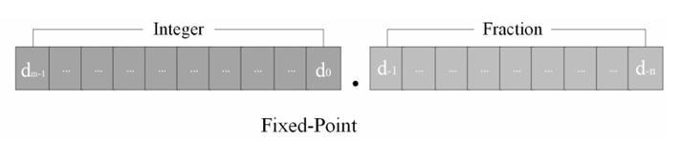
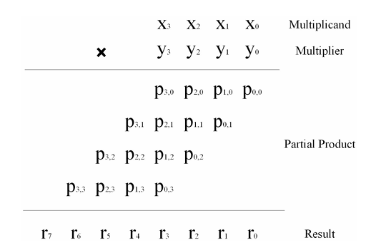
FIXED POINT UNSIGNED MULTIPLIERS
4 bit multiplication example[1]

Slide 8
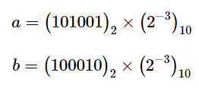
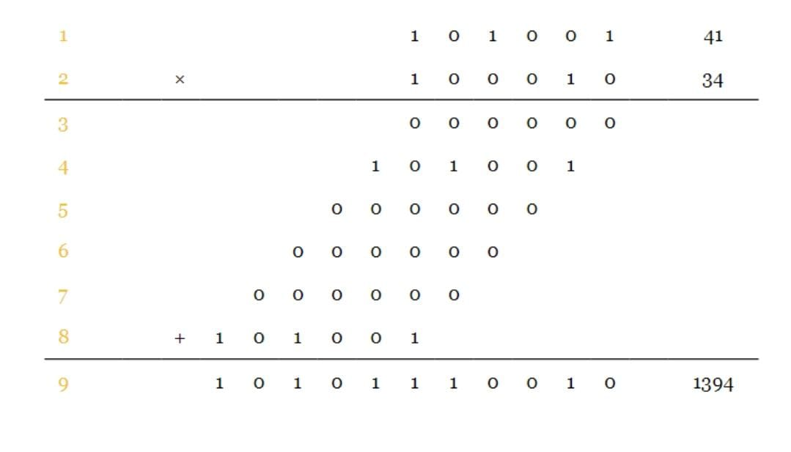


EXAMPLE
which simplifies to
6bit unsigned multiplication example[4]

Slide 9
Block Diagram
Approximate Multiplier
Type
(U, S, FP)
Algorithm
(log, linear, hybrid)
Architecture
(input, pp, acc, enc)
Circuit
(BR,ECD,GP)
Exact Multiplier
Error Analysis
(MRED, NMED)

Slide 10
APPROXIMATION PARTIAL PRODUCTS (APP)
Approximating altered and other partial products focuses on reducing computational complexity while maintaining acceptable accuracy. The key ideas are:
Approximation of Altered Partial Products :- Generate signals from the multiplication process are accumulated in columns using simplified operations, such as OR gates instead of full adders. This reduces power consumption and hardware complexity without causing significant accuracy loss .This technique is beneficial for applications like signed multipliers (e.g., Booth multipliers) and other arithmetic operations, where a small error does not drastically affect the final output.
Approximation of Other Partial Products:- Truncation: The least significant bits (LSBs) of the partial products are discarded to simplify the calculation, which results in minor errors but reduces the hardware requirements.

Slide 11
Approximate Compressors: Simplified adders, such as 3:2 or 4:2 compressors, are used to reduce the area and energy consumption of the sum operations in the partial products.
3. Energy Efficiency in Neural Networks :- Approximate multiplication techniques are particularly useful in neural networks where minor errors in computation can be tolerated, especially in deep learning models. This allows the use of approximate multipliers to save energy and improve the efficiency of matrix multiplications and dot products in training or inference.
These techniques are crucial for designing low-power hardware accelerators for applications like image recognition or real-time neural network processing, where power efficiency is essential and slight inaccuracies are acceptable.

Slide 12
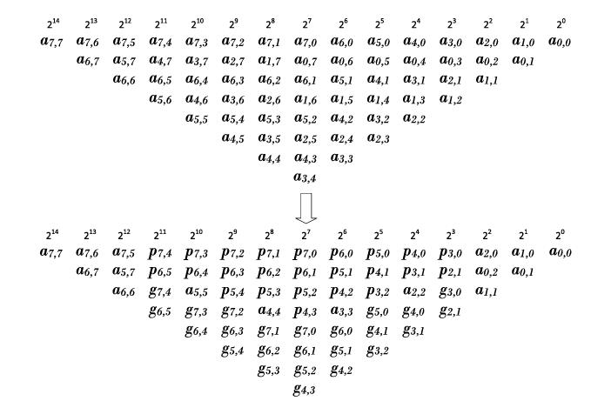
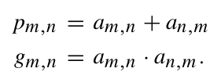
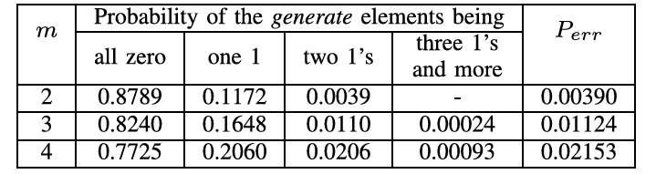
Transformation of generated partial products into altered partial products[2]
Probability statistics of generate signal[2]

Slide 13
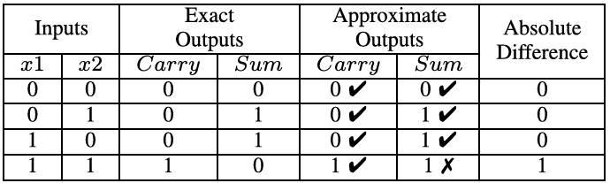

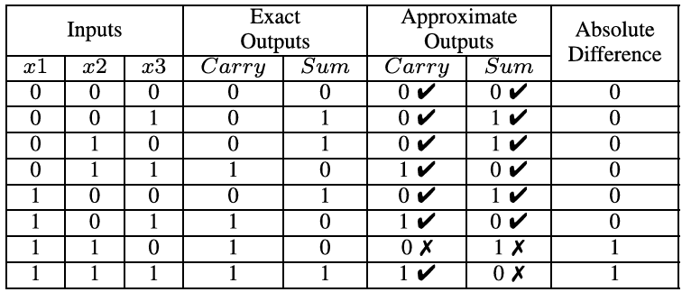
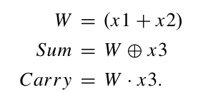
Truth table of approximate half adder[2]
Truth table of approximate full adder[2]

Slide 14
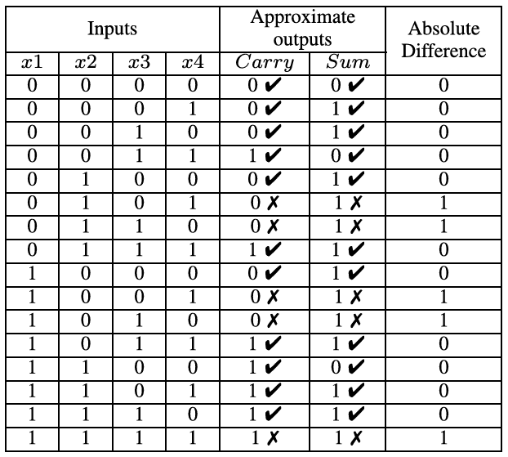
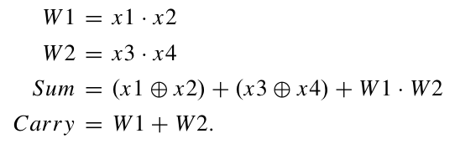
Truth table of approximate 4-2 compressor[2]

Slide 15
BROKEN ARRAY MULTIPLIER
"Broken Array Multipliers" (BAMs) is an energy-efficient approach for designing approximate multipliers, particularly for applications in neural networks and image processing.
BAMs work by selectively simplifying or approximating certain multiplication operations, focusing on parts of the computation that have minimal impact on the output's overall accuracy.
This approach leverages the tolerance of neural networks to minor computational errors, allowing for significant reductions in energy consumption and hardware complexity.
For neural networks, BAMs optimize operations like the multiply-accumulate (MAC) process by using techniques such as reduced precision or approximated arithmetic units. This results in a balance between computational efficiency and accuracy.

Slide 16
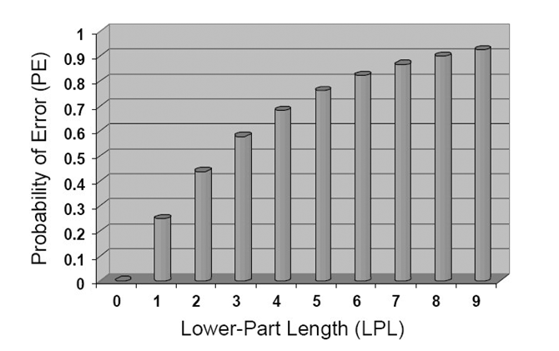
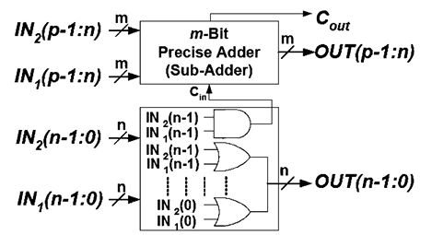
Lower-part-OR Adder Hardware structure[3]
Probability of producing error[3]

Slide 17
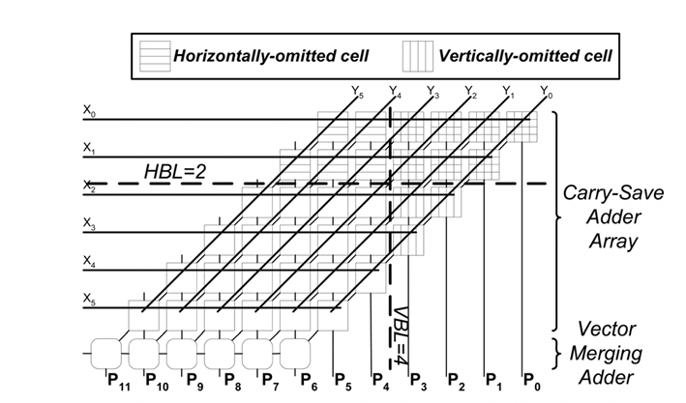
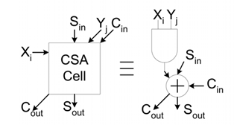
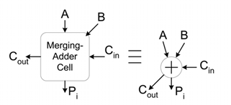
Hardware structure of the Broken-Array Multiplier (BAM)[3]

Slide 18
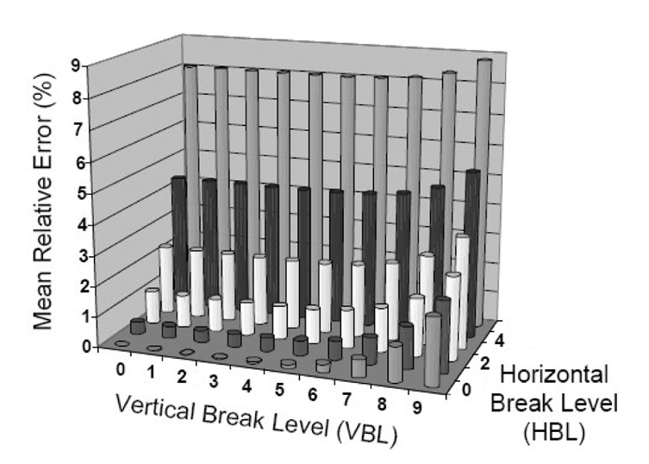
VBL and HBL when zero, no approximation
As VBL and HBL increases error increases
Optimized value is in-between these extremes
BAM mean relative error for different HBL and VBL (WL=10) [3]

Slide 19
EVALUATION PARAMETERS
MRED(Mean Relative Error Distance)
NMED(Normalized Mean Error Distance)
Power
Resource Utilization of FPGA (LUT, FF)

Slide 20
System Specifications/Requirements
FPGA Board: Zynq-7000
Development Tools: Xilinx Vivado
HDL: Verilog, System Verilog
Neural Network Framework: TensorFlow

Slide 21
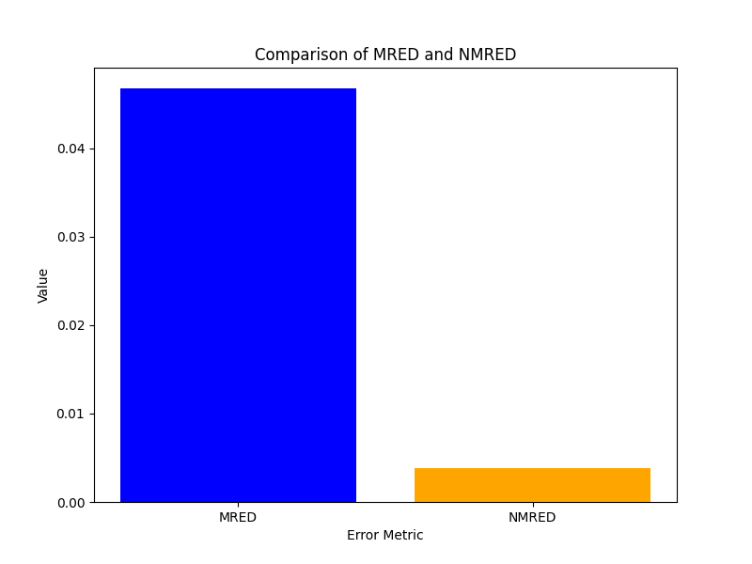
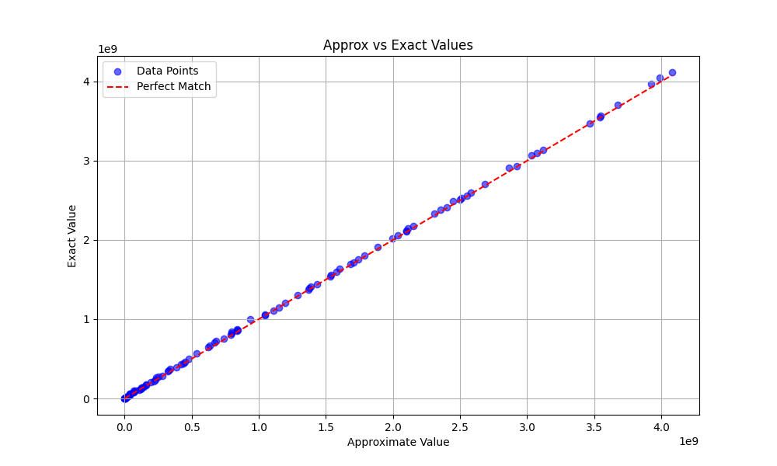
SIMULATION RESULTS (APP)

Slide 22
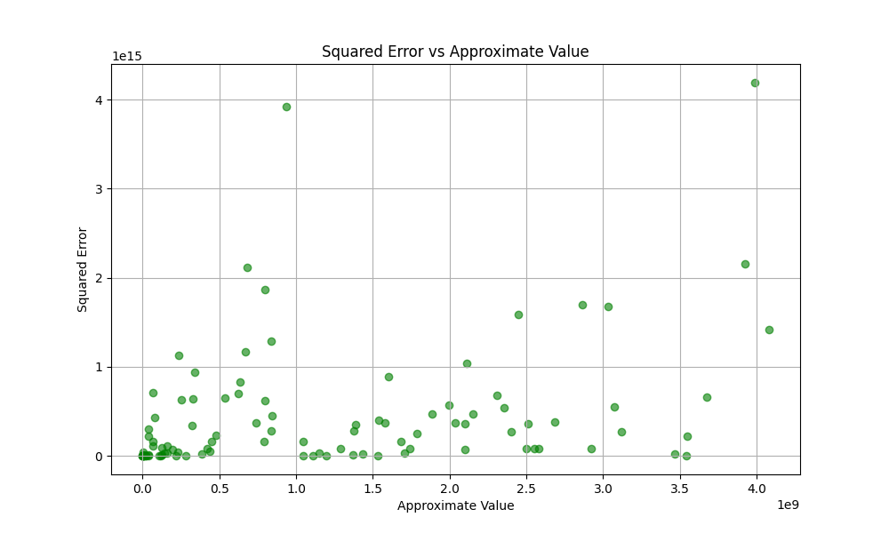
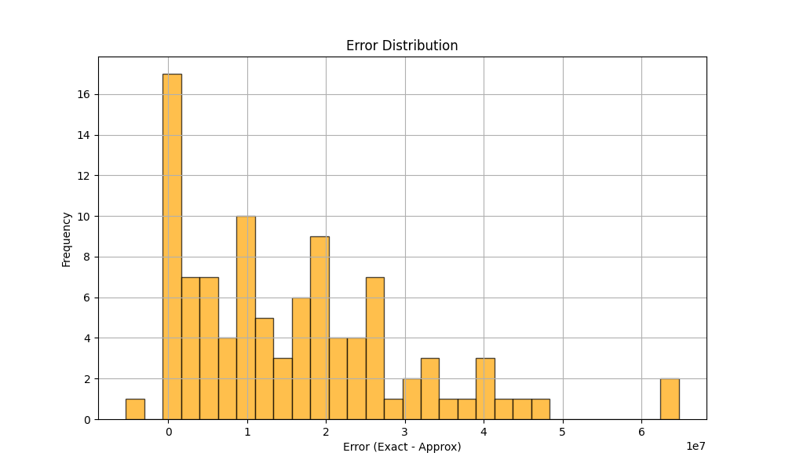

Slide 23
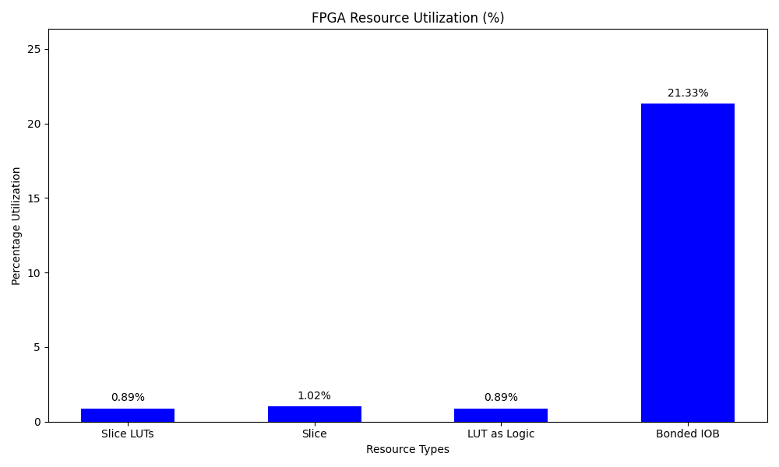
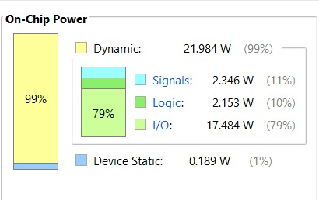


Slide 24
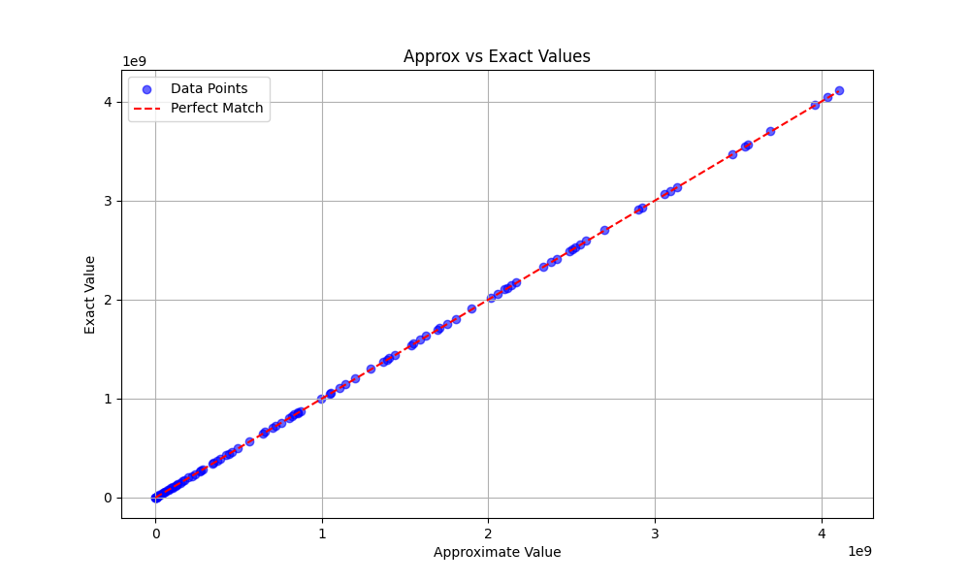
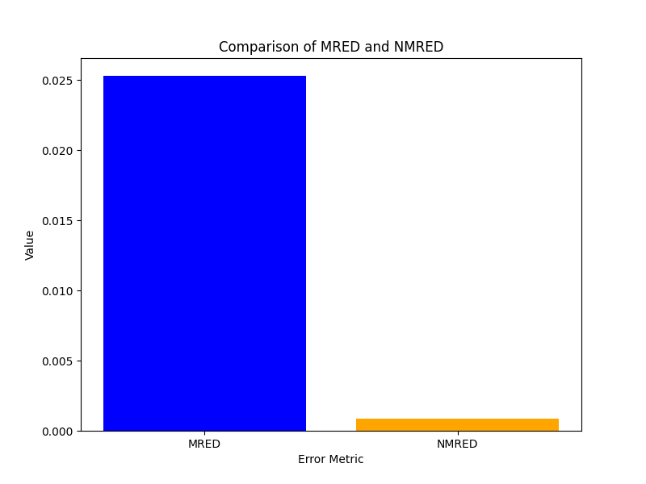
SIMULATION RESULTS (BAM)

Slide 25
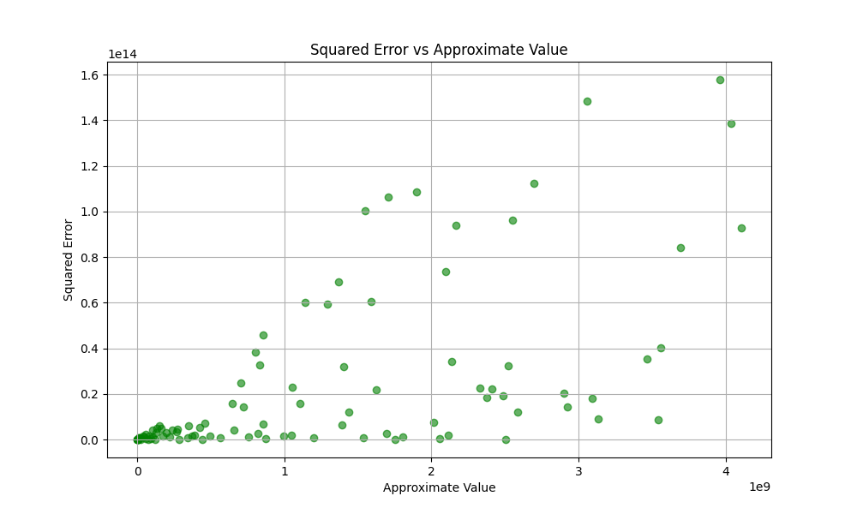
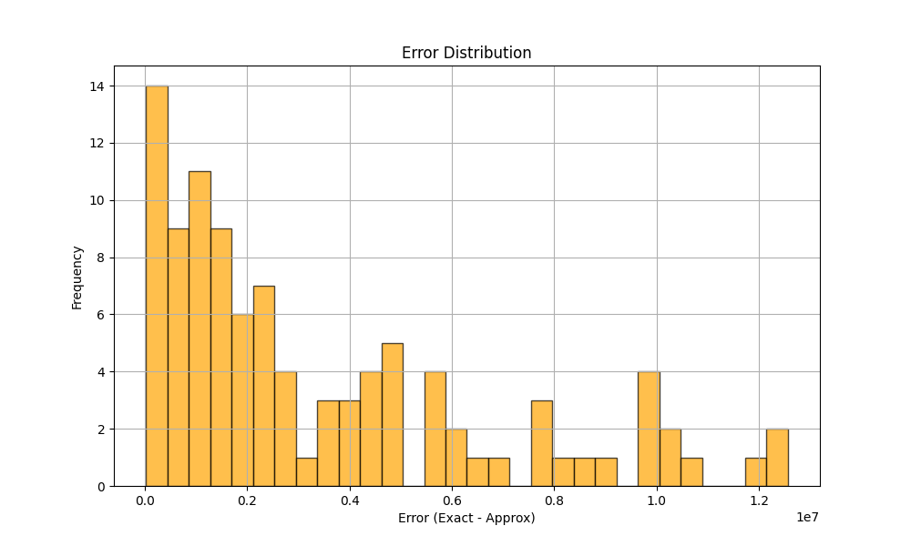

Slide 26
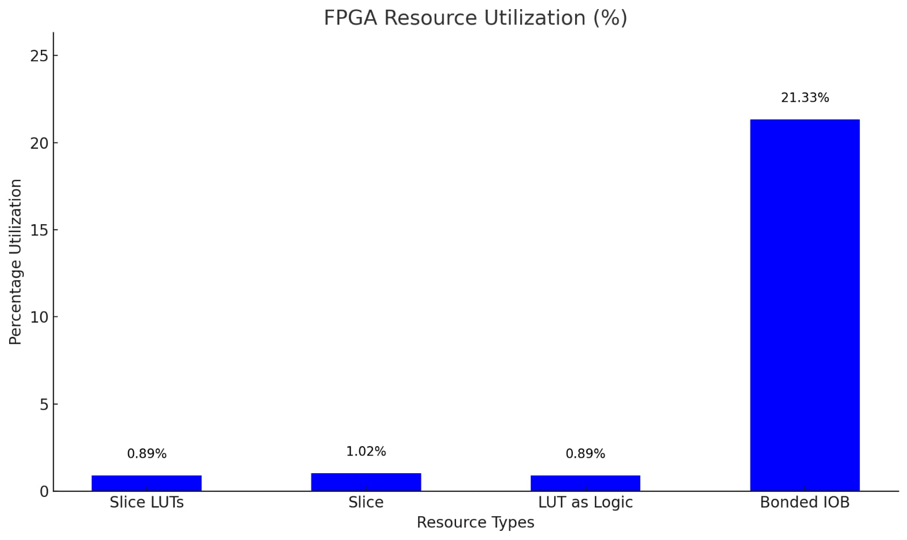
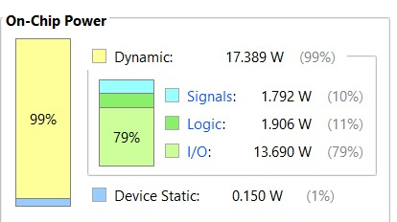


Slide 27
COMPARING APP & BAM
 | APP | BAM
MRED | 0.046 | 0.025
NMED | 0.0038 | 0.00083
Power | 22.173W | 17.539W
Resource Utilization(Slice) | 0.89% | 0.33%

Slide 28
ROAD MAP
Phase 1
Literature Review
Phase 3 Implementation
Phase 5
Testing and Analysis
Phase 2
Design and Simulation
Phase 4
NN Integration
Phase 6
Publication Preparation

Slide 29
APPLICATIONS
Energy-efficient approximate multipliers are essential for deploying neural networks in resource-constrained environments.
Key applications include:
Edge AI & Embedded Systems : Real-time processing for mobile, IoT, and wearable devices, enabling tasks like image and speech recognition with low power consumption.
Image & Video Processing : Speeding up image recognition and video analysis in devices like security cameras and AR glasses.
Healthcare Devices : Low-power real-time health monitoring for wearable systems like ECG/EEG sensors.
Smart Sensors & IoT : Enabling energy-efficient decision-making in smart city and industrial sensors for anomaly detection and predictive maintenance.
Low-Power Consumer Electronics:Power-efficient voice assistants and smart home devices for real-time speech recognition and processing.

Slide 30
REFERENCES
.Ying Wu, Chuangtao Chen, Weihua Xiao, Xuan Wang, Chenyi Wen, Jie Han, Xunzhao Yin, Weikang Qian, and ChengZhuo.2024. ASurveyonApproximateMultiplier Designs for Energy Efficiency: From Algorithms to Circuits. ACM Trans. Des. Autom. Electron. Syst. 29, 1, Article 23 (January 2024), 37 pages
.Suganthi Venkatachalam and Seok-Bum Ko. 2017. Design of power and area efficient approximate multipliers. IEEE Transactions on Very Large Scale Integration (VLSI) Systems 25, 5 (2017), 1782–1786.
.HamidRezaMahdiani,AliAhmadi,SiedMehdiFakhraie,andCaroLucas.2009.Bio-inspiredimprecisecomputational blocks for efficient VLSI implementation of soft-computing applications. IEEE Transactions on Circuits and Systems I: Regular Papers 57, 4 (2009), 850–862.
.https://www.allaboutcircuits.com/technical-articles/multiplication-examples-using-the-fixed-point-representation/

Slide 31
THANK YOU

