Slide 1
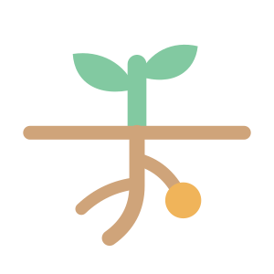
Taproot
Find the real reason a student is stuck in maths and science, then fix it
AI for Education · Craft N Code Karnataka 2026
craft-n-code-karnataka.vercel.app
Notes:
Taproot is a five-minute check-up for maths and science. A student names the chapter they're stuck on, and Taproot traces the trouble down to the earlier skill where it really starts, then helps them fix it.

Slide 2
Maths scores fall from 57% in Class 3 to 32% in Class 10 as gaps pile up
Tests say “weak in this chapter”
never why. Students re-read the chapter, but the gap is in an older skill.
+0.37 SD in 4.5 months
when teaching matched each student's real level, not their class (Muralidharan et al., AER 2019)
Notes:
Maths is built in layers. National Achievement Survey 2021: average maths scores drop from 57% in Class 3 to 32% in Class 10. School tests only say a student is weak in a chapter, never why. And we know targeting the real level works: the Mindspark trial in Delhi raised maths scores by 0.37 standard deviations in four and a half months.

Slide 3
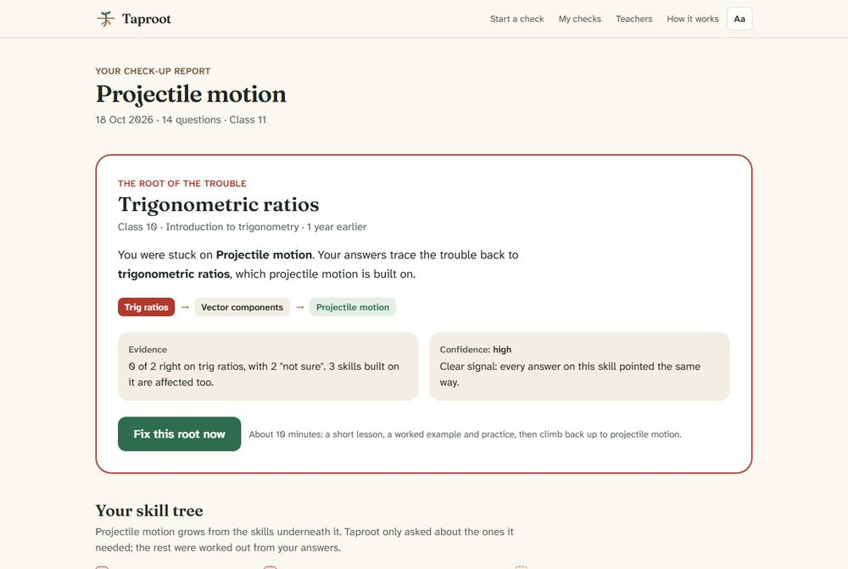
Taproot traces a stuck chapter down its roots to the skill where the trouble starts
1
Name the chapter
or paste the exact problem you can't solve
2
Answer ~14 one-tap questions
each with a reason, plus an “I'm not sure” option
3
See the root gap and the mix-up
e.g. trig ratios, from Class 10: swapping sine and cosine
A student stuck on projectile motion is traced back to trigonometric ratios
Notes:
Here's the flow. The student picks a chapter or pastes a problem, answers about fourteen quick questions, and gets a report that draws the chapter as a plant with its prerequisite skills as roots. The root gap is highlighted, with the misconception behind it and a confidence level.

Slide 4
Every wrong answer is a diagnosis, so the repair targets the exact mix-up
1
Trace
Questions walk down the prerequisite tree
2
Root found
The failed skill whose foundations are solid
3
Repair
A lesson aimed at the student's own mix-up
4
Practise
A worked example and three practice questions
5
Climb back
Skill by skill, up to the original chapter
Wrong options are built from named misconceptions. 115 question templates compute fresh numbers and exact answers; each wrong option is the answer a specific mix-up produces (adding fractions top-and-bottom, using ×3.6 to turn km/h into m/s). That is how Taproot can say why, not just where.
Notes:
Because every wrong option is the answer a specific misconception produces, Taproot knows why the student went wrong. The repair lesson starts from that mix-up, then a worked example, three practice questions, and a climb back up to the chapter they were stuck on. It suggests a re-check three days later.

Slide 5
A transparent algorithm makes the diagnosis; AI widens coverage and is cross-checked
Diagnostic engine (no AI)
AI on Groq (open-weight models)
Hand-built skill graph: 34 skills, Class 6 to 11
Each skill decided by a sequential probability ratio test (Wald, 1945): stop at about 20 : 1 odds
Binary search below the deepest unexplained failure
Checks sibling branches for a second gap
Maps any topic or pasted problem to a skill tree linked to the checked skills
gpt-oss-120b writes questions; qwen3.8-27b solves them blind; only agreed questions are used
Lessons start from the student's actual wrong answers
Featured chapters work fully without AI
Cross-check on the live API: 16 of 16 AI-written questions passed, a third model agreed on 14, and 5 of 5 off-topic or injection prompts were refused.
Notes:
The diagnosis itself isn't a black box: it's a sequential evidence test and a binary search over the skill tree. AI comes in to cover any topic: one model builds the tree and writes questions, and a model from a different family solves them without the answer key. Only questions where both agree are shown, labelled as AI-written.

Slide 6
On 10,000 simulated students, Taproot names the true root gap first 85% of the time
13.8
questions on average, vs 35.5 to test every skill
1.0%
false alarms, vs 17.7% when testing every skill
100%
of planted wrong answer keys caught by the AI cross-check
Notes:
We tested the method on 10,000 simulated students with hidden gaps, careless slips and lucky guesses. Taproot's first answer is the true root gap 85% of the time in about 14 questions. A normal chapter test finds it under 5% of the time. Testing every skill is slightly more accurate but takes 35 questions and raises false alarms for 18% of students with no gap. 90 plus unit tests and 27 browser tests with accessibility scans back the rest.

Slide 7
Teachers see what to re-teach, and students never share anything personal
Class dashboard: what to re-teach
10 B Maths · 8 check-ups
Students join with a class code: no account, no password, no name
A class sees only the outcome (chapter, root gap, mix-up), deleted after 90 days
Reports stay on the device; share links carry no answers
Keyboard use, screen-reader maths, dark mode, WCAG AA contrast
Trigonometric ratios 4 of 8
Swaps sine and cosine (3)
Factorising 2 of 8
Drops the sign of the constant
Rearranging formulas 1 of 8
Moves a term without changing its sign
Notes:
For teachers there's a class dashboard. A teacher signs in, makes a class and shares a six-character code. Each check-up a student finishes adds its outcome to the dashboard, ranked by root gap, so one lesson can fix the skill most of the class is missing. Students never create accounts and no names or answers are stored. It's built for accessibility: full keyboard use, screen-reader friendly maths and dark mode.

Slide 8
Next: a classroom pilot with Karnataka students
Honest limits
With another month
Evidence so far is from simulation, not classrooms
Guessing remains: about 1 in 7 diagnoses misses the true root first
Five hand-checked chapters; other topics rely on AI
English only for now
Pilot in classrooms, compared with teachers' judgement
Kannada, and more hand-checked chapters
Teachers assign a chapter and track gaps shrinking
Offline support for low-connectivity schools
Try it: craft-n-code-karnataka.vercel.app Code: github.com/aditya-sridhar-git/Craft-N-Code-Karnataka
Notes:
We're honest about the limits: the evidence is from simulation, guessing still causes some misses, and only five chapters are hand-checked. With another month we'd pilot in Karnataka classrooms against teachers' judgement, add Kannada and more chapters, and let teachers assign chapters and track gaps closing. Try it at the link on screen.

