Slide 1

Indoor Navigation Assistance
Rohan Tammara V.S. Aditya
Gokul T Anandan Mohan Venkat
Vaibhav Balloli

Slide 2


The What
The hurdle of daily navigation.

Slide 3
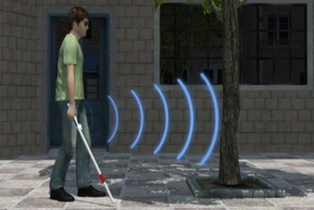
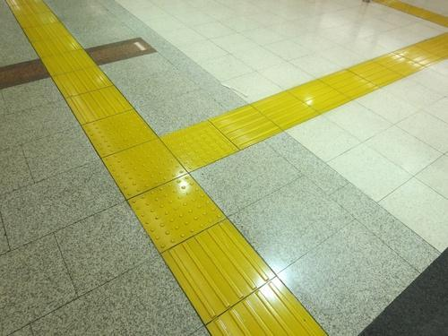
Current Solutions

Slide 4
The Why
What they fall short of . . .

Slide 5
Main Focus
Gentle
Intuitive
Quiet

Slide 6
Sensei
Your indoor navigation assistant

Slide 7
Product Design - 1.0
Vibration Actuator
Feedbacks
The Sensei Wristband.
Estimated Cost for Production - ₹750

Slide 8
Preliminary User Feedback
“Intuitive and helpful as an accessory to my cane.”
@LVPEI
“I would use a device that is portable and stylish.”
@LVPEI
“Maybe helpful, but a judgement can only be made after testing. ”
@LVPEI
Some remarks from the visually impaired at LVPEI.

Slide 9
MVP - Minimum Viable Product
An intuitive feedback mechanism because simple is better.
Scalable and modular - no boundaries.

Slide 10


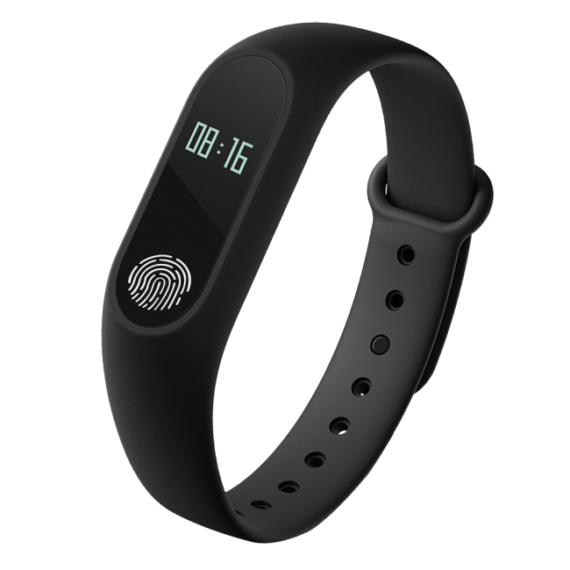

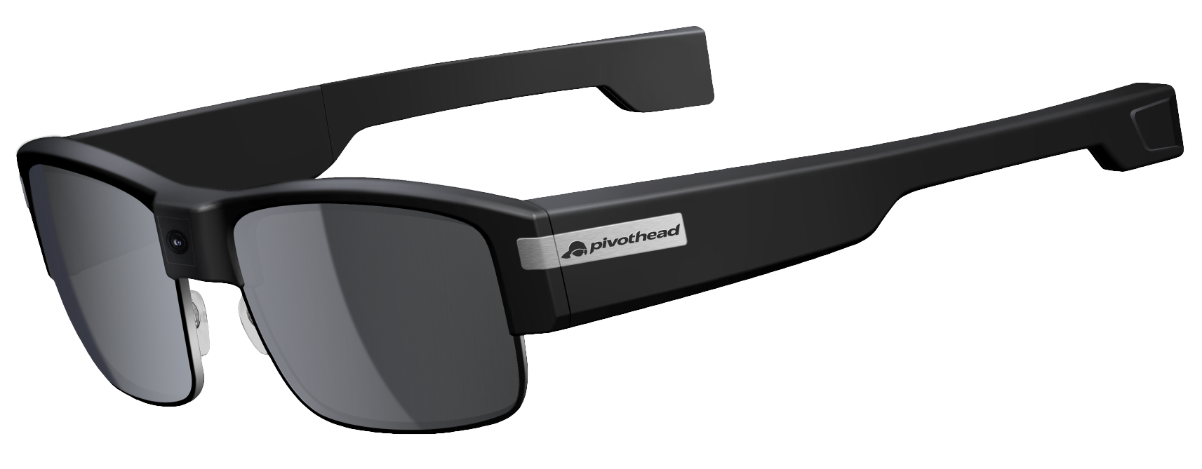

Possible Integrations
Hardware
Platforms
Services

Slide 11
Product Stages
Step 1
Step 3
Step 5
Step 2
Step 4
Develop the MVP and deploy the alpha it in a small community
Plan improvements based on production feedback
Develop integration with core services
Development |  |  |  | Production |  |  | Upgrades
Improve and fine tune the product based on customer feedback
Integrate computer vision, audio based services.

Slide 12
Thank You

