Slide 1

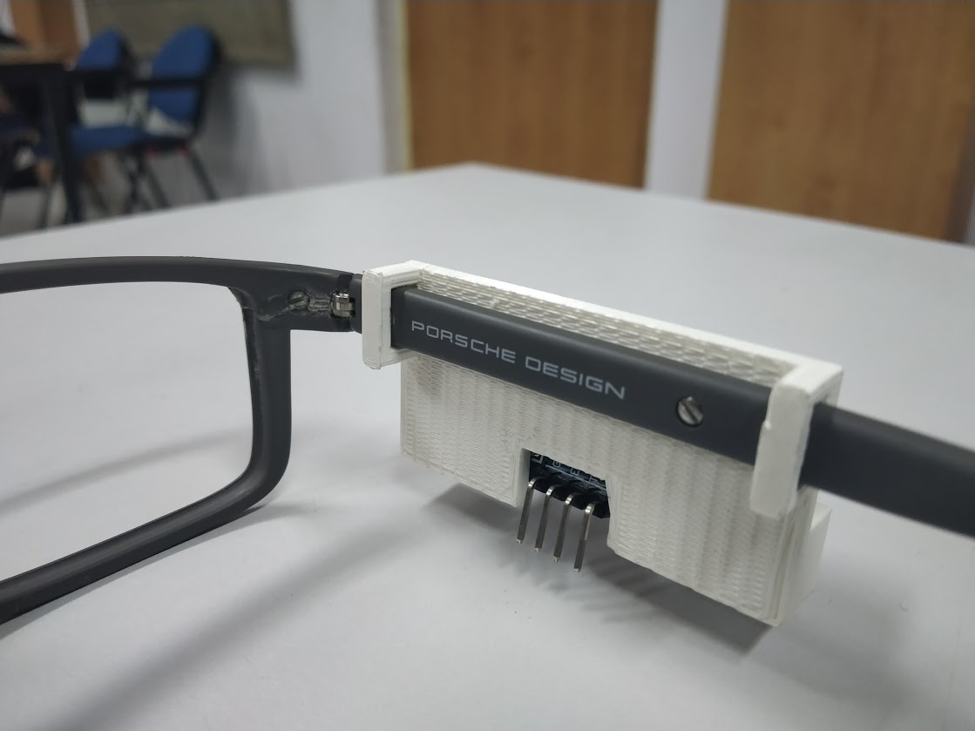

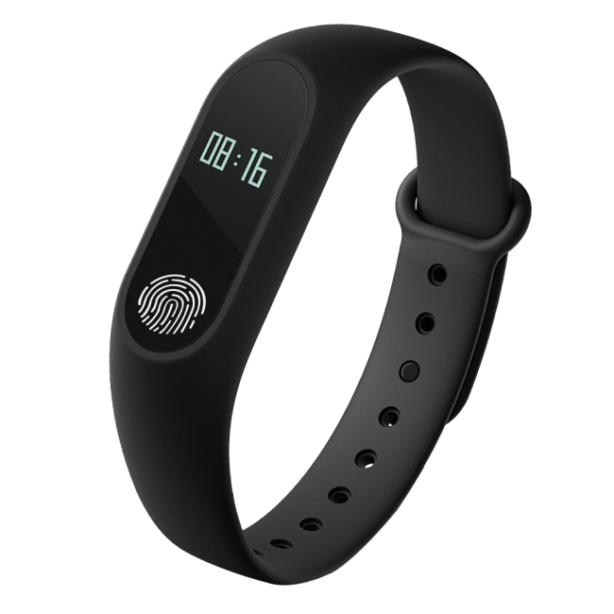





Project Title: Sensei
Team:
Gokul T Anandan,
Vaibhav Balloli,
Rohan Tammara,
V.S. Aditya,
Mohan Venkat
Proposed Approach
Problem Statement
Navigating through a room, which comes naturally to most of us, can be quite a challenge to the visually impaired. They mostly use auxiliary devices such as the white cane to overcome this difficulty to an extent. But the cane is not an elegant solution since there’s trial and error involved along with the obvious problem of limited reach.
Using proximity sensors, nearby obstacles and open pathways are identified and through the wrist-wear. The user is notified of the direction by a clockwise vibration, to indicate right and an anti-clockwise one to indicate left. The proximity sensors are mounted as clip-ons on spectacles and the wrist wear consists of a series of vibration actuators.
Impact
Being simplistic in design and highly intuitive in its feedback mechanism, it will help them navigate their surroundings more naturally and therefore imbibe more confidence in the users. This confidence will translate to users who are more comfortably independent of others.
It also goes without saying that the accuracy it adds to their movement helps them save a lot of time and effort.
Validation
A primitive research of target users at the L.V. Prasad Eye Institute gave us some key insights as to what kind of device they were comfortable using. We received a positive feedback as they found the design to be natural and hence, were showing interest in using it. We hope this is an indication towards a more welcoming user base which would help in the rapid proliferation of our product.
Future Work
Integrate existing smart bands and evolving technologies like Augmented Reality and Computer Vision with the MVP.

