Slide 1
IBM University Engagement Project Submission
“Exploring the Power of Agentic AI with IBM Granite and LangFlow”

Slide 2

Project Tile –
Al-Powered College Admission Chatbot Using IBM watsonx Assistant
Domain of Project –[
Education ]
Student Name | Recent Passport Pho to | Email ID | Mobile number [WhatsApp]
V.Aditya |  | Adityavantharam999@gmail.com | 7416784935

Slide 3
Problem Statement -
Problem Statement : College Admission Chatbot
The Challenge
Students often face difficulty finding accurate information about admissions, courses, eligibility, fees, and important dates.
The Objective
Build an AI-Powered College Admission Chatbot that provides instant responses and guidance to students during the admission process.
Features
Course Information Eligibility Guidance Fee Details Admission Deadlines
Document Requirements FAQ Support
24/7 Assistance
Expected Outcome
A smart chatbot that improves student experience and reduces the workload of admission staff

Slide 4
Technology Used
Tech Stack (Mandatory)
Useany one ofthefollowing approaches:
IBM watsonx Assistant IBM watsonx.ai
IBM Granite Models
Natural Language Processing (NLP) IBM Cloud
I used:
IBM watsonx Assistant + IBM watsonx.ai + Granite Models

Slide 5
Proposed solution:
Proposed Solution: AI-Powered College Admission Chatbot
The proposed solution is an AI-powered chatbot developed using IBM watsonx Assistant, IBM watsonx.ai, and Granite Models. The chatbot is designed to assist students by providing instant and accurate information related to college admissions. It offers a user-friendly interface that allows students to interact naturally and receive quick responses to their queries.
The chatbot helps students obtain information about available courses, eligibility criteria, fee structures, required documents, admission procedures, and important deadlines. By automating responses to frequently asked questions, the system reduces the workload of admission staff and improves the overall admission experience.
Key Features:
Course Information and Program Details Eligibility Criteria Guidance
Fee Structure Information Required Documents Support Admission Process Assistance Important Dates and Deadlines
Frequently Asked Questions (FAQs) 24/7 Student Support

Slide 6
Langflowcomponent Used -
Langflow Component Used
Chat Input – Interface where students enter admission-related queries.
IBM watsonx AI Agent – Processes student questions using IBM Granite Models and generates accurate responses.
Name of IBM Granite Model – Granite-3.3-8B-Instruct – Used for understanding queries and generating intelligent answers.
Chat Output – Displays AI-generated responses related to courses, eligibility, fees, documents, and admission procedures.
Prompt Component – Provides instructions and context to ensure accurate admission-related responses.
File Component – Stores and retrieves admission information, course details, fee structures, and eligibility criteria for analysis and response generation.

Slide 7
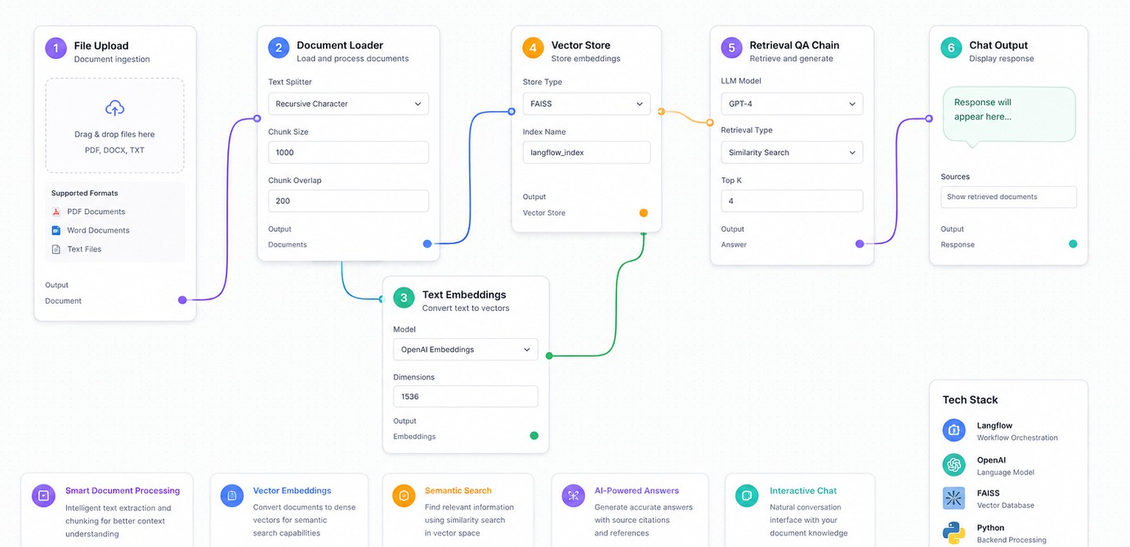
Langflowworkflow -

Slide 8
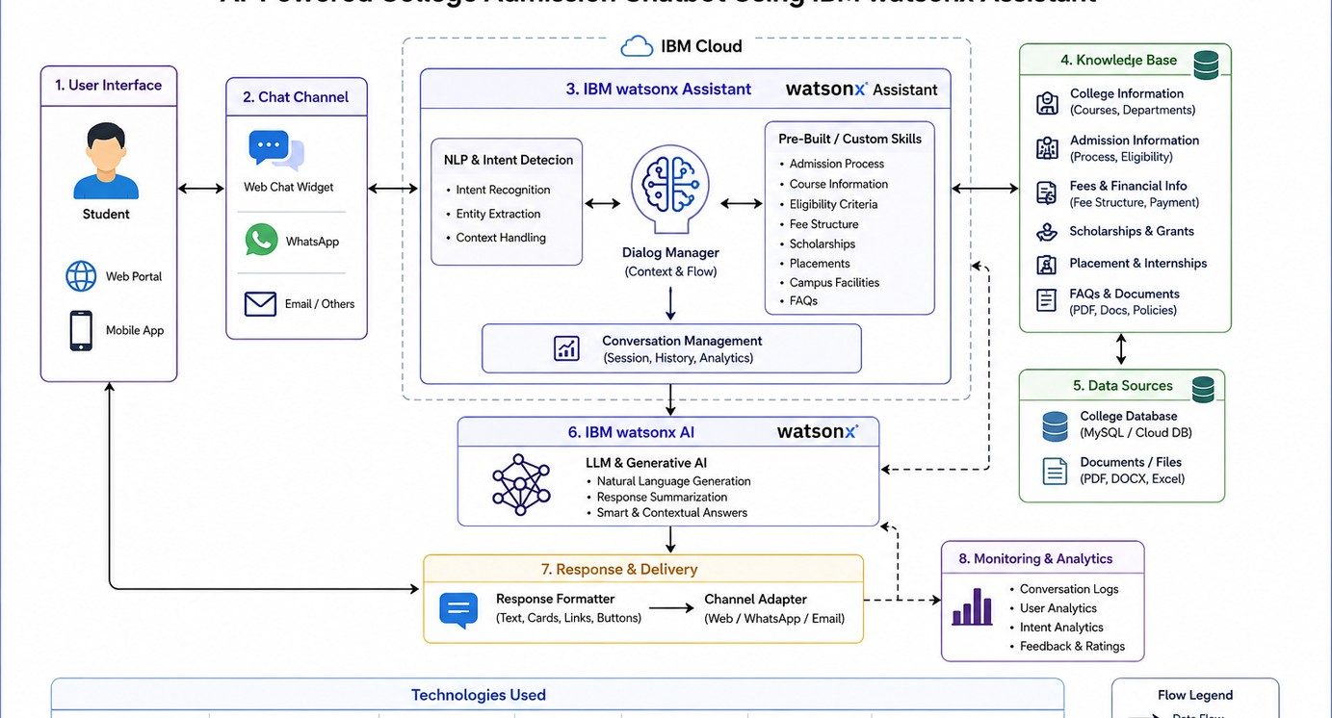
Architecture blueprint

Slide 9
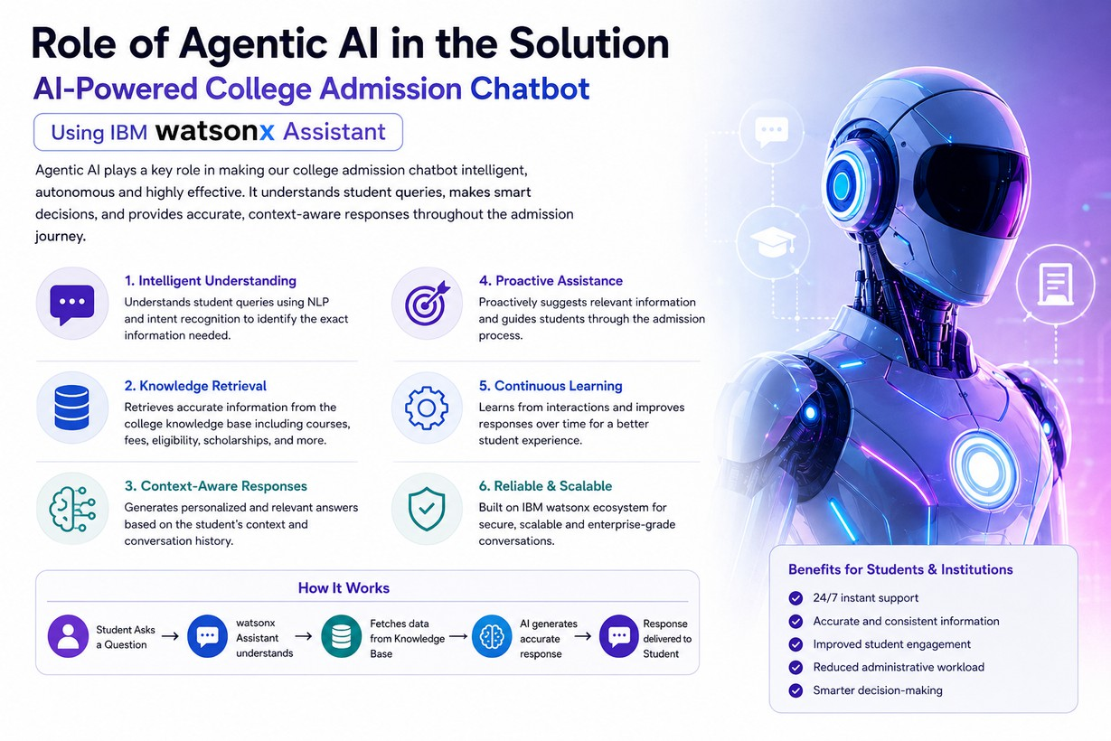

Slide 10
Technology Used
Langflow Platform – For designing and orchestrating chatbot workflows visually.
IBM Granite Model – For natural language understanding, reasoning, and personalized responses.
IBM Cloud – Provides a reliable, secure, and scalable environment for deployment.
RAG – Fetches real-time college information before generating responses.
IBM watsonx.ai – For AI model deployment, embeddings, and governance.
Vector Database (FAISS/Chroma) – For storing and retrieving admission-related information efficiently.

Slide 11
Novelty and Uniqueness
AI-Powered Admission Assistance – Provides instant and intelligent responses to student admission queries.
Real-Time Information Retrieval – Uses RAG to fetch accurate details about courses, fees, eligibility, and scholarships.
Personalized Student Guidance – Recommends suitable courses and admission information based on student interests.
24/7 Availability – Ensures continuous support without requiring manual intervention.
IBM watsonx Assistant Integration – Enhances conversational capabilities with advanced NLP and intent recognition.
Scalable and Secure Solution – Built on IBM Cloud for reliable, secure, and enterprise-grade performance.
Improved Admission Experience – Simplifies the admission process by providing quick, accurate, and user-friendly assistance.

Slide 12
Git Hub Link
https://github.com/aditya-vantharam/Al-Powered-College-Admission-Chatbot-Using-IBM-watsonx-Assistant
·
·

Slide 13
Future Scope
Integration with College Management Systems –
The chatbot can be integrated with college databases and admission portals to provide real-time information on courses, seat availability, application status, and admission deadlines.
AI-Powered Voice Assistant & Multilingual Support –
Future versions can support voice-based interactions and multiple languages, enabling students from diverse backgrounds to access admission information more easily and effectively.
Personalized Course Recommendations –
Using AI and student preferences, the chatbot can recommend suitable courses, programs, and career paths based on academic interests and eligibility.
Automated Application Assistance –
The chatbot can guide students through the admission process, helping them fill out applications, upload documents, and track their admission status in real time.

Slide 14


