Slide 1
Problem Statement 1
Prediction of customers who are eligible for loan amount so that they can be specifically targeted by banking company based on the different attributes of customer.
Data is split into 2 csv files:
Training Data: Data for training models
Test data: Predict customers which are eligible for loan (i.e. Y or N)
Problem link: Click here

Slide 2
Training Data Description
Variable | Description
Loan_ID | Unique Loan ID
Gender | Male/ Female
Married | Applicant married (Y/N)
Dependents | Number of dependents
Education | Applicant Education (Graduate/ Under Graduate)
Self_Employed | Self employed (Y/N)
ApplicantIncome | Applicant income
CoapplicantIncome | Coapplicant income
LoanAmount | Loan amount in thousands
Loan_Amount_Term | Term of loan in months
Credit_History | credit history meets guidelines
Property_Area | Urban/ Semi Urban/ Rural
Loan_Status | Loan approved (Y/N)

Slide 3
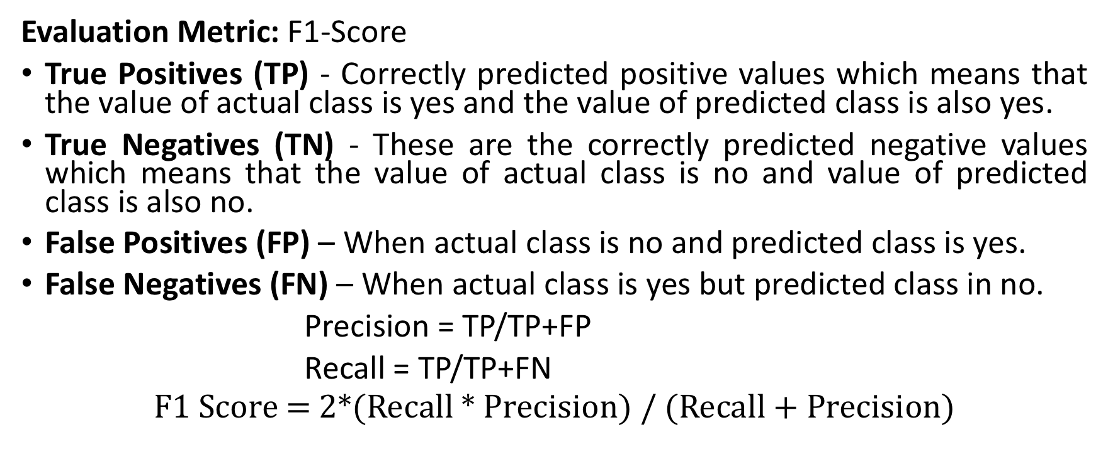
Twitter Sentiment Analysis
Evaluation Metric: F1-Score
True Positives (TP) - Correctly predicted positive values which means that the value of actual class is yes and the value of predicted class is also yes.
True Negatives (TN) - These are the correctly predicted negative values which means that the value of actual class is no and value of predicted class is also no.
False Positives (FP) – When actual class is no and predicted class is yes.
False Negatives (FN) – When actual class is yes but predicted class in no.
Precision = TP/TP+FP
Recall = TP/TP+FN
$$\text{F}\text{1 }\text{Score}\text{ = 2∗(}\text{Recall}\text{ ∗ }\text{Precision}\text{) / (}\text{Recall}\text{ + }\text{Precision}\text{)}$$

