Slide 1
CS684 Project

Slide 2
Tentative Deadline:
Project is divided into two tasks:
Final Presentation and Demonstration: 12/04/2021 and 15/04/2021
Tasks | Release Date | Doubt clearing session | Deadline
Task 1 | 22/03/2021 | 25/03/2021 | 01/04/2021
Task 2 | 29/03/2021 | 05/04/2021 | 08/04/2021

Slide 3
Task 1:
Project has three parts -
Hardware side (Firebird V and components)
Algorithm side (based on Simulation)
IoT side (Web based and GUI development)
Both tasks will cover each part of the project.
Hence Task 1 is divided into two subtasks - Task 1A and Task1B

Slide 4
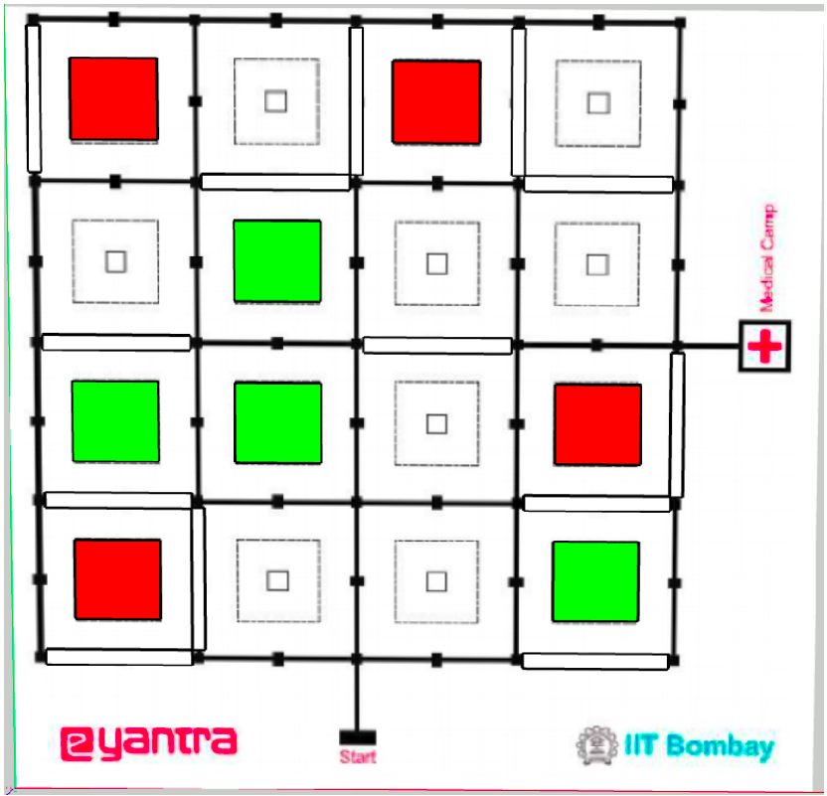
Task 1A:
Algorithm Side (on Simulator)
Problem Statement - Scan the entire medical camp and find out the plot locations of injured people.
Output - <Plot No> - <Type of Injury>
E.g. 1 - MajorInjury
Challenges:
Line following
Color sensor interfacing
Debris detection
Path planning

Slide 5
Task 1B:
Hardware and IoT side
Problem Statement: Get one request from the server, satisfy the request through robot and acknowledge back to server.
Note: Robot can start from the node of requested plot. It just have to traverse till mid-point marker.
Challenges:
Color sensor interfacing
End to end communication
Interactive GUI development
Time keeping on Robot.

Slide 6
Hardware Side (Hints):
Color Sensor Interfacing:
https://cs684-iitb.github.io/CS684-Spring-2021/Resources.html
Communication between Firebird V and ESP32:
https://drive.google.com/drive/folders/1vac3uNvSwOX17k1qqO0ARTgmKYEigYFd
Timer/Counter on Firebird V: (Alternative RTC on ESP32)
https://drive.google.com/drive/folders/1AMpRDXjxTLKOb-KZuS81j4n-uo7Nea3e

Slide 7
CS684 Final Project
IoT Part

Slide 8
Role of IoT
The arena is an abstraction of a disaster-affected area.
The robot is tasked with scanning the area (or arena), and satisfying the on-demand requests.
These requests (rpc) are sent from the cloud server at an interval of approximately 45 seconds.
The requests are intercepted by a laptop and forwarded to the robot.
The robot can choose to perform the operations as demanded by the requests or ignore them.
If the robot chose to perform the operations, the result should be returned to the laptop and laptop forwards the result to the server.

Slide 9
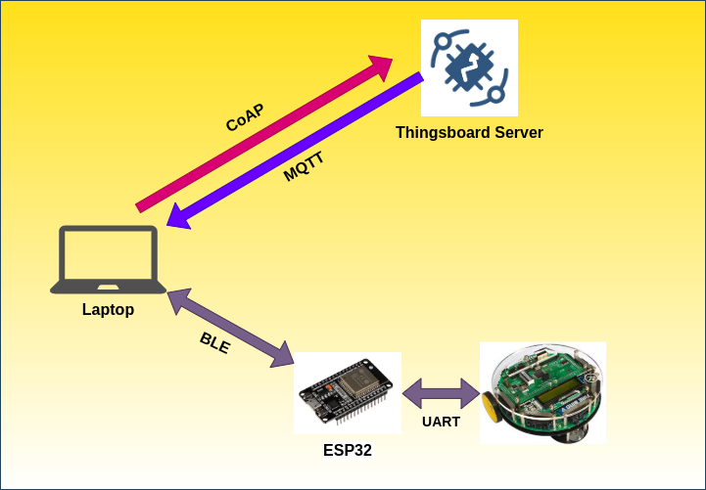
Overview of Communication

Slide 10
Communication
Thingsboard to Laptop - MQTT
Laptop to Thingsboard - CoAP
Laptop to ESP32 - BLE
ESP32 to Laptop - BLE
ESP32 to Firebird 5 - UART
Firebird 5 to ESP32 - UART

Slide 11
Data Formats
Thingsboard to Laptop - JSON (as specified in the next slides)
Laptop to Thingsboard - JSON (as specified in the next slides)
Laptop to ESP32 - Any
ESP32 to Laptop - Any
ESP32 to Firebird 5 - Any
Firebird 5 to ESP32 - Any

Slide 12
Server Requests
Requests are of two types: Fetch Nearest and Scan.
Fetch Nearest request demands reaching the nearest specified injury location and beep the buzzer. Convey the result to the thingsboard after reaching and beeping at the location.
Scan request demands scanning a particular plot. Convey the result to the thingsboard after reaching, identifying and beeping at the location.
The request should be completed in stipulated time also provided in the request (completeIn).
The result should also contain the time taken by the robot to complete the request.

Slide 13
Fetch Nearest - Request
{
"method": "fetchNearest",
"params": {
"type": "majorInjury",
"id": 2415498415,
"serverTime": 1616352000,
"completeIn": 10
}
}

Slide 14
Fetch Nearest - Result
{
"id": 2415498415,
"plot": 3,
"timeTaken": 7
}

Slide 15
Scan - Request
{
"method": "scan",
"params": {
"plot": 7,
"id": 65318,
"serverTime": 1616352045,
"completeIn": 40
}
}

Slide 16
Scan - Result
{
"id": 65318,
"type": "minorInjury",
"timeTaken": 35
}

Slide 17
Presentation of Theme Run
Develop a nice and self-explanatory UI for the theme run.
It can be a web app, a desktop app, or a mobile app (or cross platform).
It should show what is happening on the arena and what the robot is doing, for example, the plot it is visiting next, the type of injury scanned, the request it is performing, etc.
Use your good judgement to determine how much information to display.

Slide 18
Thank you!

