Slide 1

SUPPLY CHAIN MANAGEMENT SYSTEM
HEALTH CARE PROBLEM STATEMENT -4
TEAM NAME - SAPLING

Slide 2

WHAT IS THE NEED FOR IT?
1. HOARDING (KEEPING THE STOCK HIDDEN UNTIL THERE IS A INFLATION IN DEMAND)
2. MISMANAGED MEDICAL INVENTORY
3. IMPROPER DELIVERY

Slide 3
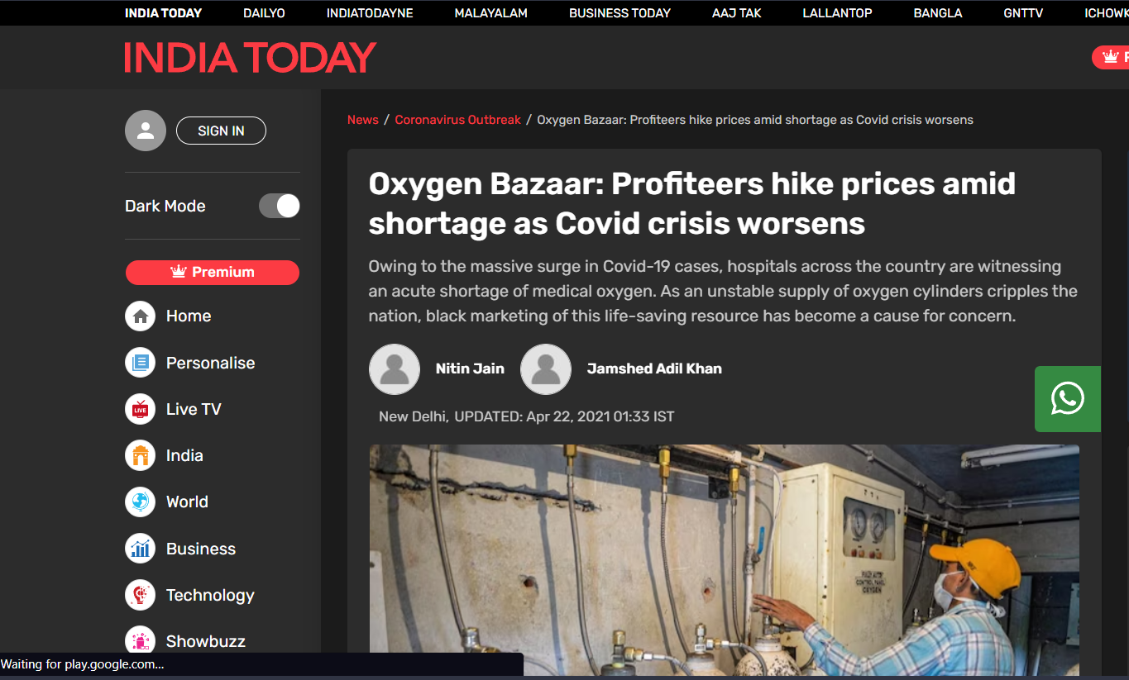
The Covid crisis was a time when there was a need for this management system in the health care system as prices hiked exponentially. Whether it was being concealed by the supplier or the medical staff the ultimate sufferer were we people as the government tried its best that the medicines reached the desired people as soon as possible.

Slide 4

WHY OUR HEALTHCARE SYSTEM NEEDS IT BADLY?
The covid time showed how much medicine supply is affected during crucial time.
Price was being hiked due to hoarding.
The citizens in need were not able to get the desired medicines

Slide 5
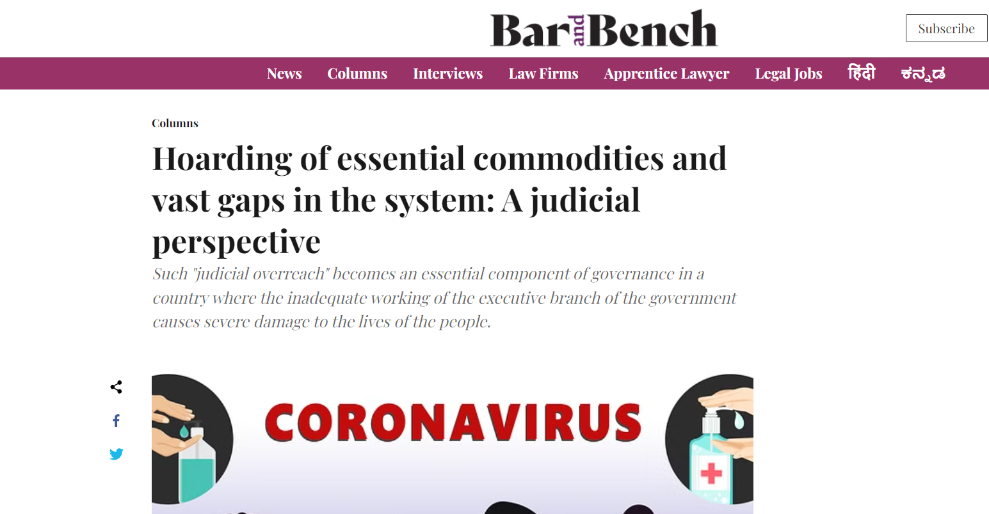
Even judicial intervention could not prevent hoarding therefore technology is needed to provide an effortless chain supply.

Slide 6
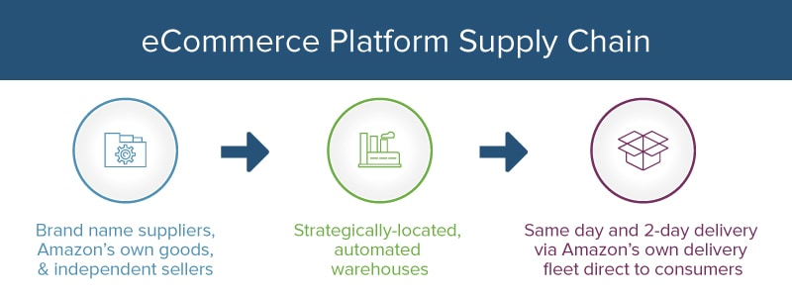
ABOUT CHAIN SUPPLY MANAGEMENT
What is chain supply management?
Chain supply management is coordinating and managing all activities involved in producing and delivering goods and services to customers. It involves managing the flow of materials, information, and finances from suppliers to manufacturers, distributors to retailers, and finally to end consumers.
Benefits of chain supply management?
Effective chain supply management can result in several benefits for businesses, including increased efficiency, reduced costs, improved customer satisfaction, and increased profitability. By optimizing the supply chain processes, businesses can reduce waste and improve productivity, resulting in lower costs and higher profits.
What problems are faced in chain supply?
Despite the benefits of chain supply management, there are also several challenges that businesses may face. These include supply chain disruptions, inventory management issues, and supplier relationship management.

Slide 7
THEREFORE WE ARE HERE WITH
MY WAREHOUSE
The future of chain supply management is likely to be shaped by advancements in technology and changing consumer preferences. Businesses will need to adapt to these changes by embracing new technologies and adopting more sustainable and ethical practices.

Slide 8
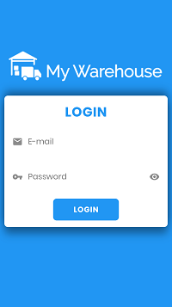
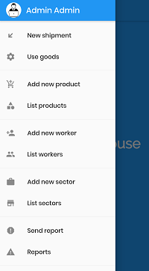
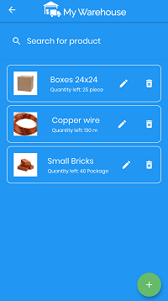
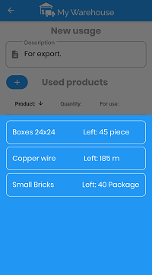
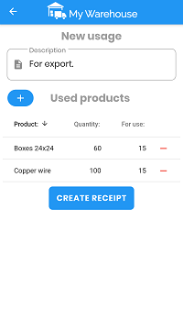
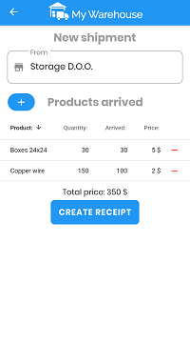
The Application’s UI
MY WAREHOUSE

Slide 9


FUNCTIONS INCORPORATED
SUPPLY MANAGERS CAN MANAGE STOCK BY ADDING OR DEDUCTING THE UNITS.
STOCKS CAN BE PREVIEWED IN ORDER TO THEIR AVAILABILITY.
SHIPMENT OF STOCKS (MEDICINE) CAN BE TRACKED
WORKER’S DATA CAN BE MANAGED

Slide 10


TECHNOLOGIES USED
-FLUTTER
-FIREBASE

Slide 11
Thank You
Team Contribution-
Nimesh Ranjan
Aditya Jaif

